Slide 1


M.Tech/MCA Program
Advanced Industry Integrated Programs
Jointly offered by University and LTIMindTree
Review III
PS1:Multi-Agent Predictive Maintenance & Root Cause Analysis For CNC Machines using Digital twin
PS2:AI – Driven subsurface Interpretation And Geo-Modeling for Upstream
Team Member
Tarun Kumar R
Knowledge partner | Implementation partner

Slide 2
Multi-Agent Predictive Maintenance & Root Cause Analysis For CNC Machines using Digital twin
Introduction
Industrial manufacturers face unplanned machine downtime costing between 50 lakh and 2 crore rupees per hour. Current maintenance systems are purely reactive teams receive alerts only after failure with no automated root cause analysis, proactive scheduling or inventory pre-positioning to reduce Mean Time to Repair.
Without historical failure analytics, maintenance teams cannot distinguish recurring faults from one-off incidents, so the same breakdowns resurface across shifts and lines.

Slide 3
Multi-Agent Predictive Maintenance & Root Cause Analysis For CNC Machines using Digital twin
Objective
Real-time Anomaly Detection: Continuously detect abnormal vibration, temperature, current, pressure, and RPM patterns to predict potential machine failures.
Programming Manual Assistant: Identify probable failure modes and root causes using FMEA knowledge, maintenance manuals, RAG, and LLM reasoning.
Cloud-Based Deployment: Deploy the predictive maintenance application using AWS EC2 and Amazon S3, with GitHub Actions enabling automated CI/CD workflows and MLflow supporting experiment tracking, model management, and artifact storage.
MTTR Reduction & Digital Twin: Reduce Mean Time to Repair through predictive alerts and real-time 3D machine visualization using AWS IoT TwinMaker and Grafana.

Slide 4
Multi-Agent Predictive Maintenance & Root Cause Analysis For CNC Machines using Digital twin
PS1-Modules
Module No | Module Name
M1 | Data Acquisition & Ingestion
M2 | Data Preprocessing
M3 | Feature Engineering
M4 | Data Balancing & Splitting
M5 | Model Architecture — RoughLSTM
M6 | Training Pipeline

Slide 5
Multi-Agent Predictive Maintenance & Root Cause Analysis For CNC Machines using Digital twin
Methodology
Stage | What We Do | Key Settings / Details | Output
1 | Dataset | Bosch CNC vibration data (x, y, z) across 3 machines × 15 ops | 1,702 CSVs; only OP02, OP05, OP08, OP11, OP14 used
2 | Normalization | Per-file Z-score per axis | x' = (x − μ) / σ
3 | Windowing | Sliding window segmentation | Window = 50, Stride = 25 (50% overlap); 500 windows sampled per file
4 | Feature Extraction | 9 canonical vibration features × 3 axes = 27 features | Mean, Std, RMS, Crest Factor, Peak-to-Peak, Dominant FFT bin, Spectral Entropy, Skewness, Kurtosis
5 | Class Balancing | Noise augmentation + Random undersampling (train only) | Gaussian noise σ = 0.05; balance Normal:Bad = 1:1
6 | Splitting | Stratified 70/15/15 (Train/Val/Test) per machine | Seed = 42 for reproducibility
7 | Model | RoughLSTM — MLP + custom Rough Set Layer | 27 → 128 → 64 → 32 → 2; Dropout 0.4/0.4/0.3; BN after each FC
8 | Rough Set Layer | Uncertainty-aware decision layer (ε = 0.1) | Lower < 0.4, Boundary 0.4–0.6, Upper > 0.6; U(x) = |p−0.5|/ε

Slide 6
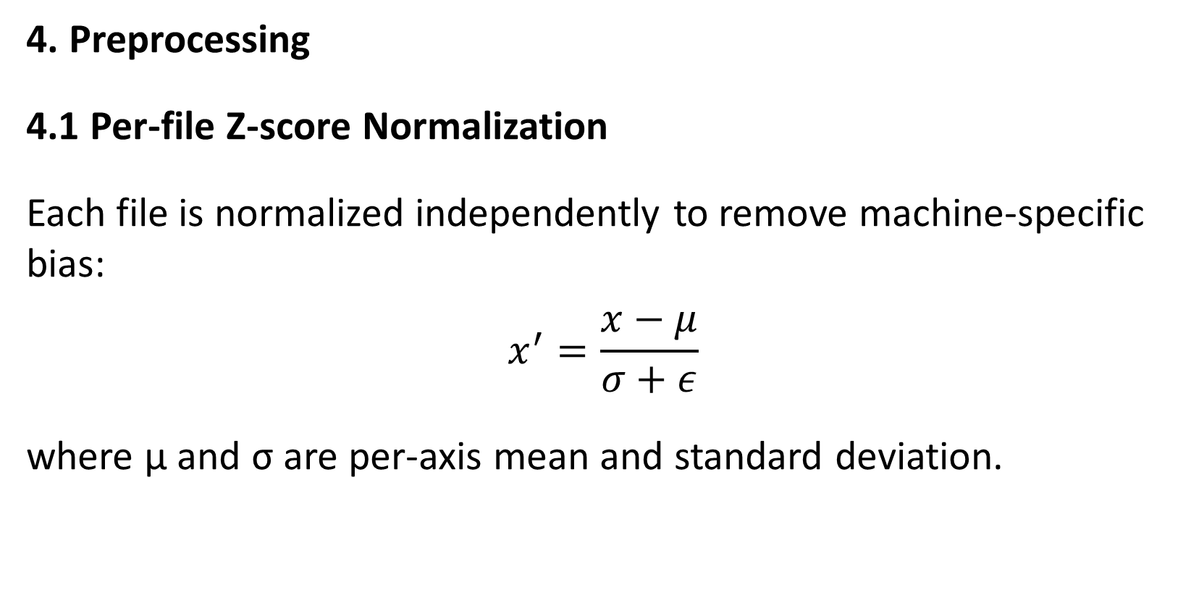
Multi-Agent Predictive Maintenance & Root Cause Analysis For CNC Machines using Digital twin
Data preprocessing & EDA
4. Preprocessing
4.1 Per-file Z-score Normalization
Each file is normalized independently to remove machine-specific bias:
$$x^{′}=\frac{x−μ}{σ+ε}$$
where μ and σ are per-axis mean and standard deviation.

Slide 7
Multi-Agent Predictive Maintenance & Root Cause Analysis For CNC Machines using Digital twin
Data preprocessing & EDA
4. Preprocessing
4.2 Sliding Window Segmentation
To convert continuous vibration into fixed-length samples:
A random subset of 500 windows is sampled per file to control dataset size.
Parameter | Value
Window size | 50 timesteps
Overlap | 25 timesteps (50%)
Stride | 25 timesteps
Windows per file (sampled) | 500

Slide 8
Multi-Agent Predictive Maintenance & Root Cause Analysis For CNC Machines using Digital twin
Data preprocessing & EDA
5. Class Imbalance Handling
Applied only on the training split to avoid leakage:
5.1 Noise Augmentation
Every training sample is duplicated with additive Gaussian noise (σ = 0.05). This doubles the training set and improves robustness to sensor jitter.
5.2 Random Undersampling
After augmentation, the majority (Normal) class is randomly downsampled to match the minority (Bad) class. This produces a balanced training set and prevents collapse to the majority class.

Slide 9
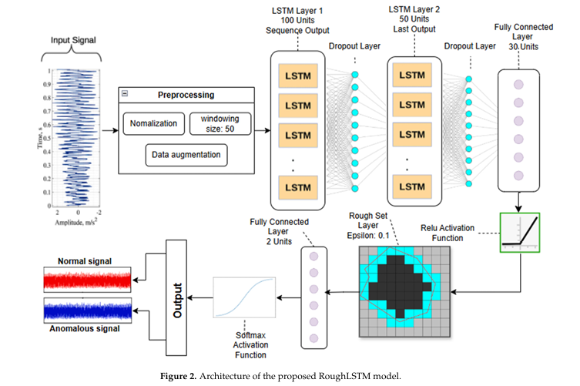
Project Title - Calibri body 18
Algorithms

Slide 10
Project Title - Calibri body 18
Results
Machine | Accuracy | AUC
M01 | 0.9291 (92.91%) | 0.9749
M02 | 0.8932 (89.32%) | 0.9231
M03 | 0.9834 (98.34%) | 0.9985

Slide 11
Project Title - Calibri body 18
Tools
AGENT ORCHESTRATION
  LangGraph : Anomaly Detector, Root Cause Analysis, Scheduler Agent
AI / LLM
  Amazon Bedrock : managed(Amazon Nova 2 Lite) LLM for reasoning, RCA report generation & agent decisions
ML / MLOps
  Visual studio : train/tune Isolation Forest + LSTM models
  SageMaker Endpoint : real-time anomaly inference
  MLflow :experiment tracking, metrics & model versioning
  DVC :dataset versioning, training data & pipeline lineage
DATA & IOT
  InfluxDB OSS v2 : time-series storage for vibration, temp, current, pressure, RPM
  Node-RED : edge data acquisition, filtering, protocol conversion & MQTT routing
  AWS IoT Core / MQTT : secure cloud connectivity for industrial devices
  AWS IoT TwinMaker : digital twin entities, assets & 3D scene context

Slide 12
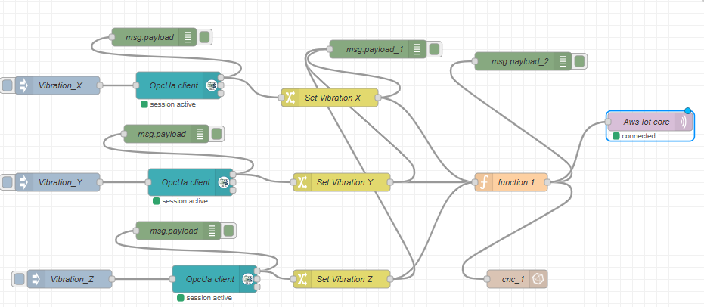
Sensor Pipeline

Slide 13
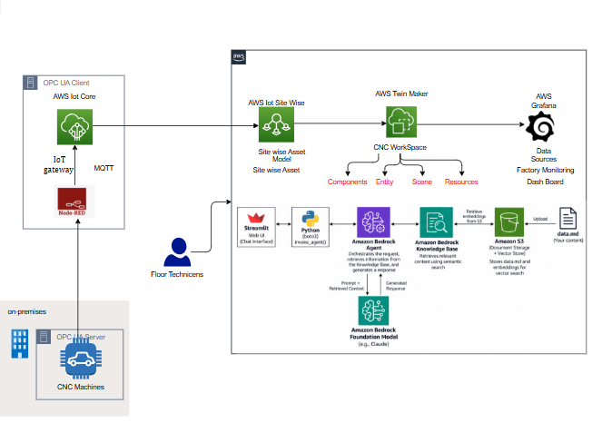
AWS Architecture

Slide 14
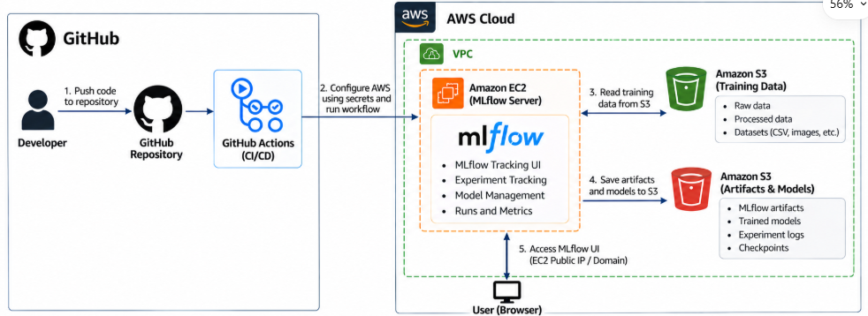
Project Title - Calibri body 18
Mlops Pipeline

Slide 15
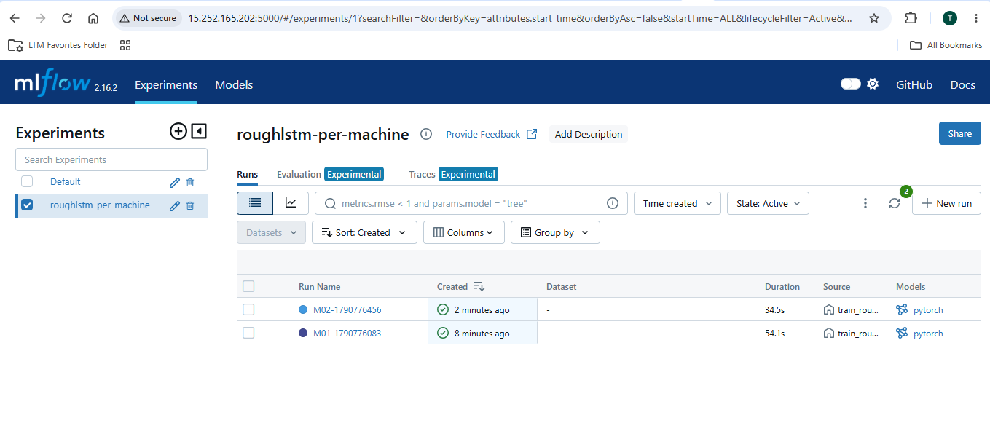
Mlfow server

Slide 16
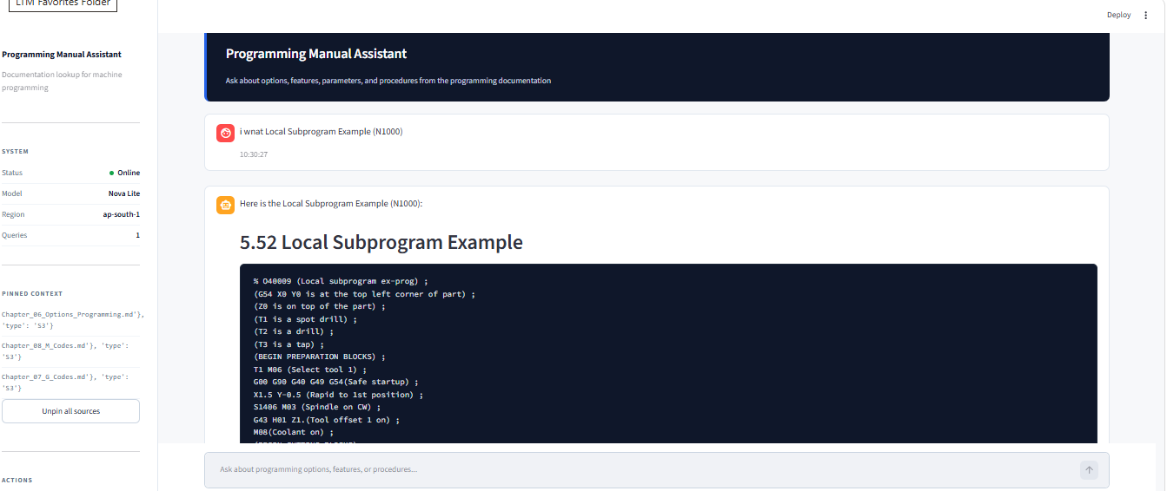
Project Title - Calibri body 18
Programming Manual Assistant

Slide 17
Driven subsurface Interpretation And Geo-Modeling for Upstream
PS2:Introduction
Well logs are continuous downhole measurements that record the physical, chemical, and geological properties of subsurface rock formations. They are the primary data source in the oil and gas industry for:
Lithology identification — distinguishing sand, shale, carbonate, and coal
Reservoir characterization — estimating porosity, permeability, and fluid content
Drilling hazard detection — identifying overpressure zones, gas pockets, and washouts
Hydrocarbon reserve estimation — quantifying producible resources
Traditional well-log interpretation relies on manual review by petrophysicists and classical statistical methods. Both approaches struggle with:
Volume — a single well can produce 50,000+ depth measurements per curve
Anomalies — subtle deviations that are easy to miss but critical to detect

Slide 18
Driven subsurface Interpretation And Geo-Modeling for Upstream
Objective
Data Preprocess well logs into 12 clean, z-score normalized series (GR, DT, RHOB).
Fine-tune Amazon's Chronos-2 foundation model on the 12 well-log series using AutoGluon.
Forecast the next 64 depth points per series with 99% prediction intervals.
Detect anomalies using conformal prediction flagging points outside the 99% PI.
5. 3D Geological Model Generation
Generate a 3D subsurface model using Delaunay-based spatial meshing.
Visualize geological structures and reservoir properties in 3D.

Slide 19
Driven subsurface Interpretation And Geo-Modeling for Upstream
Methodology
Stage | Description | Technique / Method | Output
1. Data Preprocessing | Clean and normalize raw well logs | Clip physical bounds, linear interpolation, per-well z-score | 12 clean series (4 wells × 3 curves), 140K points
2. Model Selection | Choose foundation model | Amazon Chronos-2 (120M params, Transformer-based) | Pretrained model loaded from HuggingFace
3. Fine-Tuning | Adapt model to well logs | AutoGluon, MSE loss, AdamW, lr=1e-5, 8 min on GPU | Fine-tuned weights, Test MSE = 0.1265
4. Forecasting | Predict future depth points | Direct multi-step forecast, 99% prediction interval | 64-step forecasts per series
5. Anomaly Detection | Flag unusual readings | Conformal prediction — sliding window (C=2048, stride 16) | Anomaly rate 0.85% (≈ theoretical 1%)
6. Deployment | User-facing application | Streamlit web app + Plotly charts

Slide 20
Driven subsurface Interpretation And Geo-Modeling for Upstream
Data preprocessing & EDA
Step 1 — Load CSV, skip units row
Read the raw file with pandas.read_csv(skiprows=[1]) so the units row is discarded.
Normalize column names to uppercase and coerce all values to numeric.
Step 2 — Keep only raw curves
Retain GR, DT, and RHOB — the physically measured logging curves.
Drop AI, AI_REL, and PHIE because they are computed from the raw curves and add no new information.
Step 3 — Clip to physical bounds
Cap each value to its physically plausible range: GR ∈ [0, 250], DT ∈ [130, 700], RHOB ∈ [1500, 3100].
This removes impossible readings caused by tool artifacts or bad-hole conditions.
Step 4 — Sort and deduplicate
Sort the series by depth and remove any duplicate depth entries.
Guarantees a monotonic, unique sequence required for time-series modeling.

Slide 21
Driven subsurface Interpretation And Geo-Modeling for Upstream
Data preprocessing & EDA
Step 5 — Linear interpolation of NaN gaps
Fill missing values by drawing straight lines between the nearest known depths on either side.
Handles gaps caused by tools starting at different depths.
Step 6 — Trim to valid depth range
Trim each curve to its own first and last valid depth.
Ensures no leading or trailing NaN sections remain in any series.
Step 7 — Per-well z-score normalization
Normalize each series using z = (x − μ) / σ, computed per well per curve.
Makes all wells statistically comparable regardless of baseline differences.

Slide 22
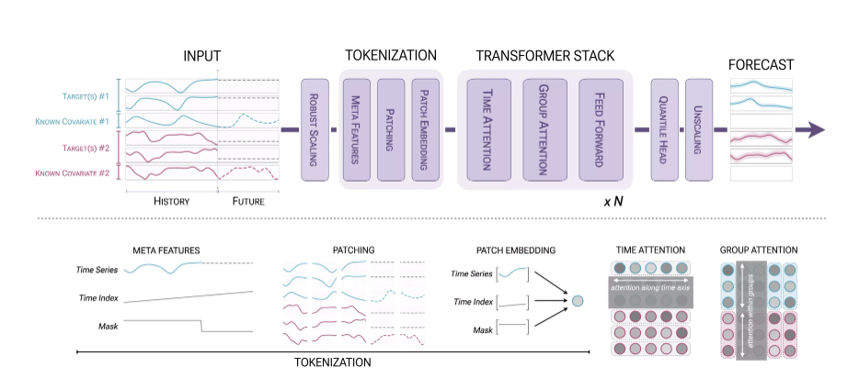
Driven subsurface Interpretation And Geo-Modeling for Upstream
Algorithms

Slide 23
Driven subsurface Interpretation And Geo-Modeling for Upstream
Interpretation Ranges
Parameter | Unit | Low | Moderate | High | Interpretation
RHOB | kg/m³ | Below 2,200 | 2,200–2,500 | Above 2,500 | Lower density may indicate higher porosity; depends on lithology
DT | µs/m | Below 250 | 250–400 | Above 400 | Higher transit time often indicates greater porosity or softer rock
GR | API | Below 30 | 30–75 | Above 75 | Lower GR often indicates cleaner rock; higher GR may indicate shale content

Slide 24
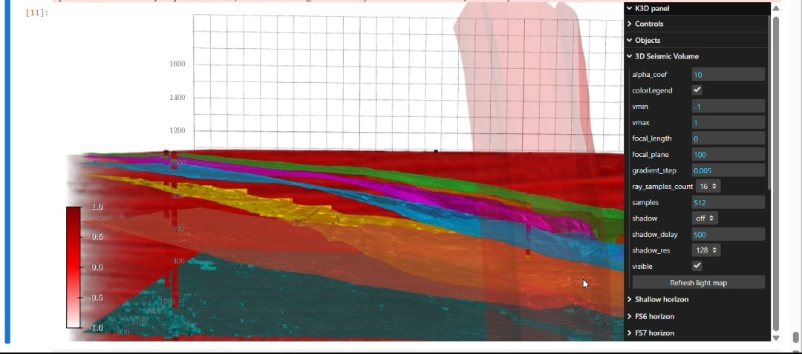
Geo- Modelling

Slide 25
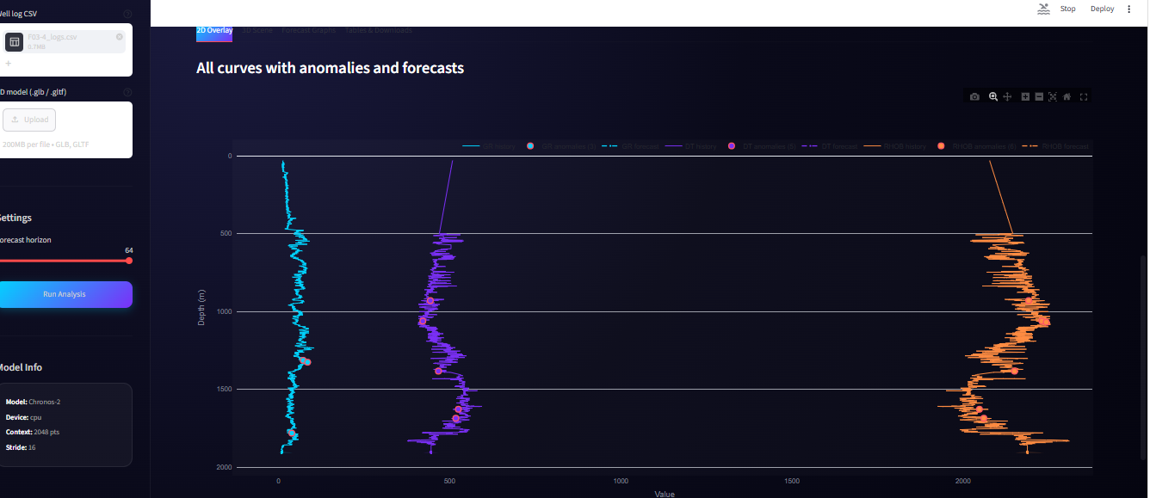
Anomaly Detection

Slide 26
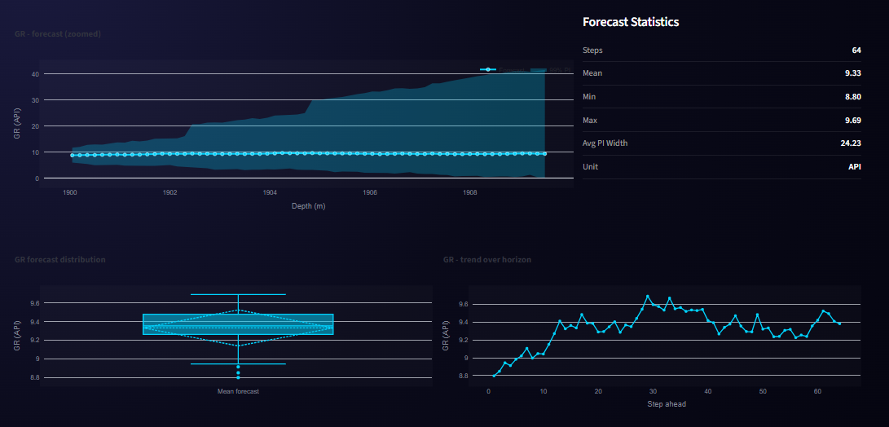
Forecast graphs per Curve

Slide 27
Driven subsurface Interpretation And Geo-Modeling for Upstream
Tools
AI / ML MODELS
Chronos-2 takes a history of a time series and outputs quantile forecasts
DATA & GEOSCIENCE
LASIO:
Well-log reading, preprocessing & quality control
NumPy / Pandas / SciPy:
Data processing, feature engineering & numerical analysis
3D GEOLOGICAL MODELING
Vedo:
3D geological visualization & subsurface modeling
Delaunay Triangulation:
3D spatial meshing and geological model generation

