Slide 1
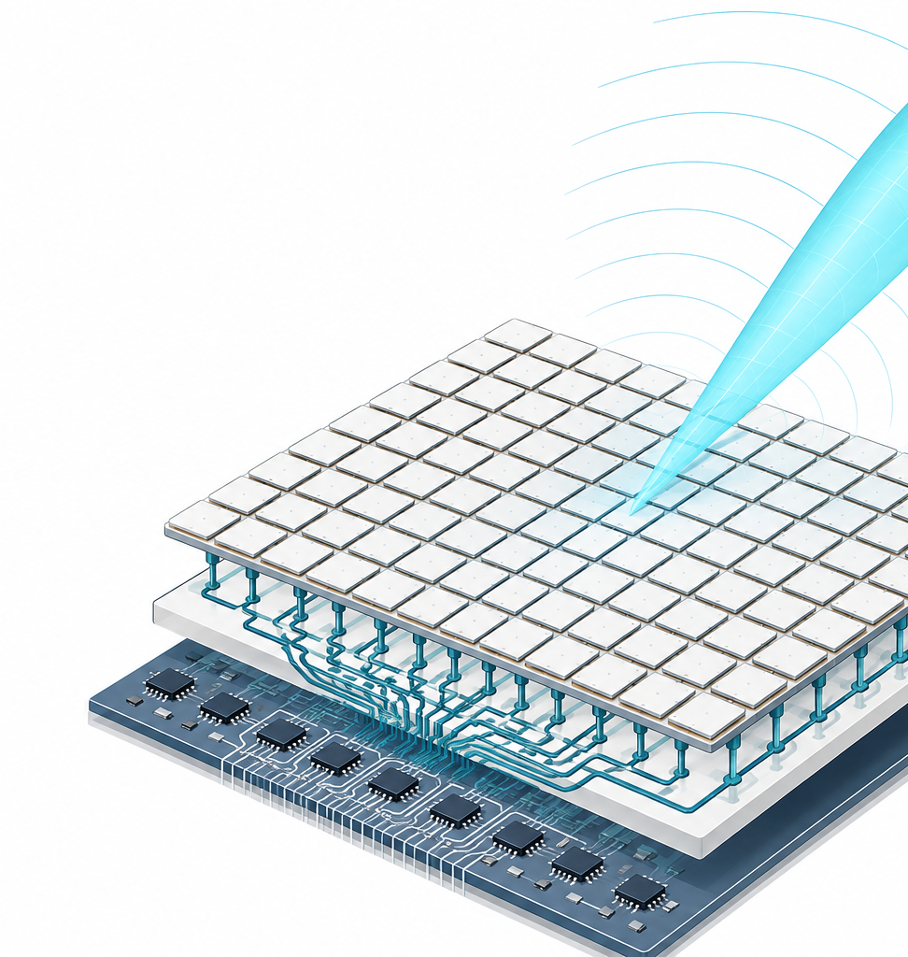
TEAM WORK PLAN
Adaptive Beamforming
Made Practical
A Guided Classroom Experience with Real Time Classroom Experiments
Jon Kraft • Tarun Cousik • Mark Yeary
Thursday, October 22, 2026
Planning review • August 27, 2026
Affiliation / logo space
LOGO 1
LOGO 2
LOGO 3
Phased array → data → adaptive weights

Slide 2
NARRATIVE
Proposed learning arc
Build one continuous story from physical intuition to adaptive interference suppression.
1 Array intuition
2 Data structure
3 Fourier viewpoint
4 Why adapt?
Array as a linear combiner
Linear array formula
Cartesian, polar, u domain
Digital channels become vectors
Matrices organize snapshots
Dot products are the core operation
Time and space Fourier Transform
Meaning of the complex exponential
Array factor is a spatial transform
Windowing and sidelobe tradeoffs
Interference can move or be adversarial
Use data to place and track nulls
Design rule
Every major algorithm should end in a guided lab that reuses the same data model, notation, and plots.
Adaptive Beamforming Made Practical
02

Slide 3
SCOPE
Detailed content map
The outline below is intentionally ordered by the learner’s mental model, not by algorithm taxonomy.
01
02
03
04
Arrays and patterns
Data and linear algebra
Fixed beamforming and limits
Adaptive beamforming
Array as a linear combiner
Uniform linear array formula
Beam steering and array factor
Cartesian and polar plots
u domain representation
Modern digital array data collection
Snapshots, vectors, matrices
Dot products and inner products
Fourier Transform in time and space
Complex exponential intuition
Array formula as a spatial Fourier transform
SINR, narrowband, wideband
Windowing and weighting
Mainlobe versus sidelobe tradeoffs
SINR consequences
Fixed base station example
Interference near a sidelobe
What fails when the scene is uncertain
Intentional jammer motivation
Data driven weights and nulling
MVDR and LCMV
SLC
LMS
RLS
Compare convergence, constraints, complexity, robustness
Adaptive Beamforming Made Practical
03

Slide 4
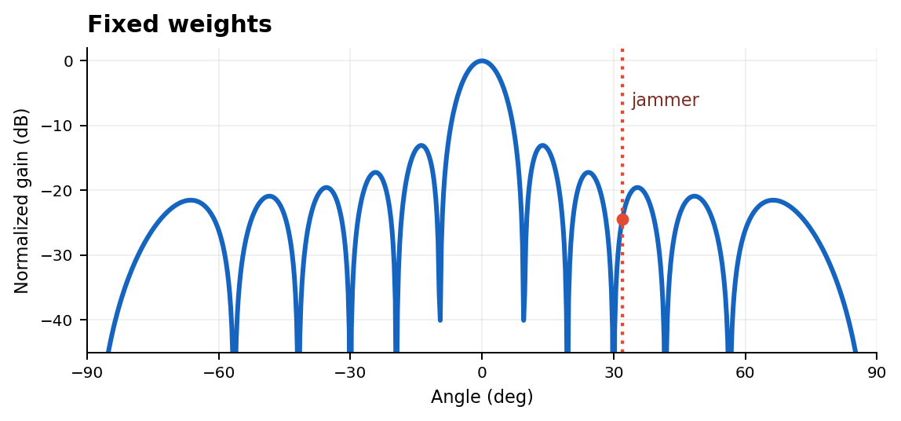
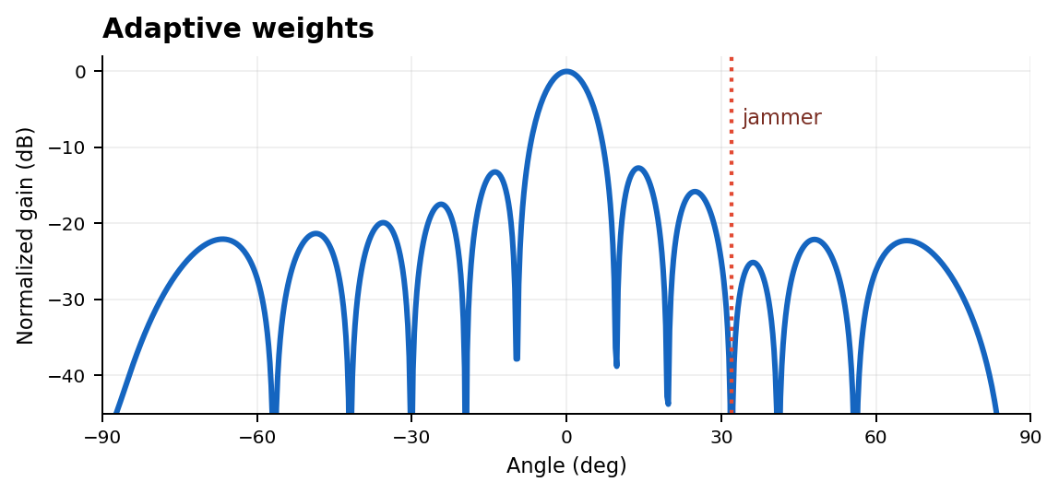
MOTIVATION
Motivating storyline: why adapt?
Start with a useful fixed beam. Then change the environment and show exactly where fixed sidelobe control stops being enough.
Scenario A
Fixed weights
Scenario B
Adaptive weights
An interferer can drift onto a sidelobe even when the original window was well chosen.
Preserve the look direction while using the data to place a null on the jammer.
Illustrative array patterns
Motivation ladder
other base station near sidelobe → non deterministic scene → intentional jammer → adaptive nulling
Adaptive Beamforming Made Practical
04

Slide 5
LABS
Hands on lab architecture
Each focus algorithm gets the same repeatable learning loop: concept, implementation, real data, then stress testing.
MVDR / LCMV
SLC
LMS
RLS
Optimal and constrained beamforming
Practical adaptive architecture
Iterative adaptation and convergence
Faster adaptation, higher complexity
lecture → notebook → real data
lecture → notebook → real data
lecture → notebook → real data
lecture → notebook → real data
Three levels, 2 or 3 exercises per level
EASY
INTERMEDIATE
HARD
Common
lab outputs
Run a known baseline
Read the pattern and SINR plots
Change one clearly defined parameter
Change array or interference geometry
Compare algorithm behavior
Explain SINR and null placement
Incomplete knowledge or moving jammer
Convergence, robustness, constraints
Make a design choice and defend it
pattern
SINR
weights
convergence
Adaptive Beamforming Made Practical
05

Slide 6
EXECUTION
Workstreams and definition of done
Use one owner and one reviewer for each workstream. The owner cell is intentionally left open for today’s discussion.
WORKSTREAM
DONE WHEN
OWNER
Narrative and slide modules
Concept sequence, transitions, speaker timing, consistent notation
TBD
Lab notebooks and solutions
Starter notebook, expected outputs, solution notebook, reset instructions
TBD
Data and hardware path
Scripted acquisition, known classroom setup, recorded fallback datasets
TBD
Figures and demonstrations
Patterns, data flow, Fourier viewpoint, interference and nulling visuals
TBD
Integration and rehearsal
Full run under target time, handoffs tested, recovery plan for demo failure
TBD
Recommended review rule: no module is “done” until a second presenter can run it without the author present.
Adaptive Beamforming Made Practical
06

Slide 7
TIMELINE
Proposed timeline to the tutorial
Eight week runway from today to October 22. Build in parallel, integrate early, then freeze the final week.
Aug 27
Sep 3
Sep 10
Sep 17
Sep 24
Oct 1
Oct 8
Oct 15
Scope and ownership
OCT
22
Foundations slides
TUTORIAL
Adaptive slides
Lab notebooks and solutions
Live data and hardware
Integration and rehearsal
Final polish and backup
Foundations
complete
All labs
runnable
Final
freeze
Adaptive Beamforming Made Practical
07

Slide 8
MEETING OUTCOME
Decisions needed today
The goal for this meeting is to leave with a locked first pass scope, clear ownership, and dates.
01
Learning arc
Confirm: array intuition → data and linear algebra → Fourier viewpoint → fixed beam limits → adaptive beamforming
MEETING OUTPUT
Algorithm scope
Confirm depth and order for MVDR / LCMV, SLC, LMS, and RLS. Decide what is explicitly out of scope.
By the end of today
02
First pass outline is frozen
Module owners are assigned
Lab template is agreed
Milestone dates are accepted
03
Lab strategy
Confirm three levels with 2 or 3 exercises each, and a common notebook structure across algorithms.
04
Data strategy
Decide the live classroom acquisition path and the recorded fallback dataset that mirrors it.
05
Ownership
Assign one owner and one reviewer to each workstream and major tutorial module.
Next internal checkpoint
Foundations module + one complete lab
Proposed default
Keep the scope narrow enough that participants can actually build, run, and interpret the algorithms during the session.
Adaptive Beamforming Made Practical
08

