Slide 1

SMART PARKING MANAGEMENT SYSTEM
OBJECT ORIENTED PROGRAMMING PROJECT

Slide 2

Project overview
Java based command line interface to create a smart parking management system.
It assigns vehicle spots based on vehicle compatability
Manages reservations and subscriptions.
It facilitates payment via UPI or credit card.
Tracks entry/exit times as well as transaction details for security purposes.

Slide 3



Supports multiple car types
System objectives
Spot types vary from cars, bikes, etc.
The system also tracks reservations, transactions and entry/exit logs for security purposes.
Dynamic fee calculation based on vehicle type, duration and peak hours/weekends.

Slide 4
System architecture
1
Package: parkinglot
2
com.parkinglot.system.model
5
com.parkinglot.system.management
Vehicle, ParkingSpot, Reservation, etc.
ParkingLot, PricingManager
com.parkinglot.system.ui
3
User interface (menu system)
4
com.parkinglot.system.payment
com.parkinglot.system.exceptions
com.parkinglot.system.payment:
Custom exceptions

Slide 5


Vehicle hierarchy
Abstract class: Vehicle
Derived classes:
Car
Bike
Truck
ElectricVehicle

Slide 6
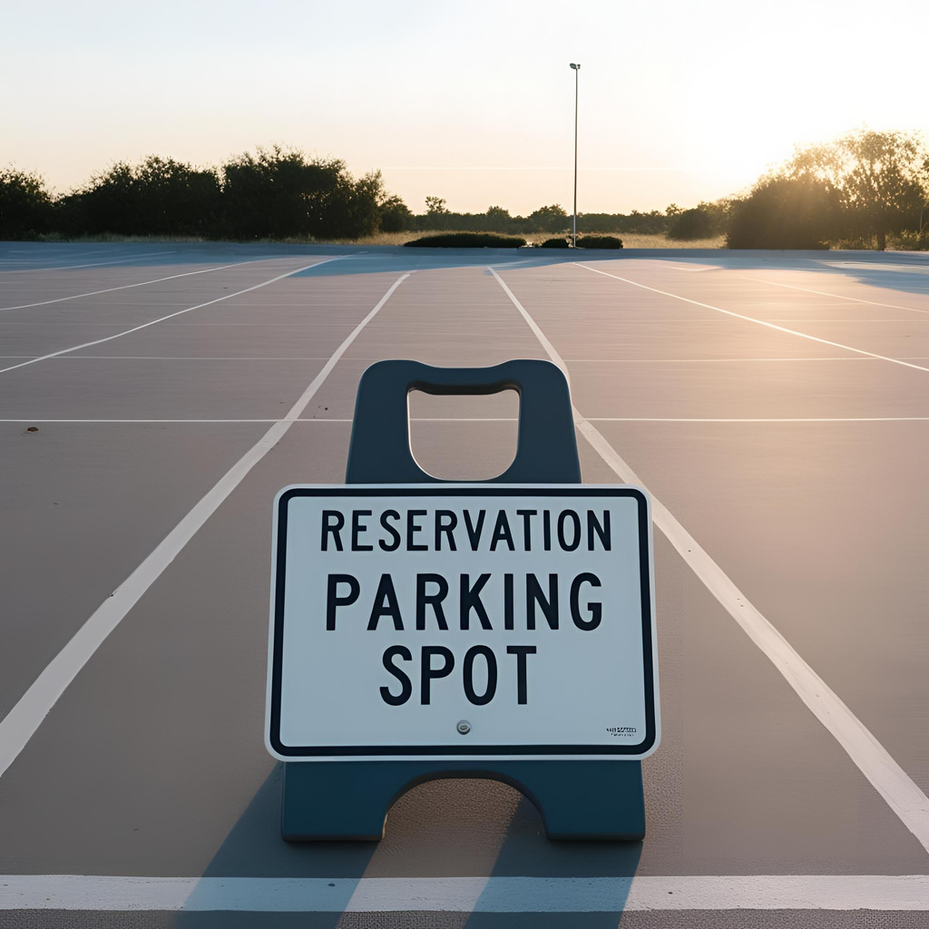
ParkingSpot and reservation
Parking Spot:
Can be of multiple types depending on car, truck, bike or electric vehicle.
Reservation:
Creates a reservation.
Active reservations can be cancelled.
Implements error handling.
Displays all active reservations.
Reservations are paid in full after exiting.

Slide 7
OOP features
Overloading
The application implements the following:
Overloading
Inheritance
Abstraction
Encapsulation
Nested Classes
Exception Handling
Inheritance
Abstraction

Slide 8
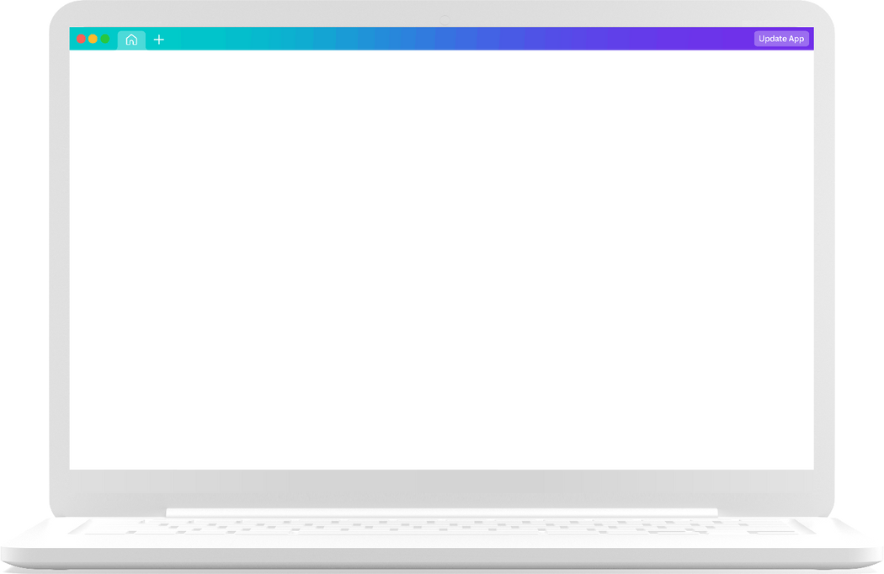

Payment and logging
Payment supports both UPI and Credit Card
Security logging takes care of entry exit, active reservations, active subscriptions and transacction history which is all saved in a file

Slide 9
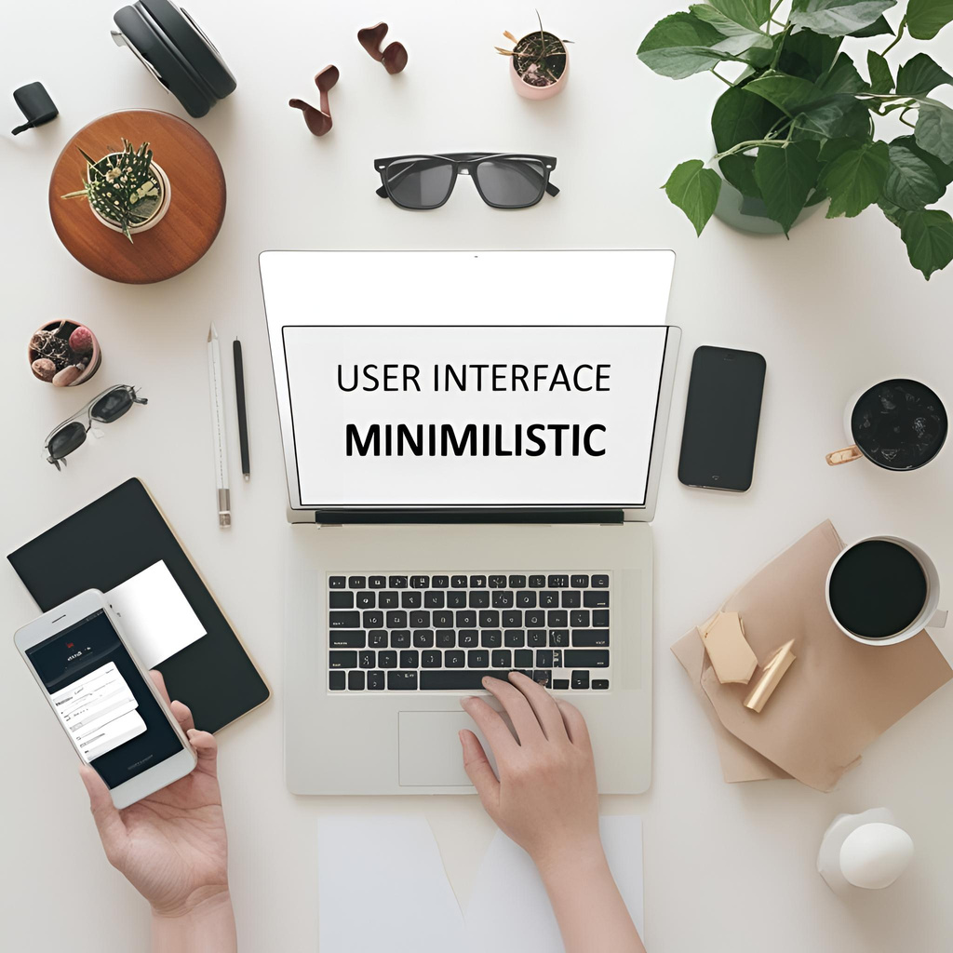
USER INTERFACE
Provides a command line interface with a menu with the following options
check in/check out vehicles.
check parking availability.
check transacction history
It facilitates payment via UPI or credit card.
Tracks entry/exit times as well as transaction details for security purposes.
Make reservations and subscriptions.

Slide 10
Thank you very much!

