Slide 1


ParkMeRight A Smart Parking System
Presented By- Under guidance of-
Tarun Dhiraj (CSE) Prof. Deepti Theng
Monika Sharma (CSE)

Slide 2
Introduction
It will come in use for reserving a parking space in a multi storey car park.
You can provide information related to your car like the name or model so that it can tell you whether there is any space left for the parking for your vehicle depending on its size.
If available, you can book it and tell the time duration for which it would be required.

Slide 3
Literature Survey

Slide 4
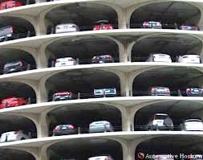
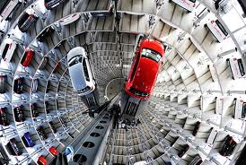
What is Multi-Storey Car Park?
A multi-storey car-park (also called a parking garage, parking structure, parking ramp, parkade, parking building or parking deck) is a building designed for car parking and where there are a number of floors or levels on which parking takes place. It is essentially a stacked car park.

Slide 5

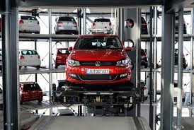
Movement of vehicles between floors can be effected by:
interior ramps - the most common type
exterior ramps - which may take the form of a circular ramp (colloquially known as a 'whirley-gig' in America)
vehicle lifts - the least common
automated robot systems - combination of ramp and elevator

Slide 6
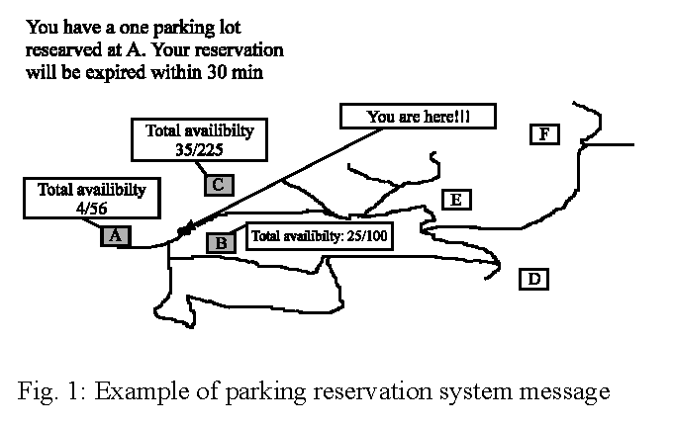
E-Parking System
It provides an alternative for patrons to enquire the availability and/or reserve a parking space at their desired parking facility to ensure the availability of vacant car park space when they arrive at the parking facility.
System can be accessed via internet on WAP enabled Android smart phone.

Slide 7
Advantages
Smart payment system can be incorporated into this system so as to make payments hustle free.
Facilitates the enforcement of tariff classes to enable the maximization of revenue for car park operators.
Disadvantages
There are lesser multi-storey car park systems in India so smart parking systems can’t be implemented here. Manual operation by an operator is required.

Slide 8
A Web Application
One web application would be made that will be used by the person in charge of that car park so that the updates can be made regularly without fail regarding free space availability, advance booking, entry and exit of cars etc.
The person involved will look after the correct and precise allotment of space without any inconvenience to the users.

Slide 9
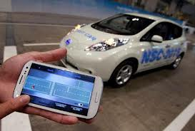
An Android Application
An android app would be there for the users (Car owners) who will be receiving the information they want through this app. This app will be in sync with the web application created above. The user can ask for allotment of space for parking if available for their car in advance by stating the size of car and time for which it is required.

Slide 10
Technologies Used

Slide 11
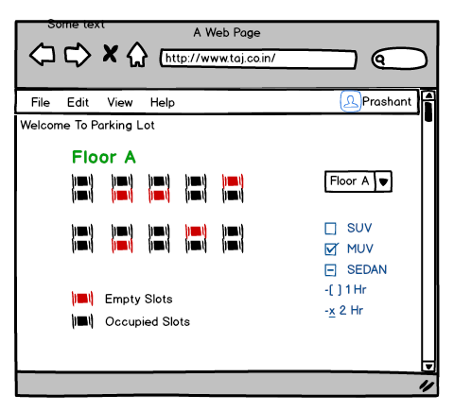
Mock Ups
Web Application on Operator’s End

Slide 12
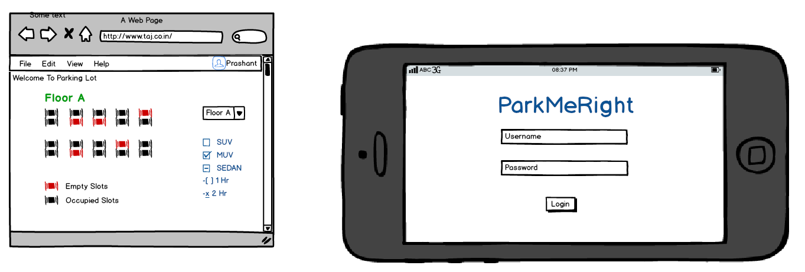
Mock Ups
Android App Login Page

Slide 13
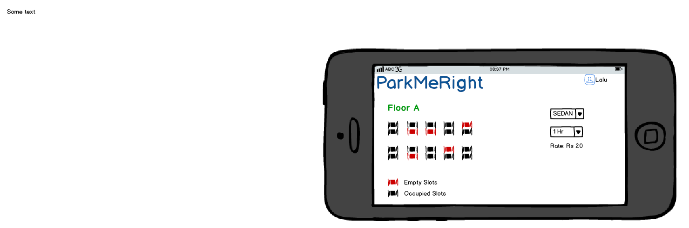
Mock Ups
Android App After successful Login

Slide 14
Future Scope

Slide 15
References
http://www.upark.in/
Car Park System: A review of Smart parking System and Its technology
M.Y.I Idris,Information Technology Journal 8(2),101-113,2009

Slide 16
Thank You!

