Slide 1




ENEL 645 Data Mining & Machine Learning Final Project Presentation
Title: Face Detection Using Siamese Model
Team Number 3:
Chetana Bijoor
Sanyam
Prabhleen Kaur
Neha Singh
Taruneesh Sachdeva

Slide 2
Motivation & Significance of the Problem
In this project, we use Siamese Neural Networks (SNN) for Face Recognition due to the below reasons:
SNN allows users to choose only a handful of images from each class or from a person.
SNN does not classify images but instead learns the similarity functions that evaluates similarity between two objects.
SNN’s are easy to train and have a fairly simple architecture.

Slide 3
Defining Dataset
Initial Dataset: 5 images per team member
Augmented Dataset: 20 images per team member (100 images)
Training Dataset: 10,000 pair of images.
Test Dataset: 54 images
These images were resized into a shape of (128, 128, 3)
To create the actual training set, each image is paired with every other image and a label is assigned to each pair.
Same class: Label 1
Different class: Label 0

Slide 4
Data Preprocessing
After labelling the image pairs, the images are converted into NumPy arrays and stored in x1.npy and x2.npy files.
Each element of x1.npy and x2.npy contains an image from each pair, such that the nth image from each file makes the nth pair with corresponding label stored in y.npy file.
As a result, we have 2 sets of images X1 and X2 of shape (10000, 128, 128, 3) and 10000 labels.

Slide 5
Methodology
Siamese Model Architecture

Slide 6
Model Algorithm:
We take two images ( Image1 and Image2 ). Both the images are feed to a single Convolutional Neural Network ( CNN ).
The last layer of the CNN produces a fixed size vector ( embedding of the image ). Since two images are feed, we get two embeddings. ( h1 and h2 ).
The Euclidean distance between the vectors is calculated.
The values then pass through a sigmoid function and a similarity score is produced.
Model Construction:
Siamese Model is built using the sequential model approach.
Four convolution layers along with the two max pooling layers are used for building the model, with LeakyReLu as the activation function.
Two instances of model are constructed with same parameters.
Outputs from the two instances of the models is applied to the dense layer with ‘sigmoid’ as the activation function.
The output of the sigmoid function is the similarity score between the two images based on which model learns the similarity.

Slide 7
Model Training
Model is trained with the different batch size, epochs, and different split ratio of training and validation data.
A patience with value 10 is used along with the monitoring of the minimum validation loss.
The best score is achieved with a batch size of 6, 100 epochs, and train vs validation data split ratio of 8000:2000.
Accuracy achieved – 54%.

Slide 8
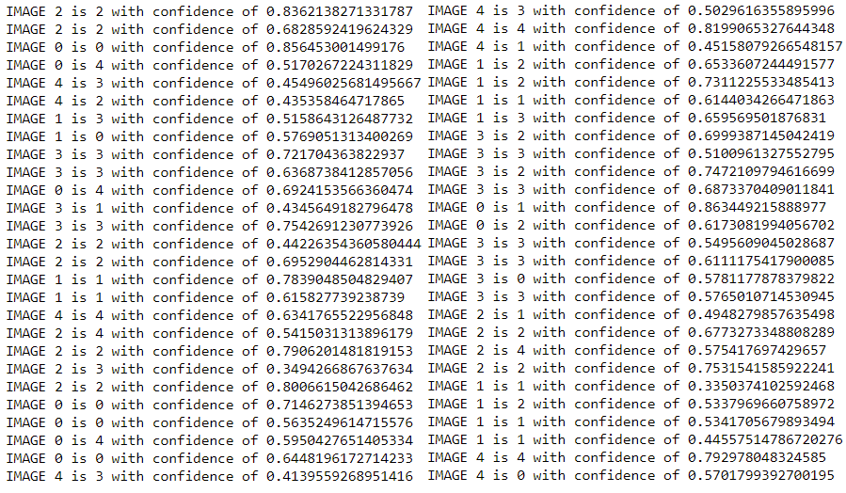
Results - Predicted Labels
Label | Person
0 | Chetana
1 | Prabhleen
2 | Sanyam
3 | Taruneesh
4 | Neha

Slide 9
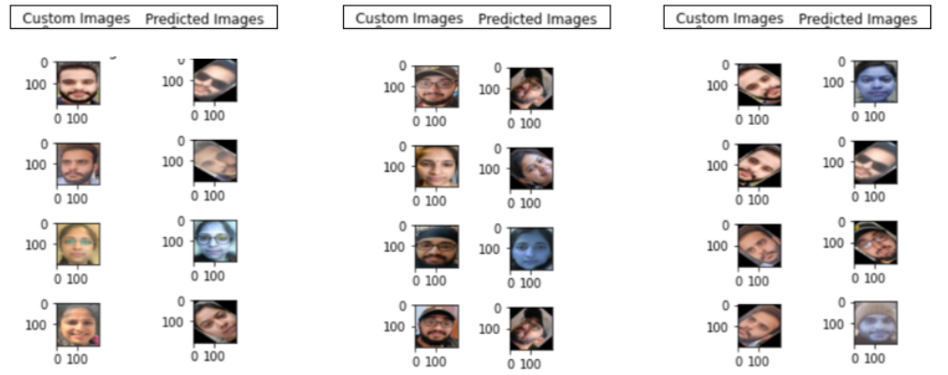
Predicted vs Actual Images

Slide 10
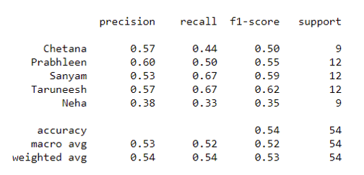
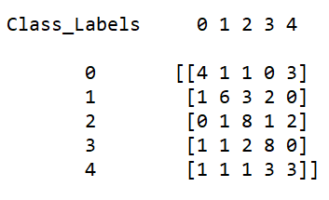
Confusion Matrix and Classification Report
Label | Person
0 | Chetana
1 | Prabhleen
2 | Sanyam
3 | Taruneesh
4 | Neha
Confusion Matrix
Classification Report

Slide 11
Challenges Faced
The approach followed by the team to implement the face detection is by converting the images to the NumPy arrays. This approach is slow and takes a lot of time in building the NumPy arrays. However, team was able to implement the project using a decent dataset of around 10,000 pair of images, on which model is trained.
Google Colab has a limit on the number of resources we can use i.e. GPU runtime, thus it becomes difficult to train a model for different set of hyperparameters for a longer duration.

Slide 12

Thank You

