Slide 1
ET AI HACKATHON 2026 · PROBLEM STATEMENT 8
ForgeMind AI
Unified Asset & Operations Brain for Industrial Knowledge
Plant docs are scattered across manuals, inspections, work orders, and incident reports.
ForgeMind puts them in one place so teams can upload, search, and ask — with sources.
forgemind.tarachand.tech

Slide 2
PROBLEM → SOLUTION
Industrial knowledge is fragmented. ForgeMind unifies it.
THE PROBLEM
THE SOLUTION
35% of engineer time lost searching for information that already exists (McKinsey, 2024).
7–12 disconnected document systems per large industrial plant.
18–22% of unplanned downtime traced to fragmented equipment history.
25% of India's experienced engineers retire within a decade — taking undocumented knowledge with them.
Upload — PDF/Word/Excel/text, parsed and persisted for the whole team.
Knowledge — keyword + semantic search, equipment map, full asset history.
Ask AI — plain-language Q&A with cited sources and grounded compliance.
Insights — live coverage score, auto-detected conflicts/gaps, Lessons Learned.
ForgeMind AI · ET AI Hackathon 2026 · PS8
2

Slide 3
HOW IT WORKS
A live intelligence layer, not a static demo
1
Upload → parse text → LLM entity extraction (equipment tags, parameters, regs, personnel, dates)
2
SQLite (documents + entities) + vector index (local embeddings, optional ChromaDB)
3
Knowledge graph grows · conflicts auto-detected · gaps recomputed — live, per upload
4
Ask AI (RAG) → OpenRouter LLM → answer grounded in retrieved regulation/SOP evidence
WHY IT'S NOT JUST A DEMO
• Uploading a real document adds real graph nodes/edges, detects real value conflicts, and closes real doc-type gaps — verified end-to-end.
• Compliance flags are grounded in retrieved evidence and marked 'unknown' rather than guessed when none exists.
ForgeMind AI · ET AI Hackathon 2026 · PS8
3

Slide 4
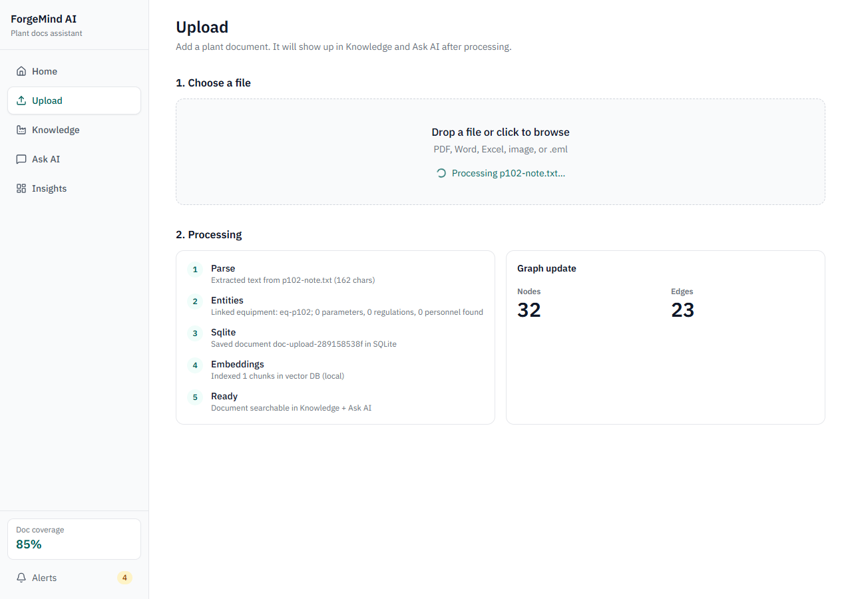
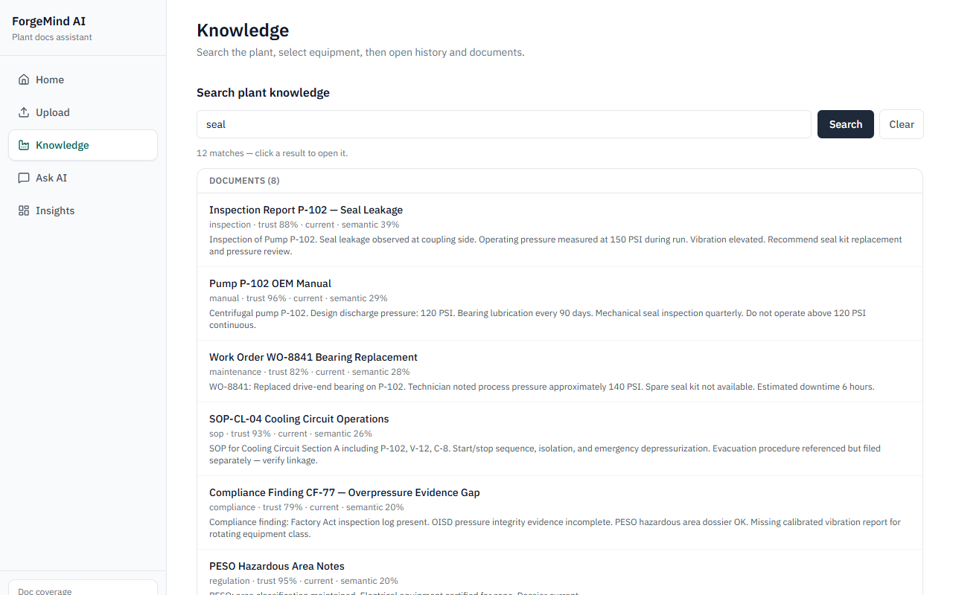
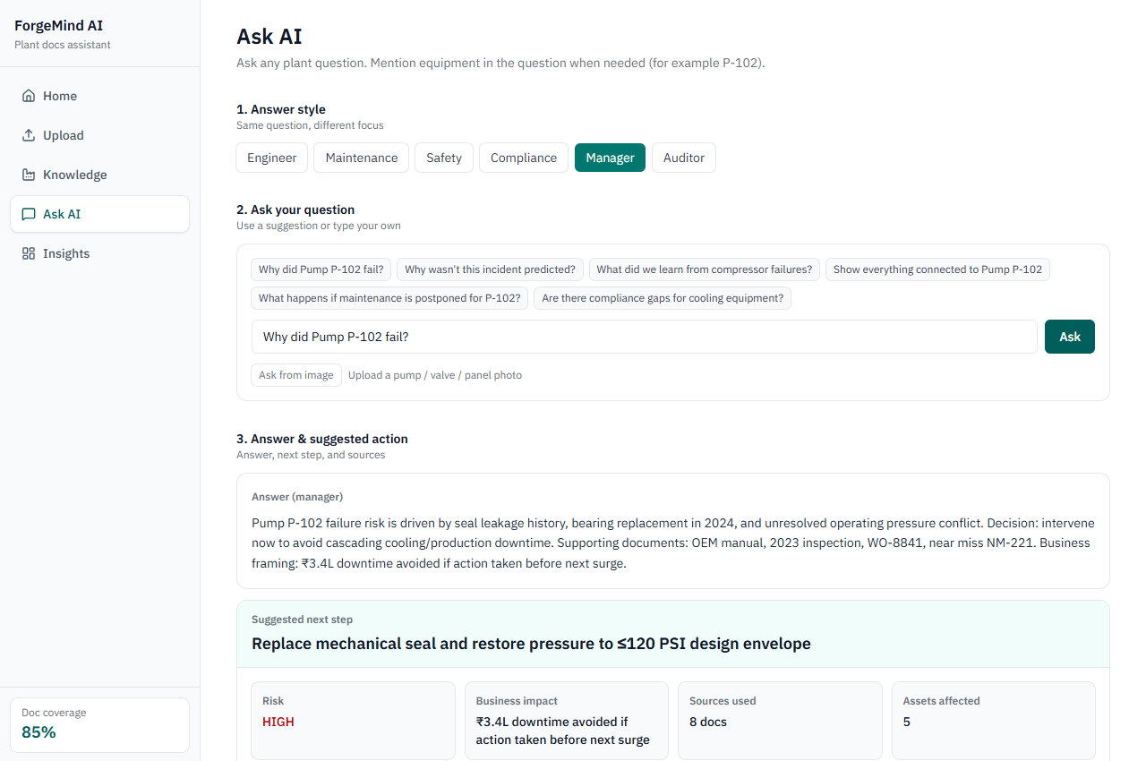
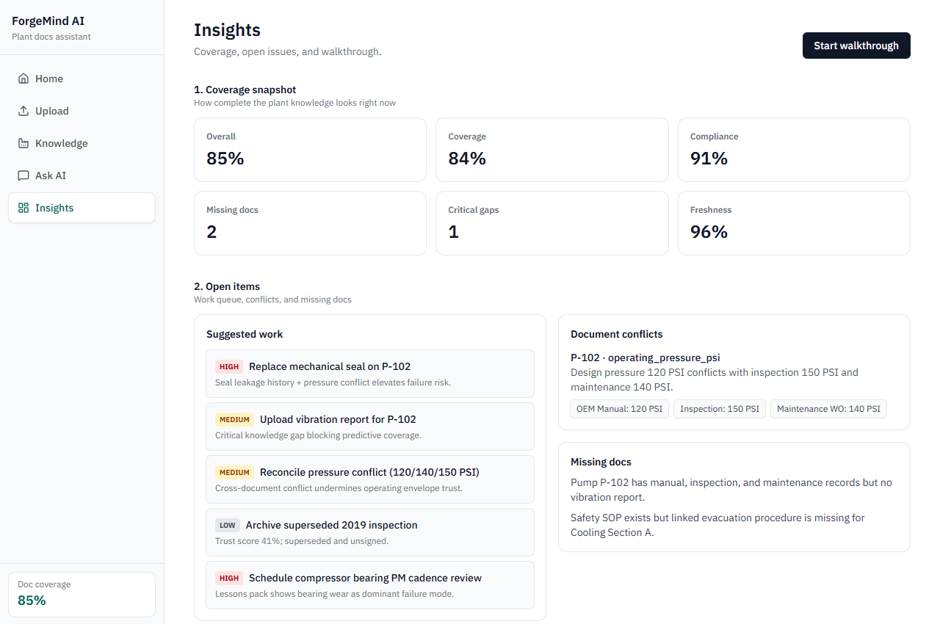
LIVE PRODUCT
Upload → Knowledge → Ask AI → Insights
Upload — live processing stages, graph grows with every file
Knowledge — keyword + semantic search across the plant
Ask AI — grounded answer with a decision card and sources
Insights — coverage, conflicts, gaps, and lessons learned
ForgeMind AI · ET AI Hackathon 2026 · PS8
4

Slide 5
JUDGING CRITERIA ALIGNMENT
Mapped directly to what was asked
Innovation — 25%
Live-growing knowledge graph, automatic conflict/gap detection.
Business Impact — 25%
Reclaims the 35% of time lost to document search; faster RCA & compliance evidence.
Technical Excellence — 20%
Real RAG, grounded compliance, resilient error handling (no hallucinated pass/fail, no CORS-masked 500s).
Scalability — 15%
SQLite → Postgres/Qdrant swap-in scaffolded; OpenRouter is model-agnostic.
User Experience — 15%
Guided walkthrough, real graph visualization, tested end-to-end with zero console errors.
Stack: Next.js + Tailwind (Vercel) · FastAPI (Render) · SQLite + local/ChromaDB vectors · OpenRouter LLM
ForgeMind AI · ET AI Hackathon 2026 · PS8
5

Slide 6
Thank you
Try it live:
https://forgemind.tarachand.tech
github.com/tarungarg18/ForgeMind-AI
Next: OCR for scanned P&IDs, async ingestion at scale, knowledge-graph-native storage,
role-based access, and multi-plant federation.

