Slide 1
Chapter 1:
Data Warehousing
1.Basic Concepts of data warehousing
2.Data warehouse architectures
3.Some characteristics of data warehouse data
4.The reconciled data layer
5.Data transformation
6.The derived data layer
7. The user interface

Slide 2
Motivation
“Modern organization is drowning in data but starving for information”.
Operational processing (transaction processing) captures, stores and manipulates data to support daily operations.
Information processing is the analysis of data or other forms of information to support decision making.
Data warehouse can consolidate and integrate information from many internal and external sources and arrange it in a meaningful format for making business decisions.

Slide 3
Definition
Data Warehouse: (W.H. Immon)
  A subject-oriented, integrated, time-variant, non-updatable collection of data used in support of management decision-making processes
  Subject-oriented: e.g. customers, patients, students, products
  Integrated: Consistent naming conventions, formats, encoding structures; from multiple data sources
  Time-variant: Can study trends and changes
  Nonupdatable: Read-only, periodically refreshed
Data Warehousing:
  The process of constructing and using a data warehouse

Slide 4
Data Warehouse—Subject-Oriented
Organized around major subjects, such as customer, product, sales.
Focusing on the modeling and analysis of data for decision makers, not on daily operations or transaction processing.
Provide a simple and concise view around particular subject issues by excluding data that are not useful in the decision support process.

Slide 5
Data Warehouse - Integrated
Constructed by integrating multiple, heterogeneous data sources
  relational databases, flat files, on-line transaction records
Data cleaning and data integration techniques are applied.
  Ensure consistency in naming conventions, encoding structures, attribute measures, etc. among different data sources
    E.g., Hotel price: currency, tax, breakfast covered, etc.
  When data is moved to the warehouse, it is converted.

Slide 6
Data Warehouse -Time Variant
The time horizon for the data warehouse is significantly longer than that of operational systems.
  Operational database: current value data.
  Data warehouse data: provide information from a historical perspective (e.g., past 5-10 years)
Every key structure in the data warehouse
  Contains an element of time, explicitly or implicitly
  But the key of operational data may or may not contain “time element”.

Slide 7
Data Warehouse - Non Updatable
A physically separate store of data transformed from the operational environment.
Operational update of data does not occur in the data warehouse environment.
  Does not require transaction processing, recovery, and concurrency control mechanisms.
  Requires only two operations in data accessing:
    initial loading of data and access of data.

Slide 8
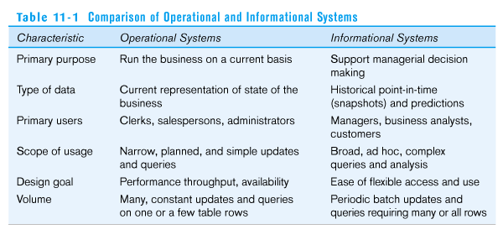
Need for Data Warehousing
Integrated, company-wide view of high-quality information (from disparate databases)
Separation of operational and informational systems and data (for improved performance)
Table 11-1: comparison of operational and informational systems

Slide 9
Need to separate operational and information systems
Three primary factors:
  A data warehouse centralizes data that are scattered throughout disparate operational systems and makes them available for DS.
  A well-designed data warehouse adds value to data by improving their quality and consistency.
  A separate data warehouse eliminates much of the contention for resources that results when information applications are mixed with operational processing.

Slide 10
Data Warehouse Architectures
1.Generic Two-Level Architecture
2.Independent Data Mart
3.Dependent Data Mart and Operational Data Store
4.Logical Data Mart and @ctive Warehouse
5.Three-Layer architecture
All involve some form of extraction, transformation and loading (ETL)

Slide 11
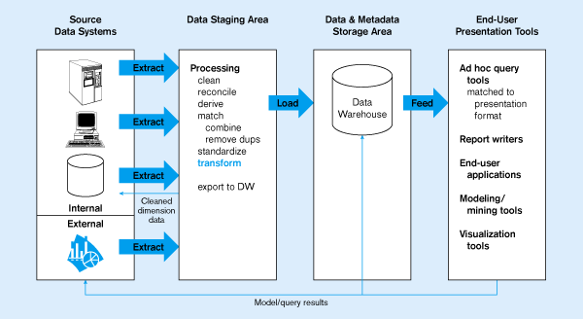
Figure 11-2: Generic two-level architecture
L
One, company-wide warehouse
T
E
Periodic extraction ➔ data is not completely current in warehouse

Slide 12
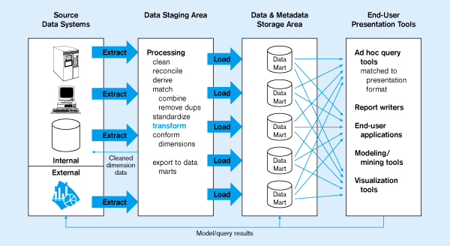
Figure 11-3: Independent Data Mart
Data marts:
Mini-warehouses, limited in scope
L
T
E
Separate ETL for each independent data mart
Data access complexity due to multiple data marts

Slide 13
Independent Data mart
Independent data mart: a data mart filled with data extracted from the operational environment without benefits of a data warehouse.

Slide 14
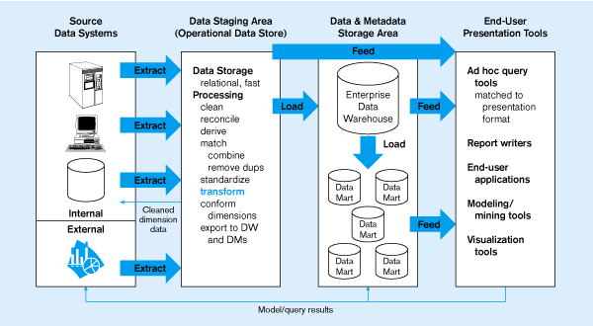
Figure 11-4:
Dependent data mart with operational data store
ODS provides option for obtaining current data
L
T
E
Simpler data access
Single ETL for
enterprise data warehouse
(EDW)
Dependent data marts loaded from EDW

Slide 15
Dependent data mart-
Operational data store
Dependent data mart: A data mart filled exclusively from the enterprise data warehouse and its reconciled data.
Operational data store (ODS): An integrated, subject-oriented, updatable, current-valued, enterprise-wise, detailed database designed to serve operational users as they do decision support processing.

Slide 16
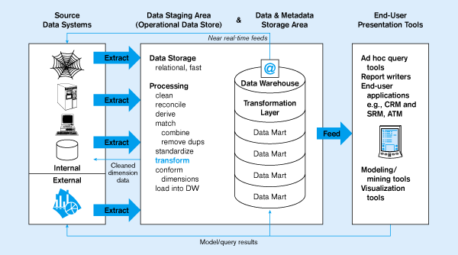
Figure 11-5:
Logical data mart and @ctive data warehouse
ODS and data warehouse are one and the same
L
T
E
Near real-time ETL for
@active Data Warehouse
Data marts are NOT separate databases, but logical views of the data warehouse
➔ Easier to create new data marts

Slide 17
@ctive data warehouse
@active data warehouse: An enterprise data warehouse that accepts near-real-time feeds of transactional data from the systems of record, analyzes warehouse data, and in near-real-time relays business rules to the data warehouse and systems of record so that immediate actions can be taken in response to business events.

Slide 18
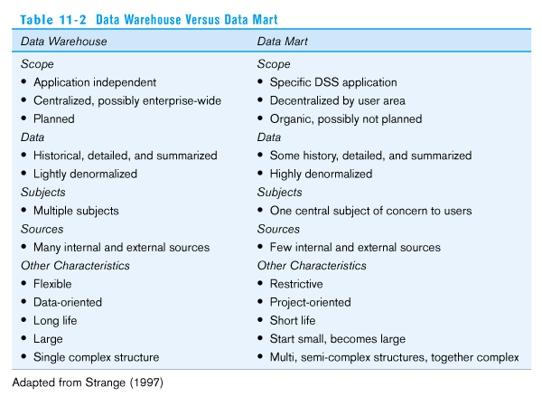
Table 11-2: Data Warehouse vs. Data Mart
Source: adapted from Strange (1997).

Slide 19
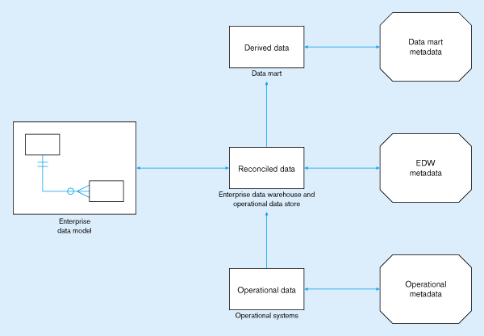
Figure 11-6: Three-layer architecture

Slide 20
Three-layer architecture
Reconciled and derived data
Reconciled data: detailed, current data intended to be the single, authoritative source for all decision support.
Derived data: Data that have been selected, formatted, and aggregated for end-user decision support application.
Metadata: technical and business data that describe the properties or characteristics of other data.

Slide 21
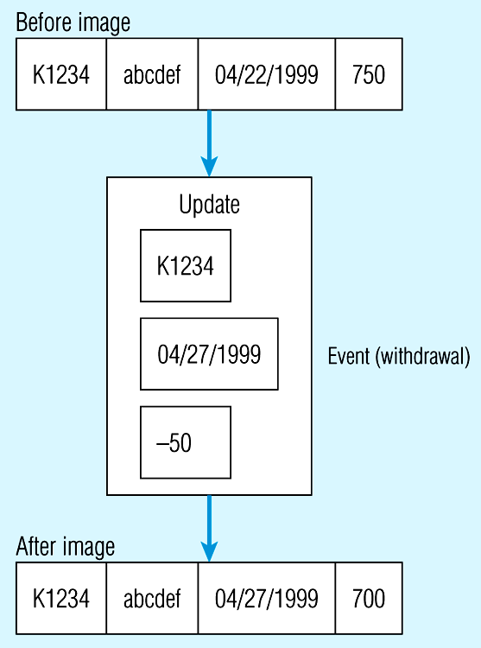
Data Characteristics
Status vs. Event Data
Figure 11-7:
Example of
DBMS log entry
Status
Event = a database action (create/update/delete) that results from a transaction
Status

Slide 22
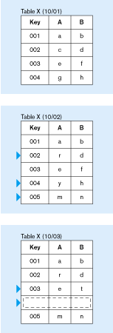
Data Characteristics
Transient vs. Periodic Data
Figure 11-8:
Transient operational data
Changes to existing records are written over previous records, thus destroying the previous data content

Slide 23
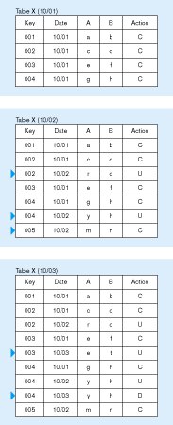
Data Characteristics
Transient vs. Periodic Data
Figure 11-9:
Periodic warehouse data
Data are never physically altered or deleted once they have been added to the store

Slide 24
Other data warehouse changes
New descriptive attributes
New business activity attributes
New classes of descriptive attributes
Descriptive attributes become more refined
Descriptive data are related to one another
New source of data

Slide 25
Data Reconciliation
Typical operational data is:
  Transient – not historical
  Not normalized (perhaps due to denormalization for performance)
  Restricted in scope – not comprehensive
  Sometimes poor quality – inconsistencies and errors
After ETL, data should be:
  Detailed – not summarized yet
  Historical – periodic
  Normalized – 3rd normal form or higher
  Comprehensive – enterprise-wide perspective
  Quality controlled – accurate with full integrity

Slide 26
The ETL Process
Capture
Scrub or data cleansing
Transform
Load and Index
ETL = Extract, transform, and load

Slide 27
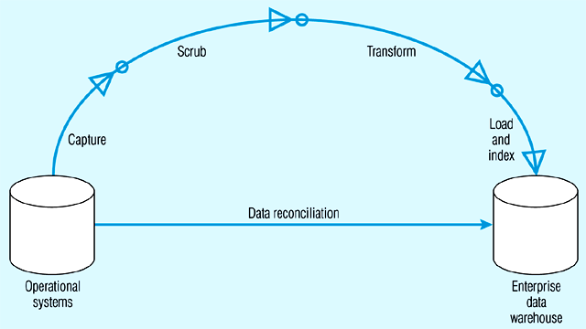
Figure 11-10: Steps in data reconciliation
Capture = extract…obtaining a snapshot of a chosen subset of the source data for loading into the data warehouse
Static extract = capturing a snapshot of the source data at a point in time
Incremental extract = capturing changes that have occurred since the last static extract

Slide 28
Figure 11-10: Steps in data reconciliation (continued)
Scrub = cleanse…uses pattern recognition and AI techniques to upgrade data quality
Fixing errors: misspellings, erroneous dates, incorrect field usage, mismatched addresses, missing data, duplicate data, inconsistencies
Also: decoding, reformatting, time stamping, conversion, key generation, merging, error detection/logging, locating missing data

Slide 29
Figure 11-10: Steps in data reconciliation (continued)
Transform = convert data from format of operational system to format of data warehouse
Record-level:
Selection – data partitioning
Joining – data combining
Aggregation – data summarization
Field-level:
single-field – from one field to one field
multi-field – from many fields to one, or one field to many

Slide 30
Figure 11-10: Steps in data reconciliation (continued)
Load/Index= place transformed data into the warehouse and create indexes
Refresh mode: bulk rewriting of target data at periodic intervals
Update mode: only changes in source data are written to data warehouse

Slide 31
Data Transformation
Data transformation is the component of data reconcilation that converts data from the format of the source operational systems to the format of enterprise data warehouse.
Data transformation consists of a variety of different functions:
  record-level functions,
  field-level functions and
  more complex transformation.

Slide 32
Record-level functions & Field-level functions
Record-level functions
  Selection: data partitioning
  Joining: data combining
  Normalization
  Aggregation: data summarization
Field-level functions
  Single-field transformation: from one field to one field
  Multi-field transformation: from many fields to one, or one field to many

Slide 33
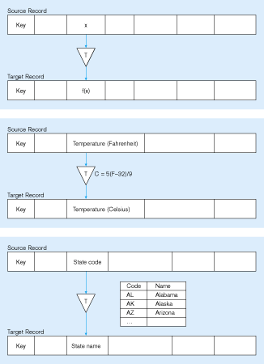
Figure 11-11: Single-field transformation
In general – some transformation function translates data from old form to new form
Algorithmic transformation uses a formula or logical expression
Table lookup – another approach

Slide 34
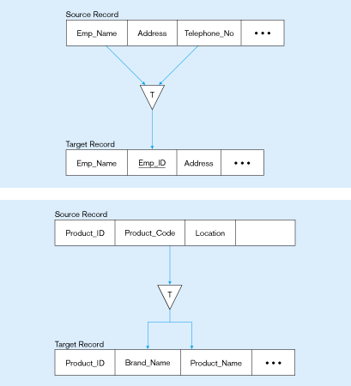
Figure 11-12: Multifield transformation
M:1 –from many source fields to one target field
1:M –from one source field to many target fields

Slide 35
Derived Data
Objectives
  Ease of use for decision support applications
  Fast response to predefined user queries
  Customized data for particular target audiences
  Ad-hoc query support
  Data mining capabilities
➔ Characteristics
  Detailed (mostly periodic) data
  Aggregate (for summary)
  Distributed (to departmental servers)
Most common data model = star schema
(also called “dimensional model”)

Slide 36
The Star Schema
Star schema: is a simple database design in which dimensional (describing how data are commonly aggregated) are separated from fact or event data.
A star schema consists of two types of tables: fact tables and dimension table.

Slide 37
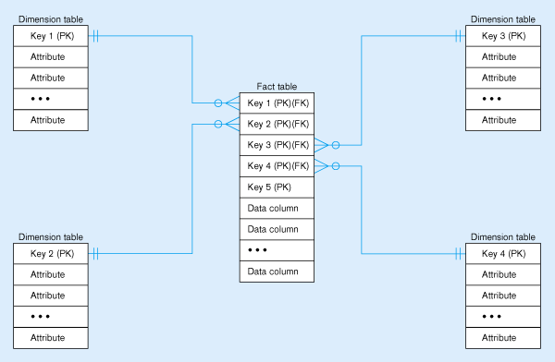
Figure 11-13: Components of a star schema
Fact tables contain factual or quantitative data
1:N relationship between dimension tables and fact tables
Dimension tables are denormalized to maximize performance
Dimension tables contain descriptions about the subjects of the business
Excellent for ad-hoc queries,
but bad for online transaction processing

Slide 38
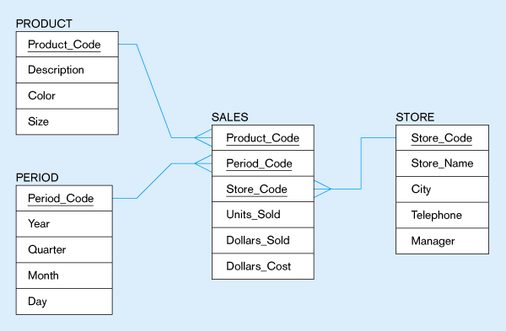
Figure 11-14: Star schema example
Fact table provides statistics for sales broken down by product, period and store dimensions

Slide 39
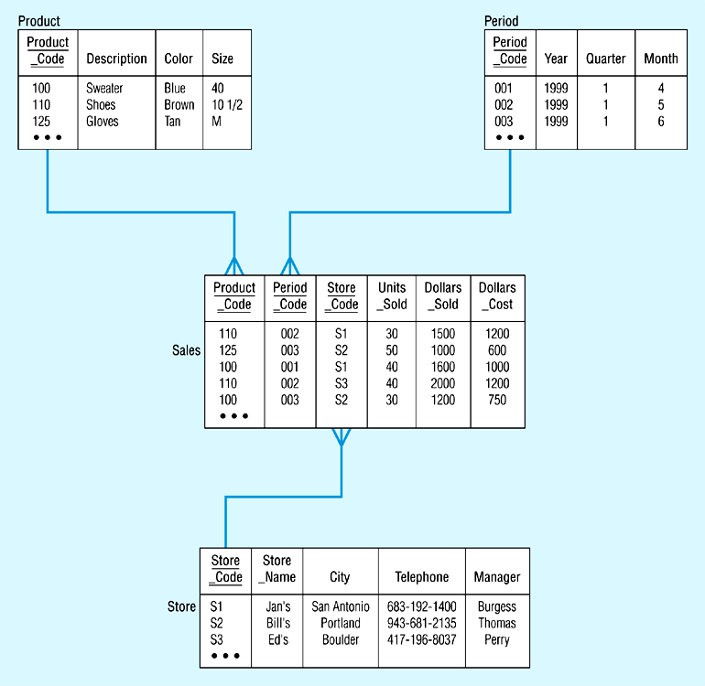
Figure 11-15: Star schema with sample data

Slide 40
Issues Regarding Star Schema
Dimension table keys must be surrogate (non-intelligent and non-business related), because:
  Keys may change over time
  Length/format consistency
Granularity of Fact Table – what level of detail do you want?
  Transactional grain – finest level
  Aggregated grain – more summarized
  Finer grains ➔ better market basket analysis capability
  Finer grain ➔ more dimension tables, more rows in fact table

Slide 41
Duration of the database
    Ex: 13 months or 5 quarters
    Some businesses need for a longer durations.
Size of the fact table
  Estimate the number of possible values for each dimension associated with the fact table.
  Multiply the values obtained in the first step after making any necessary adjustments.

Slide 42
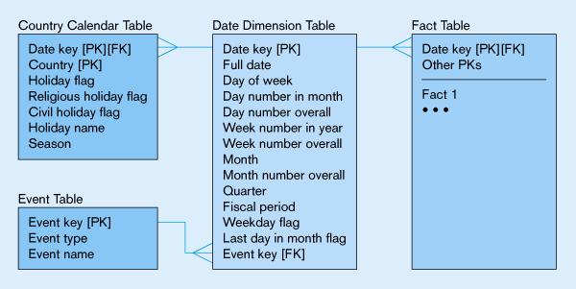
Figure 11-16: Modeling dates
Fact tables contain time-period data
➔ Date dimensions are important

Slide 43
Variations of the Star Schema
1. Multiple fact tables
2. Factless fact tables
3. Normalizing Dimension Tables
4. Snowflake schema

Slide 44
Multiple Fact tables
More than one fact table in a given star schema.
Ex: There are 2 fact tables, one at the center of each star:
  Sales – facts about the sale of a product to a customer in a store on a date.
  Receipts - facts about the receipt of a product from a vendor to a warehouse on a date.
  Two separate product dimension tables have been created.
  One date dimension table is used.

Slide 45
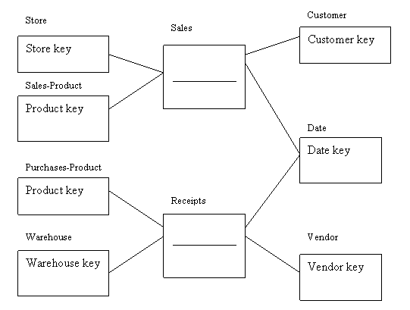

Slide 46
Factless Fact Tables
There are applications in which fact tables do not have nonkey data but that do have foreign keys for the associated dimensions.
The two situations:
  To track events
  To inventory the set of possible occurrences (called coverage)

Slide 47
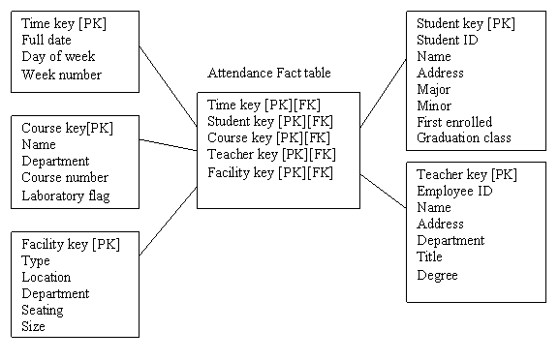
Factless fact table showing occurrence of an event.

Slide 48
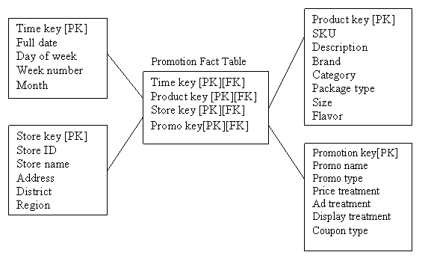
Factless fact table showing coverage

Slide 49
Normalizing dimension tables
Dimension tables may not be normalized. Most data warehouse experts find this acceptable.
In some situations in which it makes sense to further normalize dimension tables.
Multivalued dimensions:
  Ex: Hospital charge/payment for a patient on a date is associated with one or more diagnosis.
  N:M relationship between the Diagnosis and Finances fact table.
  Solution: create an associative entity (helper table) between Diagnosis and Finances.

Slide 50
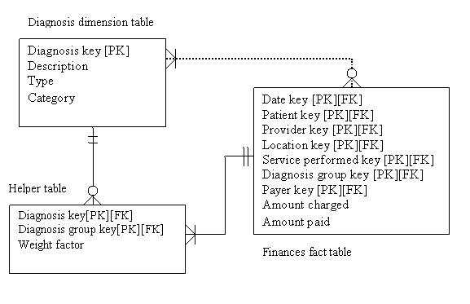
Multivalued dimension

Slide 51
Snowflake schema
Snowflake schema is an expanded version of a star schema in which dimension tables are normalized into several related tables.
Advantages
  Small saving in storage space
  Normalized structures are easier to update and maintain
Disadvantages
  Schema less intuitive
  Ability to browse through the content difficult
  Degraded query performance because of additional joins.

Slide 52
Example of snowflake schema
time
item
time_key
day
day_of_the_week
month
quarter
year
item_key
item_name
brand
type
supplier_key
supplier
Sales Fact Table
supplier_key
supplier_type
time_key
item_key
branch_key
branch
location
location_key
location_key
street
city_key
branch_key
branch_name
branch_type
units_sold
city
dollars_sold
city_key
city
province_or_street
country
avg_sales
Measures

Slide 53
The User Interface
A variety of tools are available to query and analyze data stored in data warehouses.
  1. Querying tools
  2. On-line Analytical processing (OLAP, MOLAP, ROLAP) tools
  3. Data Mining tools
  4. Data Visualization tools

Slide 54
Role of Metadata (data catalog)
Identify subjects of the data mart
Identify dimensions and facts
Indicate how data is derived from enterprise data warehouses, including derivation rules
Indicate how data is derived from operational data store, including derivation rules
Identify available reports and predefined queries
Identify data analysis techniques (e.g. drill-down)
Identify responsible people

Slide 55
Querying Tools
SQL is not an analytical language
SQL-99 includes some data warehousing extensions
SQL-99 still is not a full-featured data warehouse querying and analysis tool.
Different DBMS vendors will implement some or all of the SQL-99 OLAP extension commands and possibly others.

Slide 56
On-Line Analytical Processing (OLAP)
OLAP is the use of a set of graphical tools that provides users with multidimensional views of their data and allows them to analyze the data using simple windowing techniques
Relational OLAP (ROLAP)
  OLAP tools that view the database as a traditional relational database in either a star schema or other normalized or denormalized set of tables.
Multidimensional OLAP (MOLAP)
  OLAP tools that load data into an intermediate structure, usually a three or higher dimensional array. (Cube structure)

Slide 57
From tables to data cubes
A data warehouse is based on a multidimensional data model which views data in the form of a data cube
A data cube, such as sales, allows data to be modeled and viewed in multiple dimensions
  Dimension tables, such as item (item_name, brand, type), or time (day, week, month, quarter, year)
  Fact table contains measures (such as dollars_sold) and keys to each of the related dimension tables

Slide 58
MOLAP Operations
Roll up (drill-up): summarize data
  by climbing up hierarchy or by dimension reduction
Drill down (roll down): reverse of roll-up
  from higher level summary to lower level summary or detailed data, or introducing new dimensions
Slice and dice:
  project and select

Slide 59
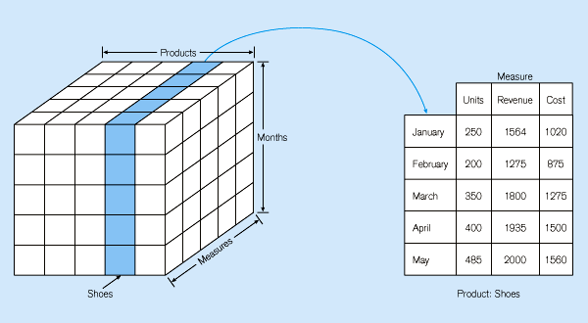
Figure 11-22: Slicing a data cube

Slide 60
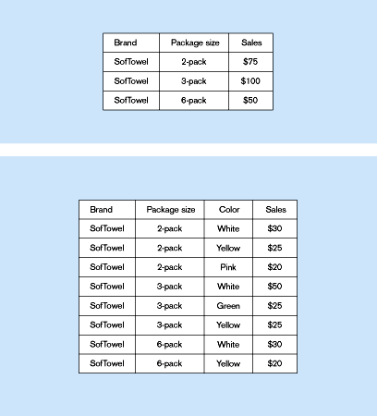
Summary report
Figure 11-23:
Example of drill-down
Drill-down with color added

Slide 61
Data Mining
Data mining is knowledge discovery using a blend of statistical, AI, and computer graphics techniques
Goals:
  Explain observed events or conditions
  Confirm hypotheses
  Explore data for new or unexpected relationships
Techniques
  Case-based reasoning
  Rule discovery
  Signal processing
  Neural nets
  Fractals

Slide 62
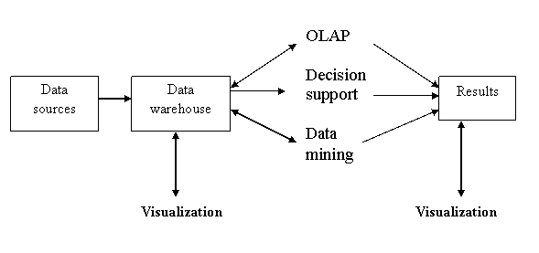
Data Visualization
Data visualization is the representation of data in graphical/multimedia formats for human analysis

Slide 63
OLAP tool Vendors
IBM
Informix
Cartelon
NCR
Oracle (Oracle Warehouse builder, Oracle OLAP)
Red Brick
Sybase
SAS
Microsoft (SQL Server OLAP)
Microstrategy Corporation

