Slide 1

Architecture
Movie booking System

Slide 2

Architecture Diagram
Explanation

Slide 3
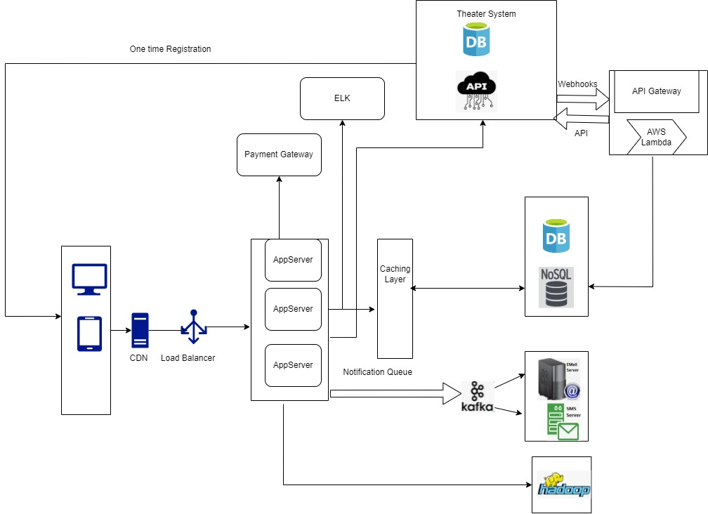

Slide 4
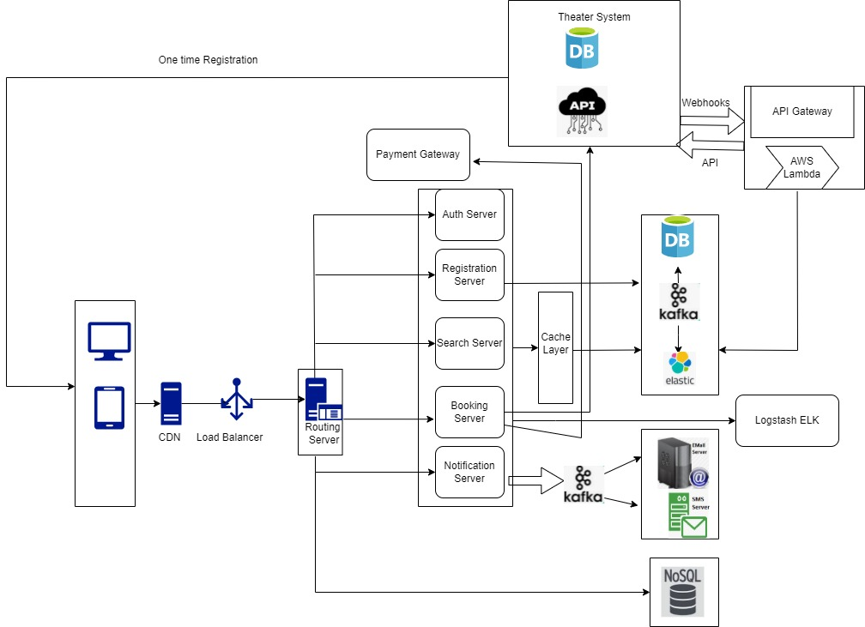

Slide 5
Explanation
1. CDN
- is placed near region to load the static content faster
2. Load Balance
- To balance the load, it can use hashing mechanism or round robin or based on number of connection per server
3. Auth Server :
- for authentication and different user roles
4. App Server
- Integrating the theater system
- Responsible for getting information from Theater system via API/Webhooks
- Reading the information from Caching layer / DB
- Connecting to Payment gateway
- Publish messages in Notification Queue
- Dumping the various user activities/ infos etc in Big data system

Slide 6
Explanation
5. RDBMS
- To store the Country/City/Theater/Audi/Movie/Show details
6. NoSql
- To store the non relational data like comment/reviews/trailers/offers etc
7. Cache Server
- To cache the relational data for quick response
8. AWS Lambda
- Can syc the database with theatre system info based on kafka notification
- For real time, theater system will send the webhook event which can be processed to sync the database
- Jobs can be scheduled on regular interval

