Slide 1

BlogSite
K SHRUTHI 1602-19-737-105
N Taruni 1602-19-737-120

Slide 2
ABSTRACT
BlogSite is a mini version of a working blogging website. Blogs are not only a way to communicate but also a way to reflect on life and art. People from different walks of life can seamlessly read blogs and publish their blogs for the world to read. Users can read other’s blog without login or signup. In order to publish a blog, one must login or sign up first.
Technology Stack Used: HTML, CSS, Java script(Client Side)

Slide 3

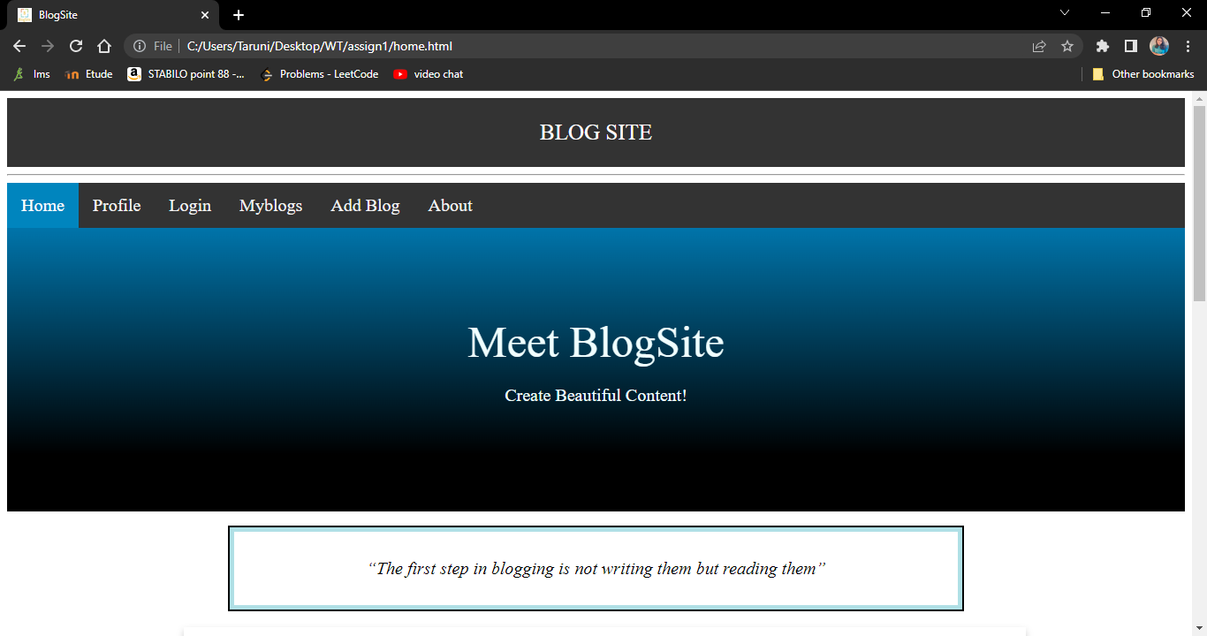
Screenshots

Slide 4
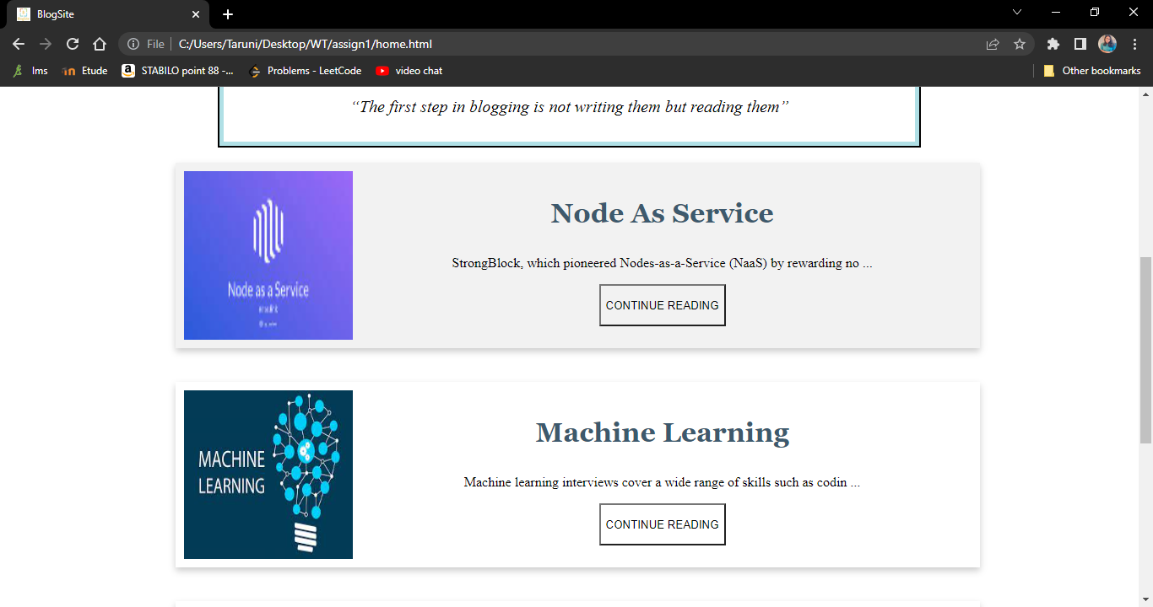

Slide 5
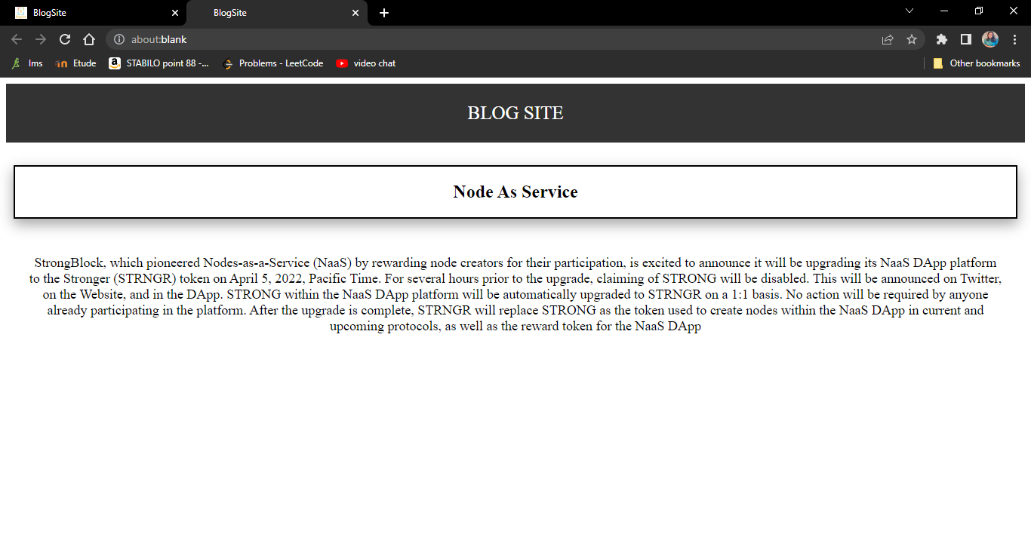

Slide 6
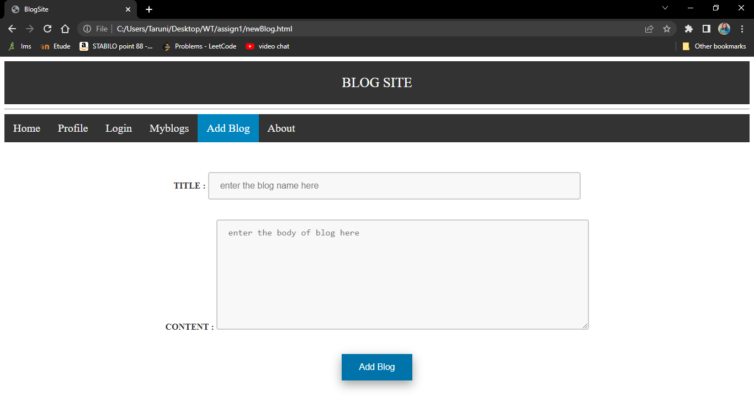

Slide 7
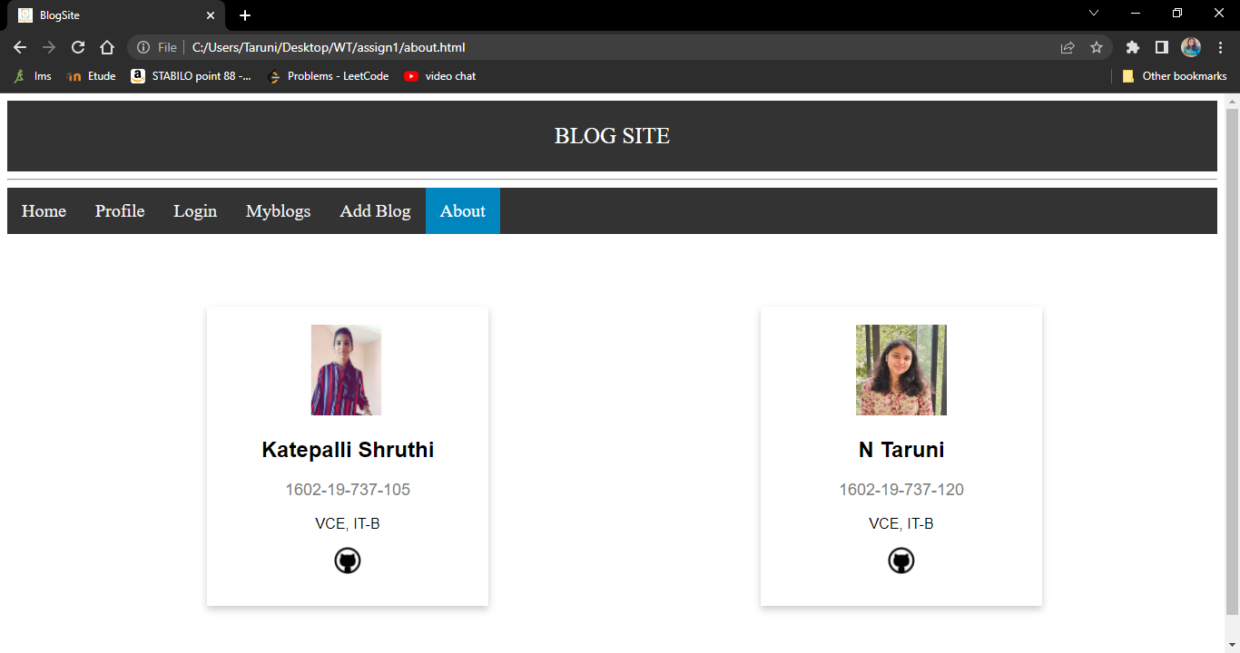

Slide 8
THANK YOU

