Slide 1
TCP
Congestion Control
Lecture material taken from
“Computer Networks A Systems Approach”, Fourth Edition,Peterson and Davie,
Morgan Kaufmann, 2007.
Computer Networks: TCP Congestion Control

Slide 2
TCP Congestion Control
Essential strategy :: The TCP host sends packets into the network without a reservation and then the host reacts to observable events.
Originally TCP assumed FIFO queuing.
Basic idea :: each source determines how much capacity is available to a given flow in the network.
ACKs are used to ‘pace’ the transmission of packets such that TCP is “self-clocking”.
Computer Networks: TCP Congestion Control

Slide 3
AIMD
(Additive Increase / Multiplicative Decrease)
CongestionWindow (cwnd) is a variable held by the TCP source for each connection.
cwnd is set based on the perceived level of congestion. The Host receives implicit (packet drop) or explicit (packet mark) indications of internal congestion.
MaxWindow :: min (CongestionWindow , AdvertisedWindow)
EffectiveWindow = MaxWindow – (LastByteSent -LastByteAcked)
Computer Networks: TCP Congestion Control

Slide 4
Additive Increase (AI)
Additive Increase is a reaction to perceived available capacity (referred to as congestion avoidance stage).
Frequently in the literature, additive increase is defined by parameter α (where the default is α = 1).
Linear Increase :: For each “cwnd’s worth” of packets sent, increase cwnd by 1 packet.
In practice, cwnd is incremented fractionally for each arriving ACK.
increment = MSS x (MSS /cwnd)
cwnd = cwnd + increment
Computer Networks: TCP Congestion Control

Slide 5
Figure 6.8 Additive Increase
Source
Destination
Add one packet
each RTT
Computer Networks: TCP Congestion Control

Slide 6
Multiplicative Decrease (MD)
Key assumption :: a dropped packet and resultant timeout are due to congestion at a router.
Frequently in the literature, multiplicative decrease is defined by parameter β (where the default is β = 0.5)
Multiplicate Decrease:: TCP reacts to a timeout by halving cwnd.
Although defined in bytes, the literature often discusses cwnd in terms of packets (or more formally in MSS == Maximum Segment Size).
cwnd is not allowed below the size of a single packet.
Computer Networks: TCP Congestion Control

Slide 7
AIMD
(Additive Increase / Multiplicative Decrease)
It has been shown that AIMD is a necessary condition for TCP congestion control to be stable.
Because the simple CC mechanism involves timeouts that cause retransmissions, it is important that hosts have an accurate timeout mechanism.
Timeouts set as a function of average RTT and standard deviation of RTT.
However, TCP hosts only sample round-trip time once per RTT using coarse-grained clock.
Computer Networks: TCP Congestion Control

Slide 8
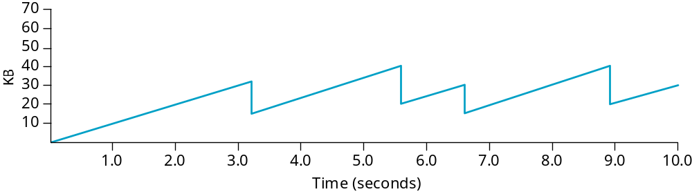
Figure 6.9 Typical TCP
Sawtooth Pattern
Computer Networks: TCP Congestion Control

Slide 9
Slow Start
Linear additive increase takes too long to ramp up a new TCP connection from cold start.
Beginning with TCP Tahoe, the slow start mechanism was added to provide an initial exponential increase in the size of cwnd.
Remember mechanism by: slow start prevents a slow start. Moreover, slow start is slower than sending a full advertised window’s worth of packets all at once.
Computer Networks: TCP Congestion Control

Slide 10
Slow Start
The source starts with cwnd = 1.
Every time an ACK arrives, cwnd is incremented.
cwnd is effectively doubled per RTT “epoch”.
Two slow start situations:
  At the very beginning of a connection {cold start}.
  When the connection goes dead waiting for a timeout to occur (i.e, the advertized window goes to zero!)
Computer Networks: TCP Congestion Control

Slide 11
Figure 6.10 Slow Start
Source
Destination
Slow Start
Add one packet
per ACK
Computer Networks: TCP Congestion Control

Slide 12
Slow Start
However, in the second case the source has more information. The current value of cwnd can be saved as a congestion threshold.
This is also known as the “slow start threshold” ssthresh.
Computer Networks: TCP Congestion Control

Slide 13
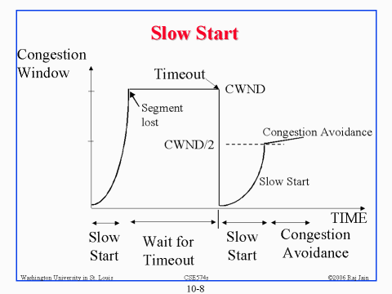
ssthresh
Computer Networks: TCP Congestion Control

Slide 14
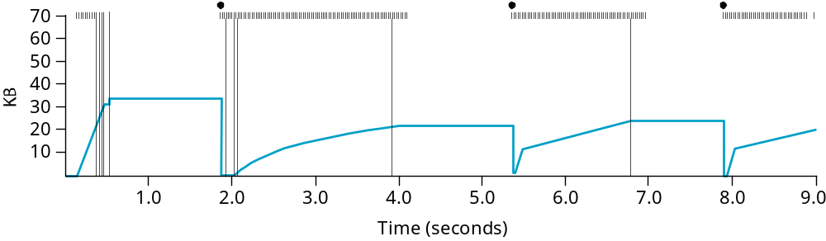
Figure 6.11 Behavior of TCP
Congestion Control
Computer Networks: TCP Congestion Control

Slide 15
Fast Retransmit
Coarse timeouts remained a problem, and Fast retransmit was added with TCP Tahoe.
Since the receiver responds every time a packet arrives, this implies the sender will see duplicate ACKs.
Basic Idea:: use duplicate ACKs to signal lost packet.
Fast Retransmit
Upon receipt of three duplicate ACKs, the TCP Sender
retransmits the lost packet.
Computer Networks: TCP Congestion Control

Slide 16
Fast Retransmit
Generally, fast retransmit eliminates about half the coarse-grain timeouts.
This yields roughly a 20% improvement in throughput.
Note – fast retransmit does not eliminate all the timeouts due to small window sizes at the source.
Computer Networks: TCP Congestion Control

Slide 17
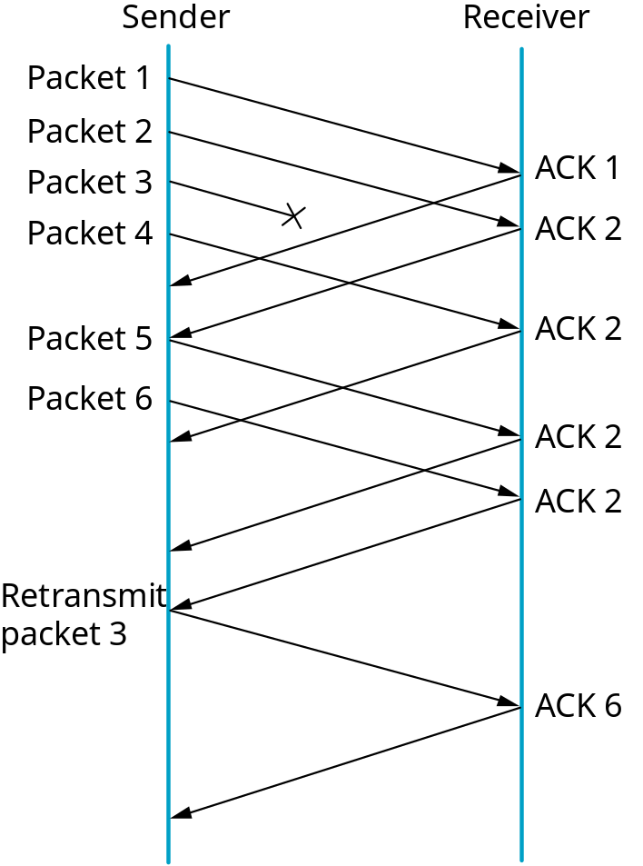
Figure 6.12 Fast Retransmit
Fast Retransmit
Based on three
duplicate ACKs
Computer Networks: TCP Congestion Control

Slide 18
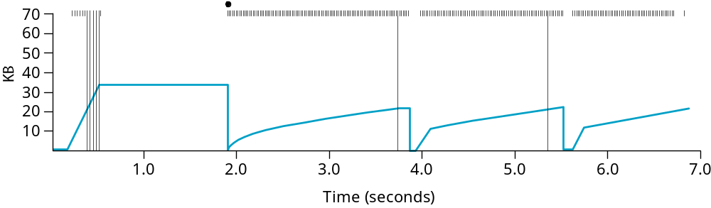
Figure 6.13 TCP Fast Retransmit Trace
Computer Networks: TCP Congestion Control

Slide 19
Fast Recovery
Fast recovery was added with TCP Reno.
Basic idea:: When fast retransmit detects three duplicate ACKs, start the recovery process from congestion avoidance region and use ACKs in the pipe to pace the sending of packets.
Fast Recovery
After Fast Retransmit, half cwnd and commence
recovery from this point using linear additive increase
‘primed’ by left over ACKs in pipe.
Computer Networks: TCP Congestion Control

Slide 20
Modified Slow Start
With fast recovery, slow start only occurs:
  At cold start
  After a coarse-grain timeout
This is the difference between TCP Tahoe and TCP Reno!!
Computer Networks: TCP Congestion Control

Slide 21
Many TCP ‘flavors’
TCP New Reno
TCP SACK
  requires sender and receiver both to support TCP SACK
  possible state machine is complex.
TCP Vegas
  adjusts window size based on difference between expected and actual RTT.
TCP Cubic
Computer Networks: TCP Congestion Control

Slide 22
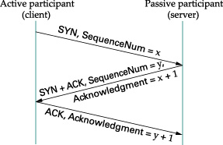
Figure 5.6 Three-way TCP Handshake
Computer Networks: TCP Congestion Control

Slide 23
Adaptive Retransmissions
RTT:: Round Trip Time between a pair of hosts on the Internet.
How to set the TimeOut value (RTO)?
  The timeout value is set as a function of the expected RTT.
  Consequences of a bad choice?
Computer Networks: TCP Congestion Control

Slide 24
Original Algorithm
Keep a running average of RTT and compute TimeOut as a function of this RTT.
  Send packet and keep timestamp t_{s} .
  When ACK arrives, record timestamp t_{a} .
  SampleRTT = t_{a} - t_{s}
Computer Networks: TCP Congestion Control

Slide 25
Original Algorithm
Compute a weighted average:
EstimatedRTT = α x EstimatedRTT + (1- α) x SampleRTT
Original TCP spec: α in range (0.8,0.9)
TimeOut = 2 x EstimatedRTT
Computer Networks: TCP Congestion Control

Slide 26
Karn/Partidge Algorithm
An obvious flaw in the original algorithm:
Whenever there is a retransmission it is impossible to know whether to associate the ACK with the original packet or the retransmitted packet.
Computer Networks: TCP Congestion Control

Slide 27
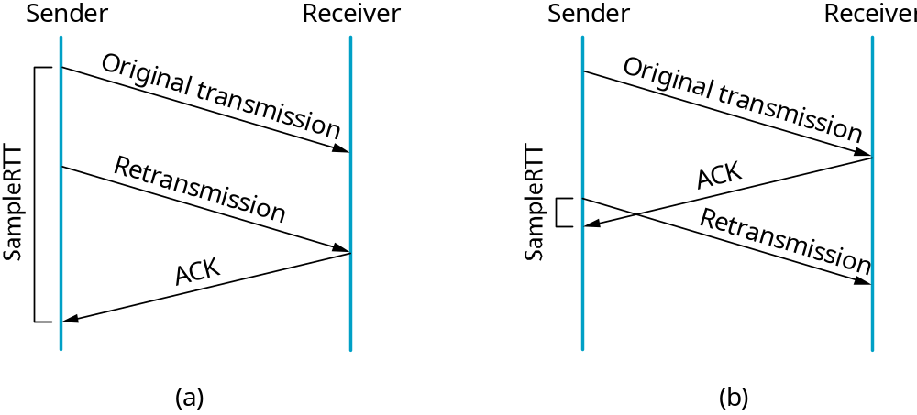
Figure 5.10 Associating the ACK?
Computer Networks: TCP Congestion Control

Slide 28
Karn/Partidge Algorithm
Do not measure SampleRTT when sending packet more than once.
For each retransmission, set TimeOut to double the last TimeOut.
{ Note – this is a form of exponential backoff based on the believe that the lost packet is due to congestion.}
Computer Networks: TCP Congestion Control

Slide 29
Jacobson/Karels Algorithm
The problem with the original algorithm is that it did not take into account the variance of SampleRTT.
Difference = SampleRTT – EstimatedRTT
EstimatedRTT = EstimatedRTT +
(δ x Difference)
Deviation = δ (|Difference| - Deviation)
where δ is a fraction between 0 and 1.
Computer Networks: TCP Congestion Control

Slide 30
Jacobson/Karels Algorithm
TCP computes timeout using both the mean and variance of RTT
TimeOut = µ x EstimatedRTT
+ Φ x Deviation
where based on experience µ = 1 and Φ = 4.
Computer Networks: TCP Congestion Control

Slide 31
TCP Congestion Control Summary
TCP interacts with routers in the subnet and reacts to implicit congestion notification (packet drop) by reducing the TCP sender’s congestion window.
TCP increases congestion window using slow start or congestion avoidance.
Currently, the two most common versions of TCP are New Reno and Cubic
Computer Networks: TCP Congestion Control

Slide 32
TCP New Reno
Two problem scenarios with TCP Reno
  bursty losses, Reno cannot recover from bursts of 3+ losses
  Packets arriving out-of-order can yield duplicate acks when in fact there is no loss.
New Reno solution – try to determine the end of a burst loss.
Computer Networks: TCP Congestion Control

Slide 33
TCP New Reno
When duplicate ACKs trigger a retransmission for a lost packet, remember the highest packet sent from window in recover.
Upon receiving an ACK,
  if ACK < recover => partial ACK
  If ACK ≥ recover => new ACK
Computer Networks: TCP Congestion Control

Slide 34
TCP New Reno
Partial ACK implies another lost packet: retransmit next packet, inflate window and stay in fast recovery.
New ACK implies fast recovery is over: starting from 0.5 x cwnd proceed with congestion avoidance (linear increase).
New Reno recovers from n losses in n round trips.
Computer Networks: TCP Congestion Control

