Slide 1

PART I – Membrane Builder

Slide 2
Automatic Protein Insertion

Slide 3
Algorithm
EXPLORING THE PHASE SPACE
AMINO ACIDS DISTRIBUTION
(GP1,GP2,GP4 are the different groups of amino acids)

Slide 4
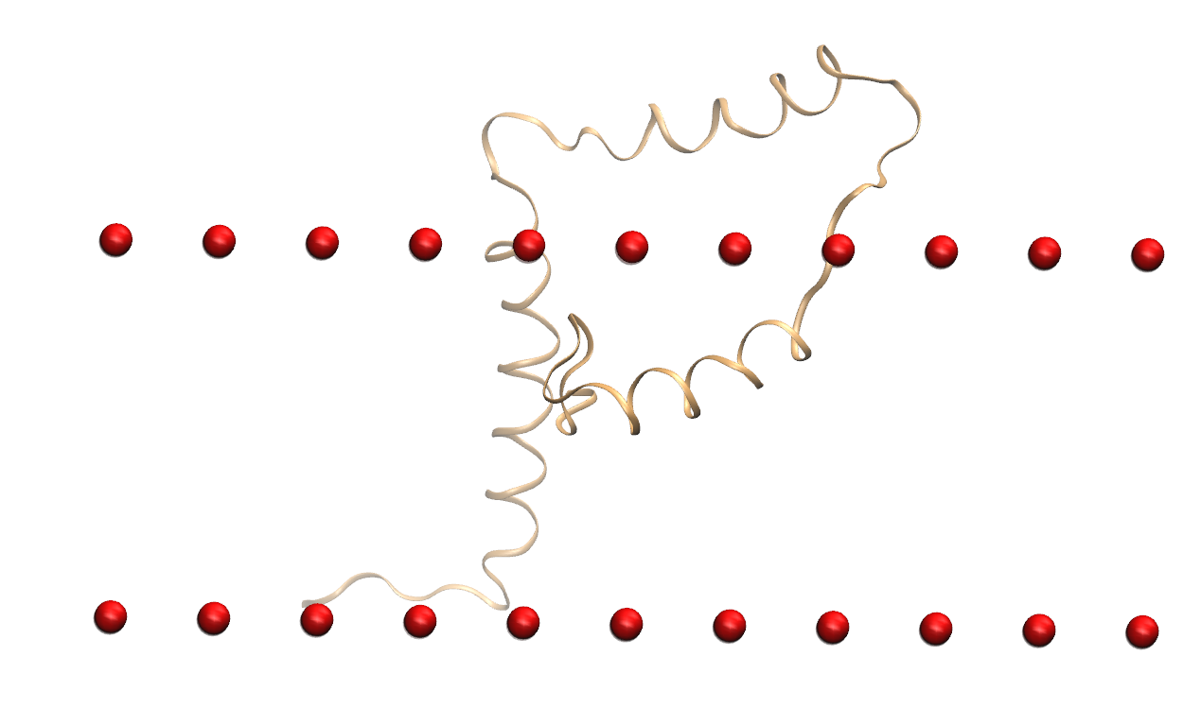
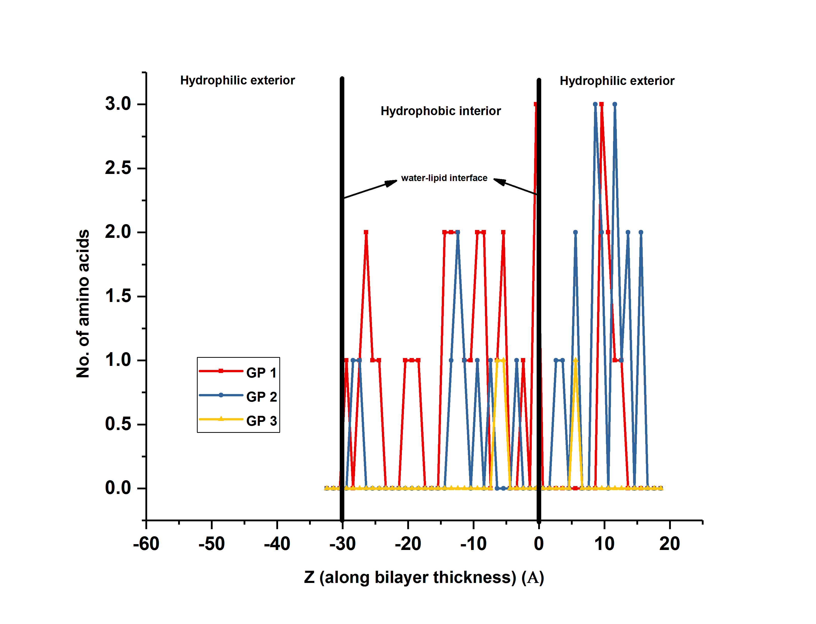
Final Profile for Viral Protein U (Vpu) (2n28)

Slide 5
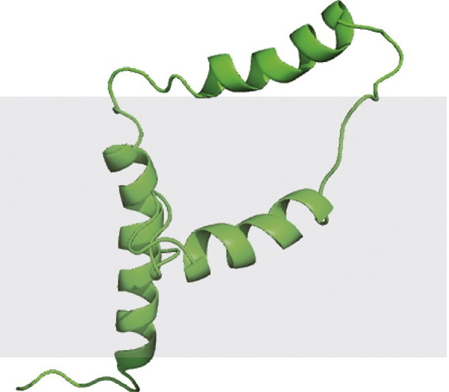
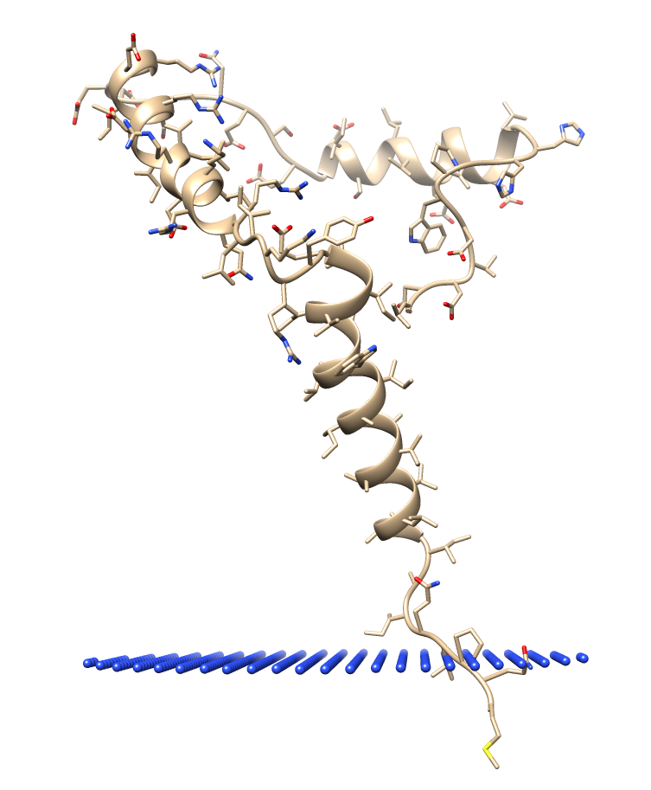
Correct Structure?
STRUCTURE FROM AMBAT
STRUCTURE FROM PPM SERVER (OPM DATABASE)
SOLID-STATE NMR STRUCTURE

