Slide 1

AIRLINE ANALYSIS THROUGH WEB SCRAPING
By T.G. Tarun Kishore

Slide 2
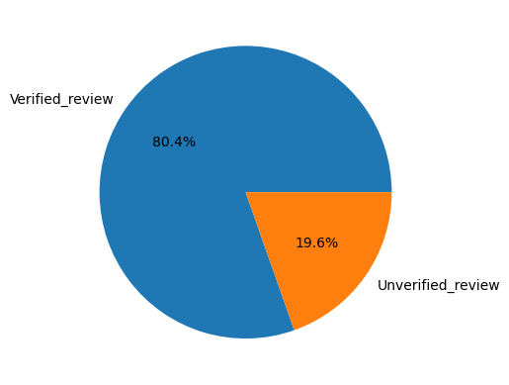
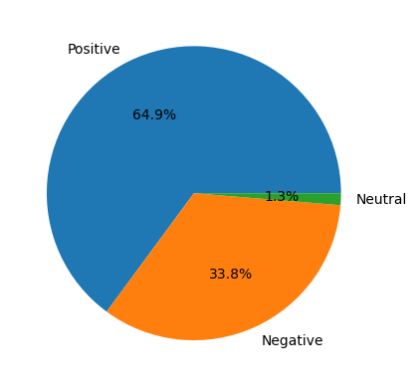
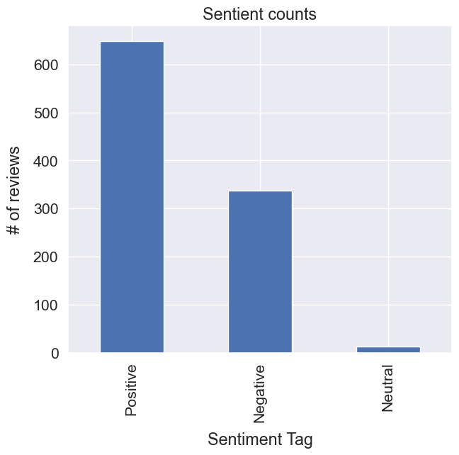
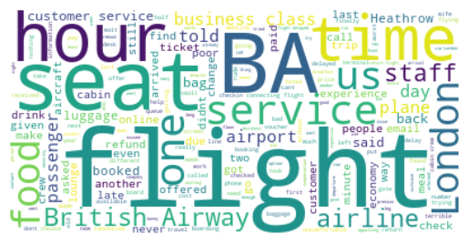
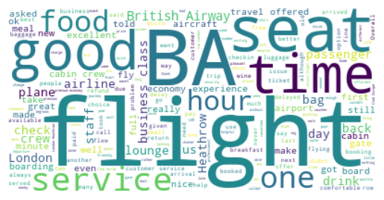
Findings From The Analysis
Verified VS Unverified
Sentiment Tag % Distribution
Sentiment Tag Count Distribution
Positive reviews – Word Cloud
Negative reviews – Word Cloud

