Slide 1

PREDICTING CUSTOMER BUYING BEHAVIOUR
By T.G. Tarun Kishore

Slide 2
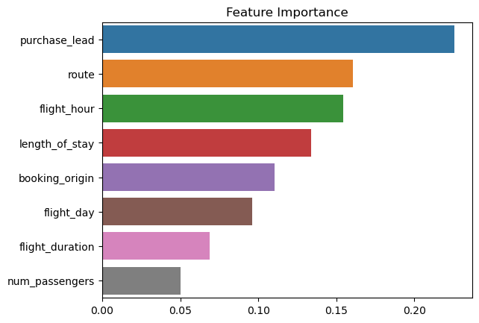
Predictive Modeling To Understand Factors That Influence Buying Behaviour
Findings:
The most important feature in the model was purchase lead which is the number of days between travel date and booking date
The top 5 features to be considered are:
Purchase Lead
Route
Flight Hour
Length of Stay
Booking Origin

