Slide 1
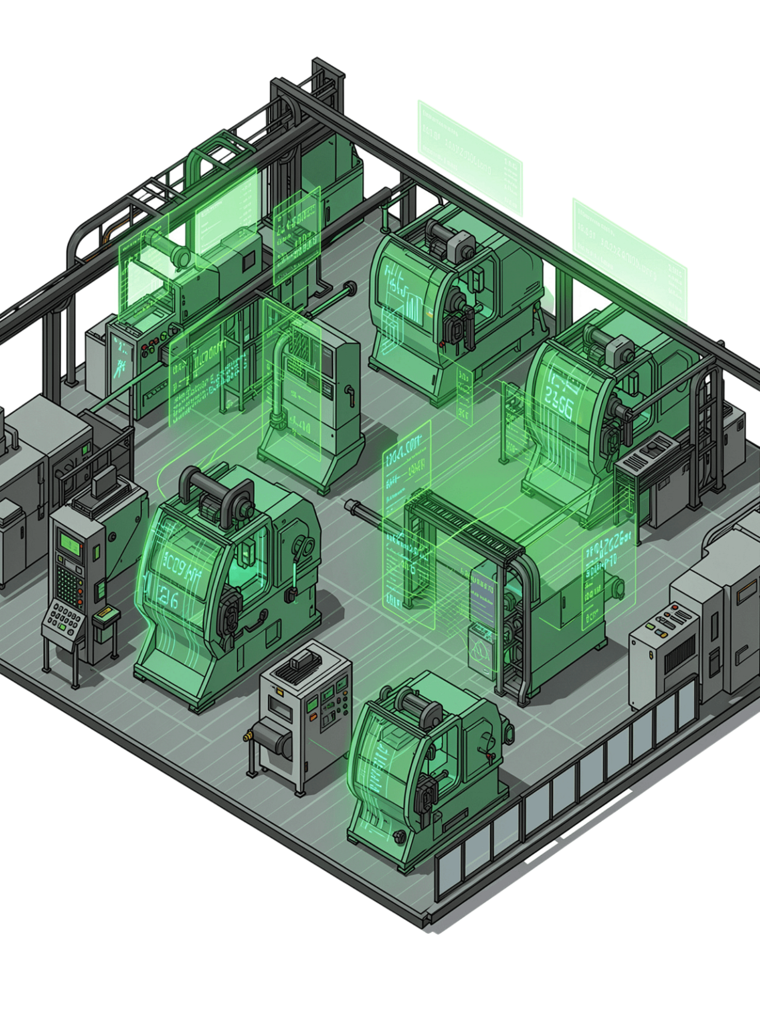
Industrial IoT-Based Machine Health Monitoring and Predictive Maintenance System for Early Fault Detection
A continuous, intelligent system for monitoring industrial machine health, enabling early fault detection and predictive maintenance — at the heart of Industry 4.0.
KOTTAKOTA TARUN
323129520079

Slide 2
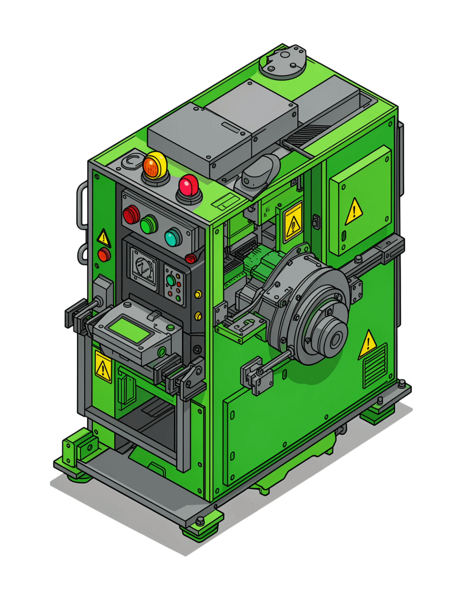
Problem Statement
Unexpected Failures
Machine breakdowns cause production delays, increased maintenance costs, and significant equipment downtime.
Reactive Maintenance
Traditional approaches rely on periodic inspections or repairs after failure — not before it.
Fault Blindness
Existing methods make it difficult to identify developing faults before they cause equipment failure.
Industry Need
Industries require intelligent, continuous machine-condition monitoring to stay competitive and reliable.

Slide 3
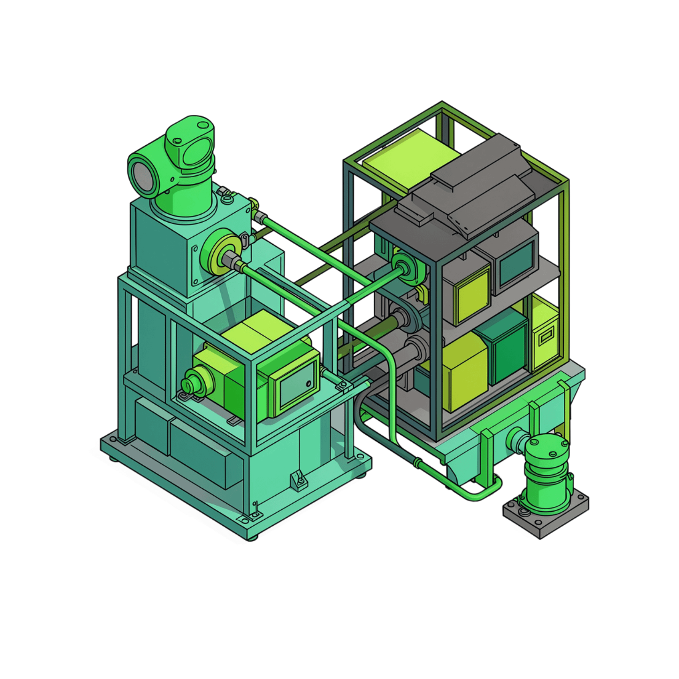

Proposed Solution
An Industrial IoT-based machine health monitoring and predictive maintenance system that continuously collects machine operating data using IoT sensors and predictive analytics.
Continuous collection of machine operating data via IoT sensors
Predictive analytics to identify abnormal machine behavior
Centralized platform for monitoring machine health across all equipment
Empowers maintenance teams to act before major failures occur
The system shifts maintenance from reactive to proactive — detecting faults early and preventing costly breakdowns.

Slide 4
System Components
The system integrates eight key hardware and software components working in concert to deliver continuous machine health intelligence.
Vibration Sensors
Temperature Sensors
Detect mechanical imbalance and bearing faults
Monitor thermal behavior and overheating risks
Current Sensors
IoT Communication Modules
Track electrical load and motor performance
Transmit sensor data reliably to the cloud
Cloud Connectivity
Real-Time Monitoring Platform
Store and process large volumes of machine data
Centralized visibility into all machine health metrics
Predictive Analytics
Secure User Interface
Analyze patterns and forecast potential faults
Role-based access for maintenance teams

Slide 5

Working Process
Collect Data
Transmit Data
Process in Cloud
Predict & Alert
The end-to-end pipeline moves from raw sensor readings to actionable maintenance alerts — continuously and automatically — ensuring faults are caught at the earliest possible stage before they escalate into costly failures.

Slide 6
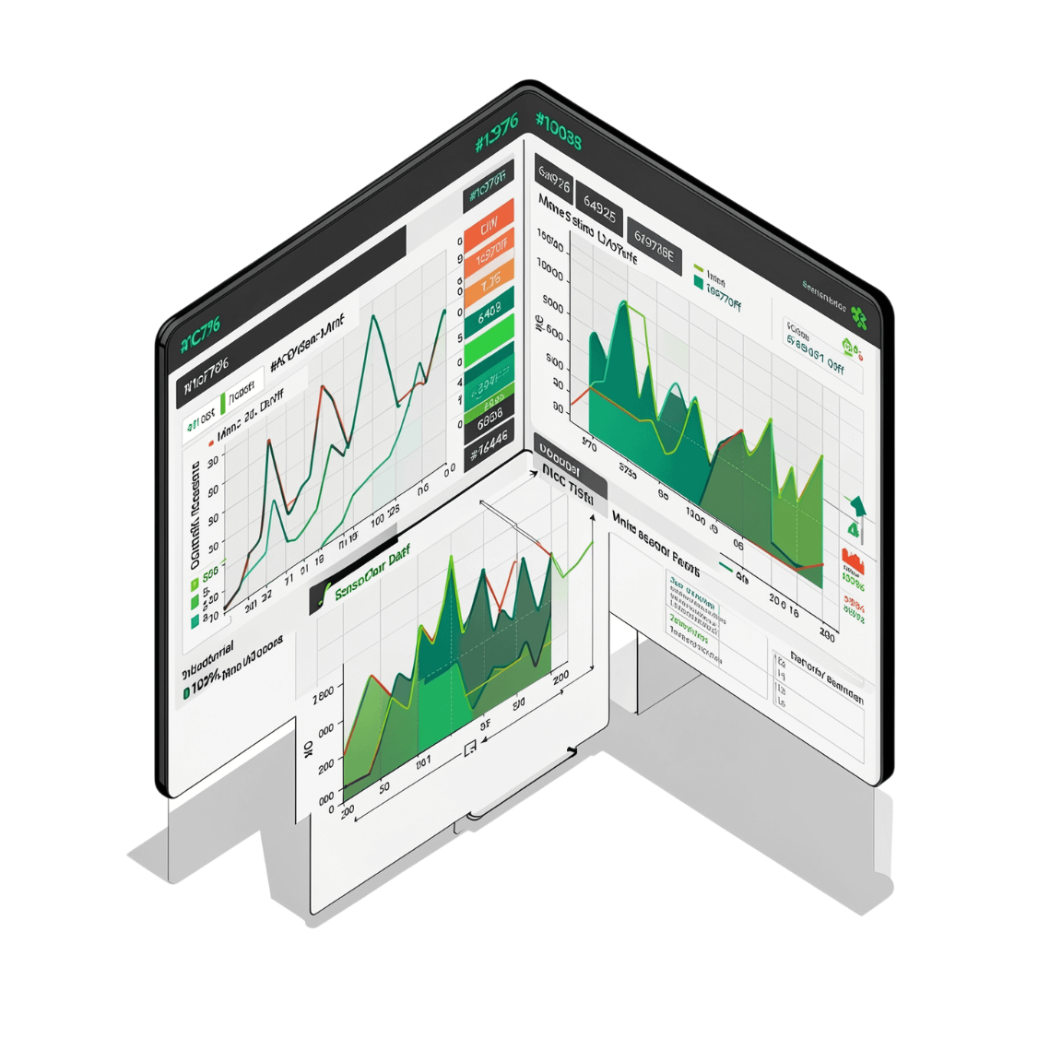
Machine Health Monitoring
What the System Continuously Tracks
Real-Time Vibration Levels
Detect mechanical anomalies as they develop
Temperature Trends
Identify overheating patterns over time
Electrical / Current Behavior
Spot motor load irregularities instantly
Machine Health Status
Overall condition score per asset
Equipment Performance & Maintenance History
Trend analysis and historical fault records
Continuous monitoring creates a live picture of machine condition, enabling teams to identify abnormal conditions the moment they emerge — not after damage has occurred.
Fault Alerts
Immediate notifications when thresholds are breached

Slide 7
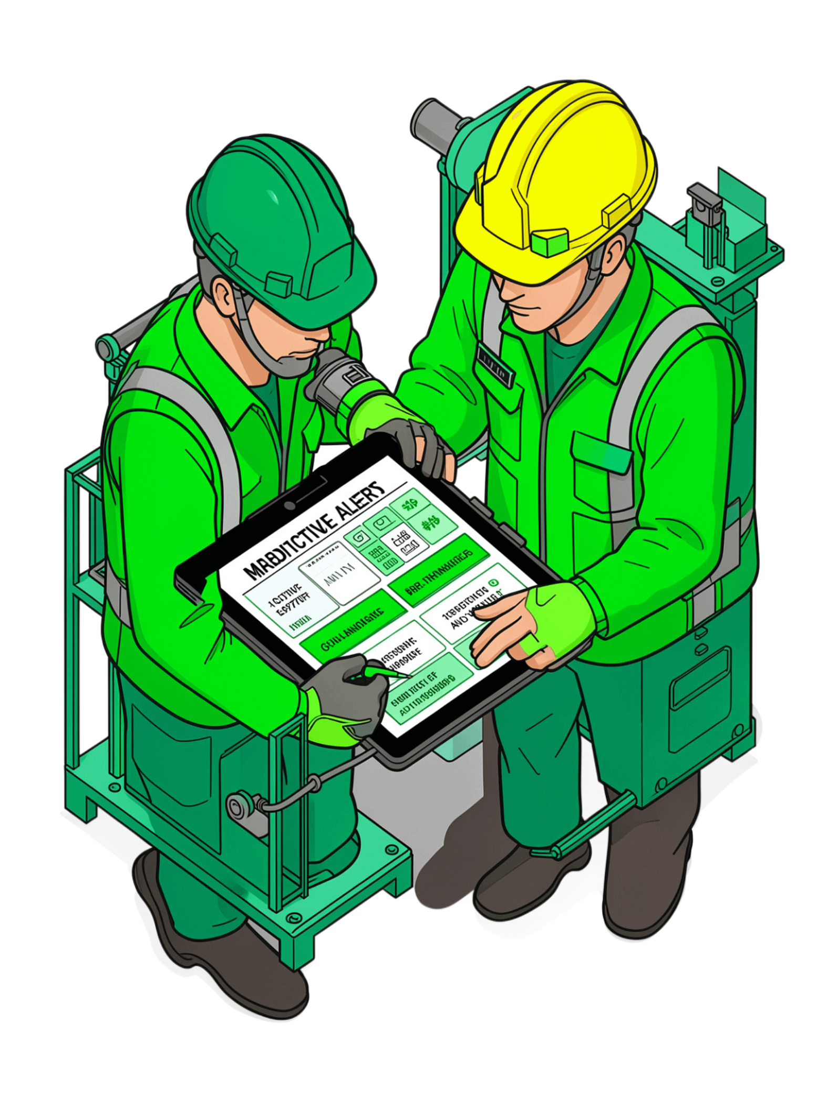
Predictive Maintenance and Early Fault Detection
Reactive Maintenance
Periodic Maintenance
Fix after failure. High costs, unplanned downtime, and production loss.
Scheduled inspections regardless of actual machine condition. Inefficient and often too late.
Predictive Maintenance ✓
Abnormal sensor patterns trigger early warnings. Teams schedule servicing before breakdowns occur — maximizing reliability and efficiency.

Slide 8
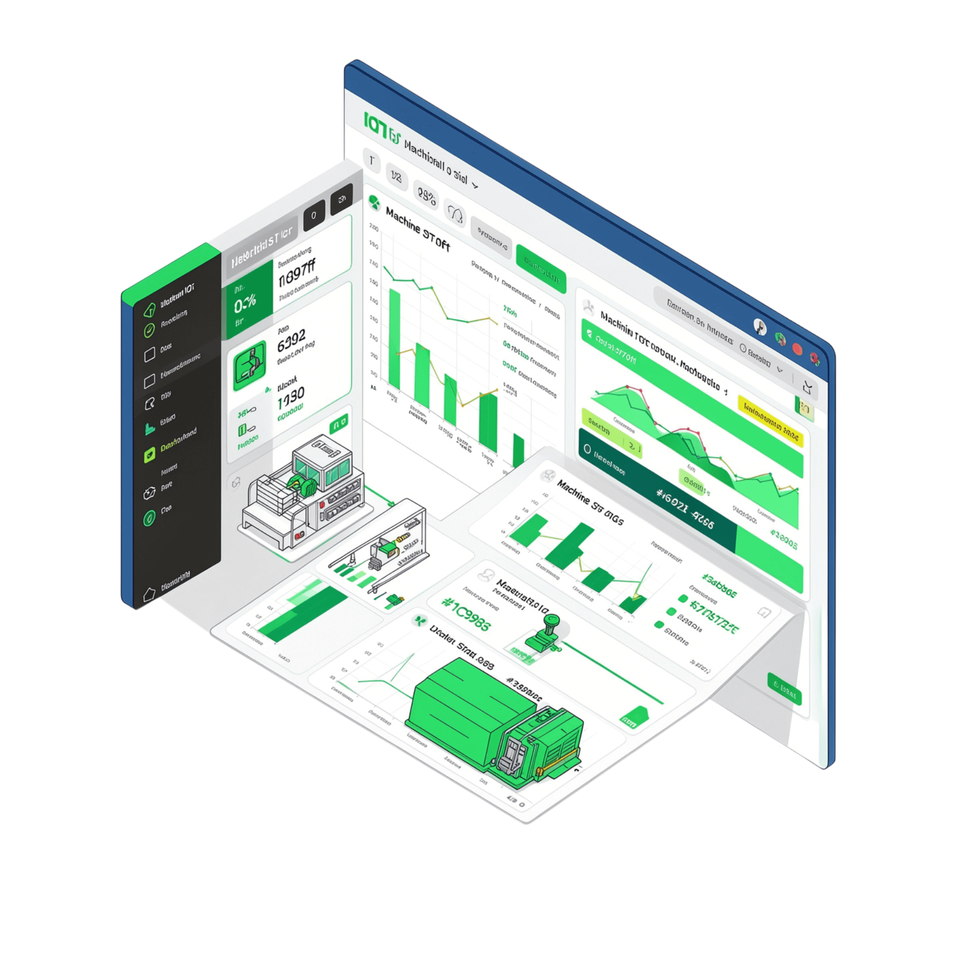
Dashboard and Analytics
What Maintenance Teams See
Machine health status — live condition per asset
Vibration levels — real-time waveform data
Temperature trends — historical and current
Maintenance history — full service log per machine
Fault alerts — prioritized notifications
Equipment performance analytics — KPIs and trends
Real-time machine information — live operational data
A secure, user-friendly interface consolidates all machine intelligence in one place — enabling maintenance teams to make fast, informed decisions with confidence.

Slide 9
Benefits and Applications
Major Benefits
Suitable Application Areas
Manufacturing Industries
Production Plants
↓ Unexpected Downtime
↓ Maintenance Costs
Targeted servicing replaces blanket periodic checks
Faults caught early prevent unplanned stoppages
Warehouses
Energy Facilities
Industrial Automation
↑ Equipment Reliability
↑ Productivity
Continuous health tracking extends asset life
Less downtime means more operational hours
⚡ Faster Fault Detection
📅 Timely Scheduling
Plan maintenance windows without disrupting production
Real-time alerts at the earliest sign of anomaly

Slide 10
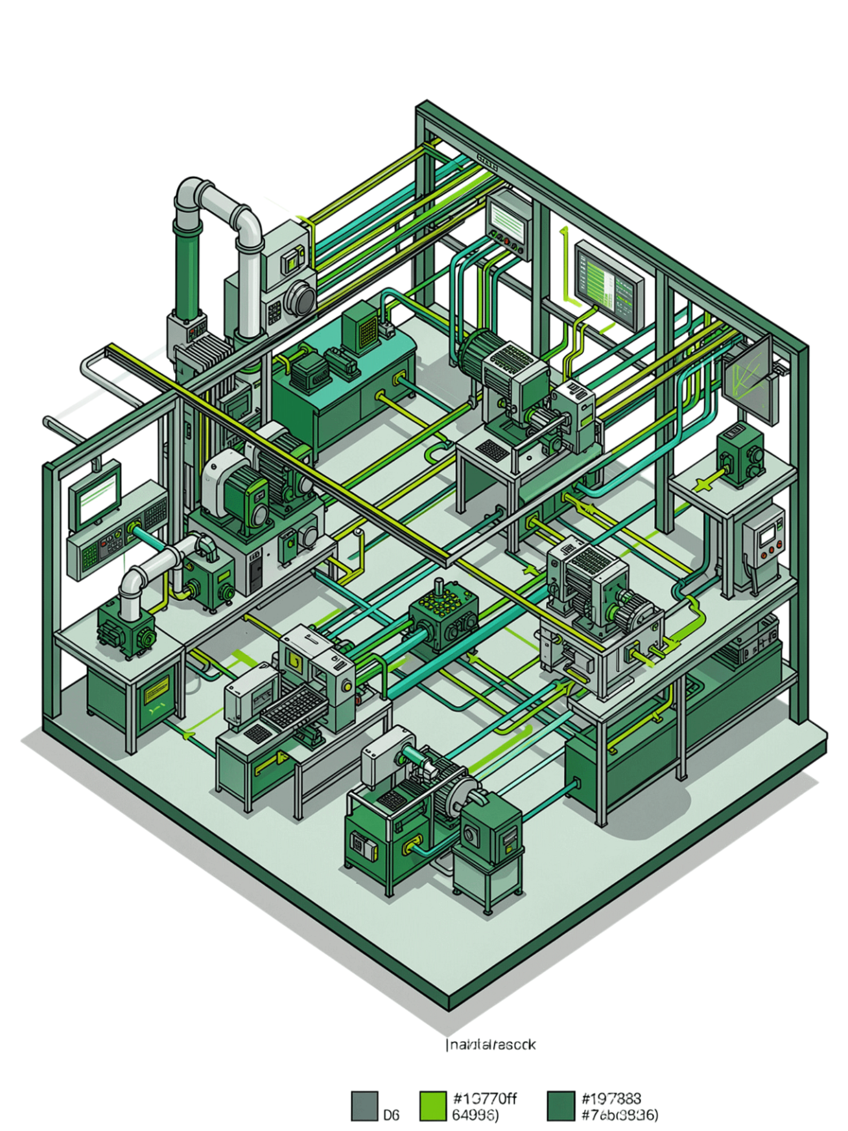
Conclusion and Future Impact
The Industrial IoT-based machine health monitoring and predictive maintenance system represents a fundamental shift in how industries manage equipment reliability. By combining continuous monitoring, predictive analytics, and early fault detection, the system minimizes unexpected breakdowns and supports timely, targeted maintenance.
Reliability
Consistent machine health tracking ensures assets perform at their best
Productivity
Fewer unplanned stoppages translate directly into more operational output
Cost Reduction
Intelligent maintenance scheduling eliminates wasteful reactive repairs
Industry 4.0
A connected, data-driven maintenance ecosystem ready for the future of manufacturing
Transforming traditional maintenance into intelligent predictive maintenance — keeping machines running, industries thriving, and the future of Industry 4.0 within reach.

