Slide 1
Analysis of Algorithms (Introduction, Time and Space Complexity)
L
Presentation by
Dr. D.Uma Devi
Associate Professor,
Dept. of CSE,
GVPCE(A)

Slide 2
Contents
Definition of Algorithm
Characteristics of Algorithm
How to Design a Algorithm

Slide 3
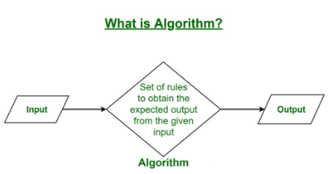
Definition of Algorithm
An algorithm is a set of rules for carrying out calculation either by hand or on a machine.
An algorithm is a sequence of computational steps that transform the input into the output.
An algorithm is a sequence of operations performed on data that have to be organized in the data structures.

Slide 4
A finite set of instruction that specify a sequence of operations to be carried out in order to solve a specific problem or class of problems is called an algorithm.
An algorithm is an abstraction of a program to be executed on a physical machine (model computation).
An algorithm is defined as set of instructions to perform a specific task within finite no. of steps.
Algorithm is defined as a step by step procedure to perform a specific task within finite number of steps.
It can be defined as a sequence of definite and effective instructions, while terminates with the production of correct output from the given input.

Slide 5
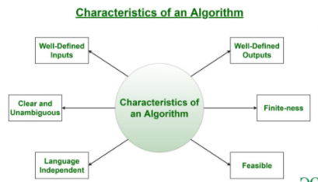

Slide 6
CHARACTERISTICS OF AN ALGORITHM
Clear and Unambiguous: Algorithm should be clear and unambiguous. Each of its steps should be clear in all aspects and must lead to only one meaning.
Well-Defined Inputs: If an algorithm says to take inputs, it should be well-defined inputs.
Well-Defined Outputs: The algorithm must clearly define what output will be yielded and it should be well-defined as well.
Finite-ness: The algorithm must be finite, i.e. it should not end up in an infinite loops or similar.
Feasible: The algorithm must be simple, generic and practical, such that it can be executed upon with the available resources. It must not contain some future technology, or anything.
Language Independent: The Algorithm designed must be language-independent, i.e. it must be just plain instructions that can be implemented in any language, and yet the output will be same, as expected.

Slide 7
How to Design an Algorithm?
In order to write an algorithm, following things are needed as a pre-requisite:
The problem that is to be solved by this algorithm.
The constraints of the problem that must be considered while solving the problem.
The input to be taken to solve the problem.
The output to be expected when the problem the is solved.
The solution to this problem, in the given constraints.
Then the algorithm is written with the help of above parameters such that it solves the problem.

Slide 8
Example: Consider the example to add three numbers and print the sum.
Step 1: Fulfilling the pre-requisites As discussed above, in order to write an algorithm, its pre-requisites must be fulfilled.
The problem that is to be solved by this algorithm: Add 3 numbers and print their sum.
The constraints of the problem that must be considered while solving the problem: The numbers must contain only digits and no other characters.
The input to be taken to solve the problem: The three numbers to be added.
The output to be expected when the problem the is solved: The sum of the three numbers taken as the input.
The solution to this problem, in the given constraints: The solution consists of adding the 3 numbers. It can be done with the help of ‘+’ operator, or bit-wise, or any other method.

Slide 9
Step 2: Designing the algorithm
Now let’s design the algorithm with the help of above pre-requisites:
Algorithm to add 3 numbers and print their sum:
START
Declare 3 integer variables num1, num2 and num3.
Take the three numbers, to be added, as inputs in variables num1, num2, and num3 respectively.
Declare an integer variable sum to store the resultant sum of the 3 numbers.
Add the 3 numbers and store the result in the variable sum.
Print the value of variable sum
END

Slide 10
Step 3: Testing the algorithm by implementing it. Inorder to test the algorithm, let’s implement it in C language. (C program to add three numbers
#include <stdio.h>
int main()
{
int num1, num2, num3; // Variables to take the input of the 3 numbers
int sum; // Variable to store the resultant sum
printf("Enter the 1st number: ");
scanf("%d", &num1);
printf("%d\n", num1);
printf("Enter the 2nd number: ");
scanf("%d", &num2);
printf("%d\n", num2);

Slide 11
printf("Enter the 3rd number: ");
scanf("%d", &num3);
printf("%d\n", num3);
// Calculate the sum using + operator
// and store it in variable sum
sum = num1 + num2 + num3;
// Print the sum
printf("\nSum of the 3 numbers is: %d", sum);
return 0;
}

Slide 12
Priori Analysis: “Priori” means “before”. Hence Priori analysis means checking the algorithm before its implementation. In this, the algorithm is checked when it is written in the form of theoretical steps. This Efficiency of an algorithm is measured by assuming that all other factors, for example, processor speed, are constant and have no effect on the implementation. This is done usually by the algorithm designer. It is in this method, that the Algorithm Complexity is determined.

Slide 13
Posterior Analysis: “Posterior” means “after”. Hence Posterior analysis means checking the algorithm after its implementation. In this, the algorithm is checked by implementing it in any programming language and executing it. This analysis helps to get the actual and real analysis report about correctness, space required, time consumed etc.
Time Factor: Time is measured by counting the number of key operations such as comparisons in the sorting algorithm.
Space Factor: Space is measured by counting the maximum memory space required by the algorithm.

Slide 14
Space Complexity: Space complexity of an algorithm refers to the amount of memory that this algorithm requires to execute and get the result. This can be for inputs, temporary operations, or outputs. How to calculate Space Complexity? The space complexity of an algorithm is calculated by determining following 2 components:
Fixed Part: This refers to the space that is definitely required by the algorithm. For example, input variables, output variables, program size, etc.
Variable Part: This refers to the space that can be different based on the implementation of the algorithm. For example, temporary variables, dynamic memory allocation, recursion stack space, etc.

Slide 15
Time Complexity:
Time complexity of an algorithm refers to the amount of time that this algorithm requires to execute and get the result. This can be for normal operations, conditional if-else statements, loop statements, etc. How to calculate Time Complexity? The time complexity of an algorithm is also calculated by determining following 2 components:
Constant time part: Any instruction that is executed just once comes in this part. For example, input, output, if-else, switch, etc.
Variable Time Part: Any instruction that is executed more than once, say n times, comes in this part. For example, loops, recursion, etc.

Slide 16
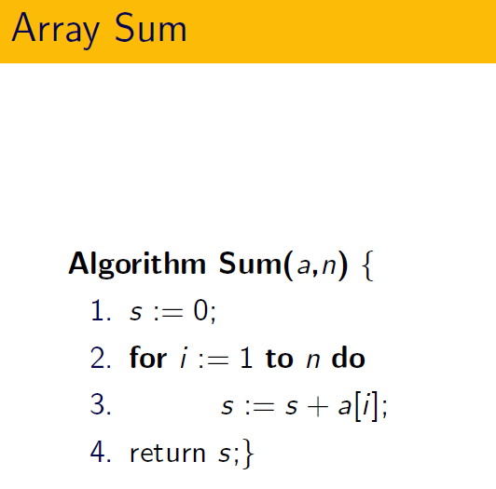

Slide 17
Running Time of an Algorithm
Algorithm | Operation performed | Number of times the operation is performed when input size is n
Step 1. __________ | Addition | t₁(n)
Step 2. __________ | Multiplication | t₂(n)
Step 3. __________ | Comparison | t₃(n)
Step 4. __________ | Division | t₄(n)
Step 5. __________ | Comparison | t₅(n)
Step 6. __________ | Addition | t₆(n)
Step 7. __________ | Multiplication | t₇(n)
Step 8. __________ | Assignment | t₈(n)
Total number of operations performed (T(n)) (Also called, operation count or running time) |  | t₁(n)+t₂(n)+t₃(n)+t₄(n)+t₅(n)+t₆(n)+t₇(n)+t₈(n)

Slide 18
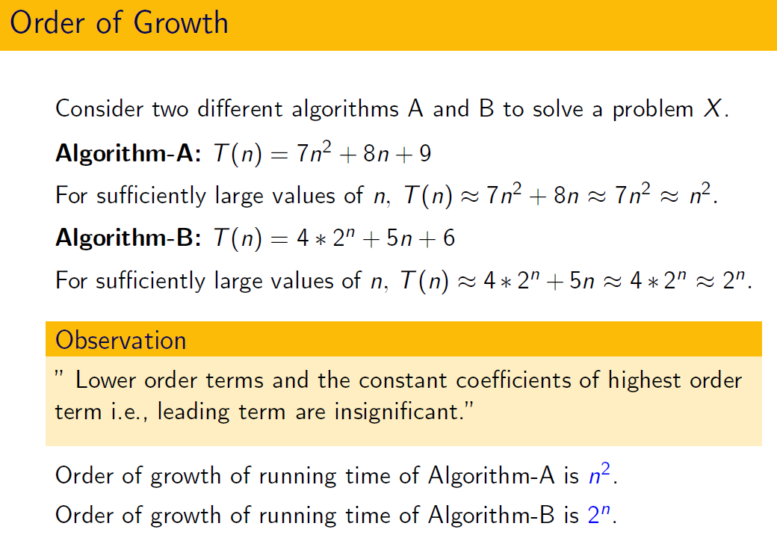

Slide 19
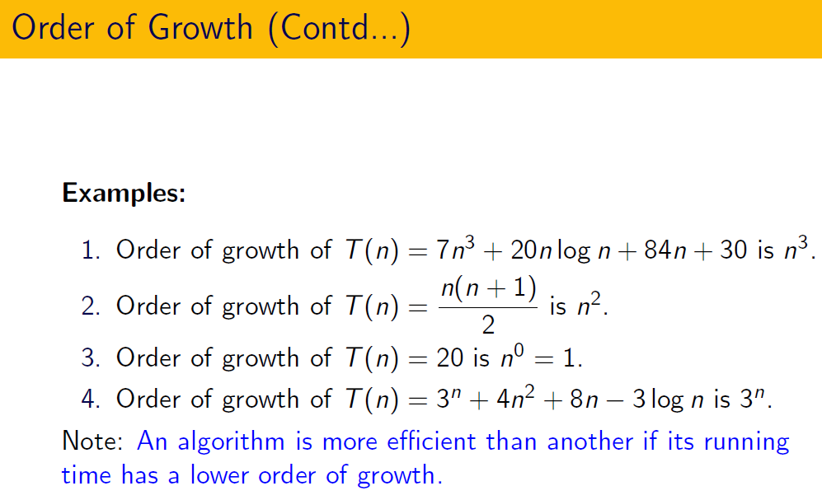

Slide 20
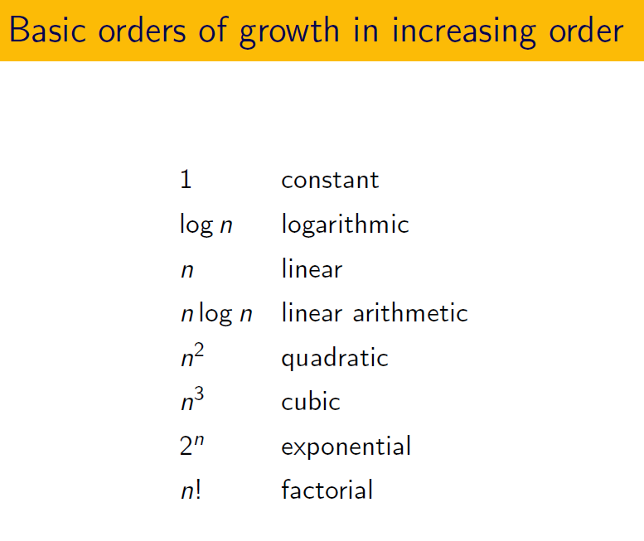

Slide 21

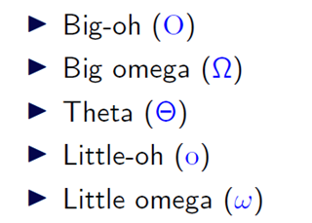

Slide 22
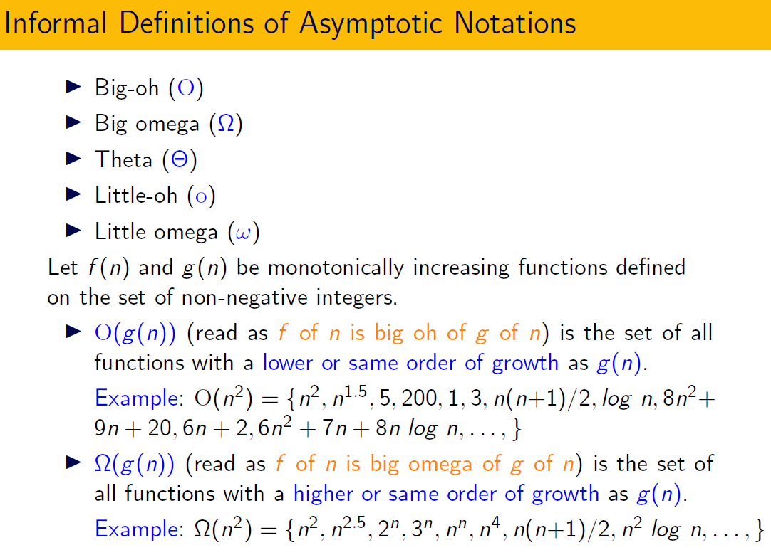

Slide 23
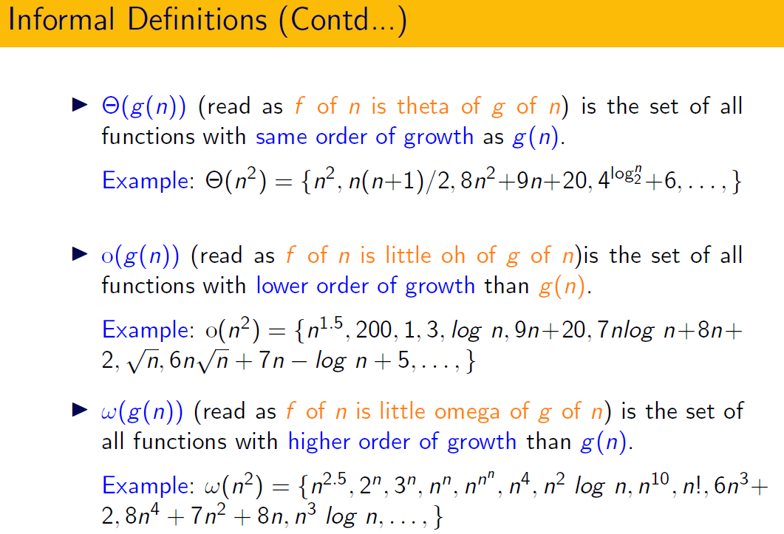

Slide 24
What is time complexity of fun()?
int fun(int n)
{
int count = 0;
for (int i = n; i > 0; i /= 2)
for (int j = 0; j < i; j++)
count += 1;
return count;
}
(A) O(n^2) (B) O(nLogn) (C) O(n) (D) O(nLognLogn)

Slide 25
Answer: (C) Explanation: For a input integer n, the innermost statement of fun() is executed following times.
n + n/2 + n/4 + … 1
So time complexity T(n) can be written as
T(n) = O(n + n/2 + n/4 + … 1) = O(n)
The value of count is also n + n/2 + n/4 + .. + 1

Slide 26
What is the time complexity of fun()?
int fun(int n)
{
int count = 0;
for (int i = 0; i < n; i++)
for (int j = i; j > 0; j--)
count = count + 1;
return count;
}
(A) Theta (n) (B) Theta (n^2) (C) Theta (n*Logn) (D) Theta (nLognLogn)

Slide 27
Answer: (B) Explanation: The time complexity can be calculated by counting number of times the expression “count = count + 1;” is executed. The expression is executed 0 + 1 + 2 + 3 + 4 + …. + (n-1) times.
Time complexity = Theta(0 + 1 + 2 + 3 + .. + n-1) = Theta (n*(n-1)/2) = Theta(n²)

Slide 28
Let w(n) and A(n) denote respectively, the worst case and average case running time of an algorithm executed on an input of size n. which of the following is ALWAYS TRUE?
(A) A(n) = Omega(W(n))
(B) A(n) = Theta(W(n))
(C) A(n) = O(W(n))
(D) A(n) = o(W(n))
(A) A
(B) B
(C) C
(D) D

Slide 29
Answer: (C) Explanation: The worst case time complexity is always greater than or same as the average case time complexity.

Slide 30
Which of the following is not O(n^2)? (A) (15^10) * n + 12099 (B) n^1.98 (C) n^3 / (sqrt(n)) (D) (2^20) * n Answer: (C) Explanation: The order of growth of option c is n^{2.5} which is higher than n².

Slide 31
Which of the given options provides the increasing order of asymptotic complexity of functions f1, f2, f3 and f4?
f1(n) = 2^n
f2(n) = n^(3/2)
f3(n) = nLogn
f4(n) = n^(Logn)
(A) f3, f2, f4, f1
(B) f3, f2, f1, f4
(C) f2, f3, f1, f4
(D) f2, f3, f4, f1

Slide 32
Explanation:
f1(n) = 2^n
f2(n) = n^(3/2)
f3(n) = nLogn
f4(n) = n^(Logn)
Except f3, all other are exponential. So f3 is definitely first in output. Among remaining, n^(3/2) is next.
One way to compare f1 and f4 is to take Log of both functions. Order of growth of Log(f1(n)) is Θ(n) and order of growth of Log(f4(n)) is Θ(Logn * Logn). Since Θ(n) has higher growth than Θ(Logn * Logn), f1(n) grows faster than f4(n).
Following is another way to compare f1 and f4.
Let us compare f4 and f1. Let us take few values to compare
n = 32, f1 = 2^32, f4 = 32^5 = 2^25
n = 64, f1 = 2^64, f4 = 64^6 = 2^36
...............
...............

