Slide 1
COGNITIVE RADIO
Simulation study of double threshold energy detection
method for cognitive radio
B.TARUN KUMAR
1501013

Slide 2
COGNITIVE RADIO
to solve spectrum utlilization
spectrum allocation policy
spectrum scarcity
deployed as pu , su

Slide 3
spectrum sensing
channel should be sensed for opportunstic spectrum access
spectrum holes
spectrum techniques -
energy detector
matched filter
cyclostationary

Slide 4
In this paper, they have are discussed a method of double threshold CSS in which each CR (Cognitive Radio) sends local decision or observed energy to the FC (Fusion Center) depending on the region in which the observed energy lies. FC then makes a final decision by combining local decisions and observed energy values.
it has been observed that the proposed method outperforms the conventional CSS in low SNR region. There is almost a 10% improvement in the cooperative probability of detection at -8 dB SNR at 0.1 probability of false alarm.

Slide 5
BACKGROUND :-
CONVENTIONAL ENERGY DETECTOR
DOUBLE THRESHOLD ENERGY DETECTOR
COPERATIVE SPECTRUM SENSING

Slide 6

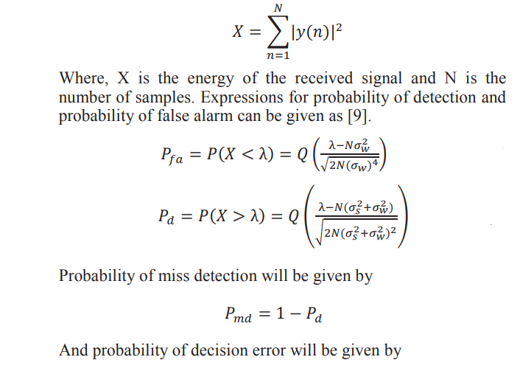
CONVENTIONAL ENERGY DECTOR -
two hypothesis
Notes:
measure energy ; compare with threshold to determine pu

Slide 7
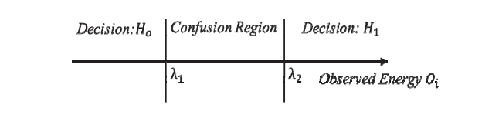
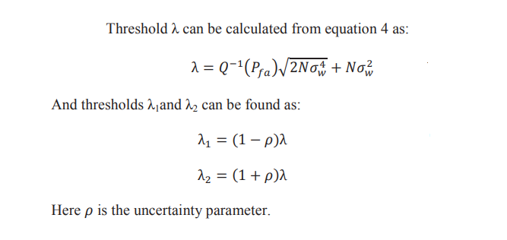
DOUBLE THRESHOLD

Slide 8
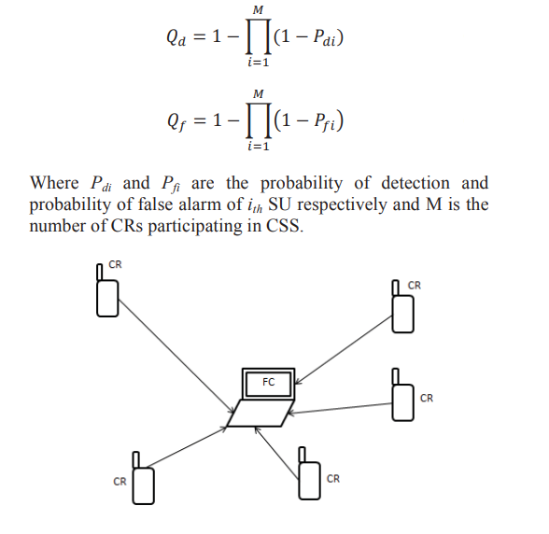
All the su identify the avaliability of pu independently each su make a binary decesion based on its local spectrum sensing and forward one bit of decesio to a common recevier.
COPERATIVE SPECTRUM SENSING :-
OR RULE
AND RULE
MAJORITY RULE

Slide 9
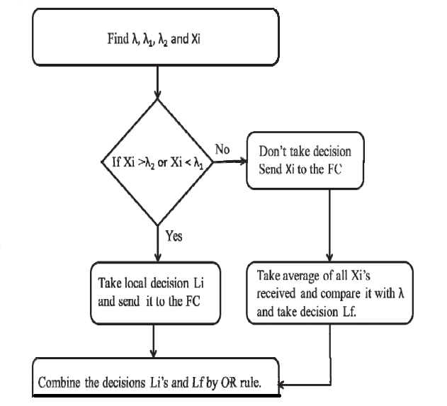
PROPOSED DOUBLE THRESHOLD ENERGY DETECTOR
IN COOPERATIVE SPECTRUM SENSING

