Slide 1
Virtual Mouse using
Mediapipe and CV2
By TARUN KUMAR
MAIT (ECE)

Slide 2
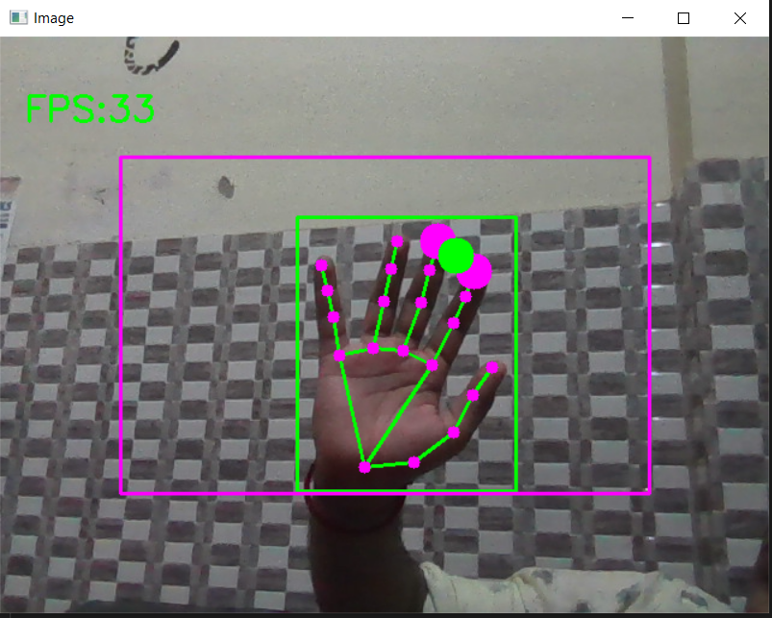
This can be achievable using Handtracking with
the help of Mediapipe Module

Slide 3
How Mediapipe module can do it.
First, we train a palm detector instead of a hand detector, since estimating bounding boxes of rigid objects like palms and fists is significantly simpler than detecting hands with articulated fingers. In addition, as palms are smaller objects, the non-maximum suppression algorithm works well even for two-hand self-occlusion cases, like handshakes. Moreover, palms can be modelled using square bounding boxes (anchors in ML terminology) ignoring other aspect ratios, and therefore reducing the number of anchors by a factor of 3-5. Second, an encoder-decoder feature extractor is used for bigger scene context awareness even for small objects (similar to the RetinaNet approach). Lastly, we minimize the focal loss during training to support a large amount of anchors resulting from the high scale variance.
With the above techniques, we achieve an average precision of 95.7% in palm detection. Using a regular cross entropy loss and no decoder gives a baseline of just 86.22%.
To obtain ground truth data, we have manually annotated ~30K real-world images with 21 3D coordinates
To better cover the possible hand poses and provide additional supervision on the nature of hand geometry, we also render a high-quality synthetic hand model over various backgrounds and map it to the corresponding 3D coordinates.

Slide 4
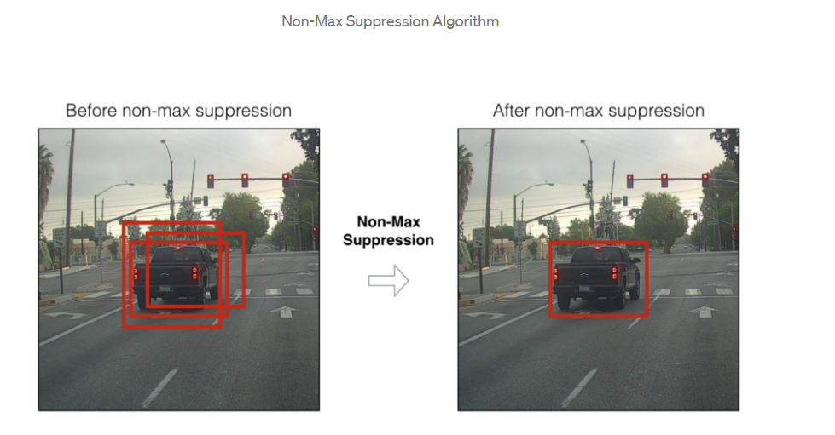
This technique also used in object
detection transfer learning model also

Slide 5
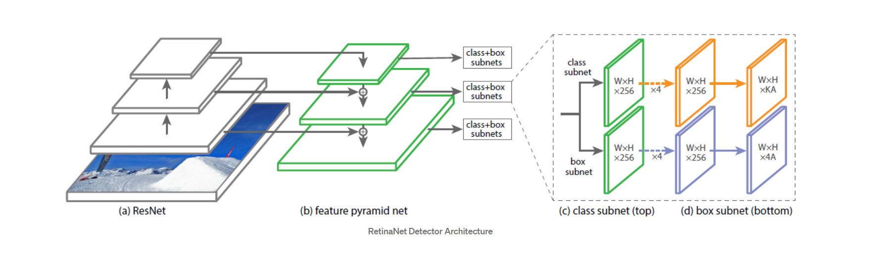
ResNet is used for deep feature extraction.
Feature Pyramid Network (FPN) is used on top of ResNet for constructing a rich multi-scale feature pyramid from one single resolution input image.
Classification subnet predicts the probability of object presence at each spatial position
Subnet is a FCN(Fully convolutional network) which applies four 3×3 conv layers, each with C filters and each followed by ReLU activations, followed by a 3×3 conv layer

Slide 6
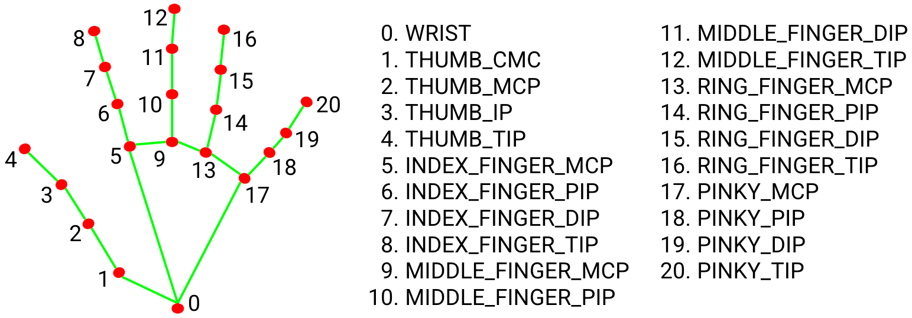

Slide 7
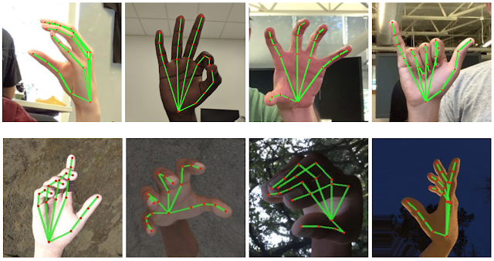
def findHands(self, img, draw=True):
imgRGB = cv2.cvtColor(img, cv2.COLOR_BGR2RGB)
self.results = self.hands.process(imgRGB)
if self.results.multi_hand_landmarks:
for handLms in self.results.multi_hand_landmarks:
if draw:
self.mpDraw.draw_landmarks(img, handLms,
self.mpHands.HAND_CONNECTIONS)
return img
cv2.cvtColor() method is used to convert an image from one color space to another. There are more than 150 color-space conversion methods available in OpenCV.
MULTI_HAND_LANDMARKS
Collection of detected/tracked hands, where each hand is represented as a list of 21 hand landmarks and each landmark is composed of x, y and z. x and y are normalized to [0.0, 1.0] by the image width and height respectively. z represents the landmark depth with the depth at the wrist being the origin, and the smaller the value the closer the landmark is to the camera. The magnitude of z uses roughly the same scale as x.

Slide 8
Controlling mouse movements using pyautogui module
Mouse pointer magically moving from its current location to coordinates (100, 100), taking 1 second in this process.
pyautogui.moveTo(100, 100, duration = 1)
click(): Function used for clicking and dragging the mouse.
pyautogui.click()

Slide 9
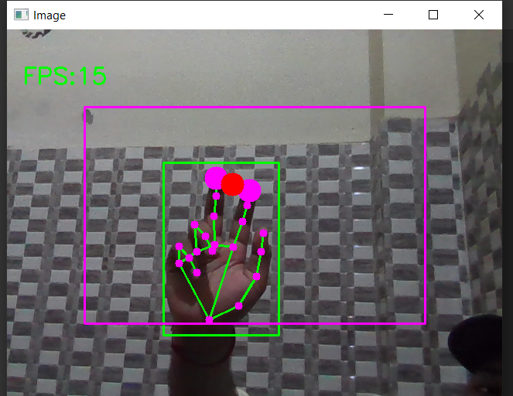
For Clicking in mouse index and middle finger must be up

Slide 10
Thank you

