Slide 1
Chapter 3: Input/Output

Slide 2
Output and Formatting Output
Syntax of cout when used with <<
Expression is evaluated
Value is printed
Manipulator is used to format the output
Example: endl

Slide 3

setprecision Manipulator
Syntax:
Outputs decimal numbers with up to n decimal places
With cout, it is used like
Must include the header file iomanip:
#include <iomanip>

Slide 4
fixed Manipulator
Normally, trailing zeros are ignored
fixed outputs floating-point numbers in a fixed decimal format (6 digits after decimal)
Example: cout << fixed;
Disable by using the stream member function unsetf
Example: cout.unsetf(ios::fixed);
The manipulator scientific is used to output floating-point numbers in scientific format

Slide 5
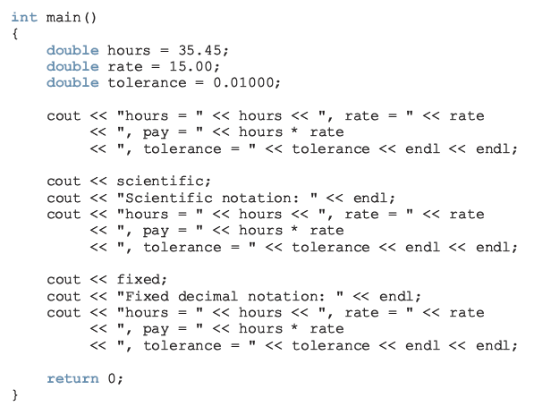
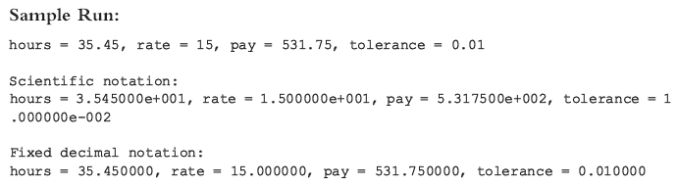

Slide 6
showpoint Manipulator
showpoint forces output to show the decimal point and trailing zeros
Examples:
cout << showpoint;
cout << fixed << showpoint;

Slide 7
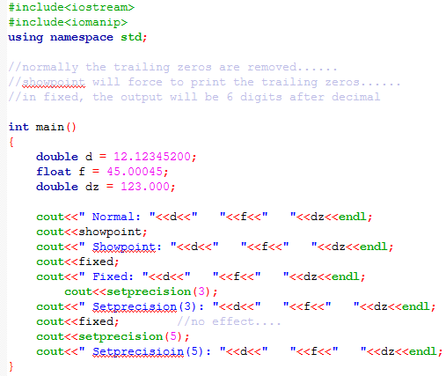


Slide 8
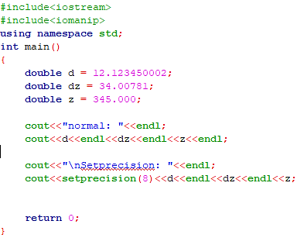
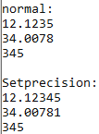
setprecision Manipulator
Setprecision without fixed and showpoint

Slide 9
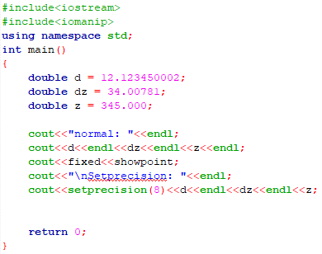
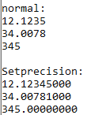
setprecision Manipulator
Setprecision with fixed and showpoint

Slide 10
setw
Outputs the value of an expression in specific columns
cout << setw(5) << x << endl;
If number of columns exceeds the number of columns required by the expression (ex: you specified setw(5) but your data is of 2 digits, it will be right-justified)
Output of the expression is right-justified
Unused columns to the left are filled with spaces
if the number of columns specified is less than the number of columns required by the output, the output automatically expands to the required number of columns;
Must include the header file iomanip

Slide 11

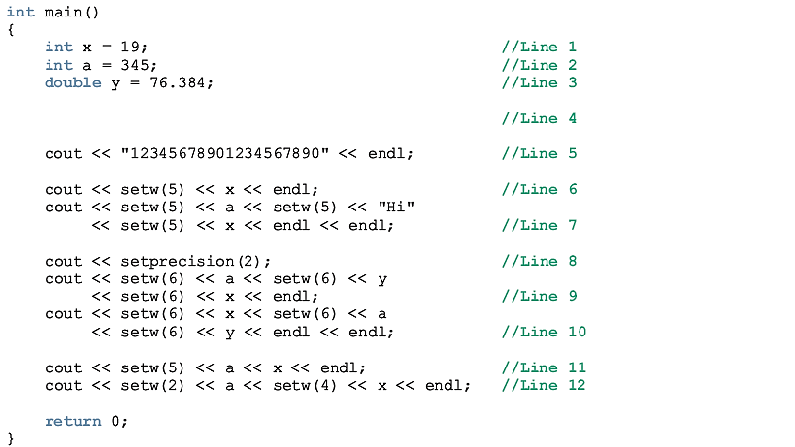
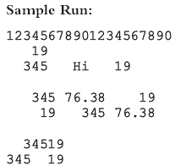
setw
Note: On Line 11, the setw(5) applies only on a, not on x (its value is printed at the current cursor).

Slide 12
Home Work Examples
Movie Tickets Sale and Donation to Charity (Page 150)
Student Grade (Page 155)

