Slide 1
Chapter 5: Control Structures II (Repetition)

Slide 2
Objectives
In this chapter you will:
Learn about repetition (looping) control structures
Explore how to construct and use count-controlled, sentinel-controlled, flag-controlled, repetition structures
Examine break and continue statements

Slide 3
Why Is Repetition Needed?
Repetition allows you to efficiently use variables
Can input, add, and average multiple numbers using a limited number of variables
For example, to add five numbers:

Slide 4
Adding 5 numbers without using loops
int n1, n2, n3, n4, n5, sum=0;
cin >> n1;
cin>> n2;
cin>> n3;
cin>>n4;
cin>>n5;
sum= sum + (n1+n2+n3+n4+n5);
cout << sum;

Slide 5
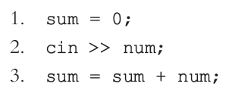
Adding 5 numbers without using loops
int n1, n2, n3, n4, n5, sum=0;
cin >> n1;
cin>> n2;
cin>> n3;
cin>>n4;
cin>>n5;
sum= sum + (n1+n2+n3+n4+n5);
cout << sum;
Step 2 and 3 need to be repeated

Slide 6
Adding 5 numbers using while loop
int n1, n2, n3, n4, n5, sum=0;
cin >> n1;
cin>> n2;
cin>> n3;
cin>>n4;
cin>>n5;
sum= sum + (n1+n2+n3+n4+n5);
cout << sum;
int number, sum=0;
int counter = 0;
while (counter < 5)
{
cin >> number;
sum= sum + number;
counter++;
}
cout << sum;
Counter is called the Loop Control Variable (LCV)

Slide 7
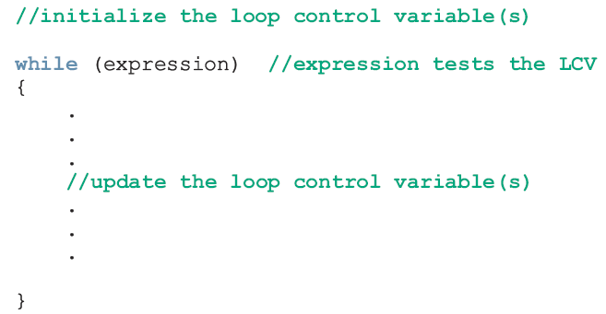
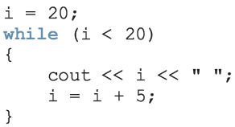
The while Loop Structure
Example:

Slide 8

The while Loop
The general form of the while statement is:
while is a reserved word
Statement can be simple or compound
Expression acts as a decision maker and is usually a logical expression
Statement is called the body of the loop
The parentheses are part of the syntax

Slide 9
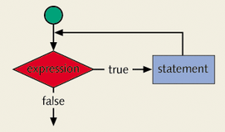
The while Loop (continued)
Expression provides an entry condition
Statement executes if the expression initially evaluates to true
Loop condition is then re-evaluated
Statement continues to execute until the expression is no longer true

Slide 10
The while Loop (continued)
Trace the program with sum not initialized.
Trace the program with the value of counter set to 1
Trace the program with counter++ removed.
Trace if the counter = 0 is removed
int number, sum = 0;
int counter= 0;
while (counter < 5)
{
cin >> number;
sum= sum + number;
counter++;
}
cout << sum;

Slide 11
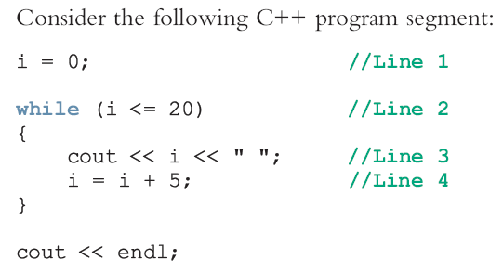
The while Loop (continued)
Output ? 0 5 10 15 20

Slide 12
The while Loop (continued)
Infinite loop: continues to execute endlessly
Can be avoided by including statements in the loop body that assure exit condition will eventually be false
i.e. i = i + 5 should be put in the while loop in order make the condition false.
Note: the variable i is called Loop Control Variable (LCV).

Slide 13
Forms of while Loop
Case 1: Counter-Controlled while Loops
Case 2: Sentinel-Controlled while Loops
Case 3: Flag-Controlled while Loops
Case 4: EoF-Controlled while Loops [will be skipped]

Slide 14
Counter-Controlled while Loops
If you know exactly how many iteration (i.e. how many times the loop should execute), the while loop becomes a counter-controlled loop [Covered in previous lecture]
The syntax is:
counter = 0;
while(counter < limit)
{
.
counter++;
.
}
Counter is called the loop control variable (lcv)
Example of a counter-controlled loop (previous lecture)

Slide 15
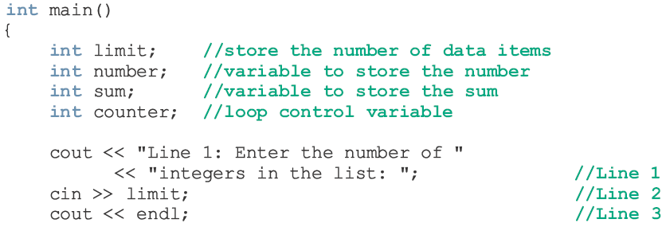
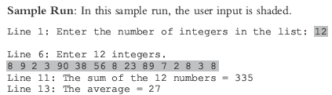
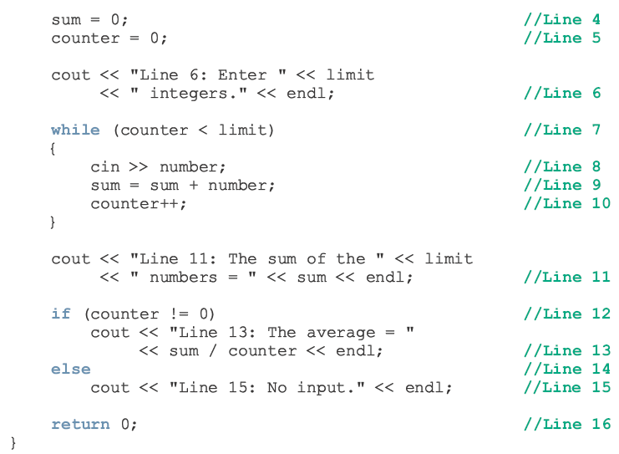

Slide 16
Sentinel-Controlled while Loops
You do not always know how many pieces of data (or entries) need to be read, but you may know that the last entry is a special value, called a sentinel.
Example: Sum integers until a value is encountered
10 30 40 22 33 -1
Sentinel

Slide 17
Sentinel-Controlled while Loops (Continued)
The control variable is tested in the condition and loop ends when sentinel is encountered
The syntax is:
cin>>variable;
while(variable != sentinel)
{
.
.
.
cin>> variable; .
}

Slide 18
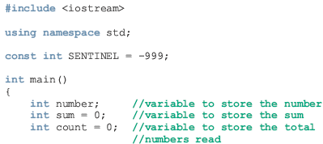
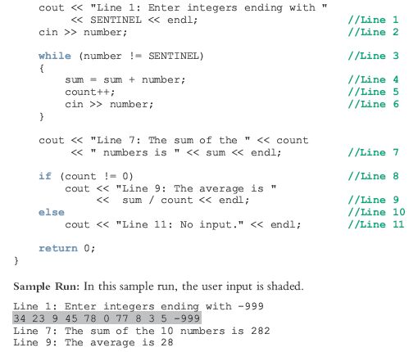

Slide 19
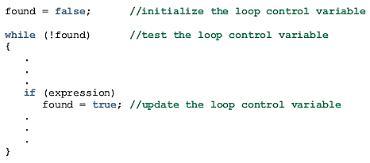
Flag-Controlled while Loops
This loop uses a bool variable to control the loop.
Suppose “found” is a bool variable. The flag-controlled while loop takes the following form:

Slide 20
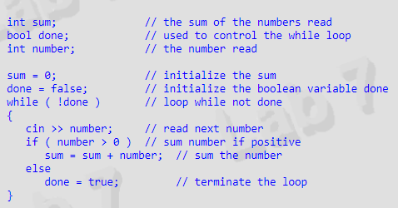
Flag-Controlled while Loops

Slide 21
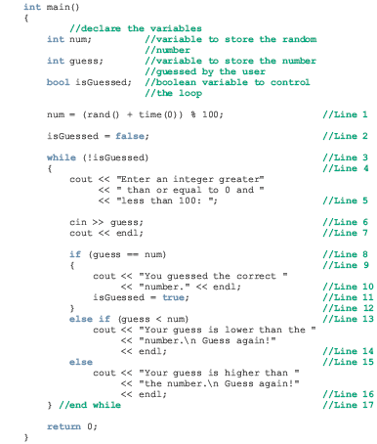
Example – Number Guess

Slide 22
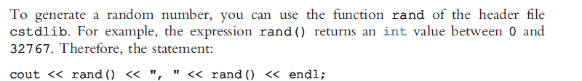
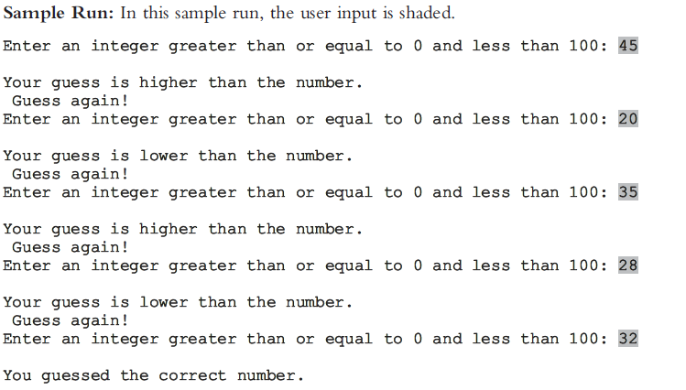
Example – Number Guess

Slide 23
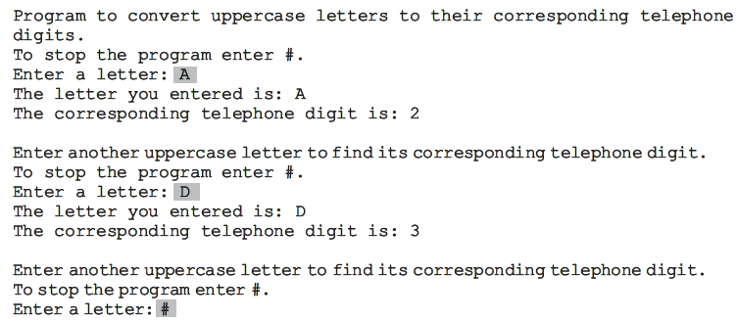
Another Example
Example 5-5 Telephone Digits page 240

Slide 24
The for Loop
int number, sum=0;
int counter= 0;
while (counter < 4)
{
cin >> number;
sum= sum + number;
counter++;
}
cout << sum;
int number, sum=0;
for (int counter= 0; counter< 4; counter++)
{
cin >> number;
sum= sum + number;
}
cout << sum;

Slide 25
The for Loop
The general form of the for statement is:
for ( initial statement; loop condition; update statement )
statement // could be simple or compound
The initial statement, loop condition, and update statement are called for loop control statements

Slide 26
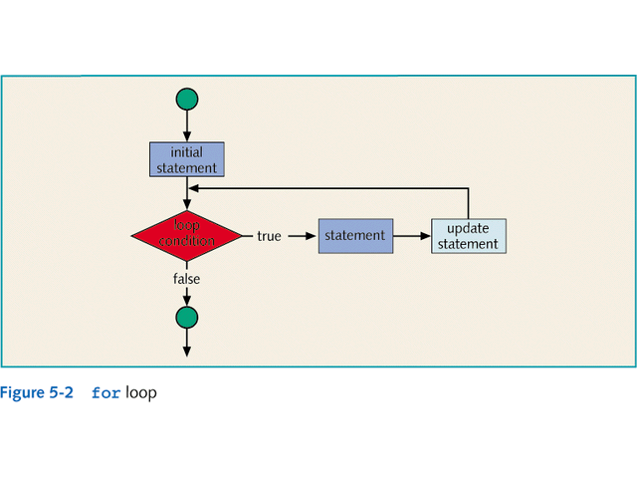

Slide 27
The for Loop (continued)
The for loop executes as follows:
initial statement executes
loop condition is evaluated
If loop condition evaluates to true
Execute for loop statement
Execute update statement
Repeat previous step until the loop condition evaluates to false

Slide 28
The for Loop (continued)
initial statement in the for loop is the first to be executed and is executed only once
If the loop condition is initially false, the loop body does not execute
The update expression changes the value of the loop control variable which eventually sets the value of the loop condition to false
The for loop executes indefinitely if the loop condition is always true

Slide 29
The for Loop (continued)
A semicolon at the end of the for statement is a semantic error
In this case, the action of the for loop is empty
Example:
for (i= 0; i< 5; i++);
cout << “*” << endl;

Slide 30
The for Loop (continued)
In a for statement, all three statements (initial statement, loop condition, and update statement) can be omitted
If the loop condition is omitted
It is assumed to be true
The following is a legal for loop:
for( ; ; )
cout<<"Hello"<<endl; // infinite loop

Slide 31
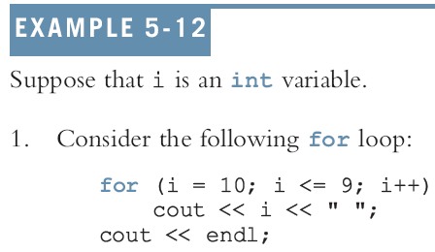

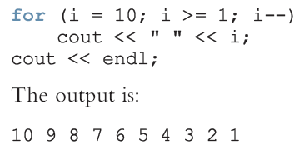
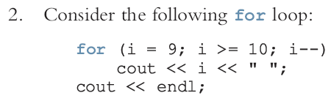


Programming Examples
Outputs???

Slide 32
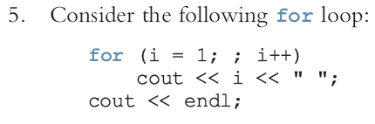
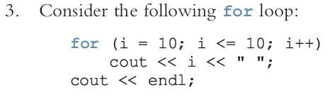
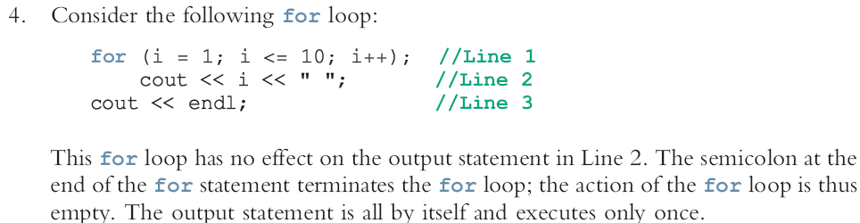
Programming Examples
Outputs???
Infinite loop: Condition always true

Slide 33
Increment & Decrement Operators
count = count + 1 increments the value of count by 1
++count; or count++; increments the value of count by 1
--count; or count--; decrements the value of count by 1
If x = 5; and y = ++x; [pre increment]
After the second statement both x and y are 6
If x = 5; and y = x++; [post increment]
After the second statement y is 5 and x is 6
[similarly, pre and post decrement]

Slide 34
Programming Examples (Important)
Classify Numbers page 270
Print Odd and Even
Sum odd and Even
Block of stars

Slide 35
The do…while Loop
The general form of a do...while statement is:
do
statement // could be simple or compound
while (expression);
The body of loop is executed at least once. Then, only the test expression is checked.
If the expression evaluates to true, the statement executes again

Slide 36
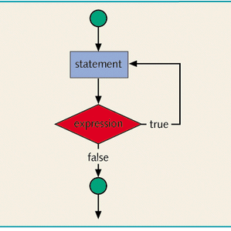
The do…while Loop (continued)
do...while loop has an exit condition and always iterates at least once (unlike for and while)

Slide 37
The do…while Loop (continued)
Useful when it makes sense to check a condition after an action happens. For example:
const int low = 60;
const int high = 100;
int pressure;
do
cin>>pressure;
while ((pressure > low) && (pressure < high));
cout<<"Help"<<endl;

Slide 38
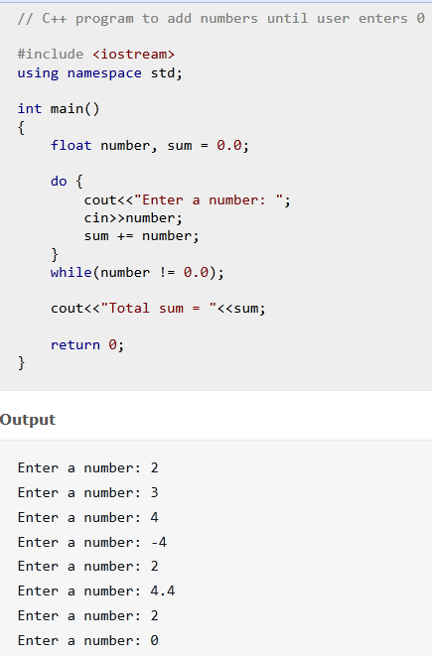
sum = sum + number

Slide 39
Break & Continue Statements
break and continue alter the flow of control
When a break statement is executed in a while, for, do/while, or switch structure, causes immediate exit from that structure.
count = 0;
while( count < 20) {
cin>>num;
if (num < 0)
break;
sum = sum + num;
count++;
}

Slide 40
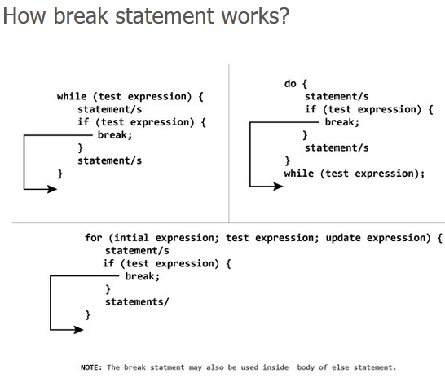
Break Statements

Slide 41
Continue Statements
continue is used in while, for, and do-while structures
When executed in a loop, It skips remaining statements and proceeds with the next iteration of the loop
count = 0;
while( count < 20) {
cin>>num;
if (num < 0)
continue;
sum = sum + num;
count++;
}

Slide 42
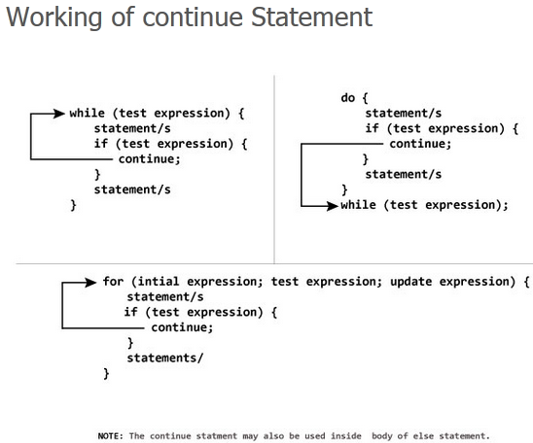
Break & Continue Statements

Slide 43
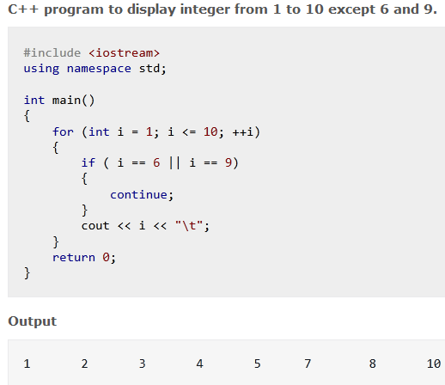
Break & Continue Statements

Slide 44
Nested Control Structures
The placing of one loop inside the body of another loop is called nesting.
When you "nest" two loops, for one repetition of the outer loop, all of the inner loop repetition are performed.
All types of loops may be nested, the most commonly nested loops are for loops.

Slide 45
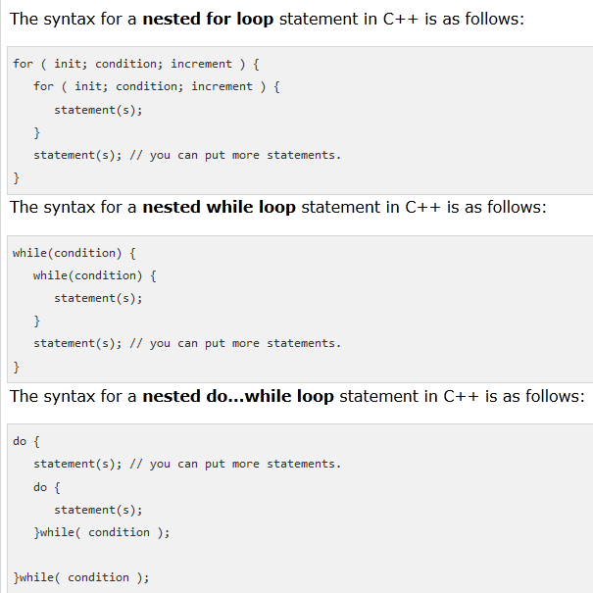

Slide 46
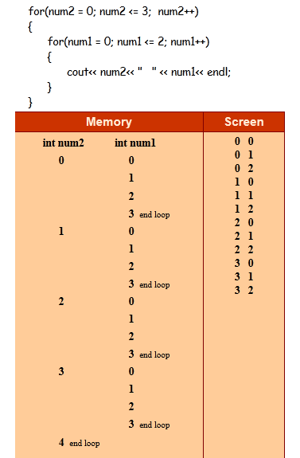
Example

Slide 47
Nested Control Structures
To create the following pattern:
*
**
***
****
*****
We can use the following code:
for (i = 1; i <= 5 ; i++)
{
for (j = 1; j <= i; j++)
cout << "*";
cout << endl;
}

Slide 48
Nested Control Structures (cont'd.)
What is the result if we replace the first for statement with the following?
for (i = 5; i >= 1; i--)
Answer:
*****
****
***
**
*

Slide 49
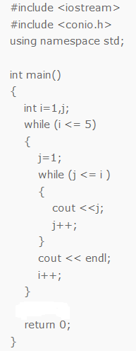
Example

Slide 50
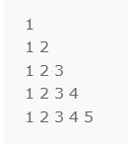
Example

Slide 51
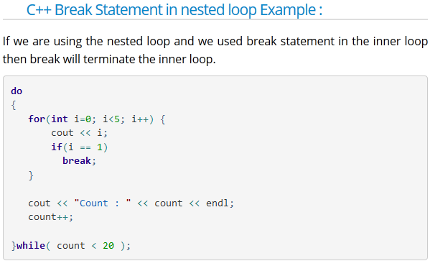
Example

Slide 52

Example

Slide 53
End of Chapter 5 Thank You!

