Slide 1
Homomorphic Encryption (Part II):
Bootstrapping, FHE, and More
Shai Halevi
* Many slides taken from Craig Gentry
May 18, 2015
Simons Institute, Cryptography Boot Camp

Slide 2
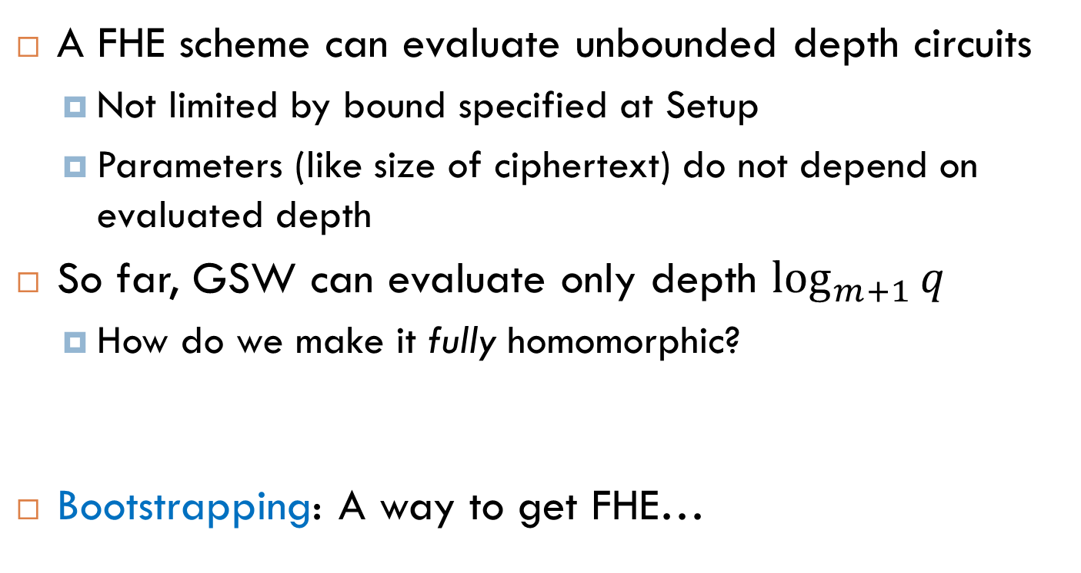
Fully Homomorphic Encryption (FHE)
A FHE scheme can evaluate unbounded depth circuits
Not limited by bound specified at Setup
Parameters (like size of ciphertext) do not depend on evaluated depth
So far, GSW can evaluate only depth $\log_{m+1}{q}$
How do we make it fully homomorphic?
Bootstrapping: A way to get FHE…

Slide 3
A Digression into Philosophy…
Can the human mind understand itself?
Or, as a mind becomes more complex, does the task of understanding also become more complex, so that self-understanding it always just out of reach?
Self-reference can sometimes be proven impossible
Godel’s incompleteness theorem
Turing’s Halting Problem

Slide 4
Philosophy Meets Cryptography
Can a homomorphic encryption scheme decrypt itself?
We can try to plug the decryption function Dec(·,·) into Eval.
If we run Eval_{pk}(Dec(·,·), c), does it work?
Suppose our HE scheme can Eval depth-d circuits, can we make Dec(·,·) fit in a depth-d circuit (or less)?
Recryption = the process of running Eval on Dec(·,·).

Slide 5
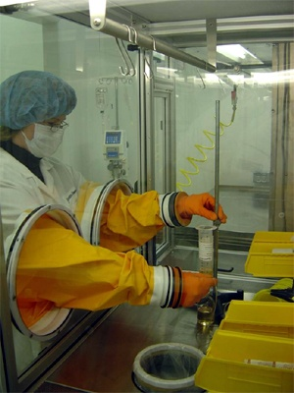
So Far: Bounded Processing
We can evaluate bounded-depth circuits f:
We get a noisy “evaluated ciphertext” y
Can still be decrypted
But eval f’(y) will increase noise too much
μ₁
f
μ₂
…
f(μ₁, μ₂ ,…, μ_{t})
μ_{t}

Slide 6
Recryption: Refreshing a Ciphertext
For ciphertext c, consider the function D_{c}(·) = Dec(·,c)
Suppose we can Eval depth d, but D_{c}(·) has depth d-1.
Include in the public key also Enc_{pk}(sk)
c
y
Must assume “circular security”
sk₁
D_{c}
sk₁
New encryption of y, with less noise.
sk₂
sk₂
…
c' =
D_{c}(sk)
…
= Dec(sk,c) = y
sk_{n}
sk_{n}
Homomorphic computation applied only to the “fresh” encryption of sk.

Slide 7
Bootstrapping Theorem (Informal)
Suppose Ɛ is a HE scheme
that can evaluate arithmetic circuits of depth d
whose decryption algorithm is a circuit of depth d-1
Call Ɛ a “bootstrappable” HE scheme
Thm: From a bootstrappable somewhat homomorphic scheme, we can construct a fully homomorphic scheme.
Technique: Refresh noisy ciphertexts by evaluating the decryption circuit homomorphically (Recryption)

Slide 8
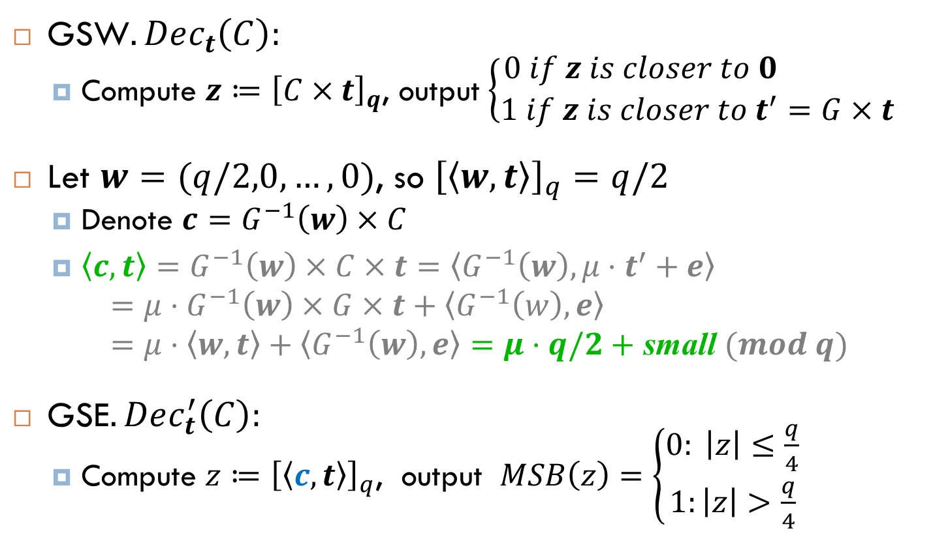
Recryption for GSW
GSW$.Dec_{t}\left(C\right):$
Compute $z≔{\left[C×t\right]}_{q}$, output $\left\{\begin{aligned}0 if z is closer to 0 \\ 1 if z is closer to t^{′}=G×t\end{aligned}\right.$
Let $w=(q/2,0,…,0)$, so ${\left[\left\langle w,t\right\rangle \right]}_{q}=q/2$
Denote $c=G^{−1}\left(w\right)×C$
$\left\langle c,t\right\rangle =G^{−1}\left(w\right)×C×t=\left\langle G^{−1}\left(w\right),μ⋅t^{′}+e\right\rangle$ $={μ⋅G}^{−1}\left(w\right)×G×t+\left\langle G^{−1}\left(w\right),e\right\rangle$ $=μ⋅\left\langle w,t\right\rangle +\left\langle G^{−1}\left(w\right),e\right\rangle =μ⋅q/2+$ small $(mod q)$
GSE$.Dec_{t}^{′}\left(C\right):$
Compute $z≔{\left[\left\langle c,t\right\rangle \right]}_{q}$, output $MSB\left(z\right)=\left\{\begin{aligned}0: \left|z\right|≤\frac{q}{4} \\ 1:\left|z\right|>\frac{q}{4}\end{aligned}\right.$

Slide 9

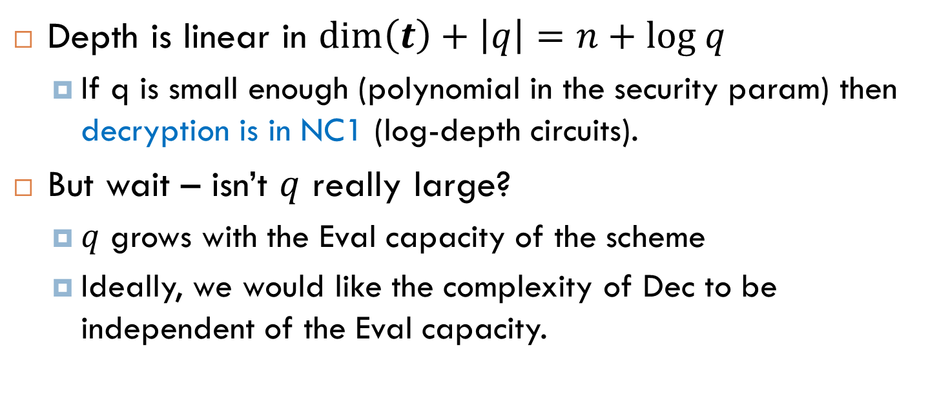
How Complex Is Decryption?
$$μ=MSB\left({\left[\left\langle c,t\right\rangle \right]}_{q}\right)$$
Depth is linear in $\dim\left(t\right)+\left|q\right|=n+log q$
If q is small enough (polynomial in the security param) then decryption is in NC1 (log-depth circuits).
But wait – isn’t $q$ really large?
$q$ grows with the Eval capacity of the scheme
Ideally, we would like the complexity of Dec to be independent of the Eval capacity.

Slide 10
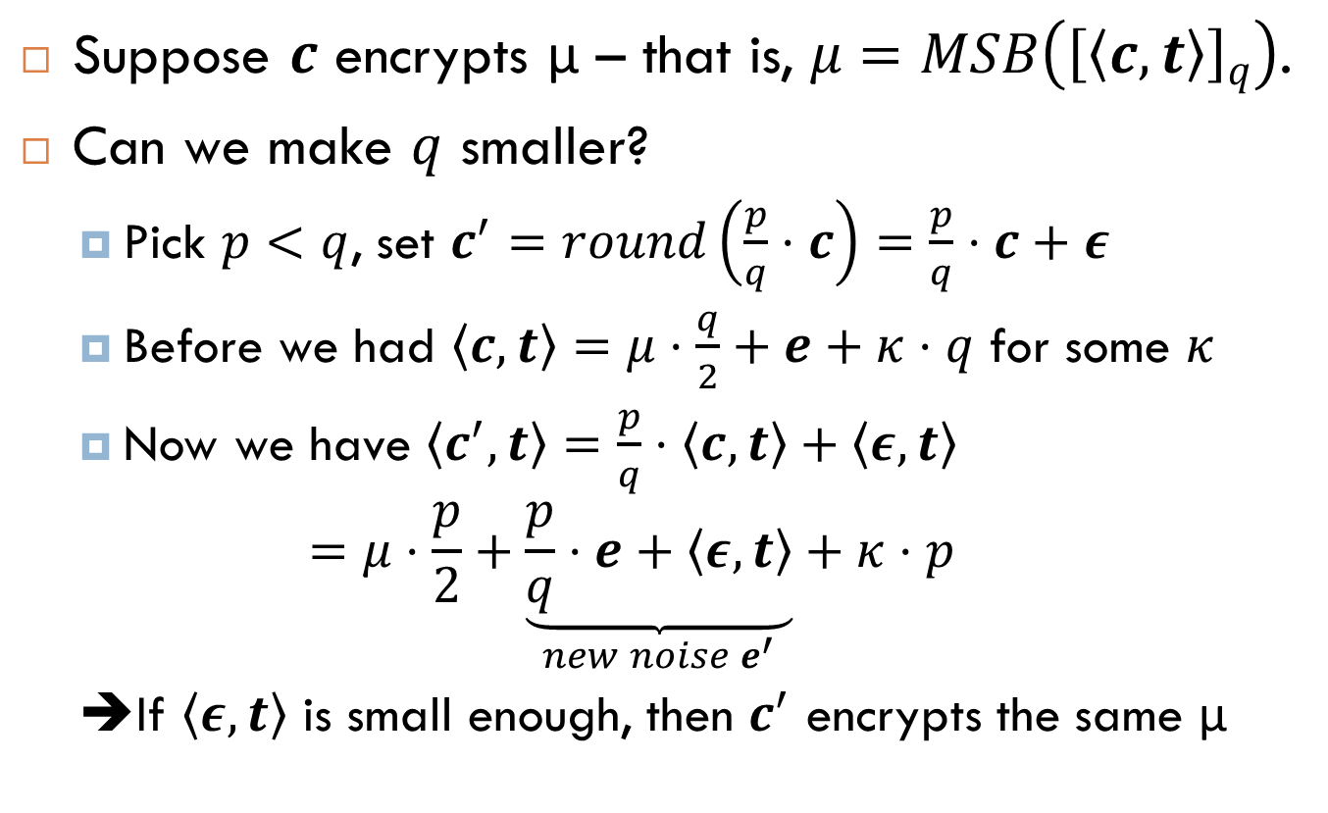
Modulus Reduction Magic Trick
Suppose $c$ encrypts μ – that is, $μ=MSB\left({\left[\left\langle c,t\right\rangle \right]}_{q}\right)$.
Can we make $q$ smaller?
Pick $p<q$, set $c^{′}=round\left(\frac{p}{q}⋅c\right)=\frac{p}{q}⋅c+ε$
Before we had $\left\langle c,t\right\rangle =μ⋅\frac{q}{2}+e+κ⋅q$ for some $κ$
Now we have $\left\langle c^{′},t\right\rangle =\frac{p}{q}⋅\left\langle c,t\right\rangle +\left\langle ε,t\right\rangle$ $=μ⋅\frac{p}{2}+\underset{new noise e^{′}}{\underbrace{\frac{p}{q}⋅e+\left\langle ε,t\right\rangle }}+κ⋅p$
➔If $\left\langle ε,t\right\rangle$ is small enough, then $c^{′}$ encrypts the same μ

Slide 11
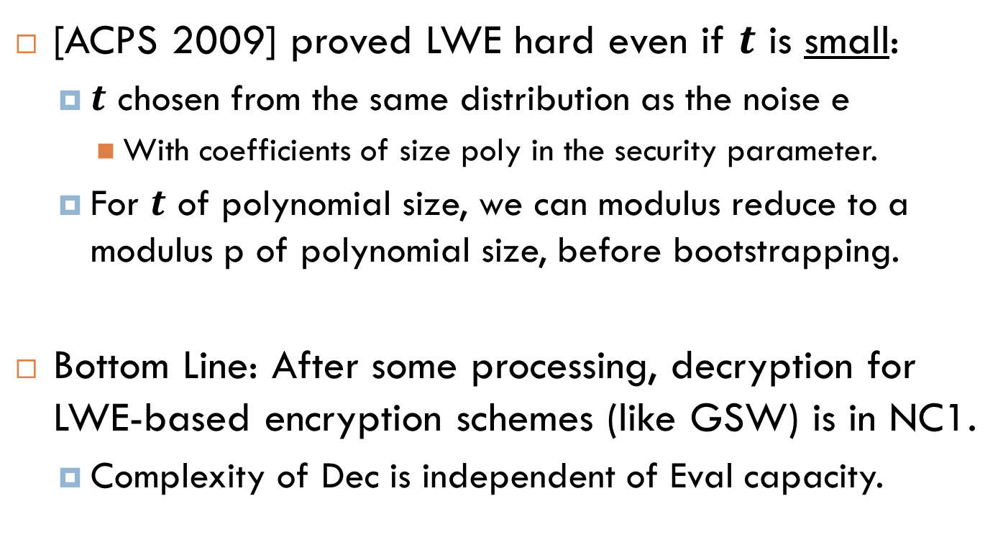
Modulus Reduction Magic Trick, Notes
[ACPS 2009] proved LWE hard even if $t$ is small:
$t$ chosen from the same distribution as the noise e
With coefficients of size poly in the security parameter.
For $t$ of polynomial size, we can modulus reduce to a modulus p of polynomial size, before bootstrapping.
Bottom Line: After some processing, decryption for LWE-based encryption schemes (like GSW) is in NC1.
Complexity of Dec is independent of Eval capacity.

Slide 12
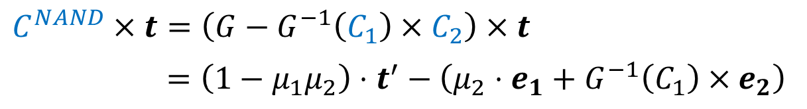
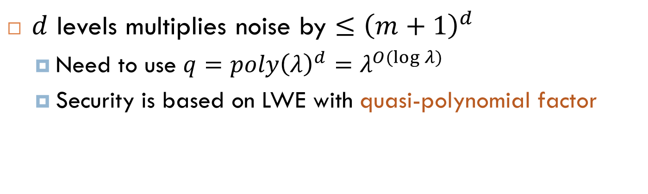
Evaluating NC1 Circuits in GSW
Naïve way: Just do log levels of NAND
Each level multiplies noise by polynomial factor.
$C^{NAND}×t=\left(G−G^{−1}\left(C_{1}\right)×C_{2}\right)×t$
$=\left(1−μ_{1}μ_{2}\right)⋅t^{′}−\left(μ_{2}⋅e_{1}+G^{−1}\left(C_{1}\right)×e_{2}\right)$
$d$ levels multiplies noise by $≤{\left(m+1\right)}^{d}$
Need to use $q=poly{\left(λ\right)}^{d}=λ^{O(\log{λ)}}$
Security is based on LWE with quasi-polynomial factor

Slide 13
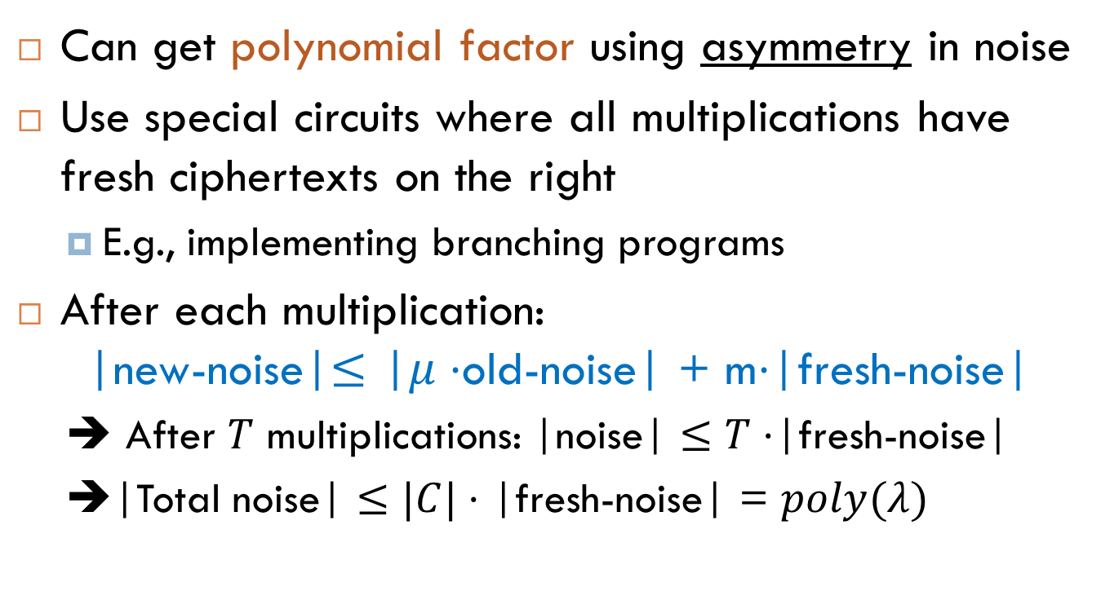
Evaluating NC1 Circuits in GSW
Can get polynomial factor using asymmetry in noise
Use special circuits where all multiplications have fresh ciphertexts on the right
E.g., implementing branching programs
After each multiplication: |new-noise|$≤$ |$μ⋅$old-noise| + m$⋅$|fresh-noise|
➔ After $T$ multiplications: |noise| $≤T⋅$|fresh-noise|
➔|Total noise| $≤|C|⋅$ |fresh-noise| = $poly(λ)$

Slide 14
Extra: Multi-key HE from LWE

Slide 15
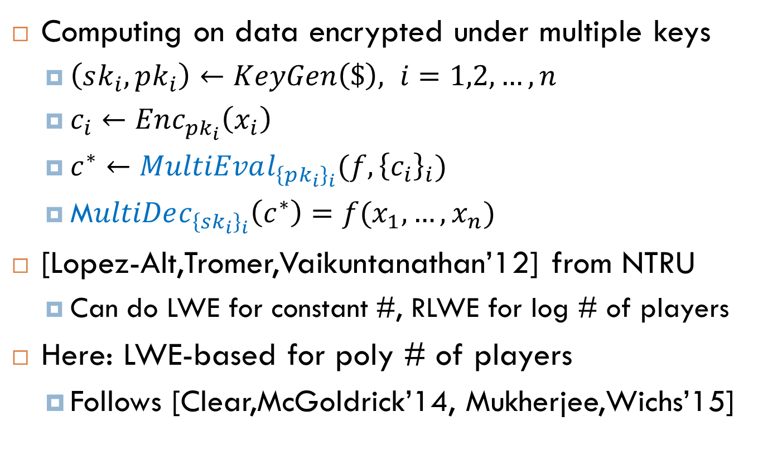
Multi-Key Homomorphic Encryption
Computing on data encrypted under multiple keys
$\left(sk_{i},pk_{i}\right)←KeyGen\left(\$\right), i=1,2, …,n$
$c_{i}←Enc_{pk_{i}}\left(x_{i}\right)$
$c^{∗}←MultiEval_{{\left\{pk_{i}\right\}}_{i}}(f, {\left\{c_{i}\right\}}_{i})$
M$ultiDec_{{\left\{sk_{i}\right\}}_{i}}\left(c^{∗}\right)=f(x_{1},…,x_{n})$
[Lopez-Alt,Tromer,Vaikuntanathan’12] from NTRU
Can do LWE for constant #, RLWE for log # of players
Here: LWE-based for poly # of players
Follows [Clear,McGoldrick’14, Mukherjee,Wichs’15]

Slide 16
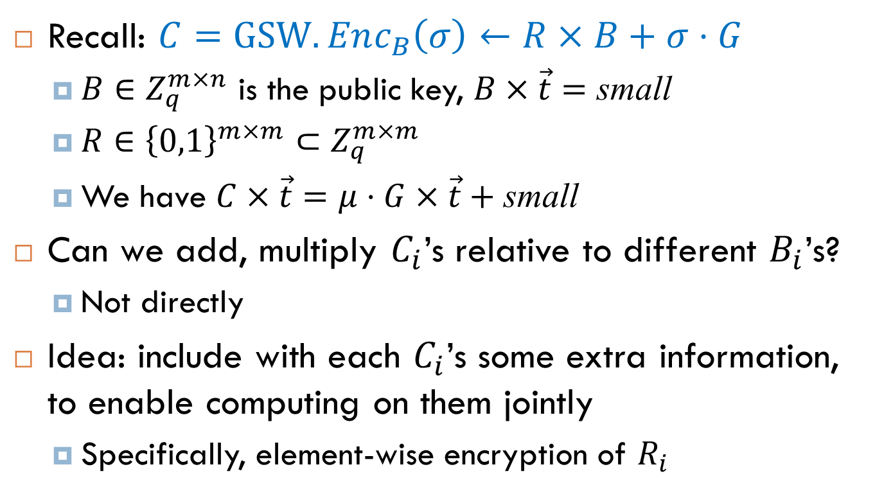
A Variation of GSW
Recall: $C=GSW.Enc_{B}\left(σ\right)←R×B+σ⋅G$
$B∈Z_{q}^{m×n}$ is the public key, $B×\vec{t}=$ small
$R∈{{\left\{0,1\right\}}^{m×m}⊂Z}_{q}^{m×m}$
We have $C×\vec{t}=μ⋅G×\vec{t}+$small
Can we add, multiply $C_{i}$’s relative to different $B_{i}$’s?
Not directly
Idea: include with each $C_{i}$’s some extra information, to enable computing on them jointly
Specifically, element-wise encryption of $R_{i}$

Slide 17
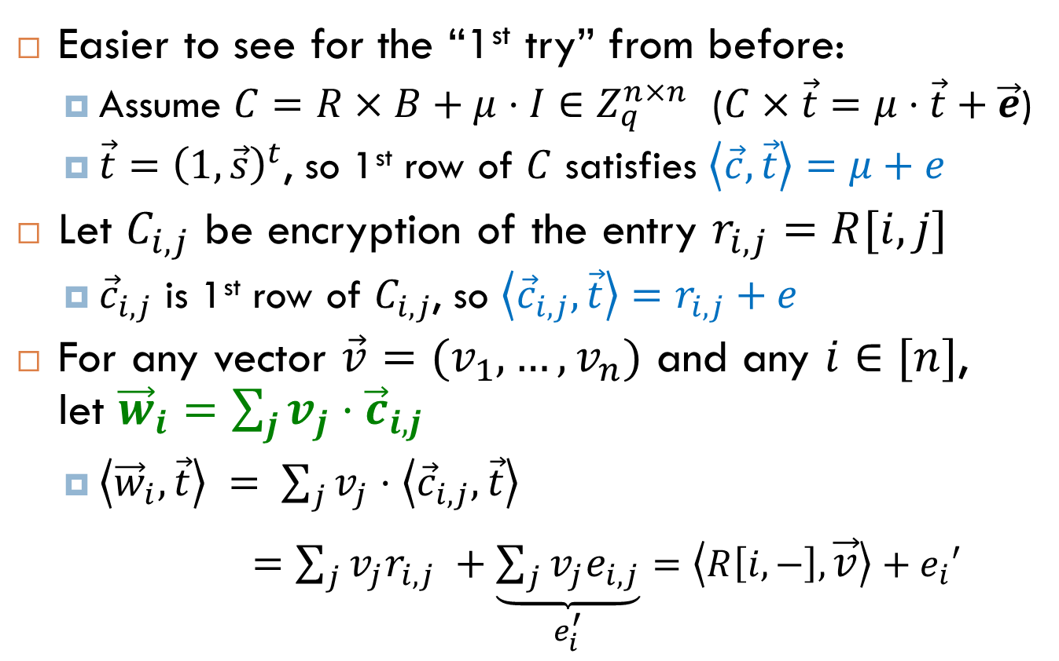
Step 1: Algebraic Trick
Easier to see for the “1st try” from before:
Assume $C=R×B+μ⋅I∈Z_{q}^{n×n}$ ($C×\vec{t}=μ⋅\vec{t}+\vec{e}$)
$\vec{t}={\left(1,\vec{s}\right)}^{t}$, so 1st row of $C$ satisfies $\left\langle \vec{c},\vec{t}\right\rangle =μ+e$
Let $C_{i,j}$ be encryption of the entry $r_{i,j}=R[i,j]$
${\vec{c}}_{i,j}$ is 1st row of $C_{i,j}$, so $\left\langle {\vec{c}}_{i,j},\vec{t}\right\rangle =r_{i,j}+e$
For any vector $\vec{v}=(v_{1},…,v_{n})$ and any $i∈[n]$, let ${\vec{w}}_{i}=\sum_{j}{v_{j}⋅{\vec{c}}_{i,j}}$
$\left\langle {\vec{w}}_{i},\vec{t}\right\rangle = \sum_{j}{v_{j}⋅\left\langle {\vec{c}}_{i,j},\vec{t}\right\rangle }$
$=\sum_{j}{v_{j}r_{i,j} }+\underset{e_{i}^{′}}{\underbrace{\sum_{j}{v_{j}e_{i,j}}}}$ $=\left\langle R\left[i,−\right],\vec{v}\right\rangle +e_{i}′$

Slide 18
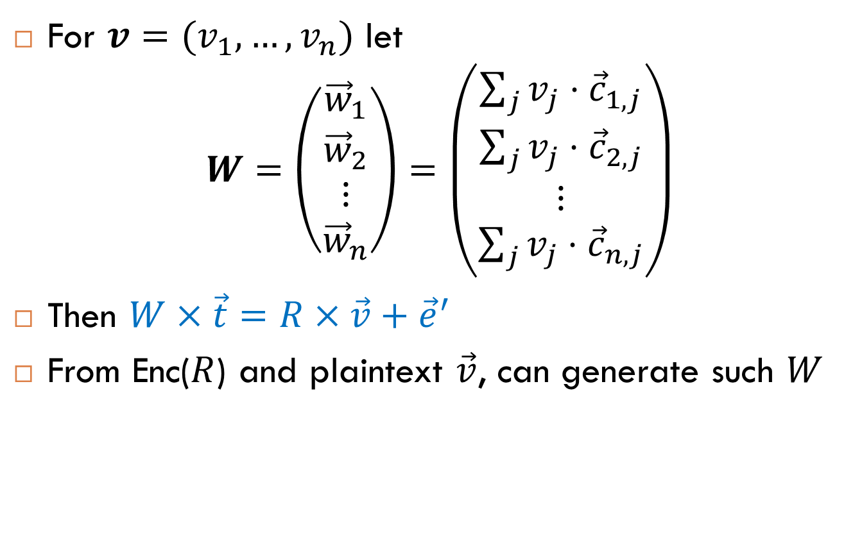
Step 1: Algebraic Trick
For $v=(v_{1},…,v_{n})$ let $W=\left(\begin{matrix}{\vec{w}}_{1} \\ {\vec{w}}_{2} \\ \begin{matrix}⋮ \\ {\vec{w}}_{n}\end{matrix}\end{matrix}\right)=\left(\begin{matrix}\sum_{j}{v_{j}⋅{\vec{c}}_{1,j}} \\ \sum_{j}{v_{j}⋅{\vec{c}}_{2,j}} \\ \begin{matrix}⋮ \\ \sum_{j}{v_{j}⋅{\vec{c}}_{n,j}}\end{matrix}\end{matrix}\right)$
Then $W×\vec{t}=R×\vec{v}+{\vec{e}}^{′}$
From Enc($R$) and plaintext $\vec{v}$, can generate such $W$

Slide 19
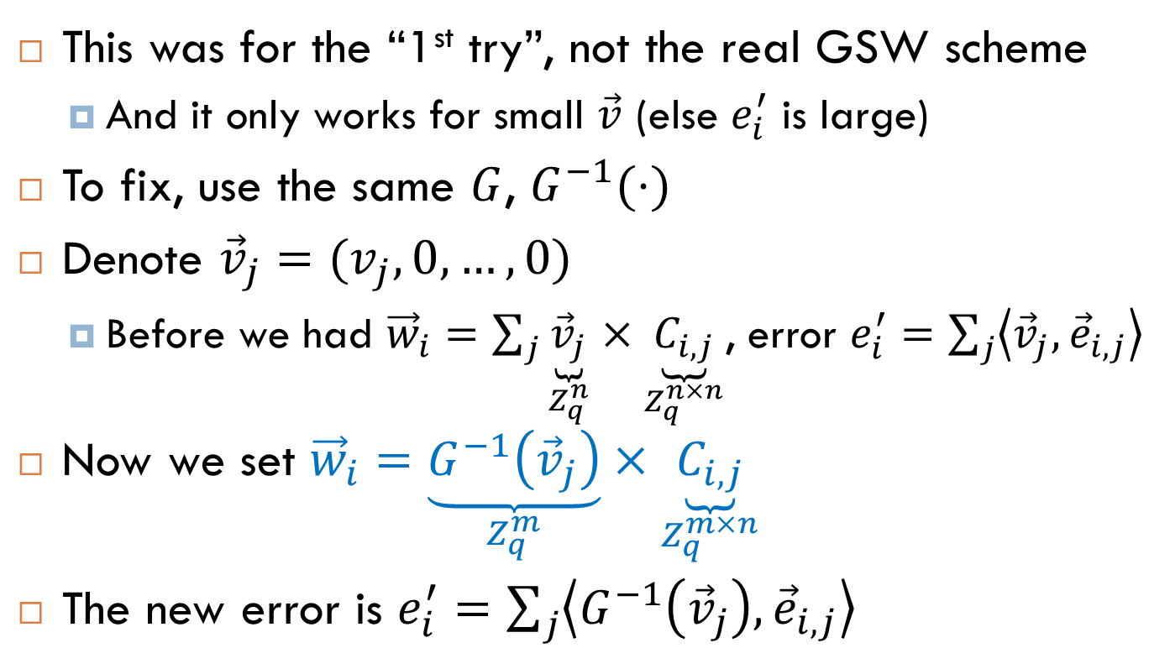
Fixing the Algebraic Trick
This was for the “1st try”, not the real GSW scheme
And it only works for small $\vec{v}$ (else $e_{i}^{′}$ is large)
To fix, use the same $G$, $G^{−1}(⋅)$
Denote ${\vec{v}}_{j}=(v_{j},0,…,0)$
Before we had ${\vec{w}}_{i}=\sum_{j}{\underset{Z_{q}^{n}}{\underbrace{{\vec{v}}_{j}}}}×\underset{Z_{q}^{n×n}}{\underbrace{C_{i,j}}}$, error $e_{i}^{′}=\sum_{j}{\left\langle {\vec{v}}_{j}, {\vec{e}}_{i,j}\right\rangle }$
Now we set ${\vec{w}}_{i}=\underset{Z_{q}^{m}}{\underbrace{G^{−1}\left({\vec{v}}_{j}\right)}}×\underset{Z_{q}^{m×n}}{\underbrace{C_{i,j}}}$
The new error is $e_{i}^{′}=\sum_{j}{\left\langle G^{−1}\left({\vec{v}}_{j}\right),{\vec{e}}_{i,j}\right\rangle }$
“real” GSW ciphertext

Slide 20
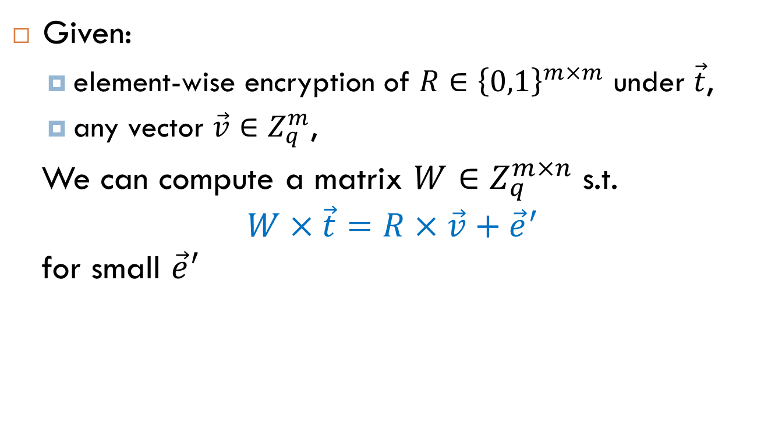
Summary So Far: Algebraic Trick
Given:
element-wise encryption of $R∈{\left\{0,1\right\}}^{m×m}$ under $\vec{t}$,
any vector $\vec{v}∈Z_{q}^{m}$,
We can compute a matrix $W∈Z_{q}^{m×n}$ s.t. $$W×\vec{t}=R×\vec{v}+{\vec{e}}^{′}$$ for small ${\vec{e}}^{′}$

Slide 21
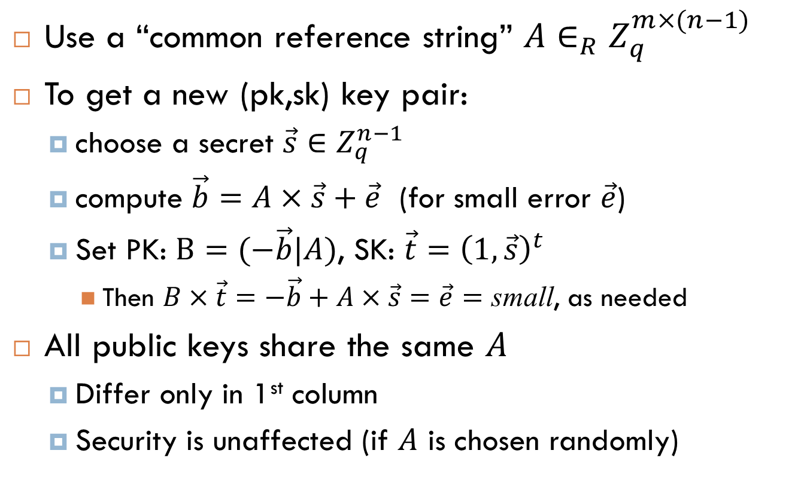
Step 2: Related Public Keys
Use a “common reference string” $A∈_{R}Z_{q}^{m×(n−1)}$
To get a new (pk,sk) key pair:
choose a secret $\vec{s}∈Z_{q}^{n−1}$
compute $\vec{b}=A×\vec{s}+\vec{e}$ (for small error $\vec{e}$)
Set PK: $B=(−\vec{b}|A)$, SK: $\vec{t}={\left(1,\vec{s}\right)}^{t}$
Then $B×\vec{t}=−\vec{b}+A×\vec{s}=\vec{e}=$ small, as needed
All public keys share the same $A$
Differ only in 1st column
Security is unaffected (if $A$ is chosen randomly)

Slide 22
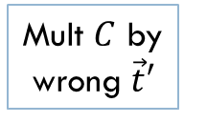
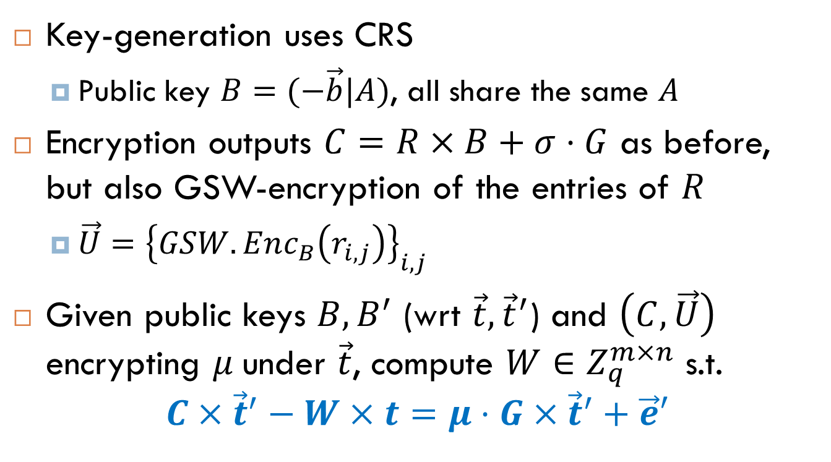
Step 3: “Masking Scheme” for GSW
Key-generation uses CRS
Public key $B=(−\vec{b}|A)$, all share the same $A$
Encryption outputs $C=R×B+σ⋅G$ as before, but also GSW-encryption of the entries of $R$
$\vec{U}={\left\{GSW.Enc_{B}\left(r_{i,j}\right)\right\}}_{i,j}$
Given public keys $B,B^{′}$ (wrt $\vec{t},{\vec{t}}^{′}$) and $\left(C, \vec{U}\right)$ encrypting $μ$under $\vec{t}$, compute $W∈Z_{q}^{m×n}$ s.t.
$$C×{\vec{t}}^{′}−W×t=μ⋅G×{\vec{t}}^{′}+\vec{e}′$$
Mult $C$ by wrong $\vec{t}′$
Correction
factor
Get the right answer

Slide 23
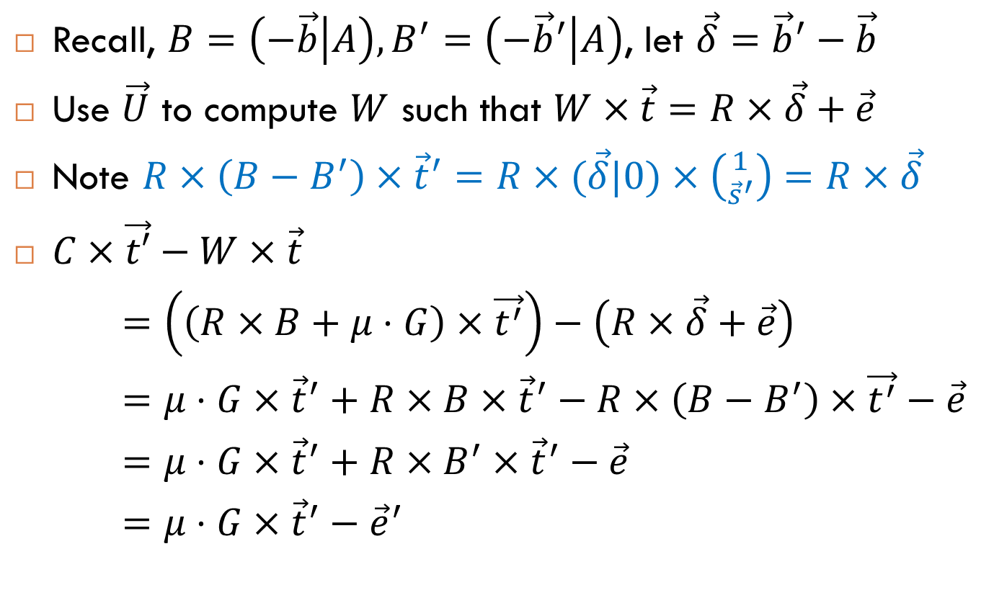
Step 3: “Masking Scheme” for GSW
Recall, $B=\left(−\vec{b} | A\right), B^{′}=\left(−{\vec{b}}^{′} | A\right)$, let $\vec{δ}={\vec{b}}^{′}−\vec{b}$
Use $\vec{U}$ to compute $W$ such that $W×\vec{t}=R×\vec{δ}+\vec{e}$
Note $R×\left(B−B^{′}\right)×{\vec{t}}^{′}=R×(\vec{δ}|0)×\left({1 \atop {\vec{s}}^{′}}\right)=R×\vec{δ}$
$C×\vec{t′}−W×\vec{t}$
$=\left(\left(R×B+μ⋅G\right)×\vec{t^{′}}\right)−\left(R×\vec{δ}+\vec{e}\right)$
$=μ⋅G×{\vec{t}}^{′}+R×B×{\vec{t}}^{′}−R×\left(B−B^{′}\right)×\vec{t^{′}}−\vec{e}$
$=μ⋅G×{\vec{t}}^{′}+R×B^{′}×{\vec{t}}^{′}−\vec{e}$
$=μ⋅G×{\vec{t}}^{′}−{\vec{e}}^{′}$

Slide 24
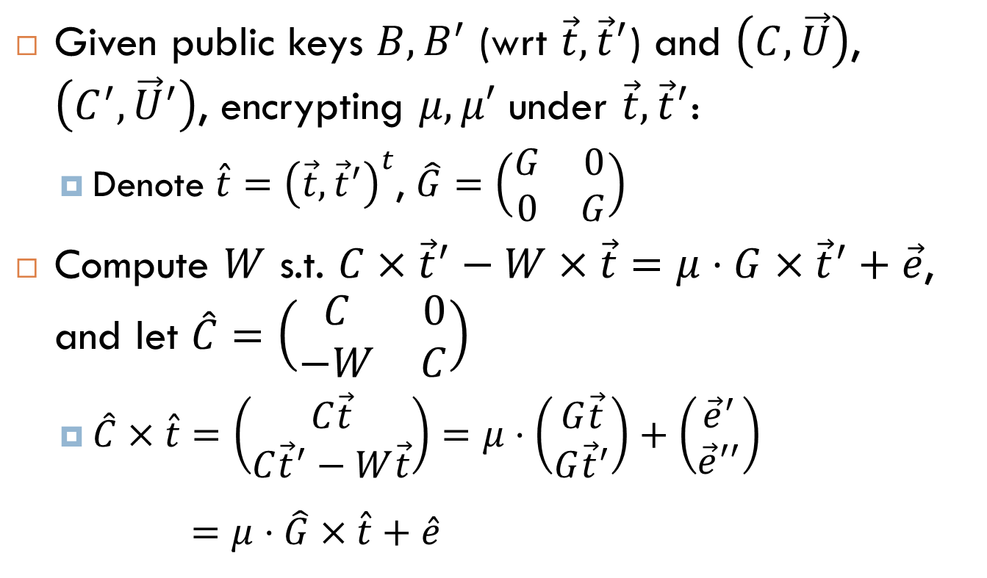
Step 4: Multi-Key HE
Given public keys $B,B^{′}$ (wrt $\vec{t},{\vec{t}}^{′}$) and $\left(C, \vec{U}\right)$, $\left(C^{′}, {\vec{U}}^{′}\right)$, encrypting $μ,μ′$ under $\vec{t}, {\vec{t}}^{′}$:
Denote $\hat{t}={\left(\vec{t},{\vec{t}}^{′}\right)}^{t}$, $\hat{G}=\left(\begin{matrix}G & 0 \\ 0 & G\end{matrix}\right)$
Compute $W$ s.t. $C×{\vec{t}}^{′}−W×\vec{t}=μ⋅G×{\vec{t}}^{′}+\vec{e}$, and let $\hat{C}=\left(\begin{matrix}C & 0 \\ −W & C\end{matrix}\right)$
$\hat{C}×\hat{t}=\left(\begin{matrix}C\vec{t} \\ C{\vec{t}}^{′}−W\vec{t}\end{matrix}\right)=μ⋅\left(\begin{matrix}G\vec{t} \\ G{\vec{t}}^{′}\end{matrix}\right)+\left(\begin{matrix}{\vec{e}}^{′} \\ {\vec{e}}^{′′}\end{matrix}\right)$
$=μ⋅\hat{G}×\hat{t}+\hat{e}$

Slide 25
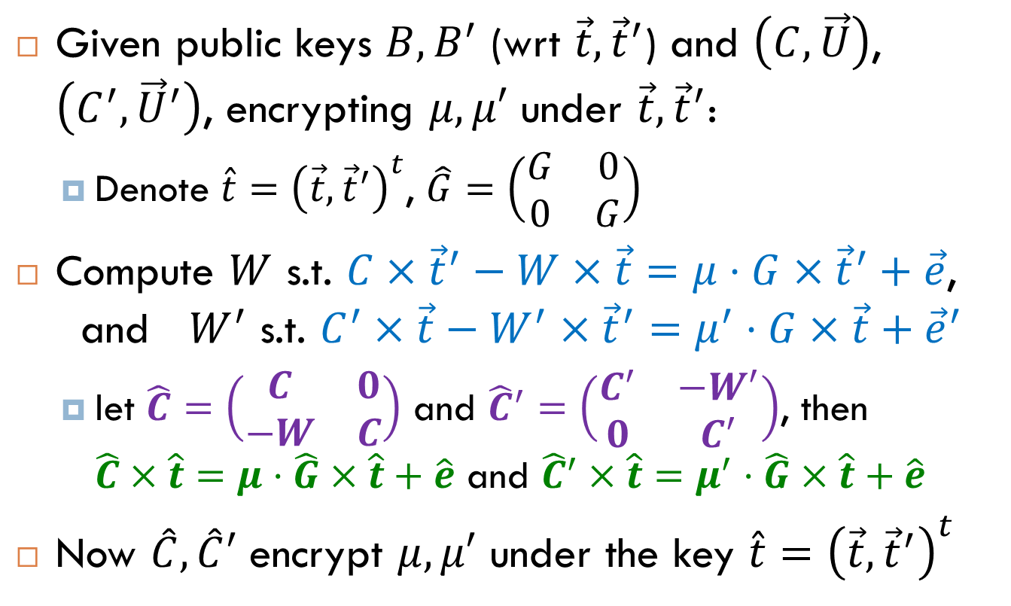
Step 4: Multi-Key HE
Given public keys $B,B^{′}$ (wrt $\vec{t},{\vec{t}}^{′}$) and $\left(C, \vec{U}\right)$, $\left(C^{′}, {\vec{U}}^{′}\right)$, encrypting $μ,μ′$ under $\vec{t}, {\vec{t}}^{′}$:
Denote $\hat{t}={\left(\vec{t},{\vec{t}}^{′}\right)}^{t}$, $\hat{G}=\left(\begin{matrix}G & 0 \\ 0 & G\end{matrix}\right)$
Compute $W$ s.t. $C×{\vec{t}}^{′}−W×\vec{t}=μ⋅G×{\vec{t}}^{′}+\vec{e}$, and $W^{′}$ s.t. $C^{′}×\vec{t}−W^{′}×{\vec{t}}^{′}=μ^{′}⋅G×\vec{t}+{\vec{e}}^{′}$
let $\hat{C}=\left(\begin{matrix}C & 0 \\ −W & C\end{matrix}\right)$ and ${\hat{C}}^{′}=\left(\begin{matrix}C^{′} & −W^{′} \\ 0 & C^{′}\end{matrix}\right)$, then $\hat{C}×\hat{t}$ $=μ⋅\hat{G}×\hat{t}+\hat{e}$ and ${\hat{C}}^{′}×\hat{t}$ $=μ^{′}⋅\hat{G}×\hat{t}+\hat{e}$
Now $\hat{C}, \hat{C}′$ encrypt $μ,μ′$ under the key $\hat{t}={\left(\vec{t},{\vec{t}}^{′}\right)}^{t}$

Slide 26
Step 4: Multi-Key HE
The construction extends naturally to many keys
Encryption under the concatenation of the keys
Dimension, noise grow linearly with the number of keys
This gives multi-key SWHE
Can be extended to multi-key FHE using bootstrapping
Decryption with the concatenation of all keys
Mukherjee & Wichs show a 1-round “threshold decryption” protocol
i’th player just multiplies by its key and add noise

Slide 27
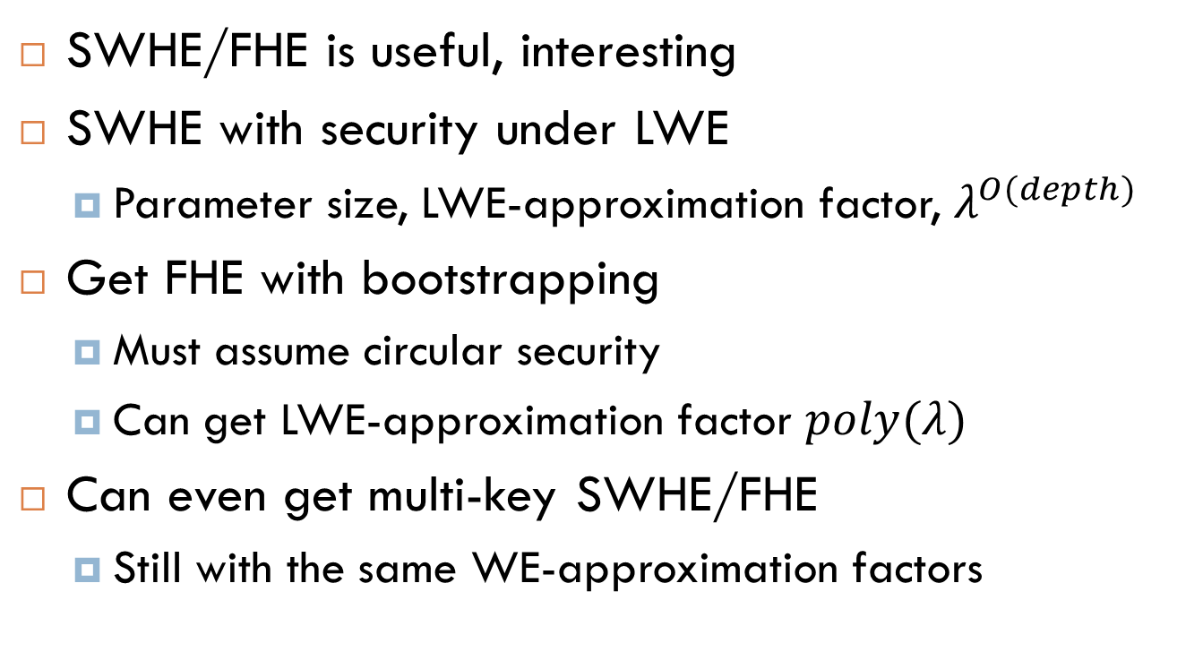
What We Covered Today
SWHE/FHE is useful, interesting
SWHE with security under LWE
Parameter size, LWE-approximation factor, $λ^{O(depth)}$
Get FHE with bootstrapping
Must assume circular security
Can get LWE-approximation factor $poly(λ)$
Can even get multi-key SWHE/FHE
Still with the same WE-approximation factors

Slide 28
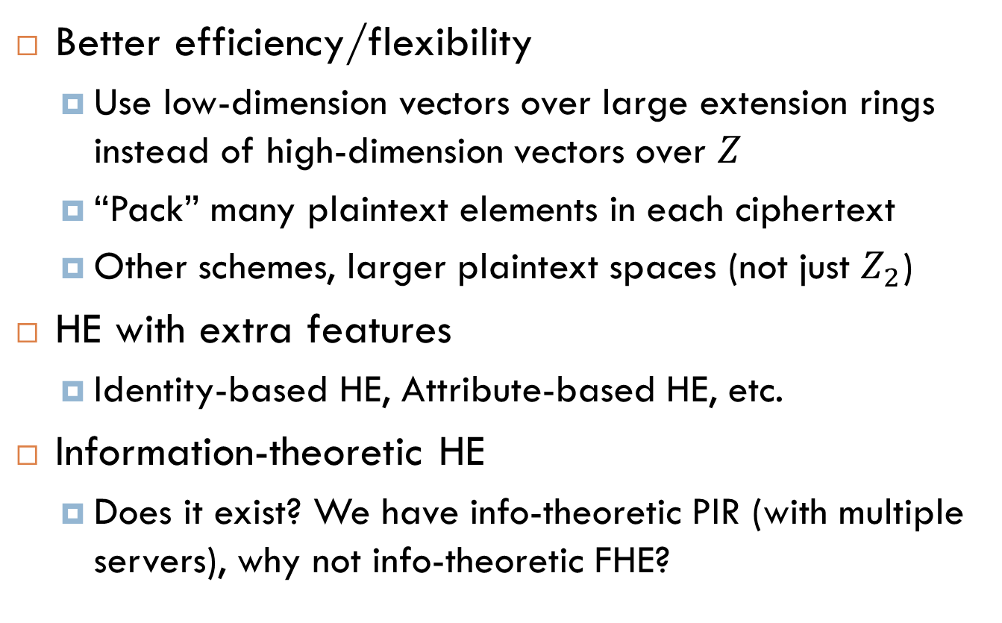
Things That We Didn’t Cover
Better efficiency/flexibility
Use low-dimension vectors over large extension rings instead of high-dimension vectors over $Z$
“Pack” many plaintext elements in each ciphertext
Other schemes, larger plaintext spaces (not just $Z_{2}$)
HE with extra features
Identity-based HE, Attribute-based HE, etc.
Information-theoretic HE
Does it exist? We have info-theoretic PIR (with multiple servers), why not info-theoretic FHE?

Slide 29
Questions?
Enough HE for one day
?
?

Slide 30
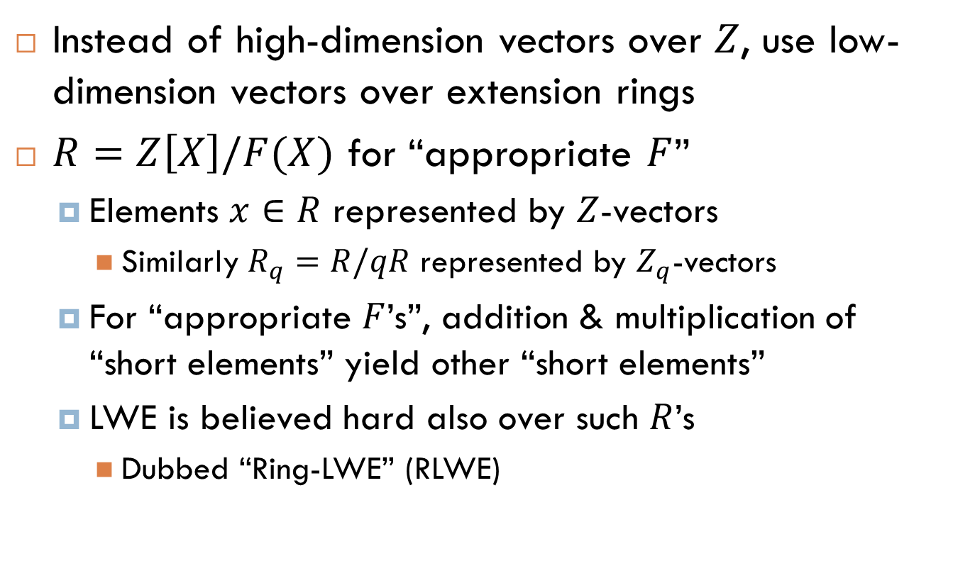
Switch to Larger Rings
Instead of high-dimension vectors over $Z$, use low-dimension vectors over extension rings
$R=Z\left[X\right]/F(X)$ for “appropriate $F$”
Elements $x∈R$ represented by $Z$-vectors
Similarly $R_{q}=R/qR$ represented by $Z_{q}$-vectors
For “appropriate $F$’s”, addition & multiplication of “short elements” yield other “short elements”
LWE is believed hard also over such $R$’s
Dubbed “Ring-LWE” (RLWE)

Slide 31
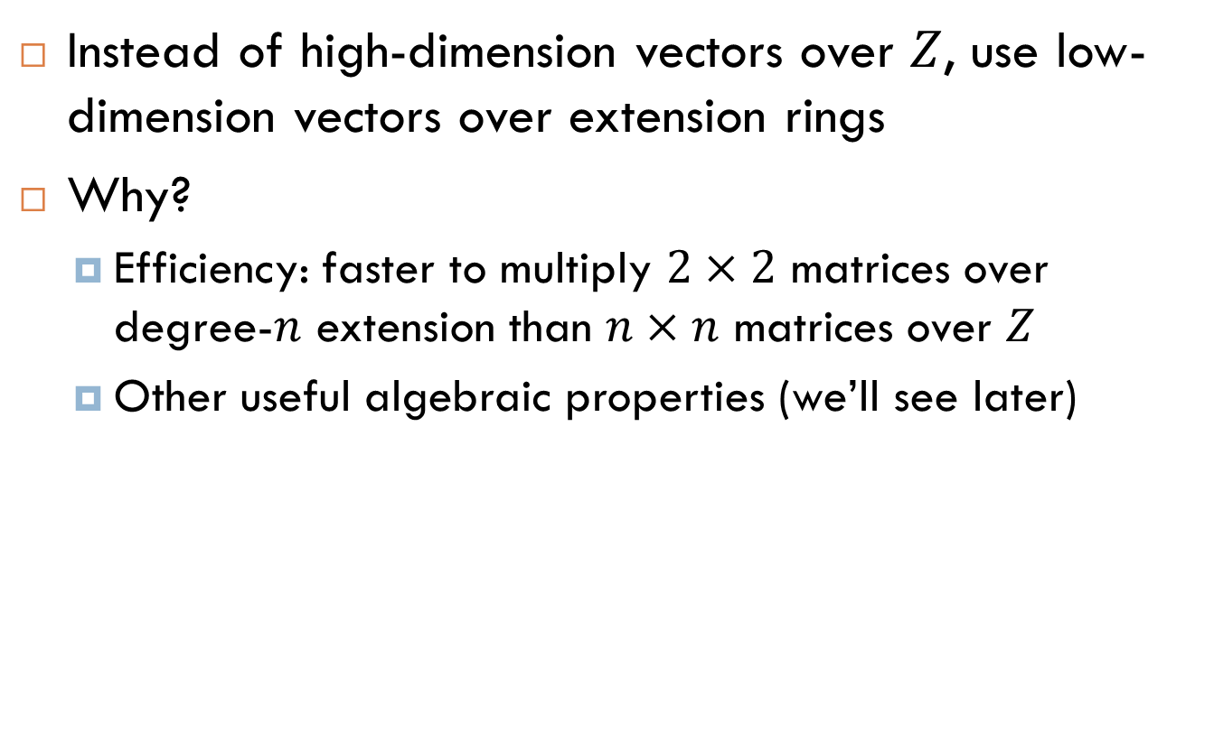
Switch to Larger Rings
Instead of high-dimension vectors over $Z$, use low-dimension vectors over extension rings
Why?
Efficiency: faster to multiply $2×2$ matrices over degree-$n$ extension than $n×n$ matrices over $Z$
Other useful algebraic properties (we’ll see later)

Slide 32
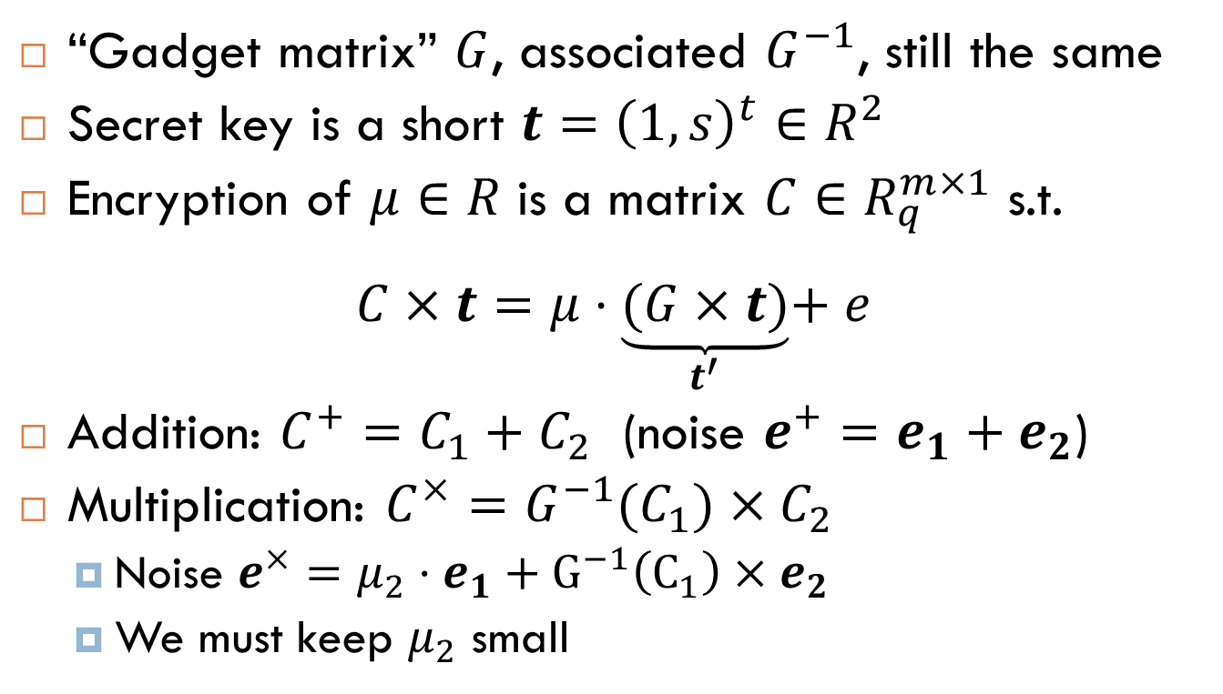
GSW Over Extension Rings
“Gadget matrix” $G$, associated $G^{−1}$, still the same
Secret key is a short $t={\left(1,s\right)}^{t}∈R^{2}$
Encryption of $μ∈R$ is a matrix $C∈R_{q}^{m×1}$ s.t.
$$C×t=μ⋅\underset{t^{′}}{\underbrace{(G×t)}}+e$$
Addition: $C^{+}=C_{1}+C_{2}$ (noise $e^{+}=e_{1}+e_{2}$)
Multiplication: $C^{×}=G^{−1}(C_{1})×C_{2}$
Noise $e^{×}={μ_{2}⋅e}_{1}+{G^{−1}\left(C_{1}\right)×e}_{2}$
We must keep $μ_{2}$ small

Slide 33
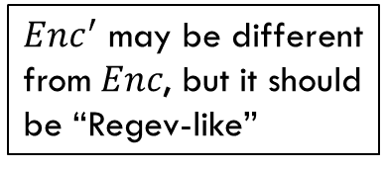
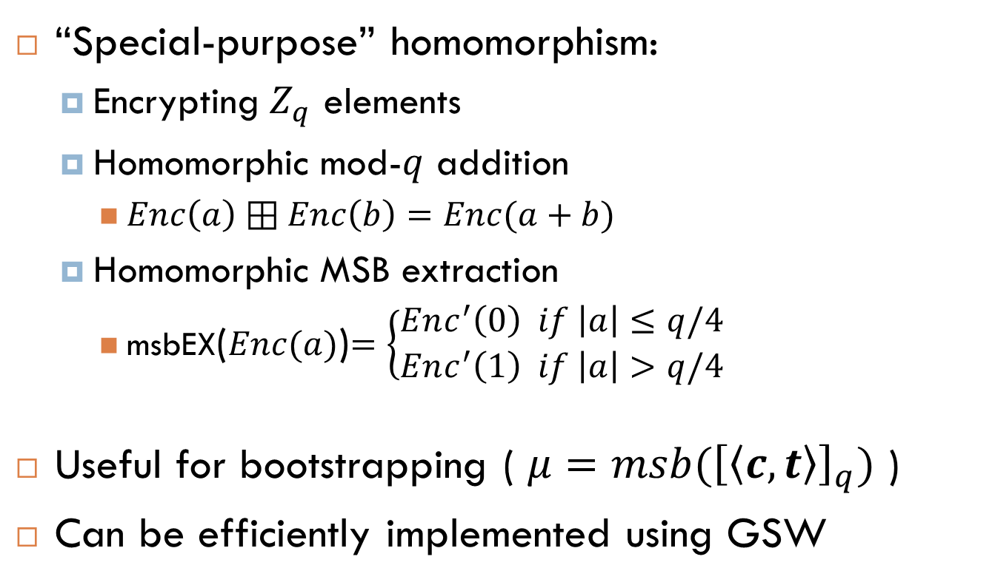
Application: Homomorphic Accumulators (based on [AP14, DM15])
“Special-purpose” homomorphism:
Encrypting $Z_{q}$ elements
Homomorphic mod-$q$ addition
$Enc\left(a\right)⊞Enc\left(b\right)=Enc(a+b)$
Homomorphic MSB extraction
msbEX($Enc(a)$)$=\left\{\begin{aligned}Enc^{′}\left(0\right) if \left|a\right|≤q/4 \\ Enc^{′}\left(1\right) if \left|a\right|>q/4\end{aligned}\right.$
Useful for bootstrapping ( $μ=msb({\left[\left\langle c,t\right\rangle \right]}_{q})$ )
Can be efficiently implemented using GSW
$Enc^{′}$ may be different
from $Enc$, but it should
be “Regev-like”

Slide 34
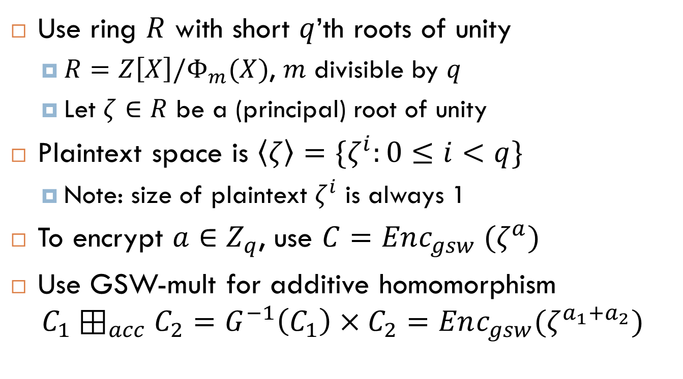
GSW➔Accumulators
Use ring $R$ with short $q$’th roots of unity
$R=Z\left[X\right]/Φ_{m}(X)$, $m$ divisible by $q$
Let $ζ∈R$ be a (principal) root of unity
Plaintext space is $\left\langle ζ\right\rangle =\{ζ^{i}:0≤i<q\}$
Note: size of plaintext $ζ^{i}$ is always 1
To encrypt $a∈Z_{q}$, use $C=Enc_{gsw} (ζ^{a})$
Use GSW-mult for additive homomorphism $C_{1}⊞_{acc}C_{2}=G^{−1}\left(C_{1}\right)×C_{2}=Enc_{gsw}(ζ^{a_{1}+a_{2}})$

Slide 35
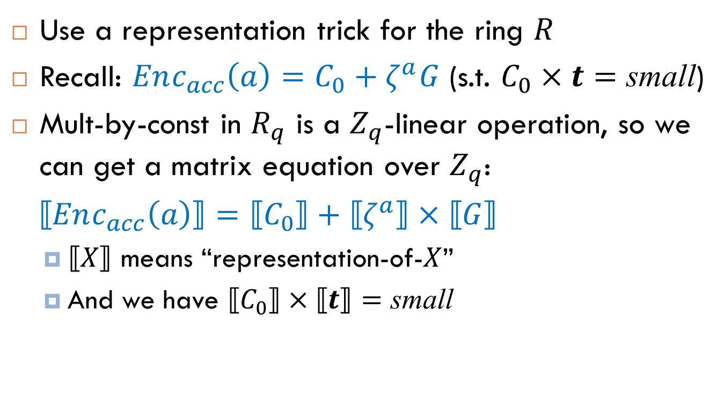
MSB-Extraction
Use a representation trick for the ring $R$
Recall: $Enc_{acc}\left(a\right)=C_{0}+ζ^{a}G$ (s.t. $C_{0}×t=$ small)
Mult-by-const in $R_{q}$ is a $Z_{q}$-linear operation, so we can get a matrix equation over $Z_{q}$:
$⟦Enc_{acc}\left(a\right)⟧=⟦C_{0}⟧+⟦ζ^{a}⟧×⟦G⟧$
$⟦X⟧$ means “representation-of-$X$”
And we have $⟦C_{0}⟧×⟦t⟧=$ small

Slide 36
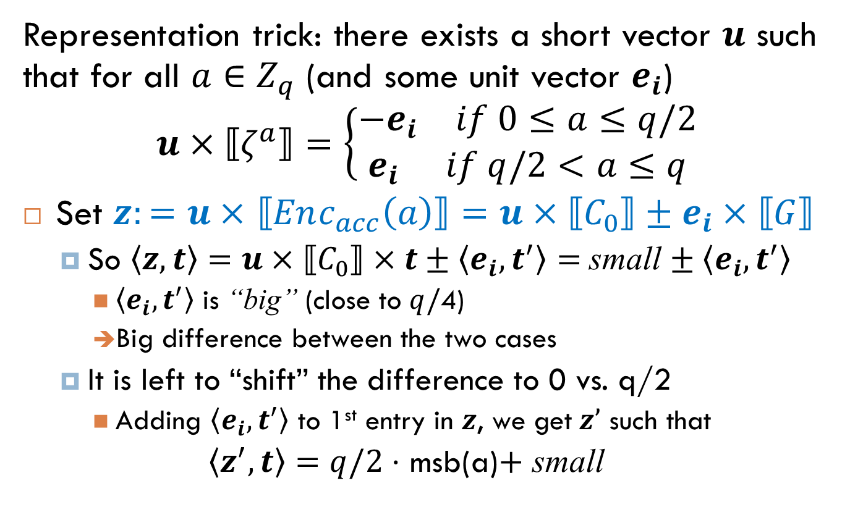
MSB-Extraction
Representation trick: there exists a short vector $u$ such that for all $a∈Z_{q}$ (and some unit vector $e_{i}$)
$$u×⟦ζ^{a}⟧=\left\{\begin{aligned}\begin{matrix}−e_{i} & if 0≤a≤q/2\end{matrix} \\ \begin{matrix}e_{i} & if q/2<a≤q\end{matrix}\end{aligned}\right.$$
Set $z:=u×$ $⟦Enc_{acc}\left(a\right)⟧=u×⟦C_{0}⟧±e_{i}×⟦G⟧$
So $\left\langle z,t\right\rangle =u×⟦C_{0}⟧×t±\left\langle e_{i},t^{′}\right\rangle =$ small $± \left\langle e_{i},t^{′}\right\rangle$
$\left\langle e_{i},t^{′}\right\rangle$ is “big” (close to $q/$4)
Big difference between the two cases
It is left to “shift” the difference to 0 vs. q/2
Adding $\left\langle e_{i},t^{′}\right\rangle$ to 1st entry in $z$, we get$z’$ such that
$\left\langle z^{′},t\right\rangle =q/2⋅$ msb(a)$+$ small

