Slide 1
MTP -1 Presentation
Development of Fully Homomorphic Encryption Scheme
By: Tarun Chauhan(2022JCS2670)
Supervisor: Prof. Ashok K. Bhateja

Slide 2
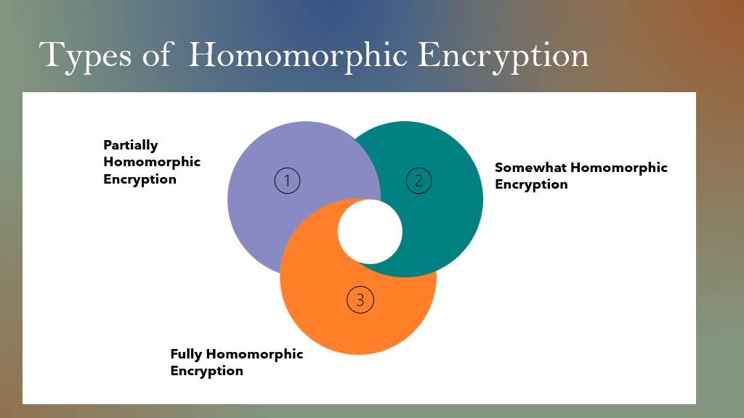

Slide 3
Earlier Work
Implemented RSA and Paillier CryptoSystem
Both are Partially Homomorphic Encryption Scheme
RSA is multiplicatively homomorphic
Paillier is additively homomorphic

Slide 4
BGN CryptoSystem
One of the first SWHE Scheme
Supports arbitrary number of additions operations and one multiplication operation.
Ciphertext size is constant
It is pairing based cryptography scheme
It has application in secure outsourcing of computations and privacy -preserving.

Slide 5
Continued…
Hardness Assumption-
Subgroup Decision Problem: Given a group G, a subgroup H of G, and an element x in G, determine whether x belongs to the subgroup H.

Slide 6
Algorithms:
KeyGen Algorithm:
Security Parameter - Tau
Two large prime numbers q1,q1 of size (Tau/2)
Set n = q1*q2
Pick 2 generators of group G, g and u.
Set h=u**q2, this h will be random generator of sub-group of G of order q1
Public Key = (n,G,G1,e,g,h)
G and G1 are groups of order n
e: GxG -> G1

Slide 7
Continued…
Encryption Algorithm:
Select m ε {0,1,.......,n-1}
Select a random r in range (0,n-1)
C = E(m,pk)= (g**m )* (h**r) ε G
Decryption Algorithm:
C’ = C**q1 = ((g**m )* (h**r))**q1 = (g**q1)**m [h**(r*q1)=1]
Let g’ = g**q1
m= D(C,sk) = find x such that g’**x == C’

Slide 8
Homomorphic Property
Addition:
c₁=E(m1) , c₂=E(m2)
c = c₁c₂h^{r} = (g ^{m1} h^{r1} )(g ^{m2} h^{r2} )h^{r} = g ^{m1 +m2} h^{r’} = E(m1+m2)
Here, r’ = r1+r2+r
Multiplication:
⇒ c=e(c1,c2) h₁^{r} ε G1
c=e(c1,c2) h₁^{r} = e(g^{m1} h^{r1} , g ^{m2} h^{r2} )h₁^{r}
= g₁^{m1.m2} h₁^{m1 r2 +r2 m1 +αq2 r1 r2 +r} = g₁^{m1 m2} h₁^{ŕ} ε G1 = E(m1*m2)

Slide 9
DGHV Scheme
It is somewhat homomorphic encryption scheme.
Works only for integers.
It has two versions - Symmetric and Asymmetric
Bootstrapping can be applied to make it fully homomorphic.
Hardness Assumption : Approximate GCD Problem(hard to recover p given xi’s)

Slide 10
Continued…
KeyGen:
Select an odd integer p, this will be our secret key.
Public key = sample x_{i} for i=0,.....,tau,
Here, x_{i} = q_{i}*p_{i} + 2*r_{i}
Pu = (x₀, x₁,........x₎ )
ri is noise, qi is used to make it secure against GCD attack

Slide 11
Continued…
Encryption:
Message = m
=> c =E(m) = (m + 2*r + 2*Σ_{iεS} x_{i} ) mod x_{0​}
Decryption:
m=D(c)
=> (c mod p) mod 2

Slide 12
Homomorphic Property
Addition: => E(m1)+E(m2)
= (m1+2*r1+2*Σ_{iεS} x_{i} ) +(m2+2*r1+2*Σ_{iεS} x_{i} ) ​
= (m1+m2) + 2*(r1+r2) + 2*Σ_{iεS} x_{i} = E(m1+m2)
Multiplication:
=> E(m1)*E(m2)
= (m1+2*r1+2*Σ_{iεS} x_{i} ) *(m2+2*r1+2*Σ_{iεS} x_{i} ) ​
= (m1*m2) + 2*(r1*m2+r2*m1+2r1*r2) + 2*(m1*Σ_{iεS} x_{i}+m2*Σ_{iεS} x_{i}+..........)
= E(m1+m2)

Slide 13
Results
S.No | Scheme | Keygen
1. | RSA | 1.0
2. | Paillier | 0.8274
3. | BGN | 60.13-220.15
4. | DGHV | -
S.No | Scheme | Encrypt
1. | RSA | -
2. | Paillier | 0.028
3. | BGN | 0.4332
4. | DGHV | -
S.No | Scheme | Decrypt
1. | RSA | 0.0028
2. | Paillier | -
3. | BGN | 0.42189
4. | DGHV | -

Slide 14
S.No | Scheme | Keygen
1. | Paillier | 0.8274
2. | BGN | 5.447
3. | DGHV | 471.91
S.No | Scheme | Addition
1. | Paillier | 0.028
2. | BGN | 0.00787
3. | DGHV | 14.66
S.No | Scheme | Multiplication
1. | Paillier | -
2. | BGN | 0.031
3. | DGHV | 0.03
Tables for KeySize 128 bits

Slide 15
Drawbacks
Noise increases linearly on addition and exponentially on multiplication, leading to incorrect decryption.
Large Key Sizes
Solution - Need to create a bootstrappable scheme by squashing the decryption circuit.

Slide 16
Squashing
m
Old Decryption algorithm
Dec_{E}
Idea : Add to public key a “hint” about sk, and this hint should not break the secrecy of encryption.
With this hint, anyone can post-process the ciphertext, leaving less work for Dec_{E} to do.
sk
c

Slide 17
Simplify Decryption
m
Old Decryption algorithm
New Approach
Dec_{E}*
Processed ciphertext c*
m
sk*
c*
The hint about sk in public key
Dec_{E}
Post -Process
sk
c
f(sk, r)
c

Slide 18
Procedure
Add to public key many real numbers
y₁,y₂,…..,y_{Ɵ} [0,2] (with “sufficient precision”)
∃ sparse set S for which ∑_{i ∈ S} y_{i} = 1/p mod 2
Enc, Eval output z_{i} = c * d_{i} mod 2 , i =1,….,Ɵ
Together with c itself
New secret key is bit-vector s₁,….,s_{Ɵ}
s_{i} =1, if i ∈ S, s_{i}=0 otherwise
New Dec(c) is c- [∑_{i} s_{i}* z_{i}] mod 2
Can be computed with a “low-degree circuit” because S is sparse

Slide 19
Future Work
Exploring more FHE schemes.
Apply homomorphic encryption on Biometrics.

Slide 20
Thank You!

