Slide 1
Git and GitHub
Contents:
What is Git and GitHub ?
Why Git ?
Useful Commands

Slide 2
GitHub
GitHub is a Git repository hosting service.
Provides a Web-based graphical interface
Git
Git is a command line tool.

Slide 3
Git
Distributed revision control.
Source code management system.
Designed and developed by Linus Torvalds.

Slide 4
Distributed revision control
Complete codebase is mirrored on every developer’s computer.
Allows branching and merging to be managed automatically.
Improves workflow.
Does not rely on a single location for backups.
Allows users to work productively when not connected to a network.

Slide 5
Source code management(VCS)
Track revisions in software.
Each revision is given a timestamp and includes the name of the person who is responsible for the change.
Various revisions may be compared, stored, and merged with other revisions.

Slide 6
Benefits
A complete long-term change history of every file.
Branching and merging.
Traceability.

Slide 7
Instance (Local)
GitHub
Install git on local machine
Make a directory (trial_01)
Initialize trial_01 as local git.
Clone repository_1
Make files and add the file.
Save the last changes.
Push the changes to the master.(changes visible in GitHub)
Pull any change done in Github to local machine/Git (when required)
Repository_1
Repository_2
Master
Initial code
File_1
File_2
Branch_1
Branch_2
Master_code
+
Extra features added to this branch.
Master_code
+
Features of branch_1
+
Extra features added to this branch.

Slide 8
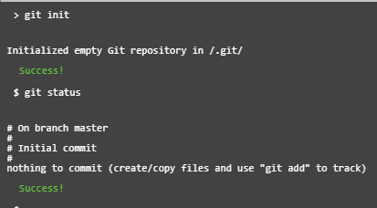
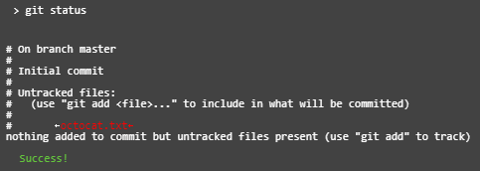

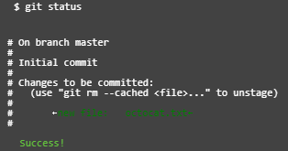
Commands
git init → to initial Git repository.
git status → to see how the repository
status has changed.
created a file called octacat.txt in repository
git add octocat.txt → to start trackingchanges made to octocat.txt, first add it to staging area.
git status → to see how the repository
status has changed.

Slide 9
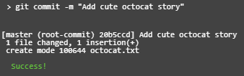
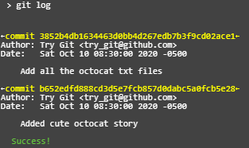


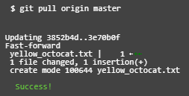
git commit → to store the files from staging area to the repository commit is used with a message.
git log → to view all the changes we have committed.
git remote add origin https://github.com/try-git/try_git.git → to push local repo to GitHub server
git push → to push local changes to origin repo (on GitHub).
git pull → to check for changes on GitHub repo and pull down any new changes.

Slide 10


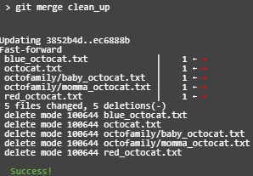

git branch clean_up → to create a new branch.
git checkout clean_up → to switch to the clean_up branch
git merge clean_up → to merge the clean_up branch into the master.
git branch -d clean_up → to delete the clean_up branch

Slide 11
Steps for creating a git repository on linux
sudo yum install git …. To install git
Create dir using "mkdir trial01“
Initialize git using " git init“
Clone the git repo to the local machine using "git clone git url" {url = https://github.com/shibafatima/shibarepo.git}
Created file using "echo "text in the file" >> files01.txt“
Add file using "git add file01.txt“
Commit the change using " git commit“
Push the fiel using "git push origin master“
Create a file in github for the pull
Pull the new file created in step 9 using "git pull“
Create a branch using "git branch branch01"
Checkout the new branch using "git checkout branch01"
Create file in branch created in step 11 . (refer step 5 to 8)
Push the branch into git using "git push origin <branchname.. here branch01>

Slide 12
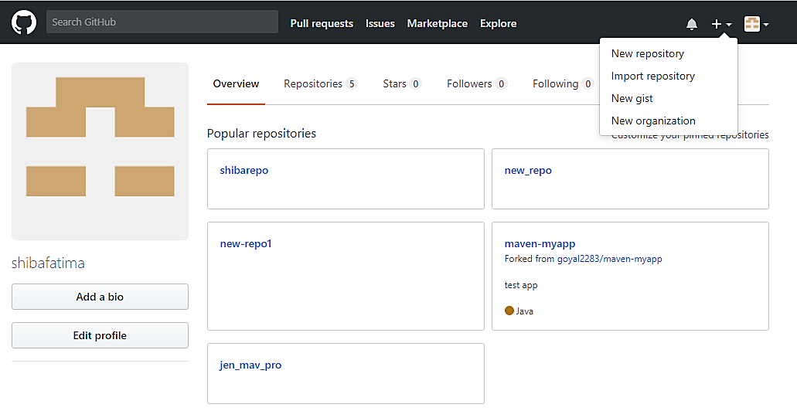
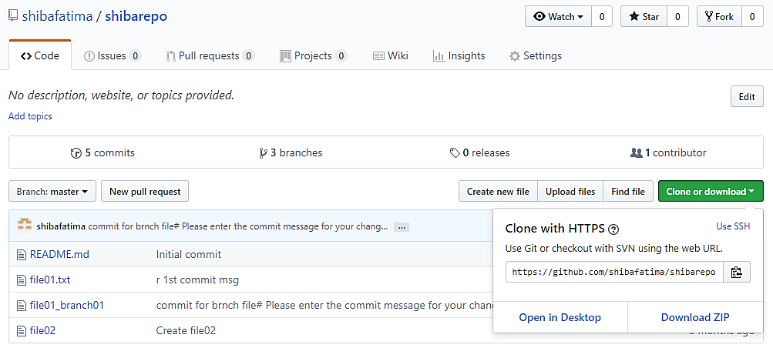
GitHub Overview
Home page layout
Repo page layout

Slide 13
THANK YOU…….!!

