Slide 1
Transformer based deep learning classification model for classifying costumer complaints

Slide 2


PROBLEM STATEMENT
Customer complaints carry a lot of importance, as they are often an indicator of the shortcomings in their products and services. If these complaints are resolved efficiently in time, they can bring down customer dissatisfaction to a minimum and retain them with stronger loyalty. This also gives them an idea of how to continuously improve their services to attract more customers.
These customer complaints are unstructured text data; so, traditionally, companies need to allocate the task of evaluating and assigning each ticket to the relevant department to multiple support employees. Its a tedious task which involves large workforce just to allocate tickets to correct departments/categories based on the ticket contents.

Slide 3
SOLUTION
Build Deep Learning NLP classification model using Transformer Model that can classify customer complaints based on the products/services.
By doing so, we can segregate these tickets into their relevant categories and, therefore, remove manual intervention and help in the quick resolution of the complaints raised by the costumers.

Slide 4







Credit card
Higher turnaround time
Human-error prone
Cost-intensive
Analyses complaint and assigns it to a department
Savings account
Consumer complaint Management system
Costumer raises complaint
Medical debt
Predicts Department based on complaint information
Instant prediction
Cheaper and can achieve higher accuracy
Can capture Insights and data for further analysis
Domestic (US) money transfer
Python RESTful server
Vehicle loan
Deep learning model
Receives/logs costumer complaints

Slide 5
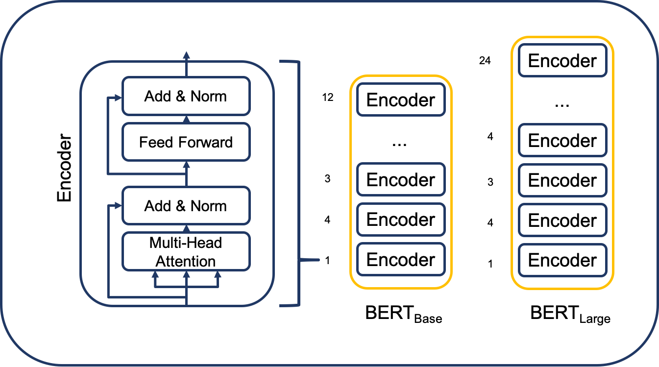
BERT Transformer Model
BERT based on the Transformer architecture stands for Bidirectional Encoder Representations from Transformers.
BERT is pre-trained on a large corpus of unlabeled text including the entire Wikipedia(2,500 million words) and Book Corpus (800 million words).
As a result, the pre-trained BERT model can be fine-tuned with just one additional output layer to create state-of-the-art models for a wide range of NLP tasks.

Slide 6
Transformers: BERT Training
1. Pretraining :Self-supervised learning
Learning:
Bi-directional context between within sentences and context across different sentences
Masked Language Modelling (MLM)
Sent. A: Citi is the <MASK1> global bank.
MLM: MASK1=leading
MASK2=Investor
Next Sentence Prediction (NSP)
Sent. B: It is the largest foreign direct <MASK2> in financial services in India.
NSP: Yes Sent. B follows Sent. A
Transformer
Model
Deep learning model which is well versed in:
organisations Products, services and offerings.
Well versed in banking domain and terminology
Dataset of all the products , services etc. Document corpus of domain knowledge
Pre-trained model ready to fine-tune in various NLP tasks

Slide 7
Transformers: BERT Training
2. Fine-tuning :
truncate/adding last layers
Freezing initial layers.
Adding new output layer
Pretrained Transformer
Model
Question Answering
Speech Recognition
Can Integrate with a chatbot and answer to queries raised by consumers
Costumer Identification & authentication
Text summarization
Sentiment Analysis
Text Classification
Summarizes large product reports and other financial /banking information
Analysis of comments and reviews by costumers to determine whether data is positive, negative or neutral
Classification of consumer complaints based on the transcript

Slide 8
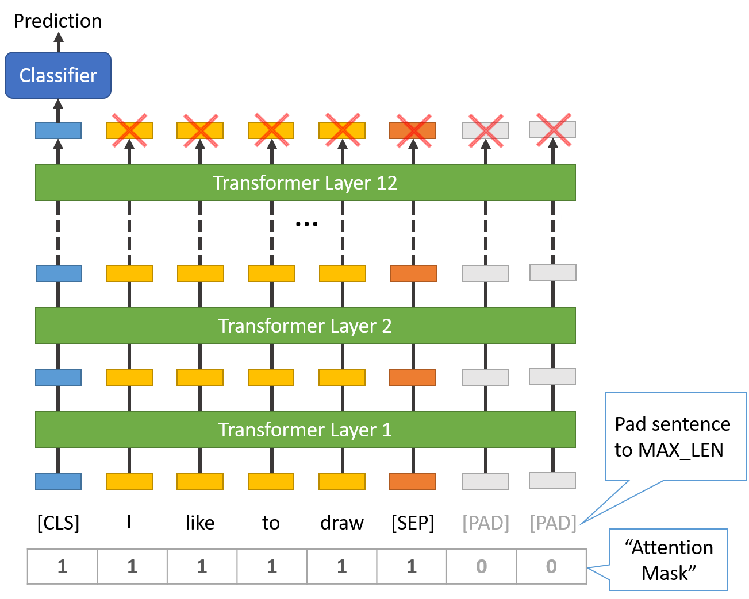
Fine-tuning : Multi-class classification

Slide 9
METHODOLOGY
Implementation Approach:
1. Dataset preparation:
Identification of dataset which consists of vast data of consumer complaints - I have used complaints dataset from https://www.consumerfinance.gov/data-research/consumer-complaints/
Data-pre-processing and cleaning
Preparation of dataset to train Deep learning neural network.
code with details can be found in my Jupyter notebook:
https://github.com/tarunmukku/citi-hackathon/blob/main/Consumer_complaints_dataset_prepration.ipynb

Slide 10
2. Fine-tune BERT model for Classification of consumer complaints :
Input data modelling:
Model Building
Model Compilation
Model Training
Model Evaluation
developed model has achieved 90% accuracy(model can further fine-tuned to get even better accuracy)
code with details can be found in my Jupyter notebook:
https://github.com/tarunmukku/BERT-multi-class-compliants-classification/blob/main/BERT_multi_class_classification_compliants_final.ipynb

Slide 11
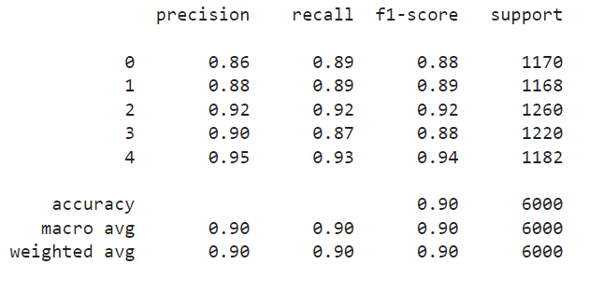
Evaluation Metrics:
The developed model achieved over 90% accuracy below is the classification report as generated by the model

Slide 12
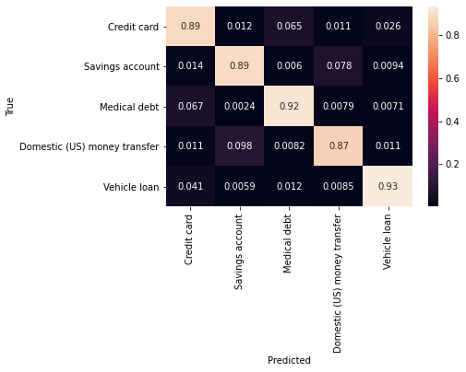
Evaluation Metrics: Heat Map of predicted Vs Ture

Slide 13
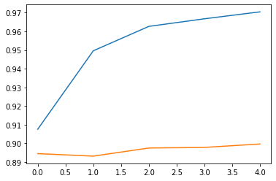
Evaluation Metrics: Plot for Train and validation accuracy

Slide 14
Business Considerations
The proposed solution is highly modular and scalable, it uses state-of-the-art technologies in fields of Artificial Intelligence/deep learning.
The Technology stack considered are all from open-source domain apart from the cloud services required to train the Neural network model and for hosting the API server.
The solution can be integrated to any of the downstream/upstream application which can interact with RESTful APIs.
The pre-trained neural network can used multitude of NLP tasks like Q&A chatbot, text summarization, sentiment analysis

Slide 15
For building the Deep learning model, dataset of consumer complaints from https://www.consumerfinance.gov/data-research/consumer-complaints/
20,000 records have been used in the POC for model building, better accuracies can be achieved with increase in number of records and GPU usage .
For the POC the consumer complainants are classified to only a five categories ['Credit card', 'Savings account', 'Medical debt', 'Domestic (US) money transfer', 'Vehicle loan'] in the interest of time and workload. Although the solution can be further extended to any number of categories at later time.
The proposed solution can also be built using T5 Encoder–decoder model accuracy but requires high GPU machine and can achieve greater refinement and accuracy

Slide 16
WORKING PROTOTYPE
Application demo link:
http://ec2-43-204-112-191.ap-south-1.compute.amazonaws.com:4000/docs
Docker Image: https://hub.docker.com/r/tarunmt/citi_fastapi_server
Video demo link:
https://drive.google.com/drive/folders/113LGEwMVHqGwTWxUIxNiPqvc5jEXiHSF?usp=sharing

Slide 17
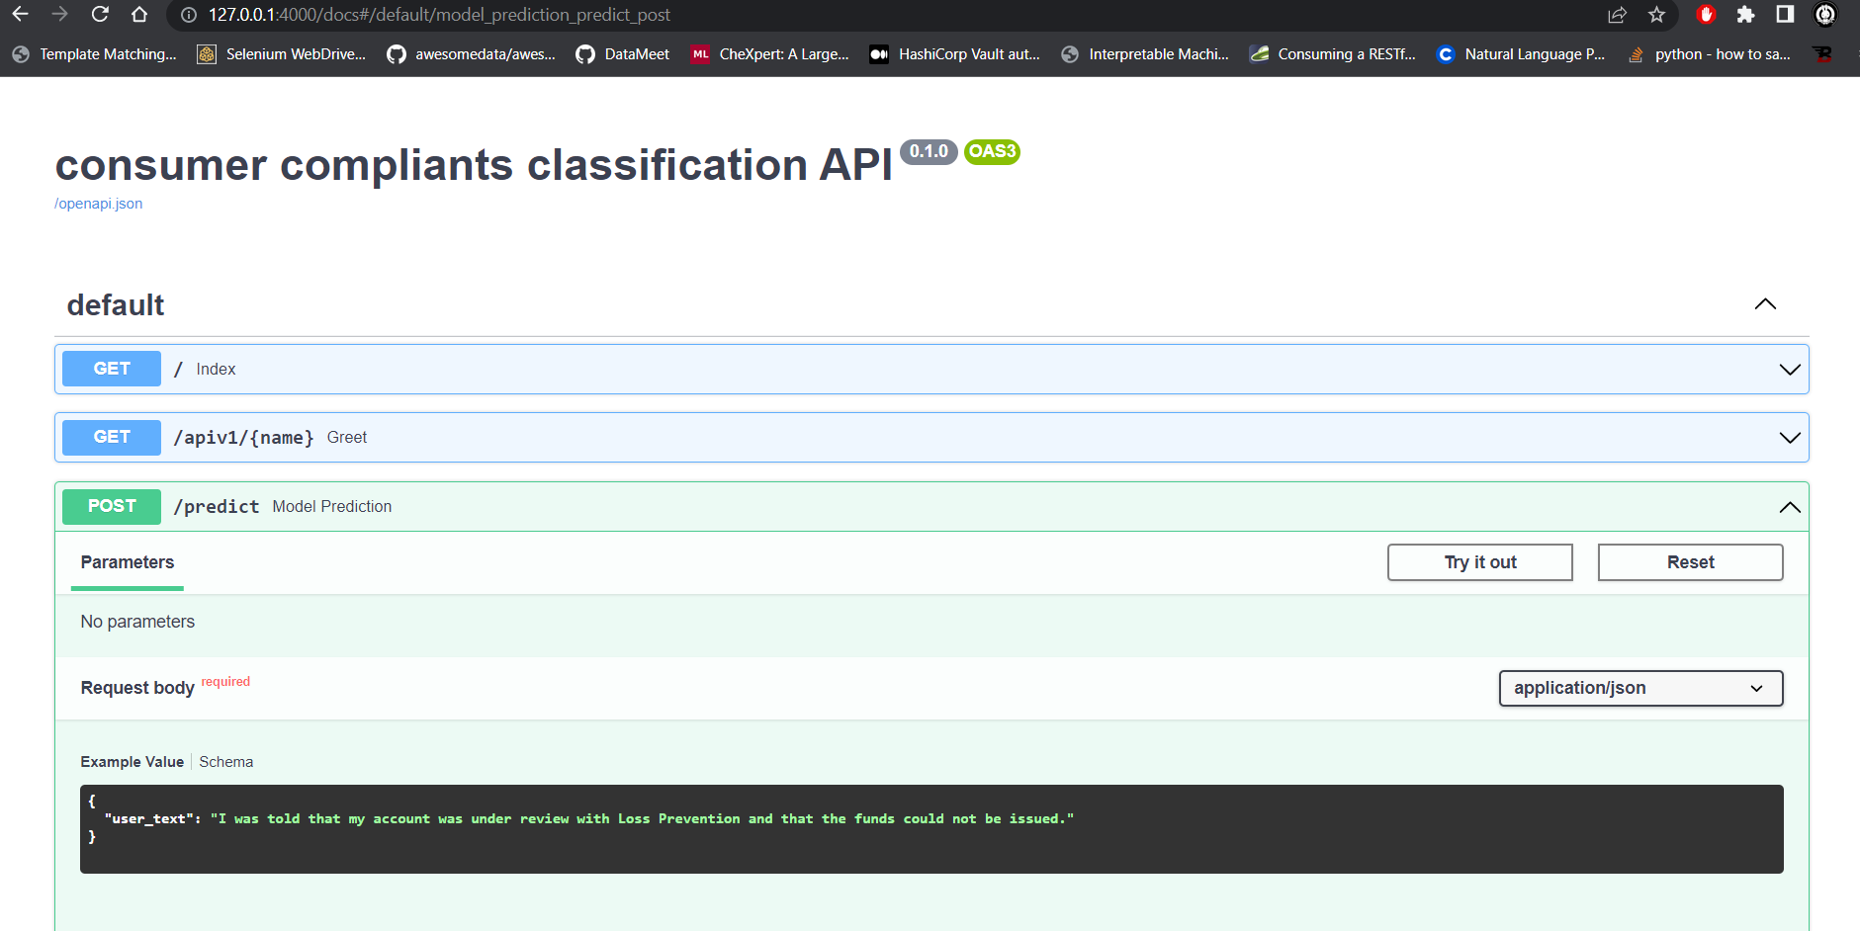
Swagger Docs for API server

Slide 18
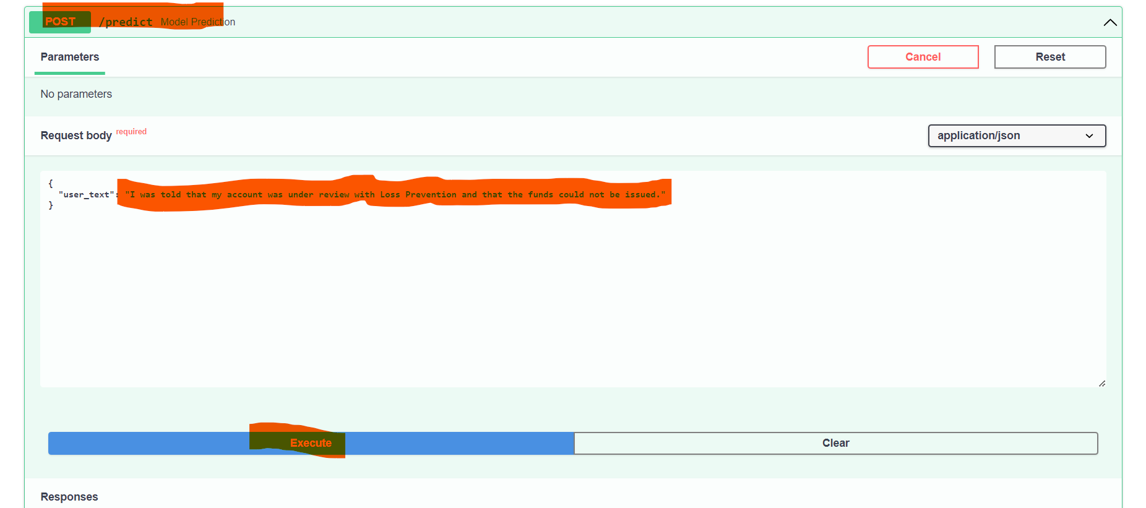
API call to the Deep learning neural network

Slide 19
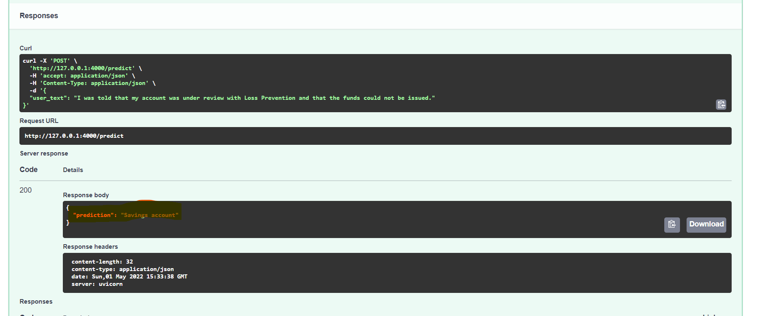
Sample request and response from the RESTFul API server of Deep learning model

Slide 20

THANK YOU

