Slide 1
INVESTMENT ASSIGNMENT SUBMISSION
Name: Tarun Mukku

Slide 2
Spark Funds: Investment Assignment
understand the global trends in investments.
Identify most suitable investment type for Spark Funds.
Analyze the based in the selected investment type and identify the top English-speaking countries.
Identify the top sectors based on the number of investments in the top 3 countries.
Recommend main sectors and countries based on Spark Funds requirement.

Slide 3
Problem solving methodology
Analyse rounds2 and companies csv files
Create master frame by merging data of both csv
Analyse the funding amount based on funding types
Plot boxplot based on the funding type
Filter data by identified funding type
Plot boxplot based on the funding type
Identify most suitable investment for spark funds
Identify top 9 countries by on the total investment
Identify top 3 English speaking countries
Identify top 3 English speaking countries
Map top3 countries data categories list to one of main sector
Identify top 3 sectors and their investment details

Slide 4
Funding Type Analysis
As per the investment type analysis:
Representative funding amount of venture type is 5 Million dollars
Representative funding amount of angel type is 0.4 Million dollars
Representative funding amount of seed type is 0.275 Million dollars
Representative funding amount of private equity type is 20 Million dollars
Considering that Spark Funds wants to invest between 5 to 15 million USD per investment round, venture type investment type is the most suitable fund.

Slide 5
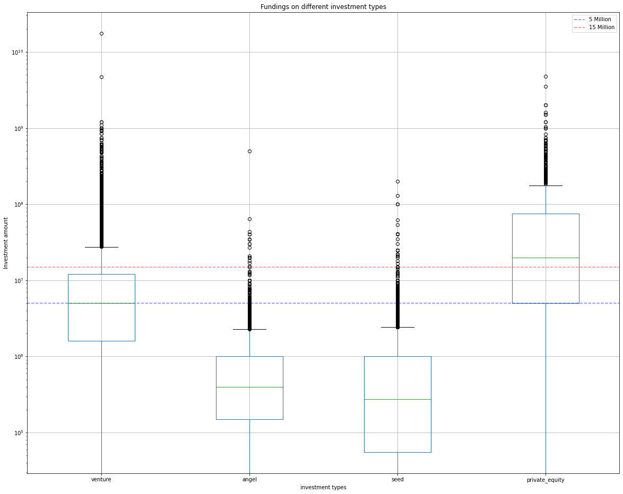
Box plot based on the investment type
Box plot showing different investment types, median is chosen as representative amount due to high amount outliners in each investment type

Slide 6
Country Analysis
Below are the top 9 countries based on the investment:
`
Country Code | Amount raised USD
USA | 422510842796.00
CHN | 39835418773.00
GBR | 20245627416.00
IND | 14391858718.00
CAN | 9583332317.00
FRA | 7259536732.00
ISR | 6907514579.00
DEU | 6346959822.00
JPN | 3363676611.00
Identified top 3 English speaking countries based on the top 9 list:
Top English speaking country | USA
Second English speaking country | GBR
Third English speaking country | IND

Slide 7
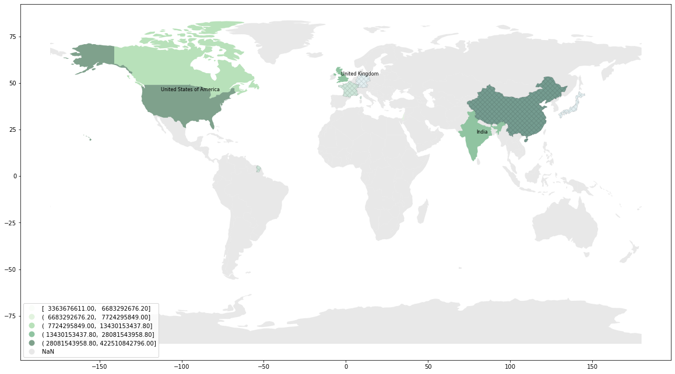
Plot showing top 9 countries with venture investment type, non-English countries are marked as ‘XX’ top 3 countries are: United states of America, United Kingdom, India

Slide 8
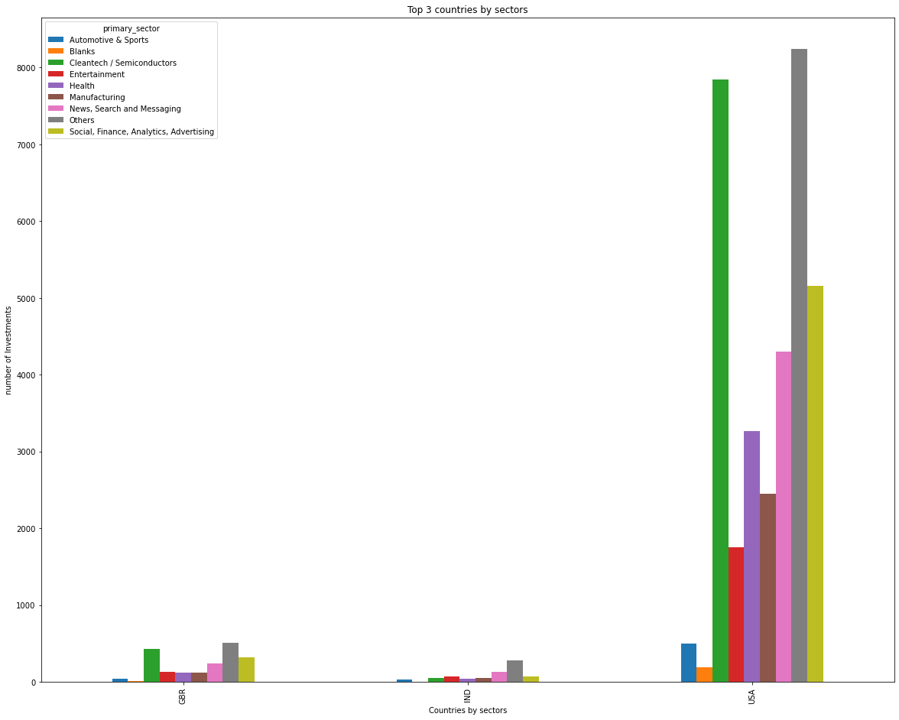
Bar graph showing number of investments in each sector in Top 3 countries

Slide 9
Conclusions:
Ideal countries and sectors to Invest:
United states of America:
35759 Investments in venture investment type with total amount 394.68 Billion dollars.
Top 3 sectors data:
United Kingdom:
2158 Investments in venture investment type with total amount 19.09 Billion dollars.
Top 3 sectors data:
India:
898 Investments in venture investment type with total amount 13.66 Billion dollars.
Top 3 sectors data:
Rank | Sector | No. of Investments | Top company
1 | Others | 8693 | SoFi
2 | Cleantech / Semiconductors | 8113 | Freescale Semiconductor
3 | Social, Finance, Analytics, Advertising | 5553
Rank | Sector | No. of Investments | Top company
1 | Others | 571 | oneweb
2 | Cleantech / Semiconductors | 456 | Immunocore
3 | Social, Finance, Analytics, Advertising | 359
Rank | Sector | No. of Investments | Top company
1 | Others | 329 | flipkart
2 | News, Search and Messaging | 154 | quikr India
3 | Social, Finance, Analytics, Advertising | 104

