Slide 1
LENDING CLUB – CASE STUDY SUBMISSION
Name: Tarun Mukku and Kaushal Macwan

Slide 2
Lending Club: EDA Analysis
understand the loan dataset.
Process the loan dataset data and Identify the required features.
Analysis on the loan data features and understand processes the feature columns.
understand the driving factors behind loan default.
Define the conclusions on the EDA analysis.

Slide 3
Problem solving methodology
Analyse the loans dataset
Data cleaning: Remove columns with all null data
Data cleaning:Removing the loan status of 'current' type
Data processing: re-format and reprocess the data for analysis
Data Cleaning: Drop duplicate and redundant columns
Data Cleaning : Removing the loans which are unique id values
Univariate Analysis: Analyze loan dataset columns
Co-relation Matrix: Analysis of relation b/w columns
Bi-variate Analysis:
Analyses data on its affects default loans
Conclusions on the analysis for loan defaults

Slide 4
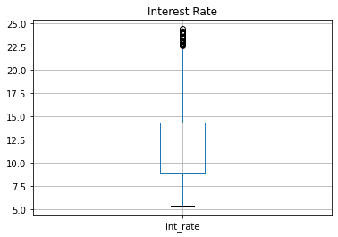
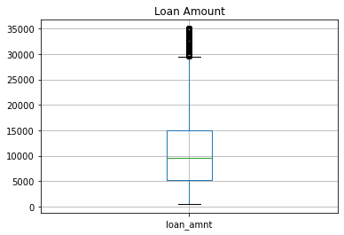
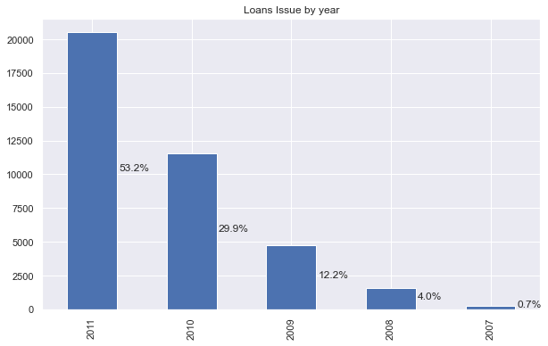
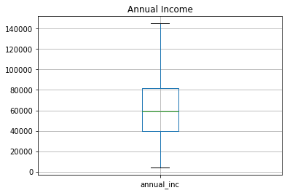
Loan dataset Univariate Analysis:
11.83% is the most representable value for interest rate and most of the interest rates are between are between 8.94% and 24%
1000$ is the most representable value of loan amount and most of the loans are between 5500$ and 15000$
The average annual income of the borrowers is between 4100 to 8300 dollars
Most loans are Issued in 2011

Slide 5
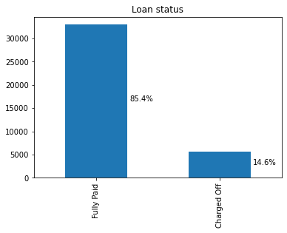
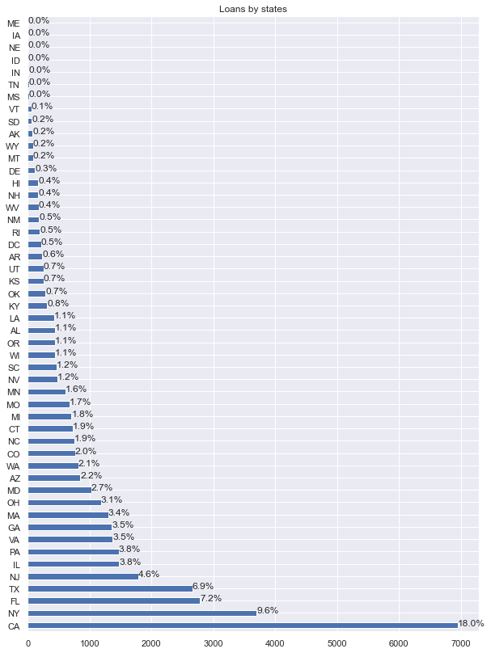
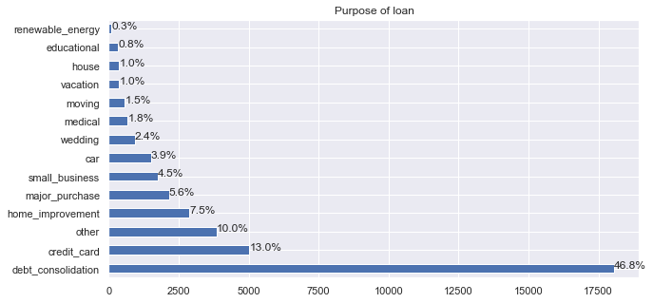
Loan dataset Univariate Analysis:
Around 15% of loans are charged off
Debt consolidation is the most common purpose of the loan followed by credit card
Most loans are Issued to CA country followed by NY

Slide 6
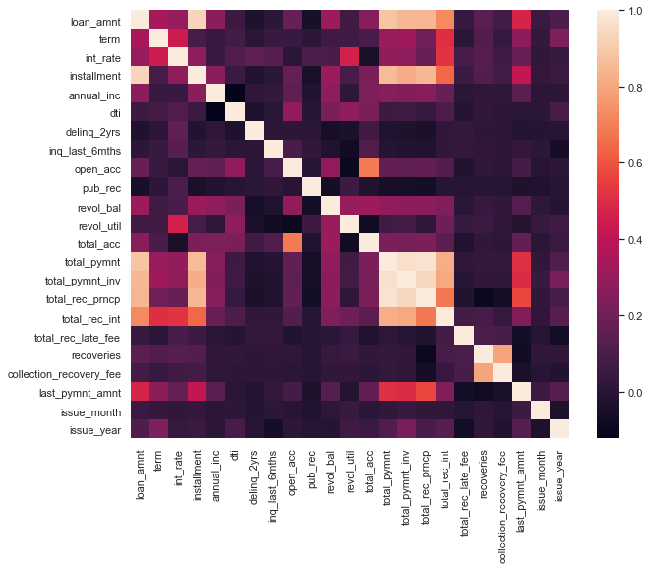
Loan dataset Co-relation Matrix:

Slide 7
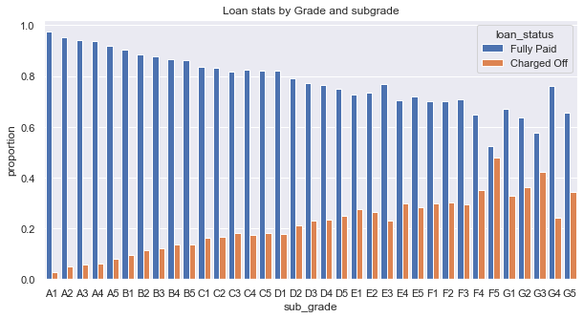
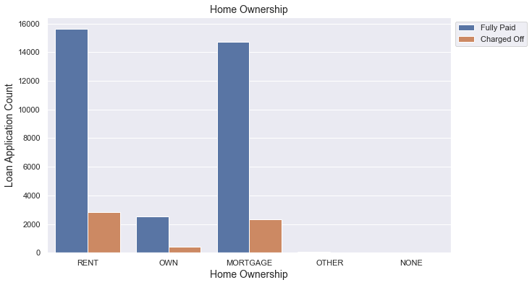
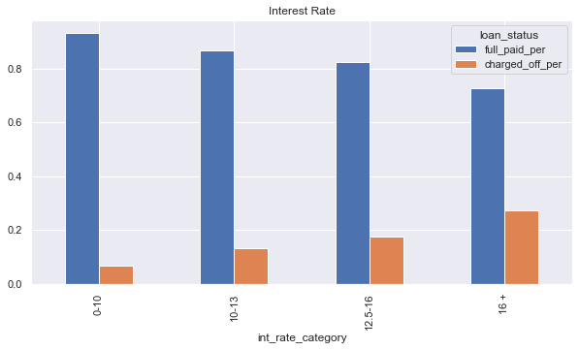
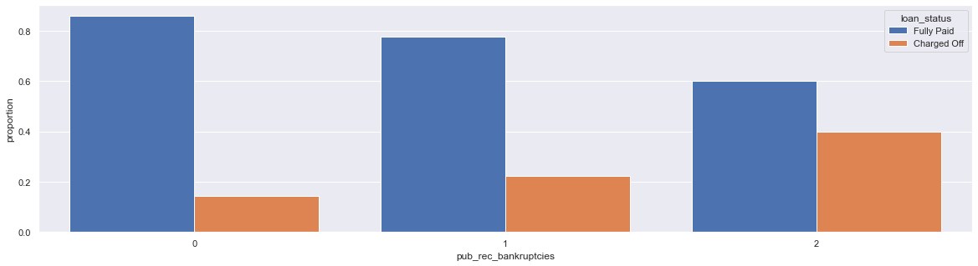
Bivariate Analysis:
Borrowers who have are living in rented place and mortgages have higher risk of defaulting the loan
Borrowers with lower grades and sub grades have higher chance of defaulting the loans
Loans with higher interest are more like to be defaulted
Borrowers with public bankruptcies record have higher risk in defaulting the loan

Slide 8
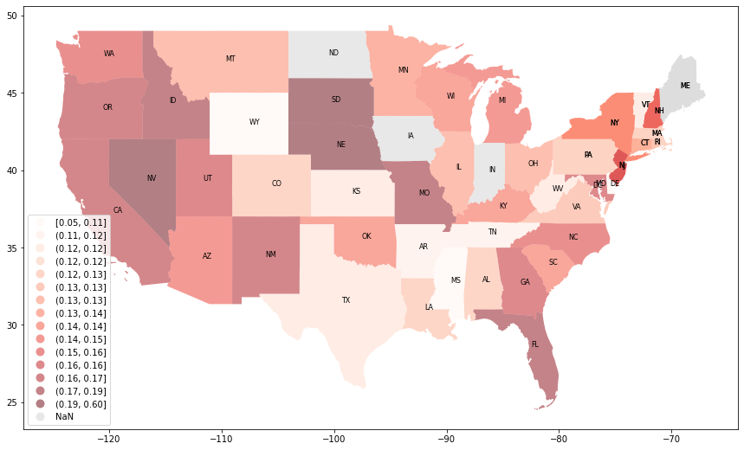
Loan dataset bi-variate analysis by state:
Plot shows states with higher defaulted loans highlighted darker. NE state has most percentage of loans which are charged off

Slide 9
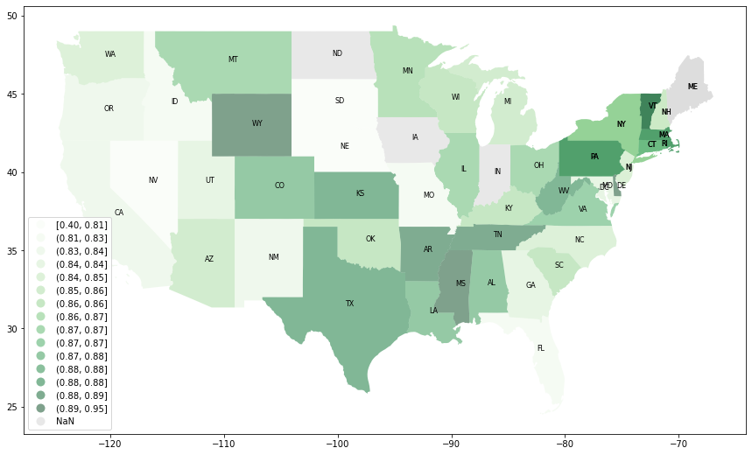
Loan dataset bi-variate analysis by state:
Plot shows states with fully paid loans highlighted darker.WY and VR are states which have high good loans

Slide 10
Conclusions:
Insights on loan data:
1000$ is the most representable value of loan amount and most of the loans are between 5500$ and 15000$.
11.83% is the most representable value for interest rate and most of the interest rates are between are between 8.94% and 24%
The average annual income of the borrowers is between 4100 to 8300 dollars
Most loans are Issued in 2011 with over 50% and lowest in 2007 with 0.2%
Most driving factors for loan defaults:
Borrowers with lower grades and sub grades have higher chance of defaulting the loans
Borrowers who have are living in rented place and mortgages have higher risk of defaulting the loan
Loans with higher interest are more likely to be defaulted
Borrowers with public bankruptcies record have higher risk in defaulting the loan
Plot shows states with higher defaulted loans highlighted darker. NE state has most percentage of loans which are charged off
Plot shows states with fully paid loans highlighted darker.WY and VR are states which have high good loans

