Slide 1

Machine Learning Hackathon CG 2022
Team Name- Tarun_MT
Team Leader Name- Tarun Mukku
Team Leader Email Address- Tarun.Mukku@gmail.com

Slide 2
Brief description of the problem at hand:
As each coin has two sides, so does technology. On one hand, with the advancement in technology the lives are getting better, on the other hand, the ill use of technology is also increasing. The suspicious activities are increasing ranging from dos attacks, phishing, hacking etc. In this hackathon, we are concerned with the increasing phishing attacks.
Typically, Phishing is a type of social engineering where an attacker sends a fraudulent (e.g., spoofed, fake, or otherwise deceptive) message designed to trick a person into revealing sensitive information to the attacker or to deploy malicious software on the victim's infrastructure like ransomware.

Slide 3
Solution proposed and description:
create a model based on the data analysis to identify if the website is legitimate or a phishing website. The Result will be determined by the two values [1, -1] where 1 represent the legitimate and -1 represents phishing
Build a model based on the techniques :
Binary Logistic Regression
Random Forest Classifier
XGBoost Classifier
CatBoost Classifier
TabNet Classifier ( sequential attention deep learning Model)

Slide 4
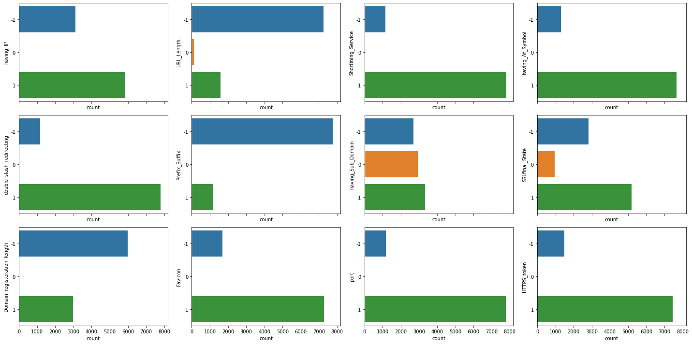
EDA Analysis:

Slide 5
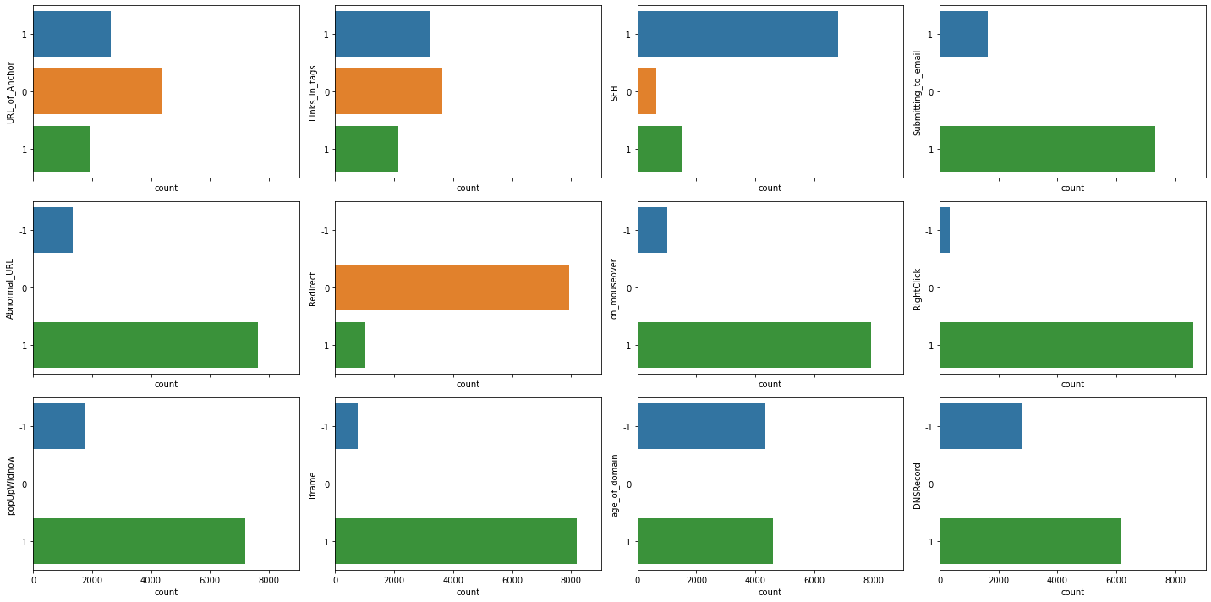

Slide 6
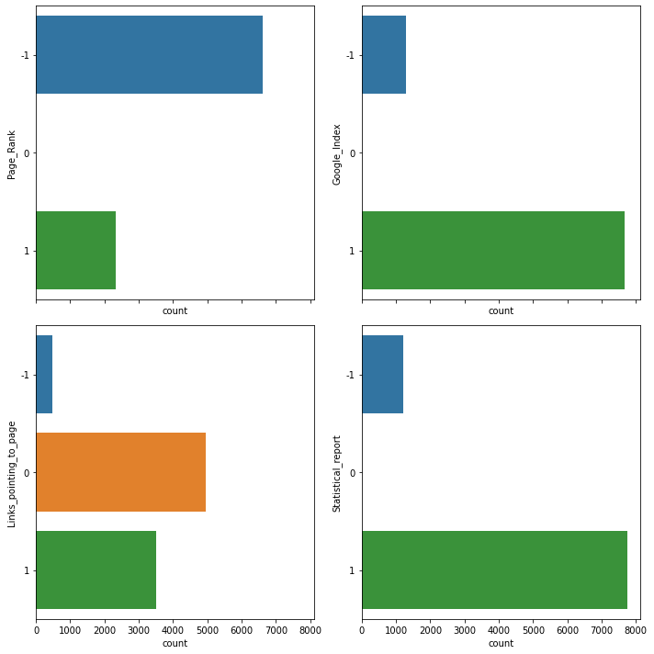

Slide 7
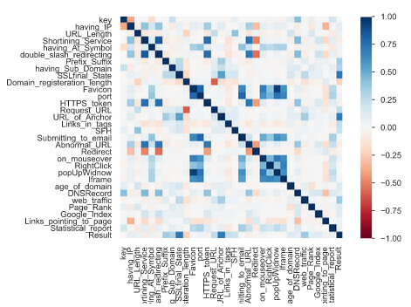
Correlation Analysis

Slide 8
Feature Selection (Logistic regression)
Methodology
Feature Engineering
collinearity Analysis
EDA Analysis
One-hot Encoding
Drop highly corelated features
Train dataset
Train-validation split
Recursive feature elimination (RFE)
Test dataset
Repeated stratified K-fold - split ratio 80:20
Best Model
Hyper-parameter tuning:
GridsearchCV,Optuna
Model building
Loss fn : Cross-Enthropy
Evalvulation : accuracy
Final result
Feature selection is performed only for logistic regression as decision and boosting trees are immune to collinearity and the dataset does not contain large number of features

Slide 9
Train-validation accuracies
 | Train Accuracy (%) | Validation accuracy (%)
Binary Logistic Regression | 93.81 | 92.17
Random Forest Classifier | 96.86 | 96.62
XGBoost Classifier | 96.64 | 96.309
CatBoost Classifier | 97.38 | 96.64
TabNet Classifier (Best Model) | 97.99 | 97.76

Slide 10
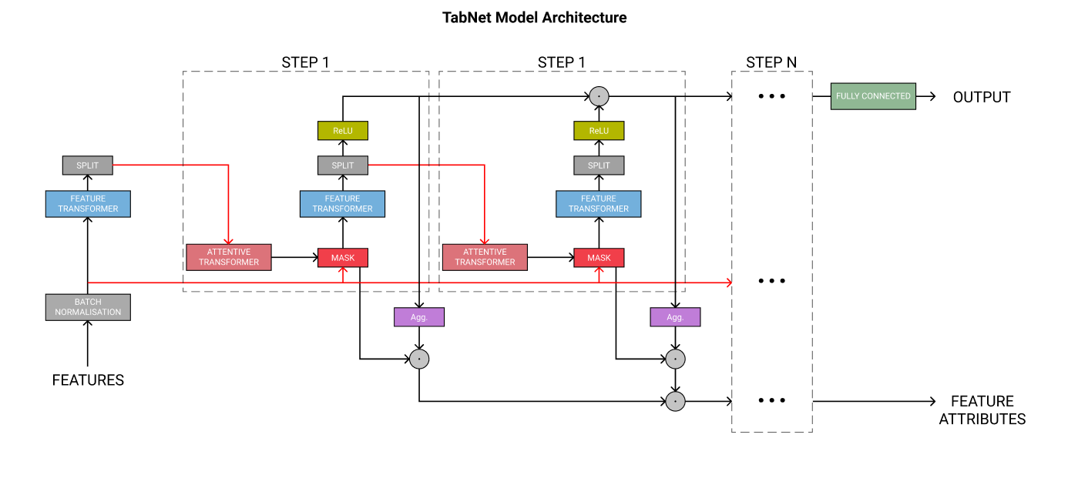
TabNet Classifier : Attentive Interpretable Tabular Learning

Slide 11
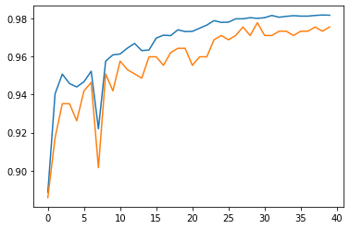
TabNet : Accuracy vs Epoch
Training
Validation
Accuracy
Epoch

Slide 12
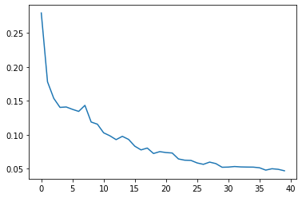
TabNet Classifier :Loss vs Epoch
Loss
Epoch

Slide 13
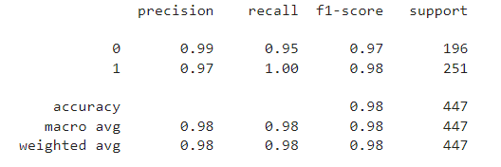
TabNet Classifier :Classification report

Slide 14
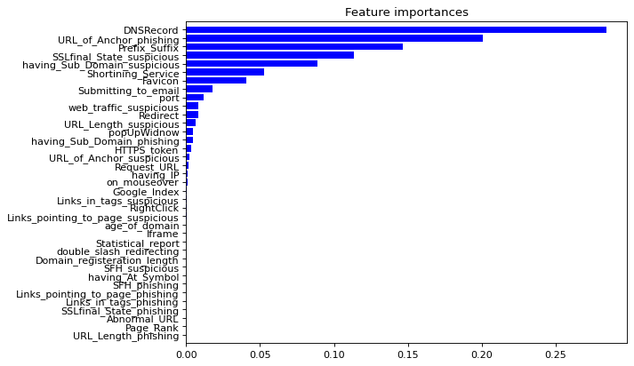
TabNet Classifier: feature Importance

Slide 15
THANK YOU

