Slide 1
Kubernetes Introduction

Slide 2
Agenda
Deployment Models
Introduction
Security
Workloads
Monitoring
Architecture
Networking
Components

Slide 3
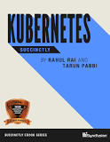
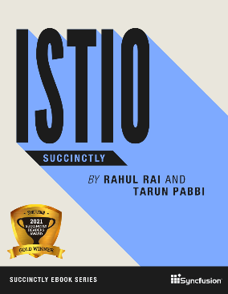
About Me
Experienced in working with public clouds and Kubernetes
Co-author Kubernetes and Istio Succinctly

Slide 4
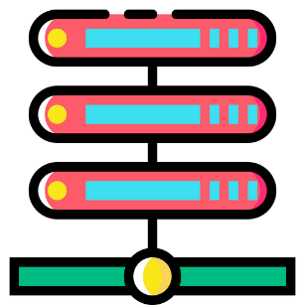
Microservices
Independent development & deployment
Improved fault isolation
Independent technology stack
Better maintenance
Notes:
1m
Handles by small teams
Easy to maintain
Independent release cycle
Can be scaled independently
Error management at services level
Different technology stack

Slide 5
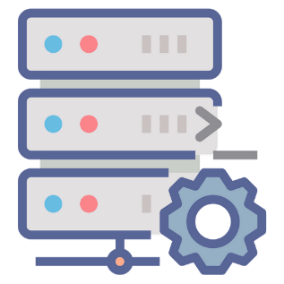
Deployment Models
Multiple service instances per host (Physical or VM)
Service instance per host (Physical or VM)
Service instance per container
Serverless deployment
Notes:
2m
https://dzone.com/articles/right-strategies-for-microservices-deployment
Challenges:
Varying frameworks and technologies
Independent resource requirements, scaling, and monitoring requirements
Deployment has to be quick, reliable, and cost-effective
1. Relatively efficient and fast resource usage
Little or complete lack of control on service instances unless each instance is a separate process
Lack of isolation
Higher risks of errors while deployment since the operations
2. allows you to run each instance separately on its host.
Under –utlization, costly, slow and time consuming
3. each service instance operates in its respective container,
Completely isolated, can manage resource allocation
Doesn't require physical separation,
Require better security management, may require more maintenance
4. managed service from cloud providers
Charged only per use
almost nil infra management requirerements
Canot be used for long running process,
Cannot be used for large resources consumption, input-output
Usually stateless

Slide 6
Kubernetes Alternatives
Docker Swarm
Nomad
Rancher
Notes:
Rancher is an open-source platform which implements a purpose-built infrastructure for running containers in production. Rancher takes in raw computing resources from any public or private cloud in the form of Linux hosts. The key product features of Rancher include cross-host networking, container load balancing, persistent storage services, multi-tenancy & user management, resource management, multi-orchestration engines and much more.
Nomad is a flexible workload orchestrator that enables an organisation to easily deploy and manage any containerised or legacy application using a single, unified workflow. It enables developers to use declarative infrastructure-as-code for deploying applications and can run a diverse workload of Docker, non-containerised, microservice, and batch applications. Its key features include deploying containers and legacy applications, device plug-ins and GPU support, federation for multi-region and multi-cloud, among others.
Docker Swarm can deploy containers much faster than Kubernetes, which allows faster reaction times for scaling on demand. By utilizing its own YAML, API, and client definitions, Kubernetes differs from other standard docker equivalents. Thus, Docker Compose or Docker CLI cannot be used to define containers.

Slide 7

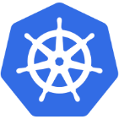
What is Kubernetes?
A Production-Grade Container Orchestration System Google-grown, based on Borg and Omega, systems that run inside of Google right now and are proven to work at Google for over 10 years.
Google spawns billions of containers per week with these systems.
Notes:
Created by three Google employees initially during the summer of 2014;
grew exponentially and became the first project to get donated to the
CNCF.
● Hit the first production-grade version v1.0.1 in July 2015. Has continually
released a new minor version every three months since v1.2.0 in March
2016. Lately v1.13.0 was released in December 2018.

Slide 8

Decouples Infrastructure and Scaling
All services within Kubernetes are natively Load Balanced.
Can scale up and down dynamically.
Used both to enable self-healing and seamless upgrading or rollback of applications.

Slide 9

Self Healing
Kubernetes will ALWAYS try and steer the cluster to its desired state.
Notes:
Its like a Wolverine of DevOps

Slide 10
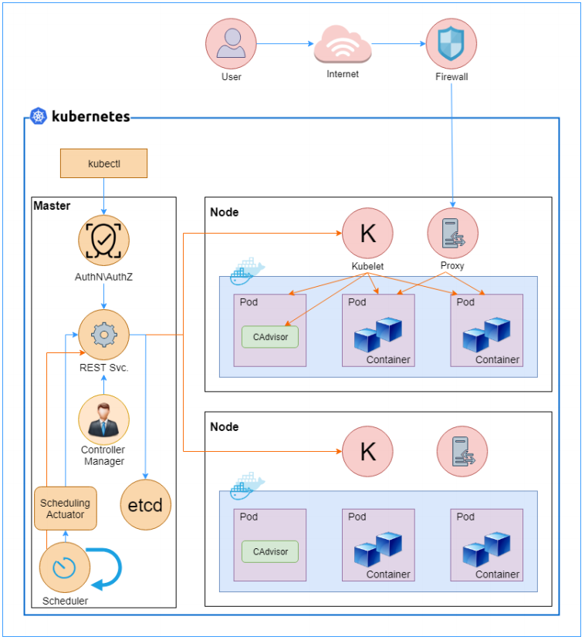
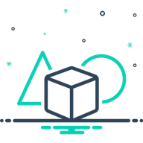
Architecture
Notes:
kube-apiserver - Provides a forward facing REST interface into the kubernetes control plane and datastore. ● All clients and other applications interact with kubernetes strictly through the API Server. ● Acts as the gatekeeper to the cluster by handling authentication and authorization, request validation, mutation, and admission control in addition to being the front-end to the backing datastore.
Etcd- etcd acts as the cluster datastore. ● Purpose in relation to Kubernetes is to provide a strong, consistent and highly available key-value store for persisting cluster state. ● Stores objects and config information.
kube-controller-manager Monitors the cluster state via the apiserver and steers the cluster towards the desired state. ● Node Controller: Responsible for noticing and responding when nodes go down. ● Replication Controller: Responsible for maintaining the correct number of pods for every replication controller object in the system. ● Endpoints Controller: Populates the Endpoints object (that is, joins Services & Pods). ● Service Account & Token Controllers: Create default accounts and API access tokens for new namespaces.
kube-scheduler Component on the master that watches newly created pods that have no node assigned, and selects a node for them to run on. ● Factors taken into account for scheduling decisions include individual and collective resource requirements, hardware/software/policy constraints, affinity and antiaffinity specifications, data locality, inter-workload interference and deadlines.
cloud-controller-manager Node Controller: For checking the cloud provider to determine if a node has been deleted in the cloud after it stops responding ● Route Controller: For setting up routes in the underlying cloud infrastructure ● Service Controller: For creating, updating and deleting cloud provider load balancers ● Volume Controller: For creating, attaching, and mounting volumes, and interacting with the cloud provider to orchestrate volumes
kubeletAn agent that runs on each node in the cluster. It makes sure that containers are running in a pod. ● The kubelet takes a set of PodSpecs that are provided through various mechanisms and ensures that the containers described in those PodSpecs are running and healthy.
kube-proxy Manages the network rules on each node. ● Performs connection forwarding or load balancing for Kubernetes cluster services.
Container Runtime Engine A container runtime is a CRI (Container Runtime Interface) compatible application that executes and manages containers. ○ Containerd (docker) ○ Cri-o ○ Rkt ○ Kata (formerly clear and hyper) ○ Virtlet (VM CRI compatible runtime)

Slide 11

Installation
Kubeadm
Docker for desktop
Minikube
Kubectl
Helm
Notes:
kind is a tool for running local Kubernetes clusters using Docker container “nodes”. kind was primarily designed for testing Kubernetes itself, but may be used for local development or CI.

Slide 12
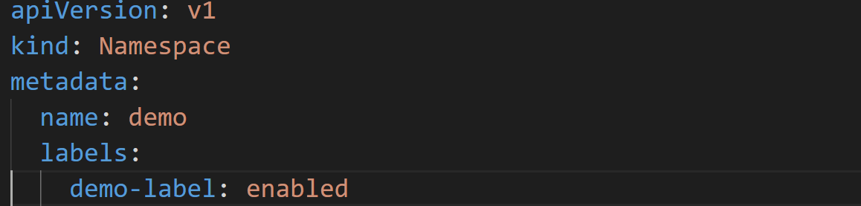
Namespaces
Namespaces are a logical cluster or environment, and are the primary method of partitioning a cluster or scoping access.

Slide 13
Labels
key-value pairs that are used to identify, describe and group
together related sets of objects or resources.
Have a strict syntax with a slightly limited character set.

Slide 14
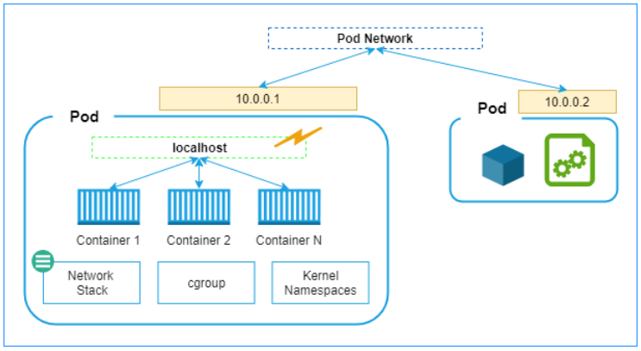
Pods
Atomic unit or smallest “unit of work” of Kubernetes.
Pods are one or MORE containers that share volumes and namespace.
They are ephemeral!
Notes:
Cattles $ pets
Pods are the most fundamental compute resource that you can stand up in Kubernetes. Put simply, if you use Kubernetes, you will be using pods.

Slide 15
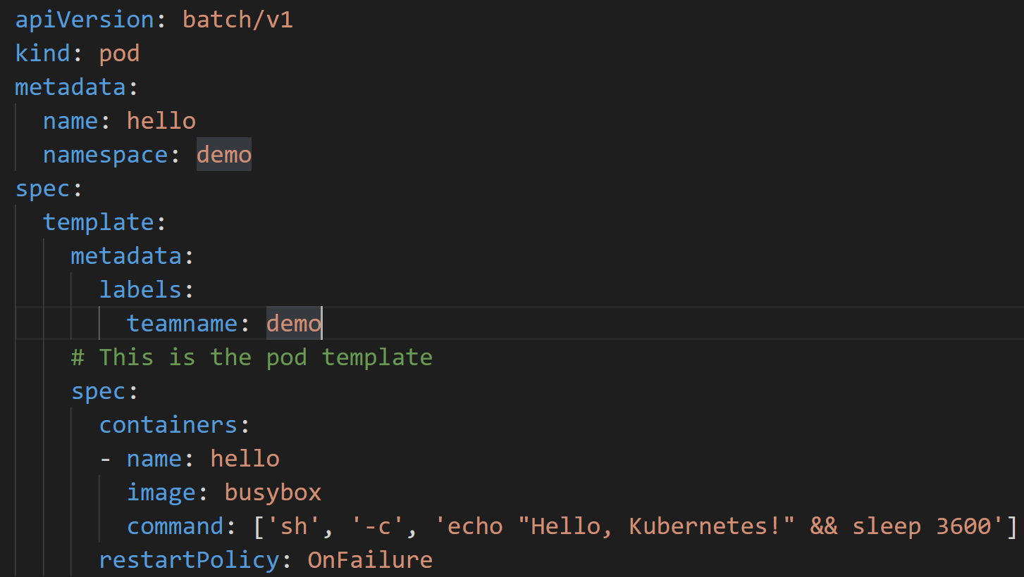
Pods - example

Slide 16
Services
Unified method of accessing the exposed workloads of Pods.
Durable resource
DNS name
<service name>.<namespace>.svc.cluster.local
NOT Ephemeral!

Slide 17
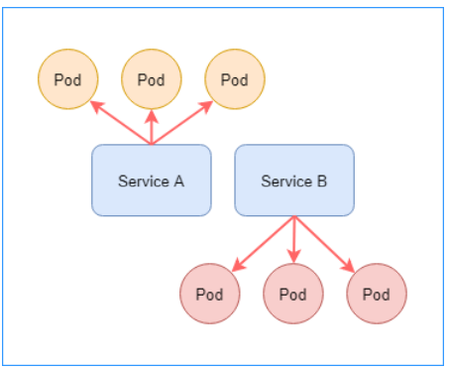
Services

Slide 18

Services
● ClusterIP (default)
● NodePort
● LoadBalancer
● ExternalName
Notes:
ExternalName is used to reference endpoints OUTSIDE the cluster. ● Creates an internal CNAME DNS entry that aliases another.
● NodePort services extend the ClusterIP service. ● Exposes a port on every node’s IP. ● Port can either be statically defined, or dynamically taken from a range between 30000- 32767.

Slide 19
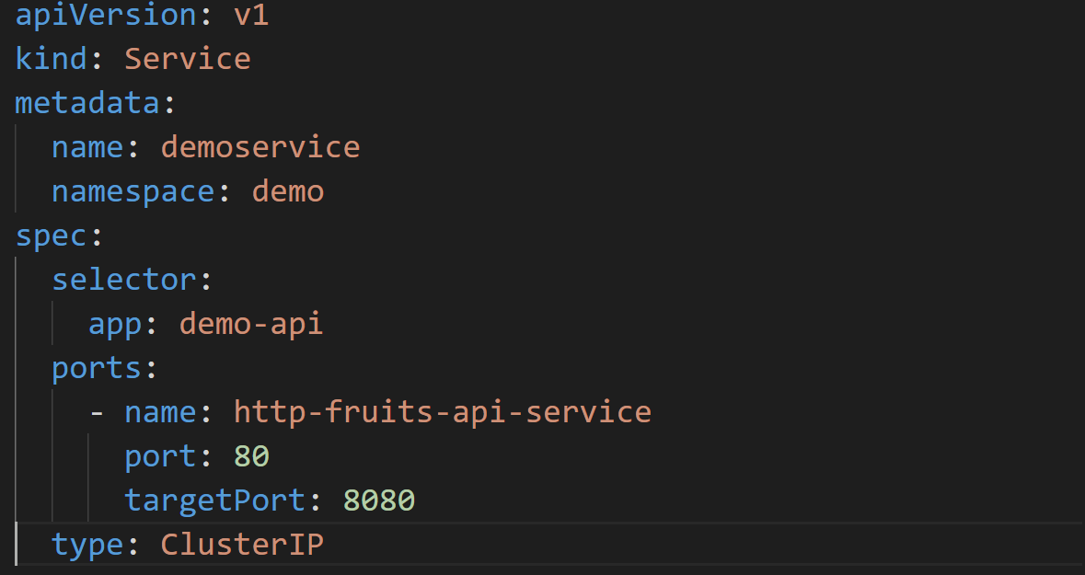
Service - example

Slide 20
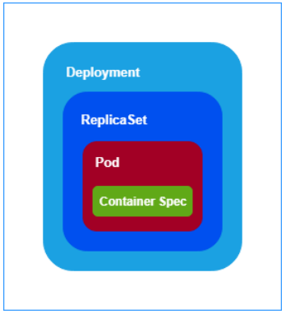
Workloads
ReplicaSet
Deployment
DaemonSet
StatefulSet
CronJob
Notes:
ReplicaSets are higher-level abstractions that are responsible for ensuring that a specified number of exact copies of a given pod are running. This system of parallelization is the foundation of Kubernetes' power. If for some reason, one or more copies of chef-server that we mentioned above should fail, our server will still be available for two reasons: (1) there are multiple, identical pods running, and (2) the ReplicaSet will create a new pod in place of the one that failed. Moreover, we can be guaranteed that we will end up with the exact number of pods we’ve requested, as any extras will be torn down.
One step higher in the abstraction hierarchy, deployments control both ReplicaSets and pods in a declarative manner. This means that you define what you want your collection of pods to be, and the deployment makes use of several other Kubernetes objects to ensure that things are as you’ve declared in your YAML file.
This is different than a ReplicaSet in that you can roll out changes to the desired state of the system by changing the pod template in your deployment YAML, and the deployment will take care of the rest. You can also revert to a previous state if things go awry. This contrasts with a ReplicaSet in that if you were to change the ReplicaSet’s YAML, and then run kubectl apply -f <ReplicaSet.yml> your original ReplicaSet will persist. And with that, you’ll be creating a second ReplicaSet.

Slide 21
Networking
Container-to-Container
Containers within a pod exist within the same
network namespace and share an IP.
Enables intrapod communication over localhost.
Pod-to-Pod
Allocated cluster unique IP for the duration of its life
cycle.
Pods themselves are fundamentally ephemeral.

Slide 22
Networking
Pod-to-Service
managed by kube-proxy and given a persistent
cluster unique IP exists beyond a Pod’s lifecycle.
External-to-Service
Handled by kube-proxy.
Works in cooperation with a cloud provider or other
external entity (load balancer).

Slide 23

Ingress – Name Based Routing
An API object that manages external access to the services
in a cluster Provides load balancing, SSL termination and name/path based virtual hosting.
Gives services externally reachable URLs

Slide 24
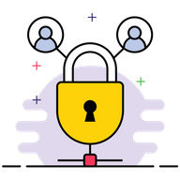
Security
Role Based Access Control
Authentication
Authorization
Secrets
Admission Control
Certificates

Slide 25

Fundamental Networking Rules
All containers within a pod can communicate with each
other unimpeded.
All Pods can communicate with all other Pods without
NAT.
All nodes can communicate with all Pods (and viceversa) without NAT.
The IP that a Pod sees itself as is the same IP that
others see it as.

Slide 26

Metrics and Monitoring
Metrics server
HPA (horizontal pod autoscaler)
Prometheus
Grafana (dashboards)
Fluentd (log shipping)

Slide 27
DEMO
https://www.katacoda.com/courses/kubernetes/guestbook

Slide 28
Questions?

Slide 29
Thank you

