Slide 1

Path Planning for Planar Hyper-Redundant Surgical Robots
Tarun Prasad, Internship Thesis
27.09.2021

Slide 2
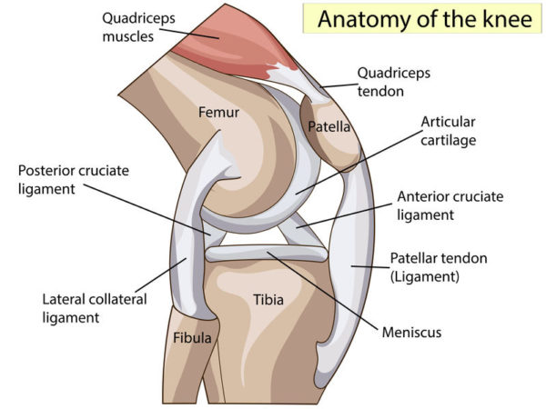
Introduction
The goal of the project is to perform path planning for a hyper redundant robotic endoscope addressing the narrow passage problem in human knee.
Ref. [1]

Slide 3
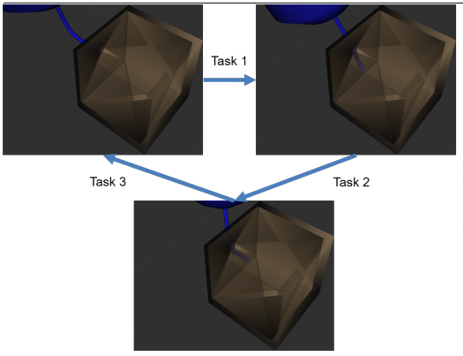
Previous Work
Kalotay, 2021: “Path Planning for Hyper-Redundant Surgical Robots” ^{[2]}
RRT BIROMED was simulated to solve the narrow passage problem.
Couldn’t outperform other algorithms.
Notes:
RRT BIROMED was simulated to solve the narrow passage problem by driving the random trees towards the goal.
Couldn’t outperform RRT Connect and other algorithms.
The issue could be because of sampling in higher dimensional configuration space.

Slide 4
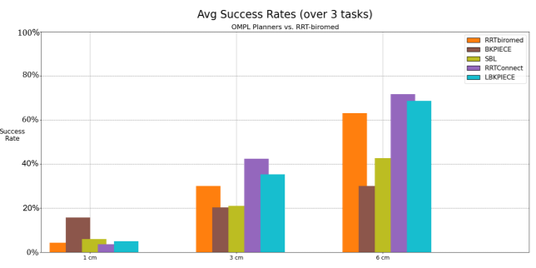
RRT BIROMED
Reported Success Rates:
RRT BIROMED didn’t outperform other algorithms.

Slide 5
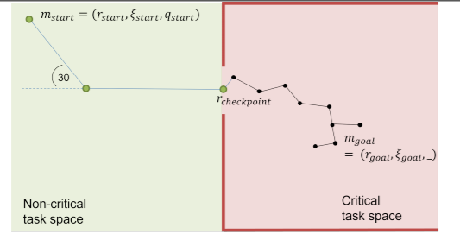
TSRRT BIROMED
TSRRT BIROMED simulated for reduced dimensional complexity in sampling.
Null Space Search and Inverse Kinematics used.
High success rate in task space trajectory planning.
Notes:
TSRRT BIROMED was simulated to reduce the dimensional complexity in sampling and to solve the configuration space problem with Inverse Kinematics (IK).
Null space search was used when the inverse kinematics yielded a configuration space solution with collision.
The reduction in the complexity of sampling lead to a very high success rate in task space trajectory planning.

Slide 6
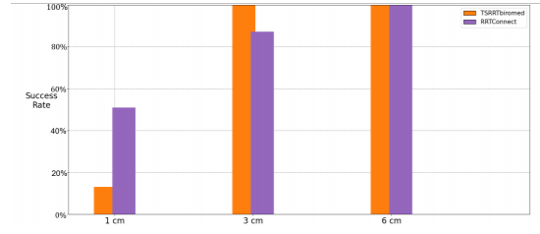
TSRRT BIROMED Discussions
R-checkpoint is an added complexity.
Null space search is computationally expensive.
Cube doesn’t incorporate internal obstacles within the knee.
Configuration Space Planner not always successful.
Notes:
Requirement of specifying an r-checkpoint is an added complexity and it could be simplifying the problem by directly driving the solution to the narrow passage.
Null space search is computationally expensive.
The cube doesn’t incorporate other internal obstacles within the knee.

Slide 7
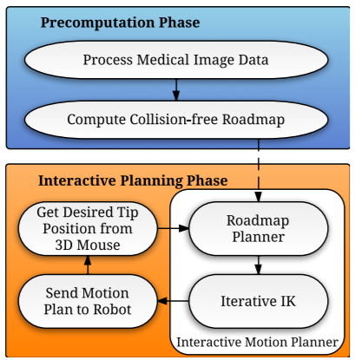
Literature Reviewed
Interactive-rate Motion Planning for Concentric Tube Robots
^{[3] Torres et al., 2012}
Pre-computed roadmap with real-time IK.
Does not address the narrow passage problem.
Notes:
Uses a pre-computed roadmap with use of real-time IK to solve for the specified goal position and orientation.
Spends a lot of time in pre-computation.
Does not address the narrow passage problem specifically.

Slide 8
Literature Reviewed
Section Patterns: Efficiently Solving Narrow Passage Problems in Multilevel Motion Planning
^{[4] Orthey et al., 2020}
Uses transformations / projections of the real space such that the narrow passage has a larger volume.
Increased probability of sampling near narrow passage.

Slide 9
Discussions regarding Previous Work
Zsombor Kalotay’s Work:
Uses a top-down approach and is focused on computationally expensive methods such as inverse kinematics and null space search.
Concentric Tube Robot’s Paper:
Focuses on using a parallel computational approach to reduce real time workload and doesn’t focus on the narrow passage problem.
Section Patterns Paper:
Focuses on transforming the coordinates to increase odds of narrow passage but is not specific to our use case.

Slide 10
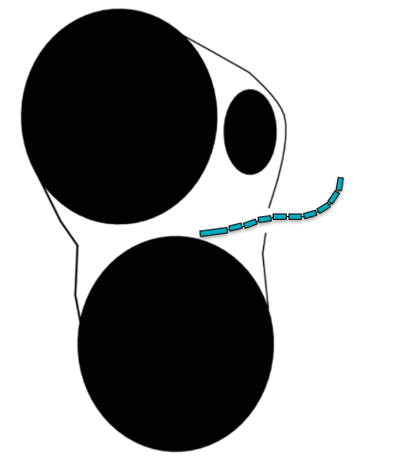
Motivation
To focus on a bottom-up approach for planning the path using intuitive methods.
To understand and visualize the challenges involved in planning the path.
To utilize a planar framework for more intuitive analysis of the algorithm and its bottlenecks.
Notes:
Instead of approaching the problem with a general approach such as a pure sampling based algorithm we can approach the problem with a an approach specific to an endoscope plan for the knee.
We could first generate a task space trajectory for expected start and goal positions and orientations.

Slide 11
Choice of Framework
Used a 2D abstraction image of the knee as the environment.
Used Python as the programming language without the dependence on other libraries in order to program the complete algorithm myself.
Ref [1]
Notes:
The same can be performed in 2D to perceive the planning more intuitively and then it can be scaled to 3D

Slide 12
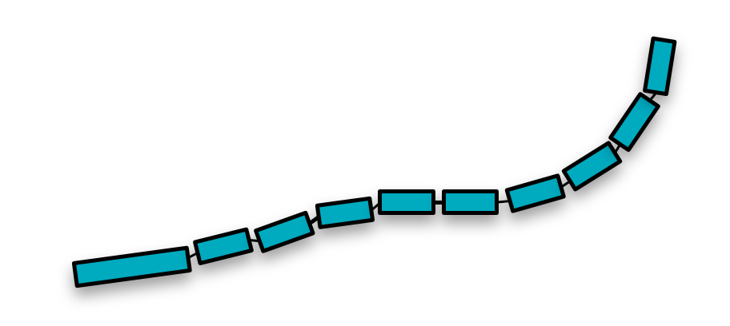
Visualization of Motivation
Fitting the endoscope on the task space trajectory

Slide 13
Goal of my Project
2D Task Space Trajectory Following Endoscope Motion Planner:
Reconstruct the Directed RRT algorithm for our 2D environment.
Develop an improved configuration space planner starting from a task space trajectory in 2D.
Use intuitive curve fitting and geometric methods for motion planning as opposed to random sampling.
Notes:
Instead of approaching the problem with a general approach such as a pure sampling based algorithm we can approach the problem with a an approach specific to an endoscope plan for the knee.
We could first generate a task space trajectory for expected start and goal positions and orientations.

Slide 14
Task Space Planner
Initialize parameters.
Generate a random node within a window around start node.
Identify nearest node from tree of nodes to random node.

Slide 15
Task Space Planner
Take a step of ρ along the line joining the nearest node to the start node and rotate the node by an angle α towards it.
If new node under collision, increase window size and repeat.
Terminate if new node is close to threshold else repeat.
ρ
α

Slide 16
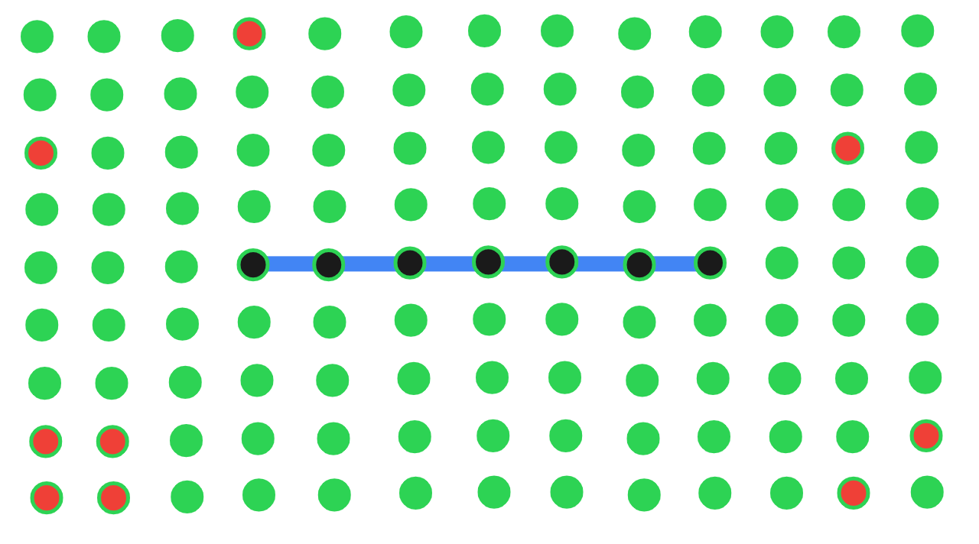
Collision Checker Illustration

Slide 17
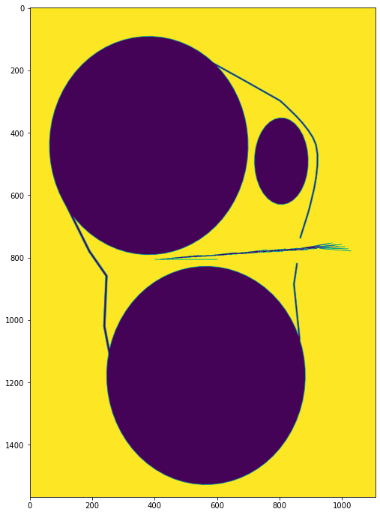
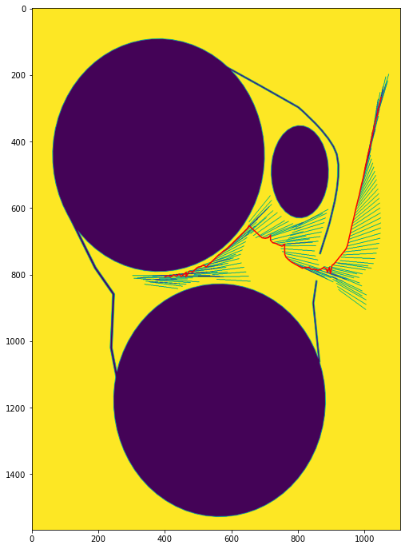
Sample Solutions
Scale:
100 units = 10 mm
Scale:
100 units = 10 mm
Each line in the graph corresponds to the above end-effector link.

Slide 18
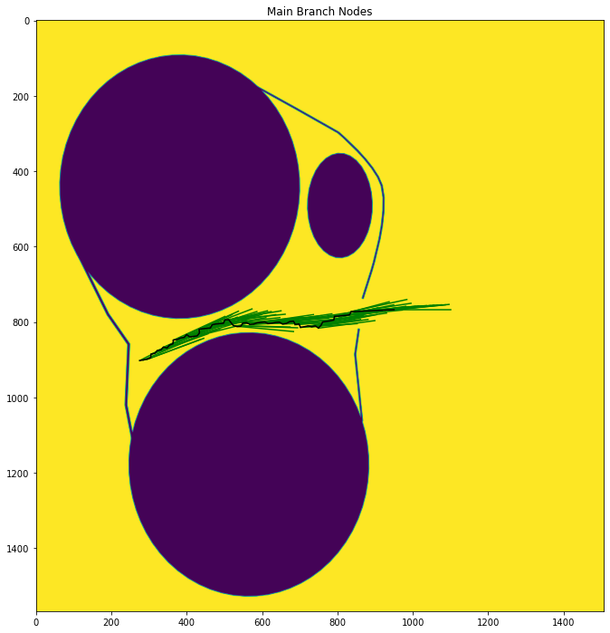
Configuration Space Planner
The real challenge begins with the approach Pursued for Configuration Space Planner:
Use the end effector configuration from task space solution at each instant.
Coordinates captured by TS solution is a representation of collision free region
Identify a trajectory line and fit the remaining endoscope links to it at each instant.
High odds of these configurations to be collision free.

Slide 19
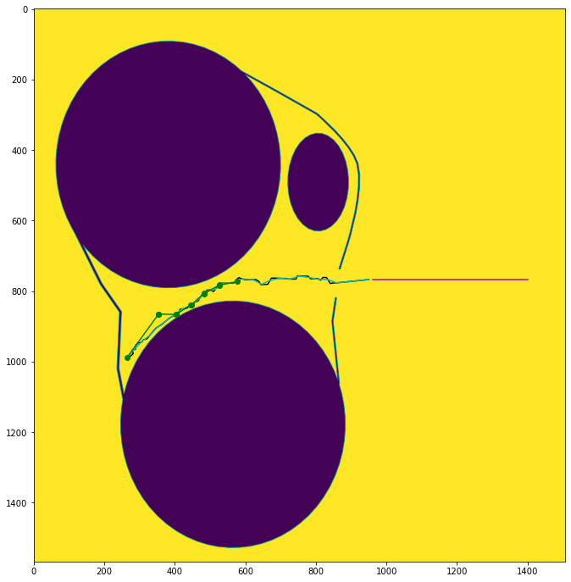
Fixed Start Reasoning
A fixed start configuration was considered to generate the task space solution.
A skewed non-critical region start configuration results in a trajectory line which is not the center of collision free zone.
The plan between two configurations in non-critical region is less challenging.

Slide 20

Choice of Trajectory Line
Lines joining the endpoints, midpoints and start points of consecutive end-effector configurations in task space solution.
Versions of these lines at center of collision free zone.
Smoothened versions of these lines.
Simple splines not pursued as it could be difficult to obtain them in 3D and the dumber task space trajectory is pursued.

Slide 21
Endoscope Fitting Approach:
Joint limits are used and instantaneous angle change is not a constraint.
Checkpoint for fitting implemented to avoid curling.

Slide 22
Discretization Explained

Slide 23
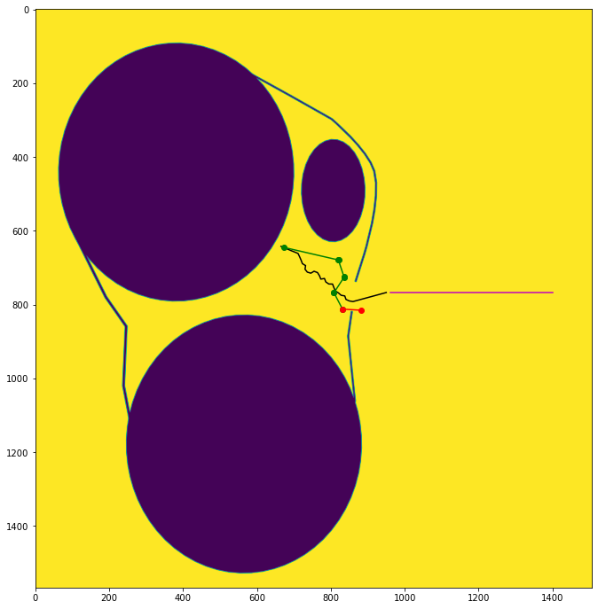
Methods to Handle Collisions
Alternate Approaches need to be worked on when we reach a collision configuration.
Every current configuration is translated to the next task space configuration before computing new configuration.
Collision can be checked in advance for this configuration and if collision is found we can look for other options.

Slide 24
Sliding Current Solution to Next Instant
Sliding current configuration space to next task space solution and checking for collision in advance:

Slide 25
Discretization Stack Approach
Checking discretization stack of configurations for collision in next instant:

Slide 26

Other Methods to Handle Collision
Fitting the midpoint of the links to the trajectory line rather than the endpoint.
Testing with other trajectory line options along the link length which better represent collision free zone.

Slide 27
Observations
Successfully Planned Paths

Slide 28
Observations
Successfully Planned Paths

Slide 29
Observations
Successfully Planned Paths

Slide 30
Results
400 Collision free end configurations were synthesized in the task space for a fixed start configuration outside the knee opening
Task Space Planner has good success rate of 79 % for these cases.
It can be increased further by increasing number of maximum iterations which is currently at 125000.
Configuration space planner has a low success rate of 42 % for successful task space solutions.
Usage of different trajectory lines didn’t vary the success rate by much

Slide 31
Discussion
The configuration space planner was effectively mostly working only for one’s which were too close to the knee opening or straight trajectories.
The trajectory line used in configuration space planner is not effectively capturing collision free region.
The method of fitting is instantaneously aligning to the best possible configuration.
The approach taken doesn’t factor in odds of getting into collision configuration in future configurations due to current action.

Slide 32
Callback to Motivation
The bottom up approach helped us effectively visualize the algorithm.
We could understand the consequences of trying simplistic approaches to stay in collision free zone.
We could conceptualize simple solutions for handling collisions by interpreting from the 2D simulations.

Slide 33
Possible Improvements
Try to utilize the entire information of collision free area rather than sticking to a line.
Divide solutions with collision into separate pieces and use sampling approaches to replace the solution pieces with collision.

Slide 34
Future Scope
Alternate approaches:
Use recursive dynamic programming methods which factor in the chances of getting into collision in the future for current action.
Restructure the problem as an optimization problem which optimizes between fitting to collision free zone and proximity to target configuration.

Slide 35
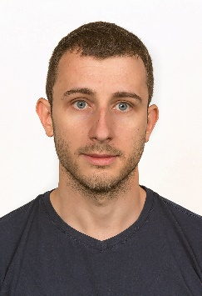


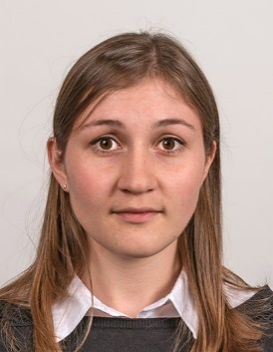
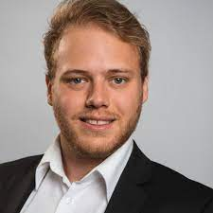

Acknowledgements
Nicolas Gerig
Murali Karnam
Prof. Georg Rauter
Manuela Eugster
Zsombor Kalotay
Funding:

Slide 36
References
[1] https://northlandorthopaedicsurgeon.co.nz/knee-surgeon/knee-anatomy/
[2] Zsombor Kalotay, “Path Planning for Hyper-Redundant Surgical Robots”, Master’s thesis, University of Basel, Switzerland, 2020.
[2] L. G. Torres, R. J. Webster, and R. Alterovitz, “Task-oriented design of concentric tube robots using mechanics-based models”, in 2012 IEEE/RSJ International Conference on Intelligent Robots and Systems, pp. 4449–4455, IEEE, 2012.
[3] Andreas Orthey and Marc Toussaint, “Task-oriented design of concentric tube robots using mechanics-based models,” in IEEE Transactions on Robotics, IEEE, 2021.

Slide 37
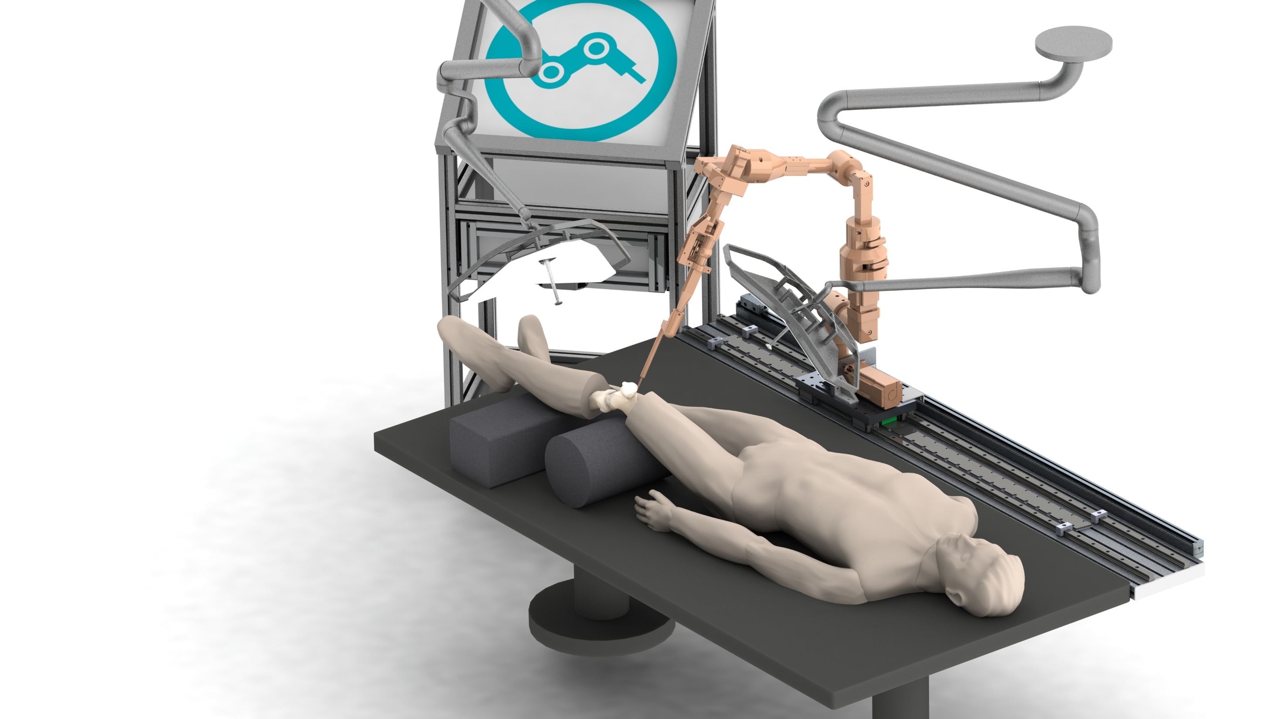
Thank you!
www.biromed.dbe.unibas.ch
tarun.prasad@unibas.ch

Slide 38
Backup Slides

Slide 39
Methods to handle Collisions
Fitting the midpoint of the links to the trajectory line rather than the endpoint.
Disregard the orientation of the end-effector from the task space solution and fit the orientation to the trajectory line.
Testing with other trajectory line options along the link length.

Slide 40
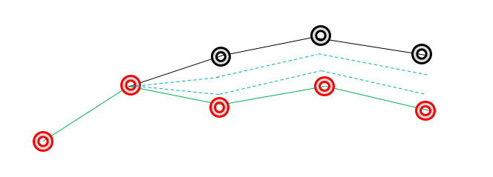
Configuration Space Planner
Discretization Explained:

Slide 41
Timeline

Slide 42
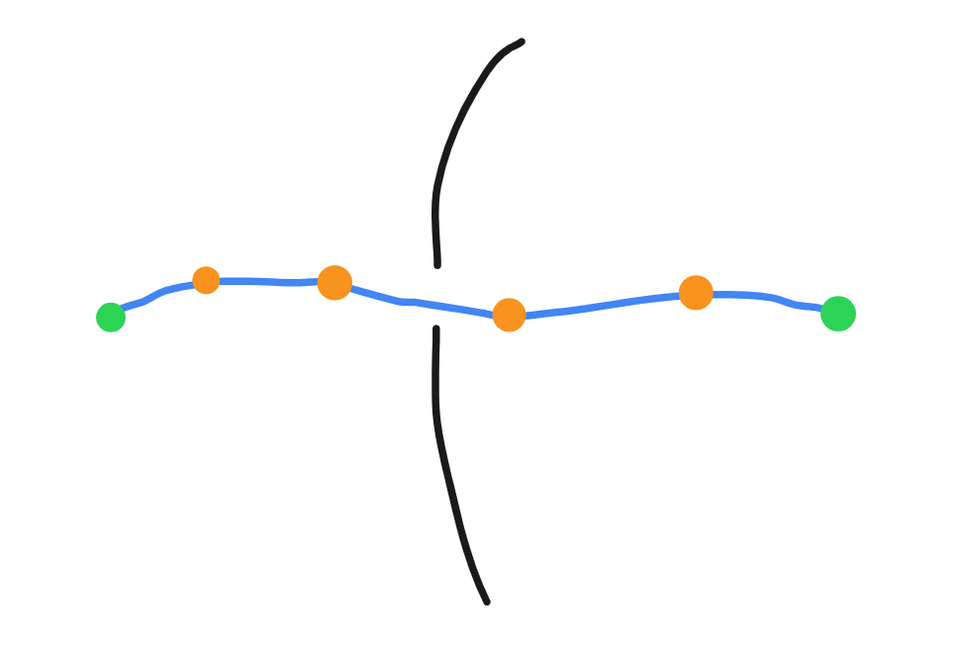
Alternatives
Combination of TSRRT BIROMED and RRT Connect / BIROMED:
Notes:
First sample a Task Space Trajectory and split it into several sub-trajectories.
Then convert the start and goal state of each of these sub-trajectories into configuration space using inverse kinematics
Perform a configuration space motion planning algorithm such as RRT Connect or RRT BIROMED in several parallel threads on each of these sub trajectories.
Could make the sampling simpler as the sub trajectories will be closer to the narrow passage.

Slide 43

Alternatives
Improvements to TSRRT BIROMED:
Notes:
When there is a failure in null space search at a given task space location within the null space search bounds we could:
Create a sub-trajectory between 2 task space points a few instances before and after the failure task space point.
Introduce a small obstacle at the failure point.
Plan a new task space trajectory for this sub-trajectory and perform TSRRT BIROMED through this.

Slide 44
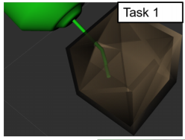
Alternatives
Improvements to TSRRT BIROMED:
Avoiding the checkpoint.
Estimating performance in actual knee.

Slide 45
Possible Directions of Work
Combination of TSRRT BIROMED and RRT Connect / BIROMED
First sample a Task Space Trajectory and split it into several sub-trajectories.
Then convert the start and goal state of each of these sub-trajectories into configuration space using inverse kinematics
Perform a configuration space motion planning algorithm such as RRT Connect or RRT BIROMED in several parallel threads on each of these sub trajectories.
Could make the sampling simpler as the sub trajectories will be closer to the narrow passage.

Slide 46
Possible Directions of Work
Improvements to TSRRT BIROMED:
When there is a failure in null space search at a given task space location within the null space search bounds we could:
Create a sub-trajectory between 2 task space points a few instances before and after the failure task space point.
Introduce a small obstacle at the failure point.
Plan a new task space trajectory for this sub-trajectory and perform TSRRT BIROMED through this.

Slide 47
Timeline
20.05.2021 to 01.07.2021
Literature Review
Identify Direction of Work
02.07.2021 to 31.07.2021
Complete and Validate Task Space Planner: Sampling and Geometric
Complete Configuration Space Planner
01.08.2021 to 20.08.2021
Scale Planner to 3D
Compare with other planners
Setup Framework of Experimentation
Present Kick-Off Meeting
Setup Task Space Planner
Identify Failure Cases of Configuration Space and Develop Methods to Solve them
Test Planner for Multiple Cases
Prepare Final Report and Presentation

Slide 48
Literature Reviewed
Zsombor Kalotay’s Master Thesis: “Path Planning for Hyper-Redundant Surgical Robots” ^{[1]}
RRT BIROMED was simulated to solve the narrow passage problem.
Couldn’t outperform other algorithms.
Notes:
RRT BIROMED was simulated to solve the narrow passage problem by driving the random trees towards the goal.
Couldn’t outperform RRT Connect and other algorithms.
The issue could be because of sampling in higher dimensional configuration space.

