Slide 1
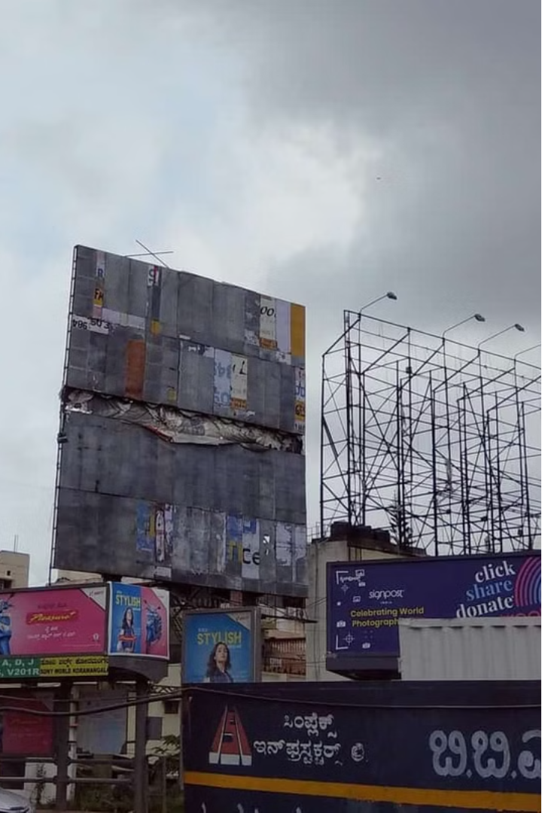
AVENTUS 2.0
Team Name – Team Void
Problem Statement:
Identification Of Illegal Hoardings in the City.

Slide 2
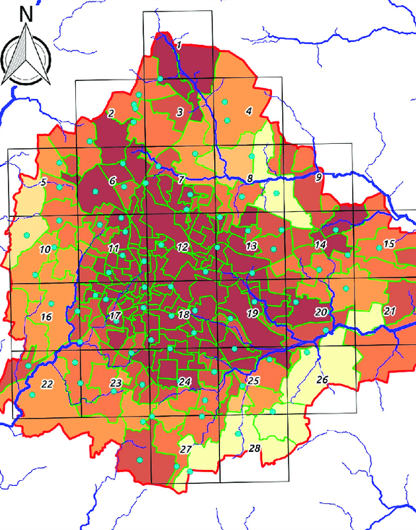
Project HELIOS:
Project Aimed at Solving the rising issue of increasing VISUAL POLLUTION ,PUBLIC SAFETY CONCERNS the detection and removal of illegal hoardings in Bengaluru.
Heat Map of Bengaluru According To Hoarding Density

Slide 3
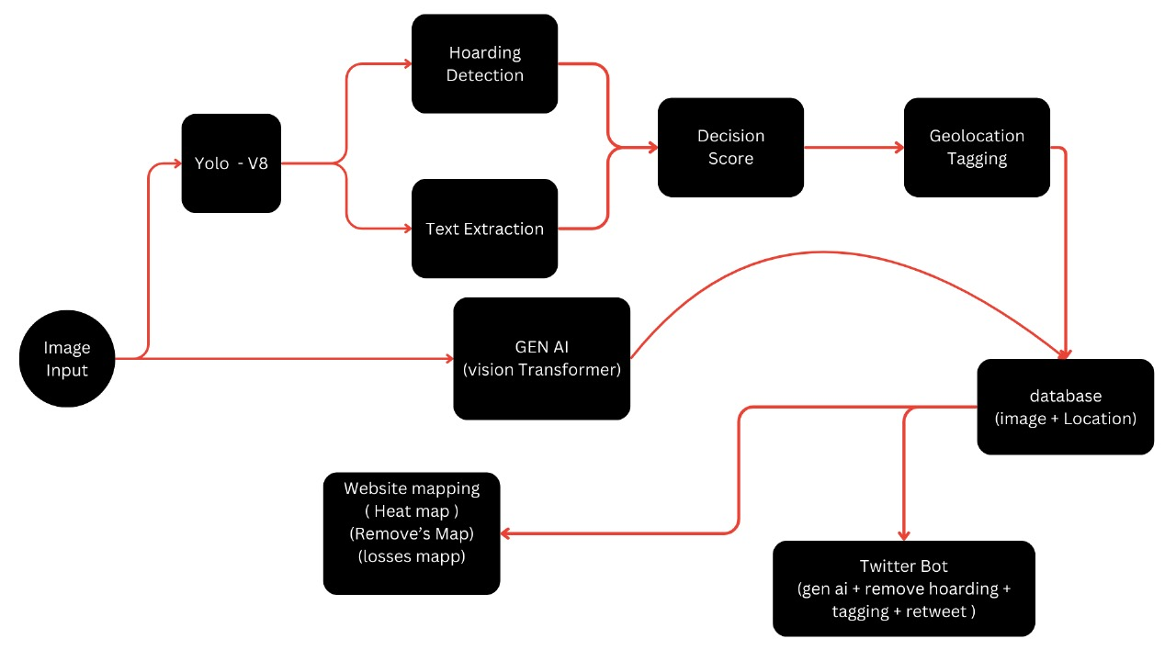

Slide 4
Tech Stack
1. YOLOv8:
Used for object detection to identify hoardings in images.
2. Python:
Primary programming language for developing the detection model and backend.
3. Streamlit:
For hosting the frontend interface.
4. Generative AI:
Vision Transformers.
5. PIL (Python Imaging Library):
For image processing tasks.
6. Telegram Bot API:
To create a bot for user engagement and rewards.
8. Ultralytics YOLO:
For model training and inference.
9. Torch:
Deep learning framework used in YOLO.
10.Annotation Tools (e.g., LabelImg):
For annotating images to create the dataset.
11.Git:
Version control for code management.
This combination of technologies enables the project to detect and report unauthorized hoardings efficiently.

Slide 5
Some Financial Terms
The BBMP could potentially earn a minimum of Rs 300 crore annually from advertising revenue. However, it currently earns only about Rs 30 crore annually from hoardings, indicating a significant shortfall.
Between 2005 and 2015, the BBMP lost approximately Rs 2000 crore in advertisement revenue due to illegal hoardings
The average price for hoardings in Bengaluru is approximately ₹288.27 per sq meter to ₹ 2000Sq meter
Average Hoardings Size
40x20 Feet (12.2x6.1 Meters)
30x10 Feet (9.1x3.0 Meters)
20x10 Feet (6.1x3.0 Meters)

Slide 6
BBMP Rules and Regulations
1
Permit Requirements
2
Size and Placement Restrictions
Strict guidelines for obtaining permits to display hoardings in the city.
Limitations on the dimensions and locations of permissible hoardings.
3
Banned Locations
4
Removal Policies
Certain areas, such as near schools and hospitals, are off-limits for hoardings.
Procedures for the BBMP to remove illegal hoardings and penalize violators.

Slide 7
Common Types of Illegal Hoardings
Temporary Structures
Unauthorized Banners
Makeshift displays, often placed without permits, that are quickly assembled and removed.
Large fabric or vinyl banners hung in public spaces without the necessary approvals.
Encroaching Signage
Abandoned Structures
Hoardings that extend beyond the permitted boundaries, encroaching on public space.
Neglected and dilapidated hoardings that remain long after their permits have expired.

Slide 8
BBMP's Enforcement Efforts
Inspection Drives
Removal Operations
Regular inspections to identify and document illegal hoardings across the city.
Dispatching teams to physically remove illegal hoardings and impose fines on offenders.
1
2
3
Issuing Notices
Providing violators with formal notices to remove illegal hoardings within a specified timeframe.

Slide 9




Challenges in Removing Illegal Hoardings
Limited Resources
Bureaucratic Hurdles
Public Resistance
Political Influence
Budgetary constraints and manpower shortages hinder the BBMP's ability to tackle the issue effectively.
Navigating the complex legal and administrative processes can slow down enforcement efforts.
Some business owners and advertisers resist the removal of their hoardings, leading to conflicts.
Instances of political interference can undermine the BBMP's ability to enforce the regulations.

Slide 10




Strategies for Compliance
Obtain Permits
Ensure that all hoardings are properly permitted and adhere to BBMP regulations.
Monitor Expirations
Regularly review permit expiration dates and renew them in a timely manner.
Maintain Structures
Regularly maintain and update legal hoardings to prevent them from becoming eyesores.
Collaborate with BBMP
Cooperate with the BBMP's enforcement efforts and address any issues or concerns proactively.

Slide 11
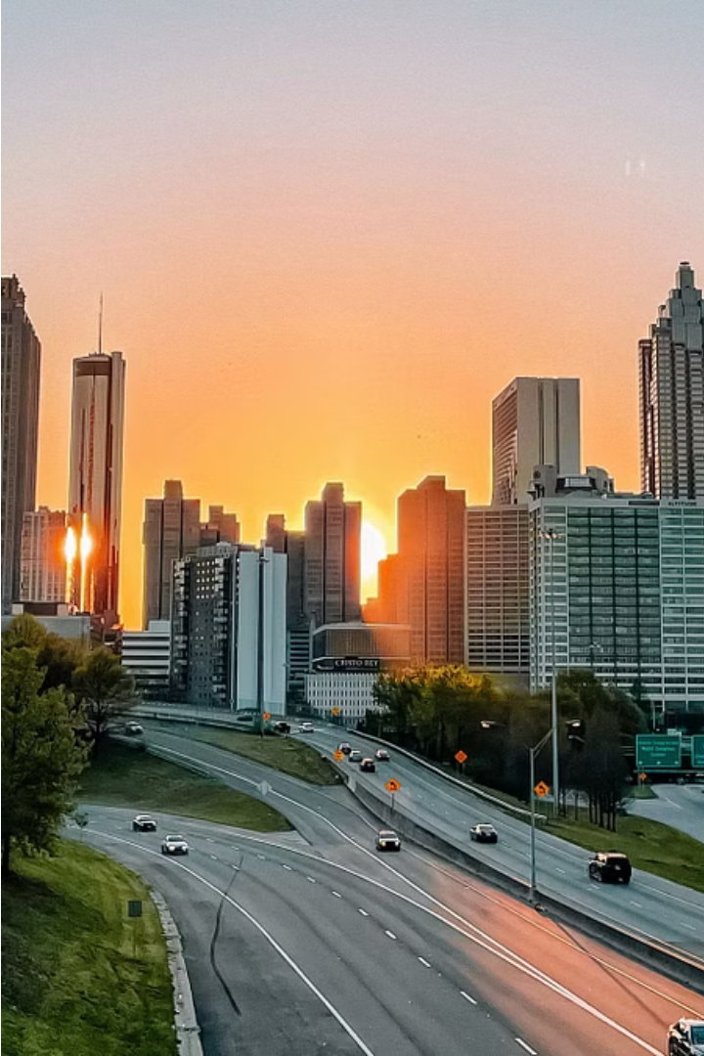
THANK YOU

