Slide 1


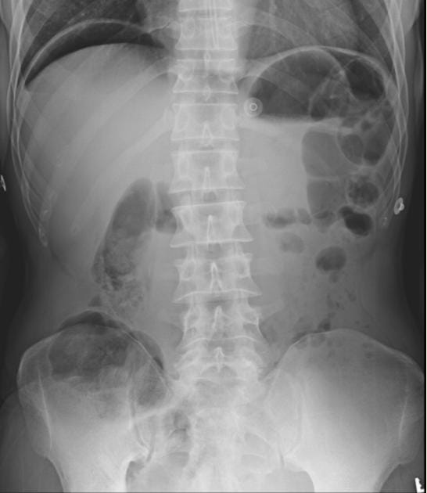
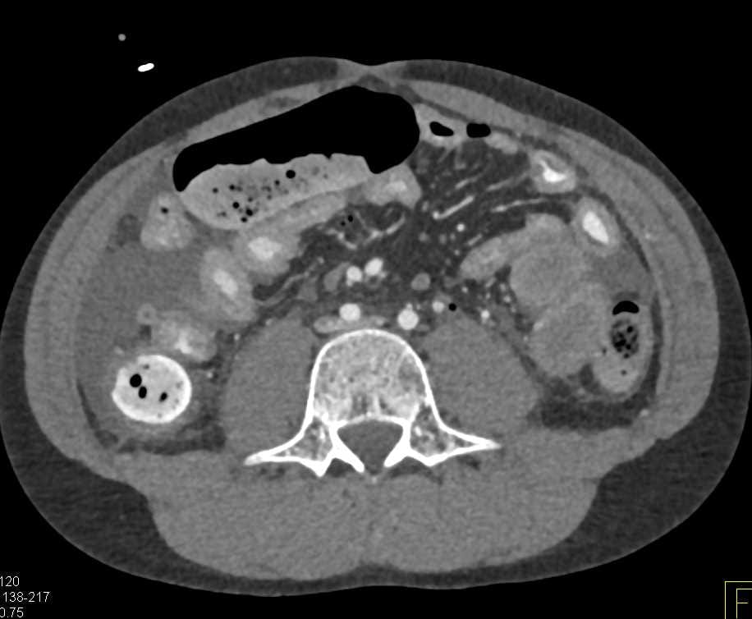

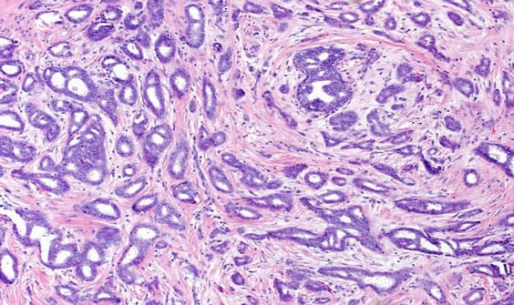
UNMASKING BREAST CANCER IN THE ACUTE ABDOMEN:
A Rare Case of Metastatic Ileal Perforation from Invasive Ductal Carcinoma
Presented by: Dr. Alla Varun Reddy
Under the guidance of Prof. & HOD Dr. P. S. Saravanan · Dr. Manoj Priyan
Department of General Surgery
38
2 days
0.5 × 0.5 cm
40 cm
year-old woman
of abdominal pain
solitary ileal perforation
proximal to the IC junction
Background
Clinical & Diagnostic Sequence
Discussion
Breast carcinoma most often metastasises to bone, liver and lung; gastrointestinal spread is rare and arises far more often from lobular than from ductal carcinoma. [1, 2]
Intestinal metastasis from breast carcinoma is uncommon, and perforation as the initial manifestation is exceedingly rare — only a limited number of cases have been reported. [3, 4]
1
The gastrointestinal tract is an unusual site for breast metastasis; the small bowel is rarer still, and perforation as the initial manifestation is exceptional.
Diagnostic trap: acute peritonitis overshadows the primary, and the breast lump had been dismissed as an abscess — delaying the true diagnosis.
An acute surgical abdomen may be the first presentation of metastatic malignancy.
Management requires emergency surgery followed by evaluation and treatment of the primary breast malignancy.
Case Presentation
38-year-old woman with abdominal pain for two days.
History of chronic NSAID abuse for pain related to a right breast lump, which had been misdiagnosed as a breast abscess.
On examination: tachycardic, with generalized abdominal rigidity.
Fig 1. Clinical photograph of the right breast showing the lump that had been misdiagnosed as a breast abscess.
2
3
Why This Case Is Unique
Investigations
Ileal perforation was the initial manifestation of previously unrecognised metastatic breast carcinoma.
Perforation as the first presentation is exceedingly rare, with only a limited number of reported cases.
Demonstrates that an acute surgical abdomen may be the first presentation of metastatic malignancy.
Erect abdominal radiograph demonstrated pneumoperitoneum.
Findings prompted emergency exploratory laparotomy (see Figs 2–3).
Fig 2. Erect abdominal radiograph demonstrating pneumoperitoneum. Fig 3. Contrast-enhanced CT of the abdomen. [Additional Information: CT findings]
Differential Diagnosis
4
NSAID-induced ulcer perforation
Infective enteritis (e.g., enteric fever)
Intestinal tuberculosis
Primary small-bowel malignancy
Metastatic malignancy — confirmed in this case
Operative Findings
Conclusion
Emergency exploratory laparotomy performed.
Solitary ileal perforation ≈ 0.5 × 0.5 cm, located 40 cm proximal to the ileocaecal junction.
Primary closure of the perforation performed after obtaining a biopsy from the perforation margin.
Ileal perforation can rarely be the presenting manifestation of metastatic breast carcinoma.
A high index of suspicion together with early histopathological confirmation is essential for accurate diagnosis and appropriate management.
Fig 4. Intraoperative photograph showing the solitary ileal perforation (≈ 0.5 × 0.5 cm), located 40 cm proximal to the ileocaecal junction.
5
Histopathology
Trucut biopsy of the breast lump confirmed invasive ductal carcinoma.
Ileal perforation-margin biopsy demonstrated metastatic deposits at the perforation site.
Breast origin of intestinal metastases is confirmed on immunohistochemistry — GATA3 (most sensitive), GCDFP-15, mammaglobin and ER; E-cadherin positivity supports ductal type. [5]
Key References
1. McLemore EC, et al. Breast cancer: presentation and intervention in women with gastrointestinal metastasis and carcinomatosis. Ann Surg Oncol. 2005;12(11):886–894.
2. Ambroggi M, et al. Metastatic breast cancer to the gastrointestinal tract: report of five cases and review of the literature. Int J Breast Cancer. 2012;2012:439023.
3. Li Y, et al. Small intestinal metastatic breast cancer: a case report and literature review. Front Oncol. 2022;12:900832.
4. Shen F, et al. Small intestinal metastasis from primary breast cancer: a case report and review of the literature. Front Immunol. 2024;15:1475018.
5. Gown AM. Markers of metastatic carcinoma of breast origin. Histopathology. 2016;68(1):86–95.
Fig 5. Histopathology (H&E) — invasive ductal carcinoma; metastatic deposits demonstrated at the ileal perforation site.
TNASICON 2026 · 49th Annual Conference · Coimbatore, Tamil Nadu · August 6–9, 2026
Case Report · Department of General Surgery

