Slide 1


Department of Information Technology
V R Siddhartha Engineering College
Smart Waste Classification and Recycling using
Deep Learning
B.Tech in Information Technology
MINI-1 Project Review Presentation
PRESENTED BY
Mr. Tarun Sahukari (228W1A1257)
Mr. Jitin Venkata Sai Kamineni (228W1A1223)
Under the guidance of
Dr. Ramesh Mande
ASSISTANT PROFESSOR

Slide 2
Contents
Introduction and Problem Statement
Objectives and Outcomes of the project
Literature Review and Summary
Datasets and Requirements
Algorithms used in the project
Architecture Diagram
Implementation steps and Execution
Results Obtained
Results Analysis
Conclusion
References

Slide 3
INTRODUCTION:
Unsorted waste contaminates air, water, and soil, leading to health risks for communities and damage to wildlife habitats.
Relying on human sorting slows down processing plants and often results in misclassified items that contaminate recycling streams.
ResNet‑50 leverages deep residual learning to extract intricate visual patterns and classify waste types with high accuracy from images.
A straightforward rule set then maps each identified material—like paper, plastic, metal, or glass—to its correct recycling pathway.
By combining automated image classification with clear disposal rules, the system accelerates throughput, minimizes contamination, and advances eco‑friendly waste management.

Slide 4
PROBLEM STATEMENT:
Traditional waste management relies on manual sorting, which is time-consuming, error-prone, and inefficient in handling large-scale waste processing.
Conventional methods struggle with inconsistent classification and improper recycling, leading to increased landfill waste and environmental impact.
This project proposes an AI-driven waste management system using Deep Learning for automated waste classification and a Rule-Based System for recycling prediction, ensuring efficient and sustainable waste processing.

Slide 5
Objectives | Outcomes
Implement deep learning (ResNet-50) model for accurate waste classification. Automate waste sorting to minimize manual intervention and errors. Use a Rule-Based System to determine optimal recycling methods. | Achieve automated and precise waste classification. Ensure an efficient and reliable recycling process with minimal human effort. Reduce landfill waste and support sustainable, eco-friendly waste management.

Slide 6
Literature Review
S.NO | PUBLICATION DETAILS | DATASETS USED | ALGORITHMS USED AND RESULTS | REMARKS
1. | Title:A Reliable and Robust Deep Learning Model for Effective Recyclable Waste Classification Authors: Hossen, M. M., Majid, M. E., Kashem, S. B. A., Khandakar, Nashbat Publication Year: 2024,IEEE Type: 2024 IEEE Access Publication | TrashNet dataset (2,527 images) | The proposed RWC-Net model, which combines DenseNet-201 and MobileNet-V2, achieved an impressive accuracy of 95.01%, outperforming existing state-of-the-art models. It demonstrated high F1-scores across various waste types, including cardboard (97.24%), glass (96.18%), metal (94%), paper (95.73%), plastic (93.67%), and litter (88.55%). This high-performance model ensures efficient and automated waste classification, contributing to improved recycling management and sustainability. | While RWC-Net achieves high accuracy on the TrashNet dataset, its performance may not translate well to real-world scenarios due to the dataset’s small size and lack of environmental variability. The under representation of the “litter” class affects robustness. Additionally, the model relies on clean, single-object images and lacks object detection capabilities, limiting practical deployment.
2. | Title:Recycle Waste Detection and Classification Model Using YOLO-V8 for Real-time Waste Management Authors: Rastari, M. A. M., Roslan, R., Hamzah, R., Teo, N. H. I., Shahbudin Publication Year: 2024,IEEE Type: 2024 IEEE International Conference on Artificial Intelligence in Engineering and Technology (IICAIET) | Garbage Classification Dataset, Recycled Waste Image Dataset, Augmented Waste Image Dataset. | The YOLO-V8 model was utilized for real-time recyclable waste classification, achieving a high accuracy of 97.63%. It was trained on a dataset of 4,039 images, which was augmented to 10,057 images and split into 80% training, 10% validation, and 10% testing. The model effectively classified recyclable waste types such as paper, glass, metal, and plastic, demonstrating strong performance for real-time waste management applications. | The YOLO-v8 model achieved high accuracy, but its performance may not generalize well to real-world environments due to limited waste categories and clean, controlled image conditions. It lacks evaluation on cluttered scenes with multiple or overlapping objects. The model also depends on high-quality images, which may hinder performance in low-light or outdoor settings.

Slide 7
3. | Title: Enhancing Waste Sorting and Recycling Efficiency: Robust Deep Learning-Based Approach for Classification and Detection Authors: Sayem, F. R., Islam, M. S. B., Naznine, M., Nashbat, M., Hasan-Zia Publication Year: 2024,SPRINGER Type: Neural Computing and Applications (2025) | WasteRecycling Plant dataset (WARP) | The Dual-Stream Network (DenseNet-201 + Multi-Axis Vision Transformer) achieved 83.11% accuracy in waste classification, while the GELAN-E model reached 63% mAP@50 for object detection. Trained on the WaRP dataset with an 80:10:10 split, these models improved waste sorting and recycling efficiency. | The dataset’s class imbalance, especially in subcategories like bottles and detergents, can bias the model. Misclassifications occur due to visually similar items and complex backgrounds. The 2S_DenseViT model, though accurate, requires high computational resources, limiting real-time use. Relying solely on RGB images restricts performance, and adding modalities like thermal or depth imaging could improve detection.
4. | Title: E-Waste Intelligent Robotic Technology (EIRT): A Deep Learning approach for Electronic Waste Detection, Classification and Sorting Authors: Joseph, I. O., Wangare, N. L., Mahoque, T. P., Tewari, P., & Majumdar Publication Year: 2023,IEEE Type: 14th ICCCNT IEEE Conference | TrashBox, Waste Pictures, eWaste datasets (total ~5,336 images) | The EfficientNet-D2 model was employed for automated e-waste classification and achieved an accuracy of 82.32%. It effectively classified five distinct e-waste categories: Battery, Electronic Board, Home Appliances, Mobile Phone, and Mouse. This performance highlights the model’s capability to handle diverse electronic waste types, contributing to improved sorting, recycling, and overall e-waste management. | EIRT system shows practical promise using EfficientNet-D2 with 82.32% accuracy, its application is limited by a small dataset and few e-waste categories. Real-world scalability may suffer due to limited environmental variability. The robot design handles only three classes physically, restricting sorting capabilities. Sensor dependency and classification precision under cluttered scenes remain unclear.
5. | Title: Waste Management System using Waste Classification on Mobile Application Authors: Polchan, M., Pukao, A., Cheunban, T., & Sinthupuan Publication Year: 2023,IEEE Type: International Conference on Digital Arts, Media and Technology (DAMT) | Custom dataset (10,000 images across 10 waste types) | MobileNetV2 achieved the highest validation accuracy of 88.64% in waste classification. It outperformed InceptionV3, ResNet34, VGG16, and CNN. Trained on 10,000 images across 10 waste categories. VGG16 and InceptionV3 overfitted, making MobileNetV2 more reliable. | Despite good validation accuracy using MobileNetV2, the model is trained and tested only in a controlled university setup. It may not generalize well to varied outdoor waste types. Real-time deployment performance on mobile devices isn't thoroughly tested. Dataset class balance and lighting variability are also not discussed.

Slide 8
6. | Title: Automated Waste Classification using Convolutional Neural Network Authors: Thinakaran, R., Somasekar, J., Neerugatti, V., & Saran, P. G. Publication Year: 2024,IEEE Type: 14th International Conference on Software Technology and Engineering (ICSTE) | UCI Waste Classification dataset | The Convolutional Neural Network (CNN) model achieved 90% training accuracy and 85% validation accuracy in classifying waste into organic and recyclable categories. It demonstrated strong generalization on unseen data, enhancing classification efficiency. By reducing reliance on manual sorting, the model shows significant potential for real-world waste management applications. | Although the CNN-based model achieved ~90% training and 85% validation accuracy, it was tested on a simple binary task (organic vs recyclable). The limited number of classes and dataset diversity constrain real-world usability. There's no assessment of performance in dynamic or cluttered environments. Overfitting risks are noted without applied mitigation techniques like dropout or regularization.
7. | Title: Harnessing Deep Learning for Sustainable Waste Classification: An Innovative Approach Using MobileNetV2 on a Diverse Bag Dataset Authors: Jain, Eshika, and Ravi Kumar. Publication Year: 2024,IEEE Type: International Conference on Cybernation and Computation (CYBERCOM) | Diverse Bag Dataset (3,000 images), including garbage bags, paper bags, and plastic bags | The MobileNetV2 (CNN) model achieved 98% overall accuracy in classifying garbage bags, paper bags, and plastic bags, with precision, recall, and F1-scores all above 96% across categories. It demonstrated balanced performance with minimal misclassifications, ensuring high reliability for real-world waste management. Its strong classification capability supports efficient automated sorting and recycling processes. | The model performs excellently (98% accuracy) on a well-curated dataset of three bag types, but overfitting signs appear after a few epochs. Lack of noisy, real-world data limits generalizability. Only bag classification is considered, not full waste categorization. Practical deployment conditions, like mixed waste or varying lighting, are not addressed.

Slide 9
LITERATURE SUMMARY
Deep learning techniques, including CNNs, EfficientNet, MobileNet and YOLO, are widely used for automated waste classification and recycling management.
Commonly used datasets for waste classification include TrashNet, WasteNet, Garbage Classification, and WARP, providing diverse images of recyclable and non-recyclable waste for training and evaluation.
Data augmentation and preprocessing techniques, such as rotation, flipping, and normalization, help improve model generalization and robustness in waste classification.
Self-attention mechanisms and ensemble learning improve classification accuracy, making waste sorting more efficient and reliable in real-world applications.
The literature highlights advancements in deep learning methodologies, dataset quality, and hybrid approaches, emphasizing the role of automation in sustainable waste management.

Slide 10
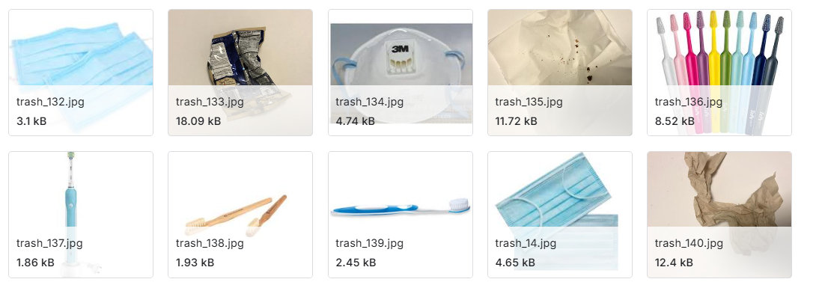
DATASETS AND REQUIREMENTS
DATASET:
Garbage Classification Dataset
The dataset includes 10 distinct waste categories with a total of 19,762 images, making it suitable for training waste classification models and improving recycling efficiency.
The classes include Metal (1,020 images), Glass (3,061), Biological waste (997), Paper (1,680), Battery (944), Trash (947), Cardboard (1,825), Shoes (1,977), Clothes (5,327), and Plastic (1,984). It is well-suited for developing classification or object detection models and creating AI-powered solutions for sustainable waste disposal.
SOURCE: Kaggle - https://www.kaggle.com/datasets/sumn2u/garbage-classification-v2/data

Slide 11
REQUIREMENTS:
Hardware:
GPU-enabled system for faster training (e.g. Google Colab, Kaggle )
Minimum 16GB RAM
Software & Frameworks:
Deep Learning: TensorFlow, Keras
Preprocessing: OpenCV, NumPy, Pandas
Programming Language : Python
Scikit-learn: Utilized for model evaluation metrics such as accuracy and dataset splitting.

Slide 12
ALGORITHMS INVOLVED
Algorithm :
For this project, we use ResNet-50, a deep neural network, for accurate waste classification, leveraging residual learning to overcome the vanishing gradient problem and enable deep network training. For recycling, we implement a Rule-Based System, which applies predefined rules to determine proper disposal methods. This combination ensures efficient, automated waste sorting and recycling management.
ResNet-50 :
A deep residual learning model designed to improve accuracy in image classification.
Uses skip connections to enable efficient training of deep networks.
Reduces the impact of vanishing gradients, allowing for better feature extraction.
Achieves high accuracy with optimized computational efficiency, making it ideal for waste classification and recycling management.
MobileNet :
A lightweight CNN optimized for mobile and embedded devices.
Uses depthwise separable convolutions to reduce size and computation.
Ideal for real-time waste classification on low-power or edge devices.
Maintains strong performance across waste categories with fast inference and minimal resource usage.

Slide 13


FORMULAS:
Convolution Operation:
(I∗K)(x,y)=m∑​n∑​I(x+m,y+n)⋅K(m,n)
Activation Function (ReLU):
f(x)=max(0,x)
Global Average Pooling:
Fully Connected (Dense) Layer:
Y=f(WX+b)
Softmax (Output Layer):

Slide 14
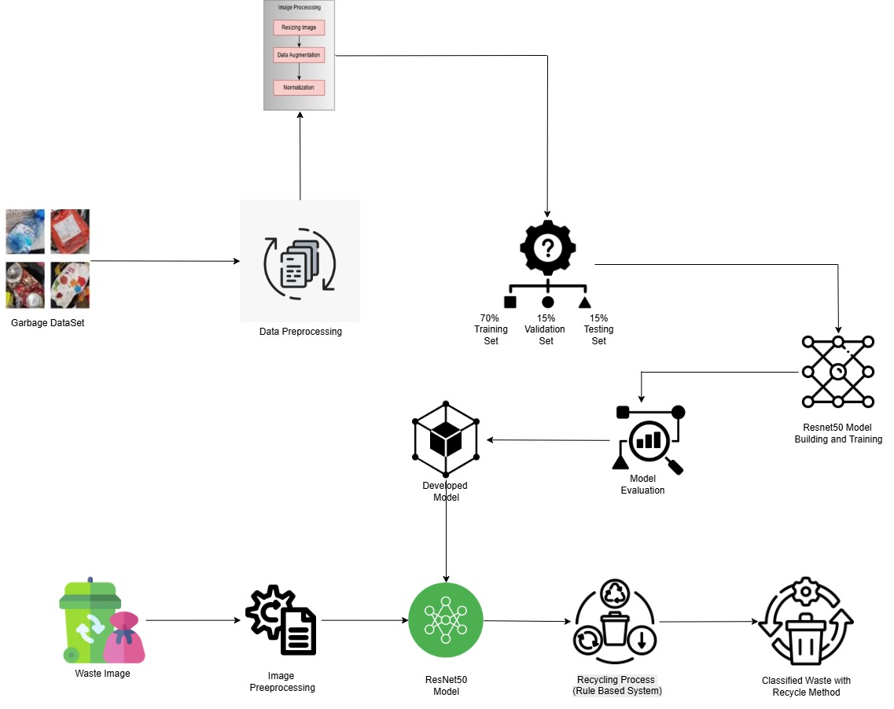
ARCHITECTURE DIAGRAM

Slide 15
Implementation steps and Execution
1. Dataset Collection:
Used a Kaggle dataset for Garbage Classification containing 19,762 images.
The dataset includes labeled images of various waste types for multi-class classification.
2. Data Preprocessing:
Normalization: Scaled pixel values to the [0,1] range to ensure consistent input for the model.
Resizing: Resized all images to 224×224 pixels to match the input size of the model.
Augmentation: Applied transformations like rotation, zoom, shear, and flipping to enhance model generalization.
Dataset split: Training – 70%, Testing – 15%, Validation – 15%.
3. Model Selection and Architecture:
ResNet-50 :
Used ResNet-50, a deep convolutional neural network pre-trained on ImageNet.
Fine-tuned the model by adding custom dense layers for multi-class garbage classification.
Unfroze the top layers of ResNet-50 for transfer learning to enhance feature learning and improve accuracy.

Slide 16
MobileNet:
Used MobileNet, a lightweight and efficient CNN pre-trained on ImageNet, ideal for mobile and real-time applications.
Replaced top layers with custom dense layers for 10-class waste classification, including dropout and batch normalization for regularization.
Fine-tuned upper layers of MobileNet to leverage transfer learning and improve classification accuracy.
4.Training Process:
Used Adam optimizer with an initial learning rate of 0.0001, adjusted via Exponential Decay Scheduling for fine-tuning.
Applied categorical cross-entropy loss and Early Stopping (patience = 5) to optimize learning and prevent overfitting.
Training involved two phases: initial training with frozen ResNet-50 base, followed by fine-tuning the top 100 layers to boost performance.
5. Execution :
The entire pipeline—from data preprocessing to model training and evaluation—was executed on Kaggle's cloud platform.
Leveraged Kaggle's free GPU acceleration to significantly reduce training time and improve model efficiency.

Slide 17
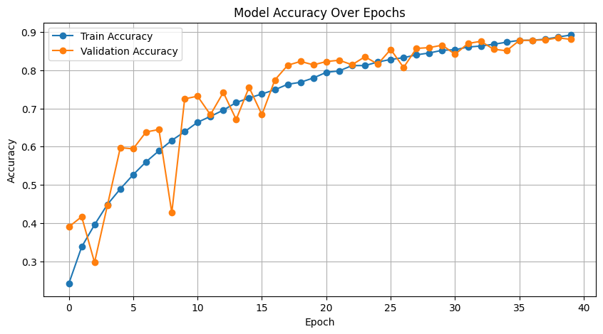
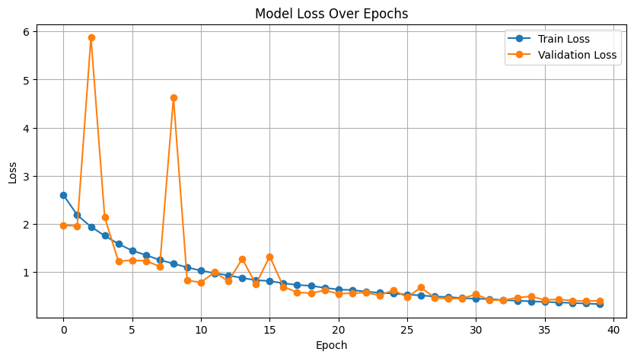
RESULTS OBTAINED
ResNet50

Slide 18
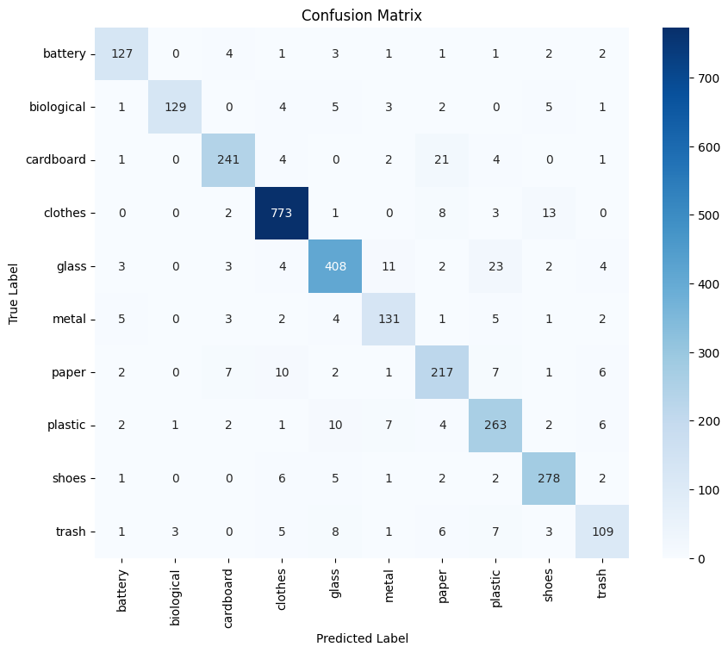
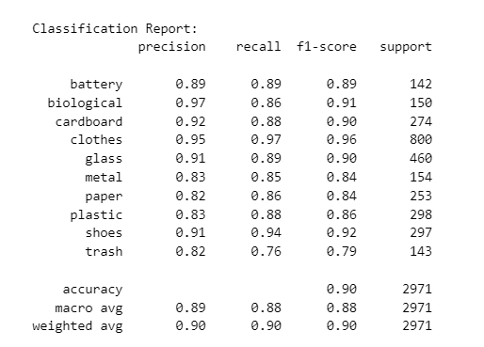
CONFUSION MATRIX
CLASSIFICATION REPORT

Slide 19
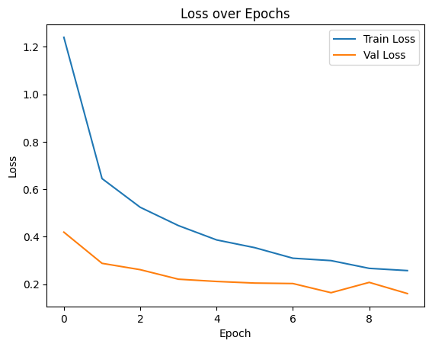
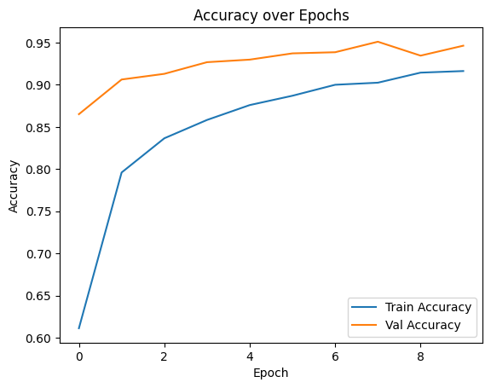
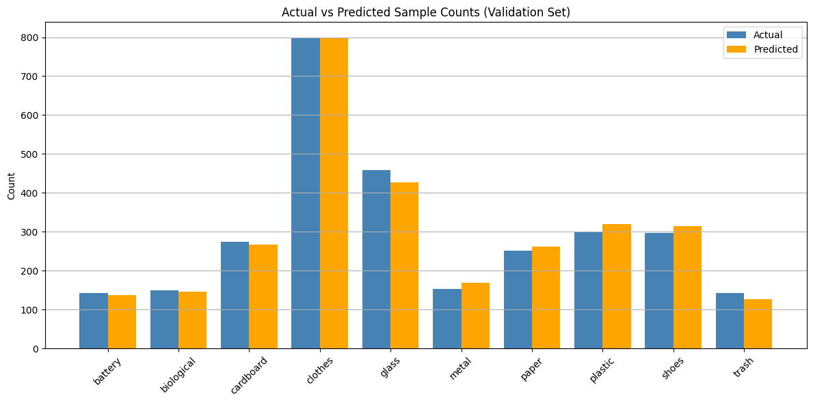
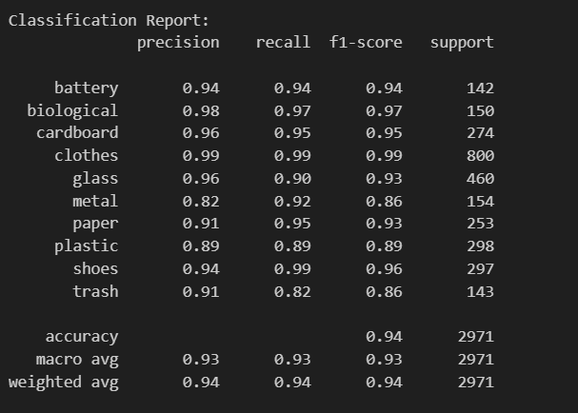
MobileNet

Slide 20
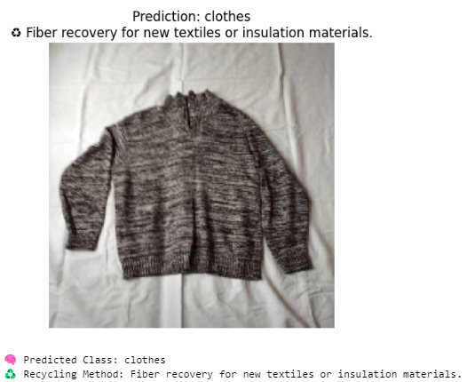
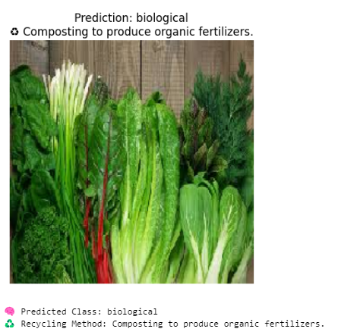
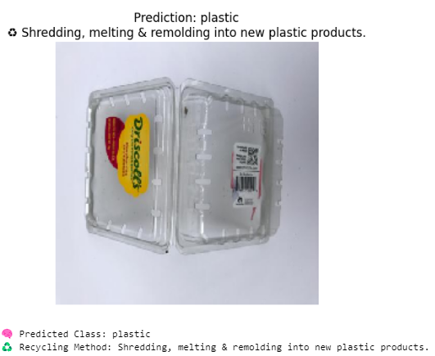
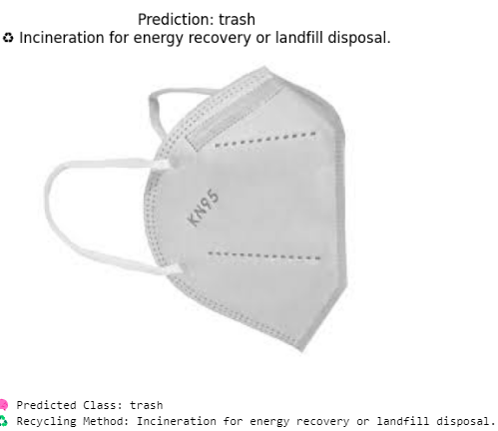
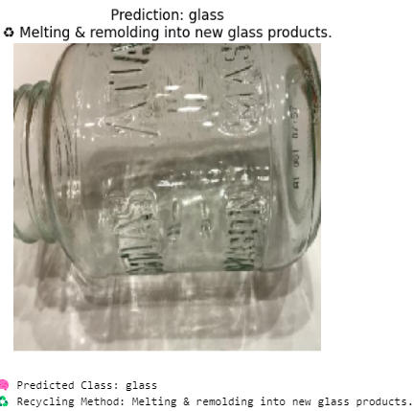
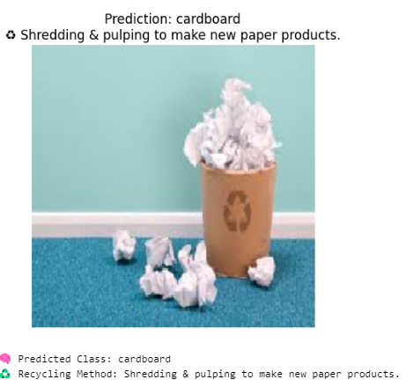
ResNet50 Model Prediction:

Slide 21
Results Analysis
ResNet50 :
The model achieved a final accuracy of 90.83%, effectively classifying various types of waste.
Performed best on clothes (F1: 0.96) and shoes (F1: 0.92), showing strong recognition of visually distinct items.
Training and validation accuracy improved consistently, showing strong learning and generalization.
Loss curves decreased steadily, indicating efficient error minimization during training.
Along with classification, the model also recommends proper recycling methods for each waste type, enhancing its practical utility.
MobileNet :
Achieved a final accuracy of 87.37%, accurately classifying different waste types.
Training and validation accuracy improved steadily, showing good learning and generalization.
Loss reduced consistently, indicating stable and efficient training.
Model maintained a balanced performance across most classes, ensuring no significant bias toward any particular waste category.

Slide 22
CONCLUSION
This project presented a robust deep learning solution for waste classification and recycling recommendation using image data.
A fine-tuned ResNet-50 CNN model was employed, achieving high accuracy across multiple waste categories.
The system not only classifies waste but also suggests relevant recycling methods, enhancing its practical utility.
Two models were implemented and evaluated:
A ResNet-50 model, a deep CNN with residual connections, used as a strong baseline for waste classification.
A MobileNet model, designed for lightweight and efficient inference, fine-tuned for improved accuracy and real-time deployment.
It promotes automated, eco-friendly waste management, reducing manual effort and improving consistency in sorting.
The approach is scalable and adaptable, showing strong potential for smart city applications and sustainable environmental systems.

Slide 23
REFERENCES
[1] Hossen, M. M., Majid, M. E., Kashem, S. B. A., Khandakar, A., Nashbat, M., Ashraf, A., ... & Chowdhury, M. E. (2024). A reliable and robust deep learning model for effective recyclable waste classification. IEEE Access, 12, 13809-13821.
[2] Rastari, M. A. M., Roslan, R., Hamzah, R., Teo, N. H. I., Shahbudin, F. E., & Samah, K. A. F. A. (2024, August). Recycle waste detection and classification model using YOLO-V8 for real-time waste management. In 2024 IEEE International Conference on Artificial Intelligence in Engineering and Technology (IICAIET) (pp. 372-377). IEEE.
[3] Sayem, F. R., Islam, M. S. B., Naznine, M., Nashbat, M., Hasan-Zia, M., Kunju, A. K. A., ... & Chowdhury, M. E. (2024). Enhancing waste sorting and recycling efficiency: robust deep learning-based approach for classification and detection. Neural Computing and Applications, 1-17.
[4] Joseph, I. O., Wangare, N. L., Mahoque, T. P., Tewari, P., & Majumdar, S. (2023, July). E-Waste Intelligent Robotic Technology (EIRT): A Deep Learning approach for Electronic Waste Detection, Classification and Sorting. In 2023 14th International Conference on Computing Communication and Networking Technologies (ICCCNT) (pp. 1-6). IEEE.
[5] Polchan, M., Pukao, A., Cheunban, T., & Sinthupuan, S. (2023, March). Waste Management System using Waste Classification on Mobile Application. In 2023 Joint International Conference on Digital Arts, Media and Technology with ECTI Northern Section Conference on Electrical, Electronics, Computer and Telecommunications Engineering (ECTI DAMT & NCON) (pp. 229-233). IEEE.
[6] Thinakaran, R., Somasekar, J., Neerugatti, V., & Saran, P. G. (2024, August). Automated Waste Classification using Convolutional Neural Network. In 2024 14th International Conference on Software Technology and Engineering (ICSTE) (pp. 169-173). IEEE.
[7] Jain, E., & Kumar, R. (2024, November). Harnessing Deep Learning for Sustainable Waste Classification: An Innovative Approach Using MobileNetV2 on a Diverse Bag Dataset. In 2024 International Conference on Cybernation and Computation (CYBERCOM) (pp. 335-339). IEEE.

Slide 24


