Slide 1
Attack detection in CANBUS
OBJECTIVE : To create a system which can detect DoS, Fuzzy and Impersonation attack and testing it on a CANBUS simulator.
Advisor : Prof. Smruti Sarangi
By : Tarun Sai Ganesh
Mentor : Omais Shafi

Slide 2
Outline
Types of attacks on CANBUS
Attack detection method
Linear regression for DoS & Fuzzy attacks
Neural network and SVM for Impersonation attack
Raspberry Pi simulator

Slide 3
Outline
Types of attacks on CANBUS
Attack detection method
Linear regression for DoS & Fuzzy attacks
Neural network and SVM for Impersonation attack
Raspberry Pi simulator

Slide 4
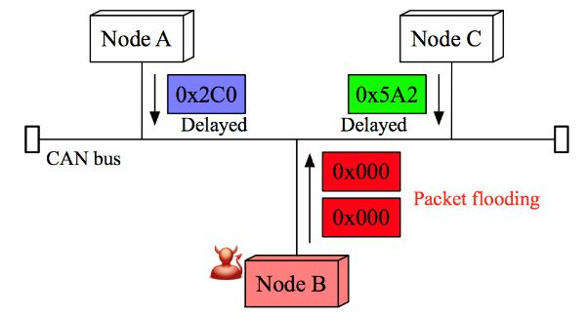
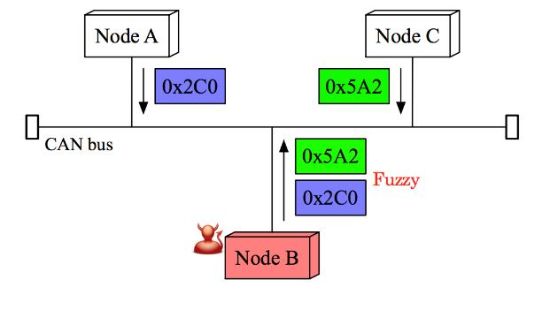
Types of attacks
DoS attack
- Injection of large number of highest priority messages.
- Causes delay
(2) Fuzzy attack
- Injection of messages with random data
- Causes unintended behaviour.

Slide 5
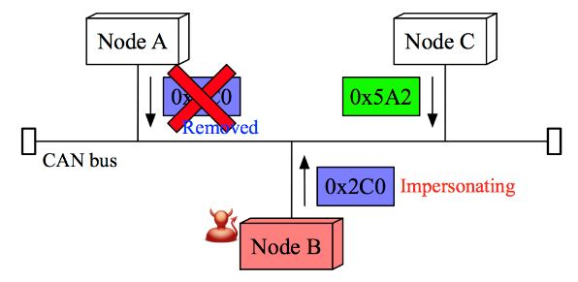
(3) Impersonation attack
Compromise an existing node, and
replace it by a malicious node
Can take complete control of the bus.
Remote frame : A frame which is used to request data with a particular identifier. It does not contain any data.
              Remote frame
Data frame : A frame which contains the data. Frame is distinguished by its identifier.
        Data frame
Types of frames:

Slide 6
Outline
Types of attacks on CANBUS
Attack detection method
Linear regression for DoS & Fuzzy attacks
Neural network and SVM for Impersonation attack
Raspberry Pi simulator

Slide 7
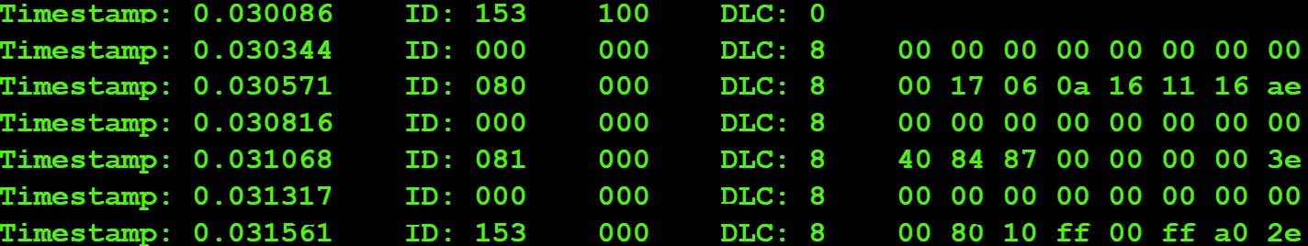
Attack detection method
Remote( data request ) frame is sent into the bus and wait till we get response frame.
Offset = number of frames that travel on the bus between a remote frame and corresponding data frame.
Time interval = time gap between remote frame and data frame

Slide 8
Outline
Types of attacks on CANBUS
Attack detection method
Observations
Linear regression for DoS & Fuzzy attacks
Neural network and SVM for Impersonation attack
Raspberry Pi simulator

Slide 9
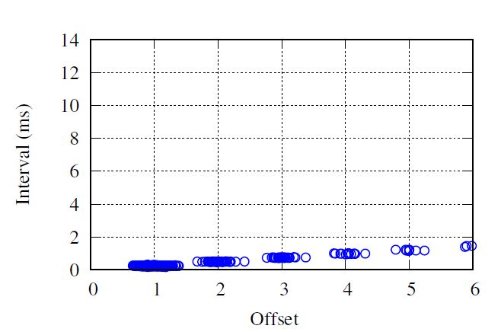
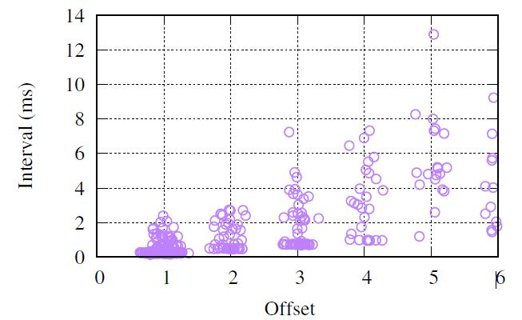
Observations :
In attack free state, offset and interval are linearly related.
This linear relationship is lost when there is DoS attack or Fuzzy attack.
Interval vs Offset in attack free state Interval vs Offset in attack state

Slide 10
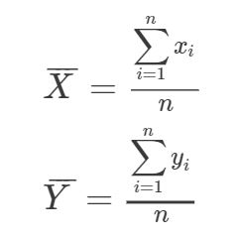
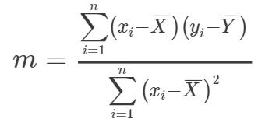

Use Linear regression for message injection ( DoS and Fuzzy) attack:
Fit a line using least squares method:
For data points , , to fit line Y = mX + c

Slide 11
Outline
Types of attacks on CANBUS
Attack detection method
Observations
Linear regression for DoS & Fuzzy attacks
Neural network and SVM for Impersonation attack
Raspberry Pi simulator

Slide 12


Impersonation detection using Time interval:
It is observed that when impersonation attack occurs,
Average time taken by malicious Average time taken by original
node to respond to remote frame node to respond to remote frame
Using threshold :
- If test interval > µ → message is fake
- If test interval > µ → message is real

Slide 13
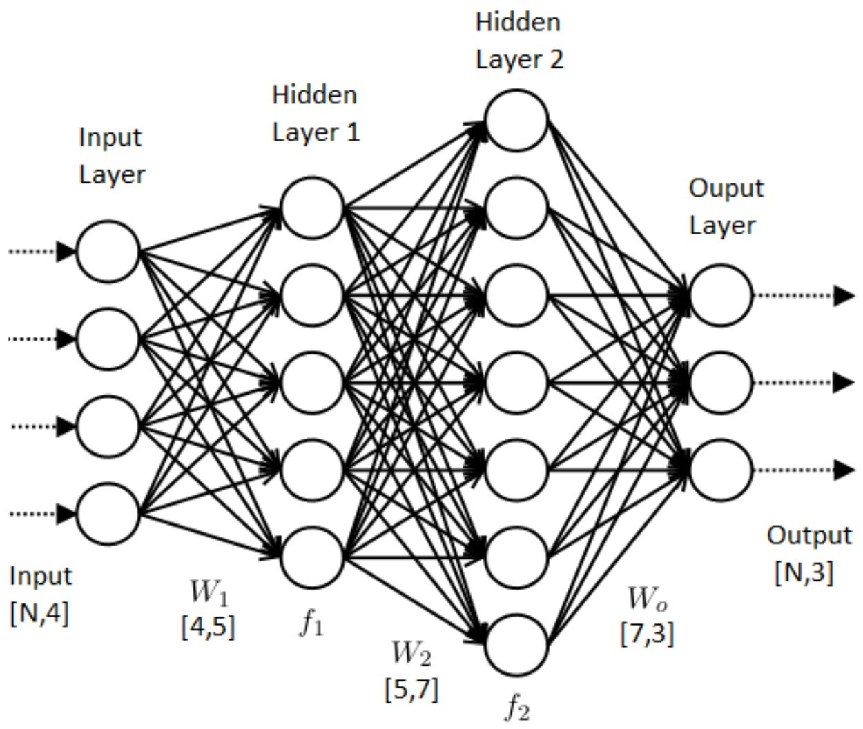
(b) Neural network:
Number of hidden layers used = 1
Number of neurons in hidden layer = 5
Results obtained :
ConfusionMatrix | YES | NO
YES | 0.3412698413 | 0.1388888889
NO | 0.121031746 | 0.3988095238
Accuracy 0.7400793651 (74%)
Precision 0.7107438017 (71%)
Recall 0.7381974249 (73%)

Slide 14
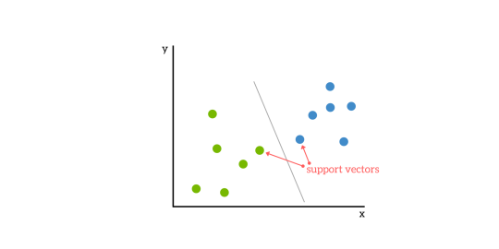
(c) Support vectors :
Accuracy = 0.6531572219
Number of support vectors = 26

Slide 15
Outline
Types of attacks on CANBUS
Attack detection method
Observations
Linear regression for DoS & Fuzzy attacks
Neural network and SVM for Impersonation attack
Raspberry Pi simulator

Slide 16
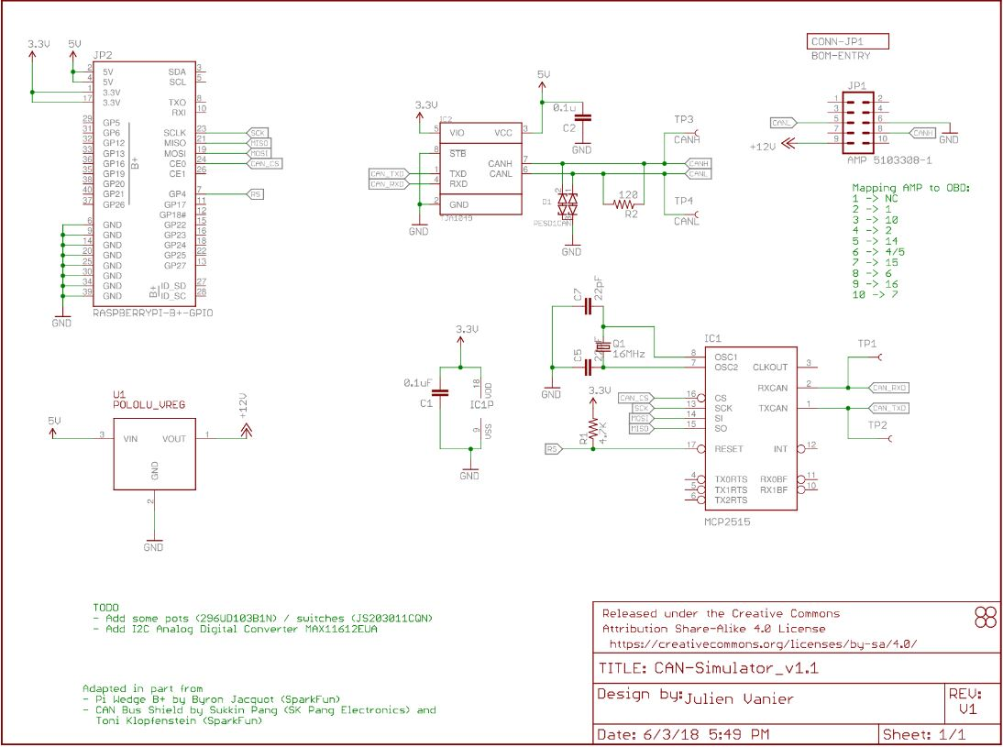
CAN message Simulator –
Using Raspberry Pi, MCP2515 microcontroller

Slide 17
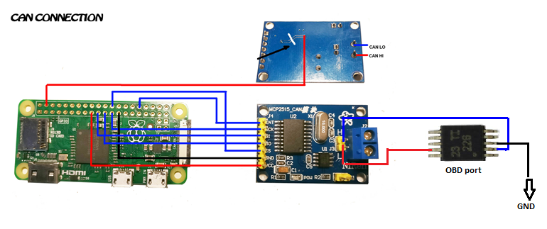
Circuit of the Simulator :
Messages on CANBUS can be read through OBD port similar to real vehicle
- MCP2515 converts logic levels to differential voltage levels of 12V, 5V etc

Slide 18
References :
http://ocslab.hksecurity.net/Dataset/CAN-intrusion-dataset
https://www.ucalgary.ca/pst2017/files/pst2017/paper-67.pdf
https://github.com/carloop/simulator
https://towardsdatascience.com/how-to-build-a-neural-network-with-keras-e8faa33d0a...

