Slide 1
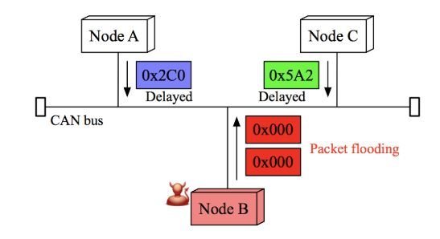
CANBUS security
Target paper : https://www.ucalgary.ca/pst2017/files/pst2017/paper-67.pdf
CAN
It is a broadcast protocol; hence attacker can easily inject any message
Work
Firstly I am trying to build simple classification technique by keeping threshold time interval as average of all the time intervals in dataset, as done in the paper.
Further, we will try to improve classification accuracy by tuning the threshold using ML techniques
Bus communication protocol for efficient transmission between in-vehicle nodes

Slide 2
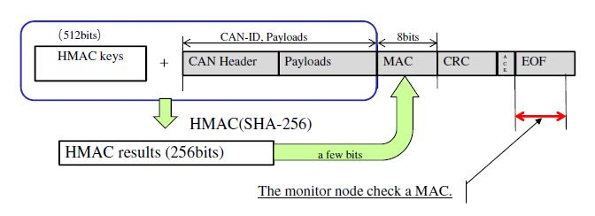
Related work :
In-vehicle networks of current vehicles lack security mechanisms against attacks:
Message Authentication Codes(MACs)
Each node stores key elements which are composed of identifier table, receiving and sending counters and the pairwise symmetric secret keys for the authentication process.
Drawback : Simple cryptographic functions used for decoding the key are easily compromised whereas complicated functions( like hash tables) require large computing power at each node
Centralised system
all the ECUs are connected to a central device and the central monitor verifies the authenticity of the message before it sends it to destined node.
Drawback : Throughput of will be less, ie., message transfer rate will be very low
Time stamp based distinction
Our target paper proposed a novel idea of intrusion detection using delay time interval between request and response messages.
Using MAC authentication codes

Slide 3
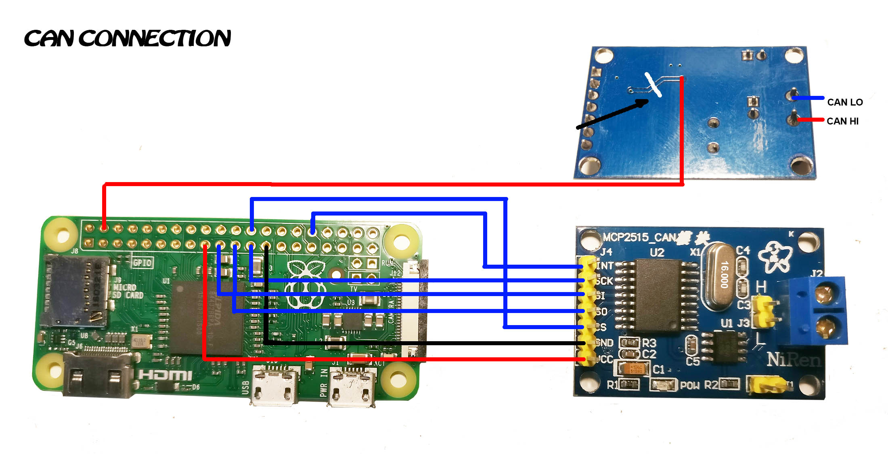
Work done :
Jan 2019 – mid Feb 2019 : Survey of different research papers published in this area
March 2019 : Design and simulation of CANBUS using Raspberry pi and other microcontrollers
Present :
Obtained a model dataset of CAN messages Implementing the algorithm proposed in the paper and check the accuracy

Slide 4
Future plans :
Once we get the proposed algorithm working:
Will try to improve accuracy by changing threshold
If possible, we will try to extract a new feature and not relying solely on offset time
After building the model, we will test it on CANBUS simulator made using Raspberry pi.

