Slide 1

Effect of Caching in a Content-Based Pub/Sub System using Kafka
Distributed Restaurant and Customer Publish/Subscribe System
Mason Nienaber, Radhit Dedania, Tarun Sai Ganesh Nerella

Slide 2
Motivation & Objectives
Database access results in significant delay
Implement content-based pub/sub system over Kafka
Cache messages at broker architecture
Due to limited capacity, employ various eviction strategies
Analyze and compare various eviction policies
Latency, throughput, hit rate, etc.
Employ two trivial caching strategies
NO caching, unlimited caching
Employ three novel eviction policies
Based on number of subscribers to record
Threshold, batched average, buffered

Slide 3
Related Works
Notification System
Thialfi
Siena
Pub/Sub Systems
SpiderCast
PolderCast
PADRES
Cluster-based Pub/Sub
Hermes
Cache Eviction Policy
Utility-driven: Maximizing overall sum of utilities(objective function) across subscribers
TTL based: sets an expiration time on each object

Slide 4
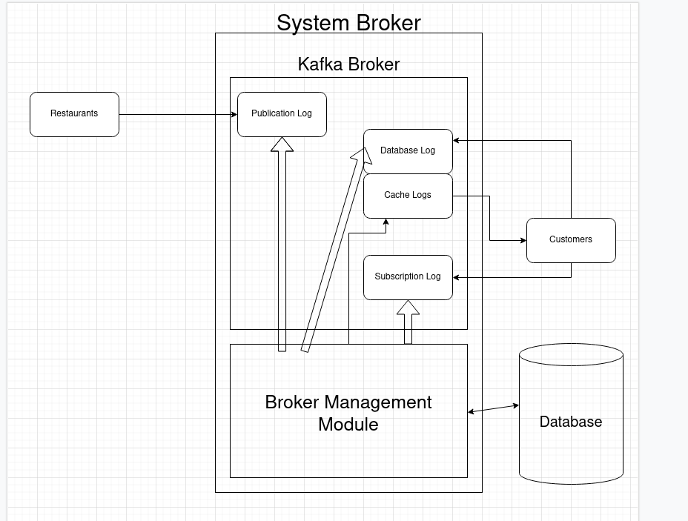
System Diagram

Slide 5
Workflow Diagram
6
2
4
5
6
7
8
8
9
Publication Log
Database Log
1
2
3
5
7
10
11
12
Consumer 1
Consumer 1 Log
5
7
1
2
3
4
6
7
9
10
Consumer 2
Consumer 2 Log
1
1
3
4
5
6
8
9
10
Consumer 3
4
Consumer 3 Log
12
Broker Management Module
Publication Record
Pub ID: Message
Sub ID + Seq No.(Key): Message(Value)
Database
(Key-Value Store)
3
Consumption Record
Poller
Cache Controller
4
Seq No: Message
2
11
Sub ID + Seq No.(Key)
Hash Tables
Database
Connector
9
Database Log Record
8
Message(Value)
10
Sub ID: Seq No.

Slide 6
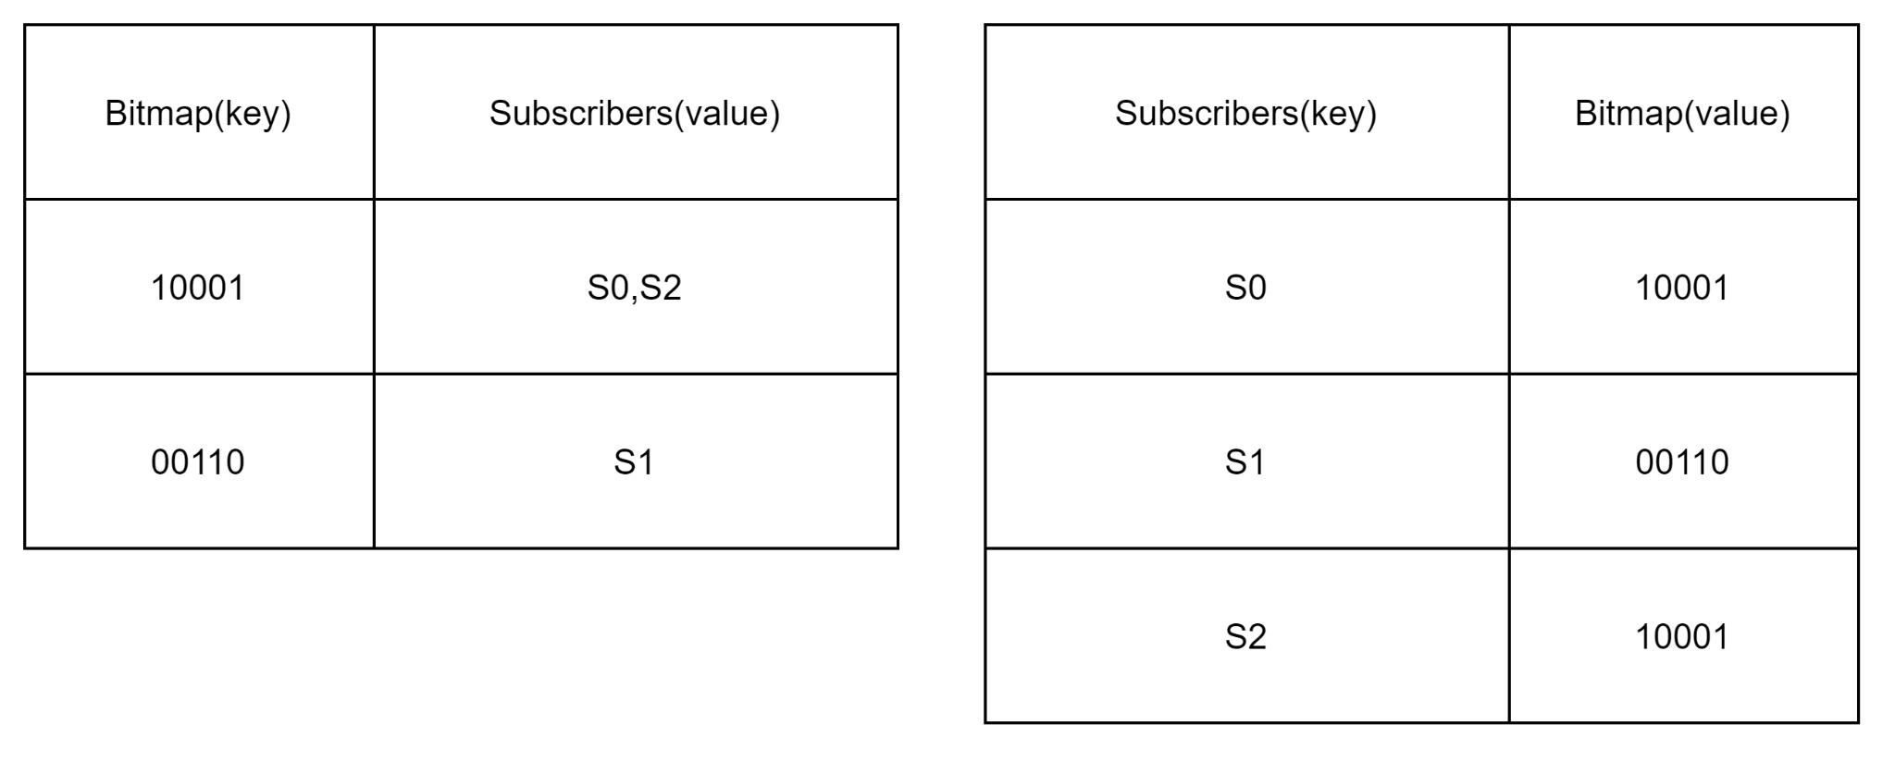
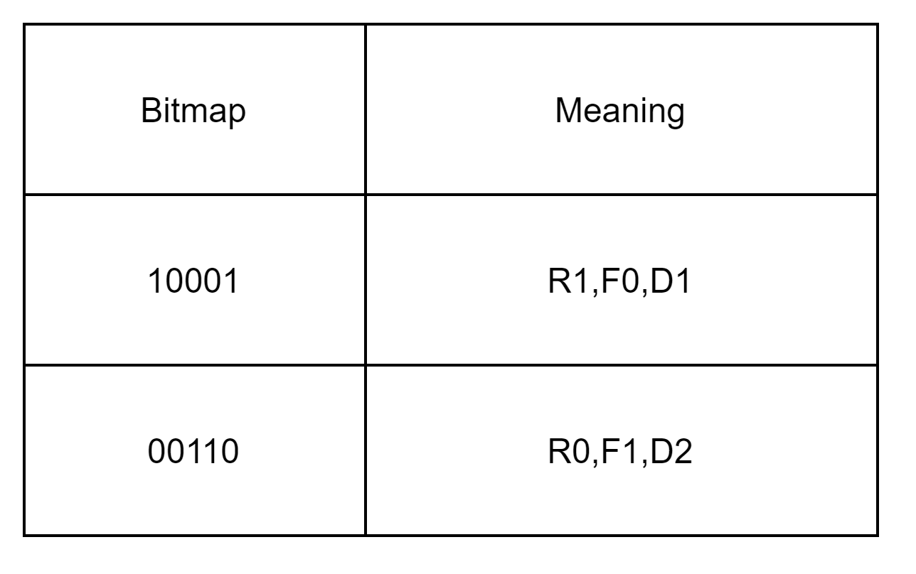
Data Structures & Representation
Forward Hash Table
Reverse Hash Table
BitMap Representation

Slide 7
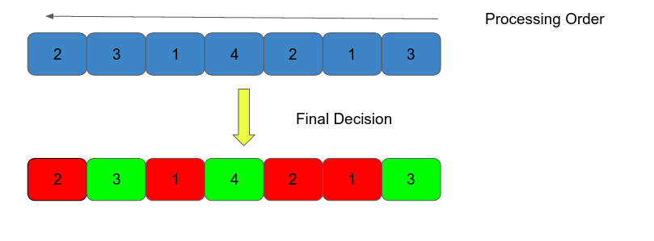
Caching Policies
Threshold Policy
Threshold = threshold + x*lambda*CV
-(1-x)*mu*CV
lambda = 0.5
mu = 0.5
CV = current value
{ x = 1 ; if cached
x = 0; not cached}

Slide 8
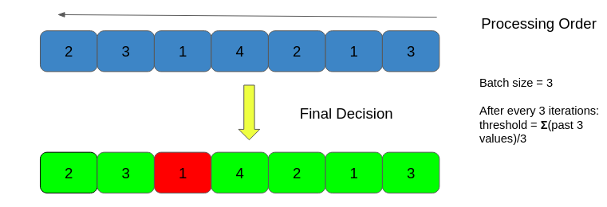
Caching Policies cont...
Mean Policy

Slide 9
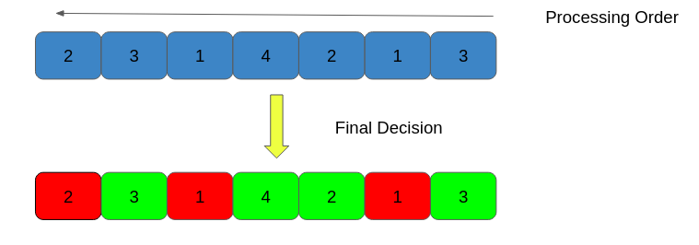
Caching Policies cont...
Buffering Policy
Threshold = gamma* cv +
Alpha * pv;
gamma = 0.7
alpha = 0.3
cv = current value
pv = previous value

Slide 10
Testing & Evaluation
Seven experiments
Four caching metrics
Input publication size benchmarks
500,800,1000,2000,5000,10000
Cache hit rate, duplication factor, end-to-end latency, throughput
Three novel caching policy parameter optimizations
Threshold (lambda/mu), Mean (batch size), Buffering (alpha/gamma)

Slide 11
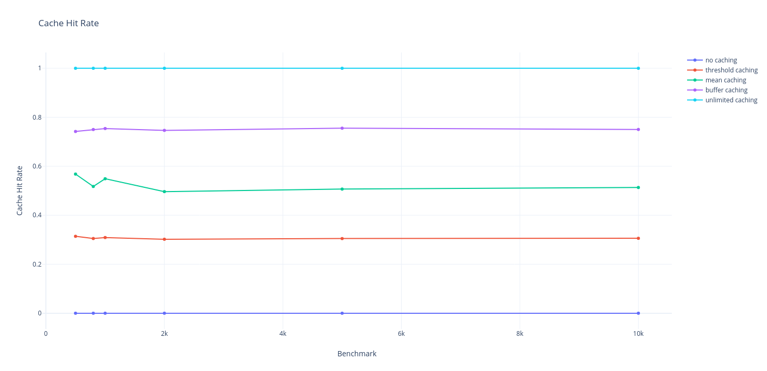
Cache Hit Rate vs. Benchmarks

Slide 12
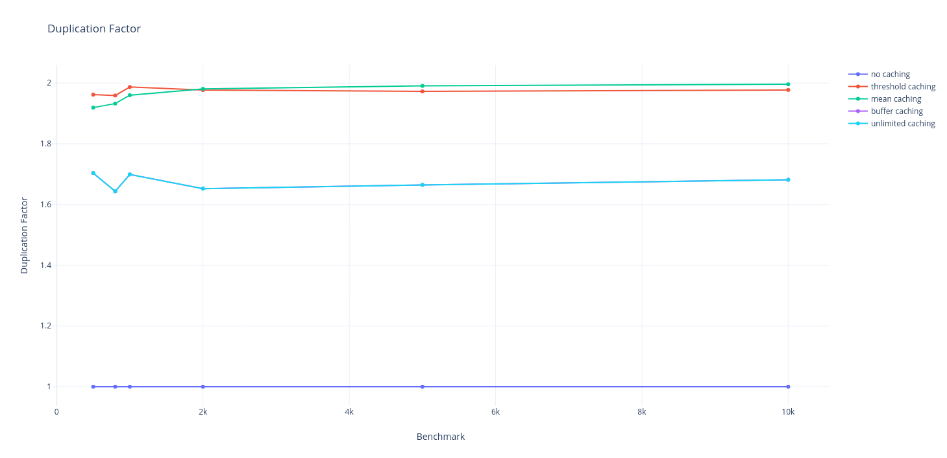
Duplication Factor vs. Benchmarks

Slide 13
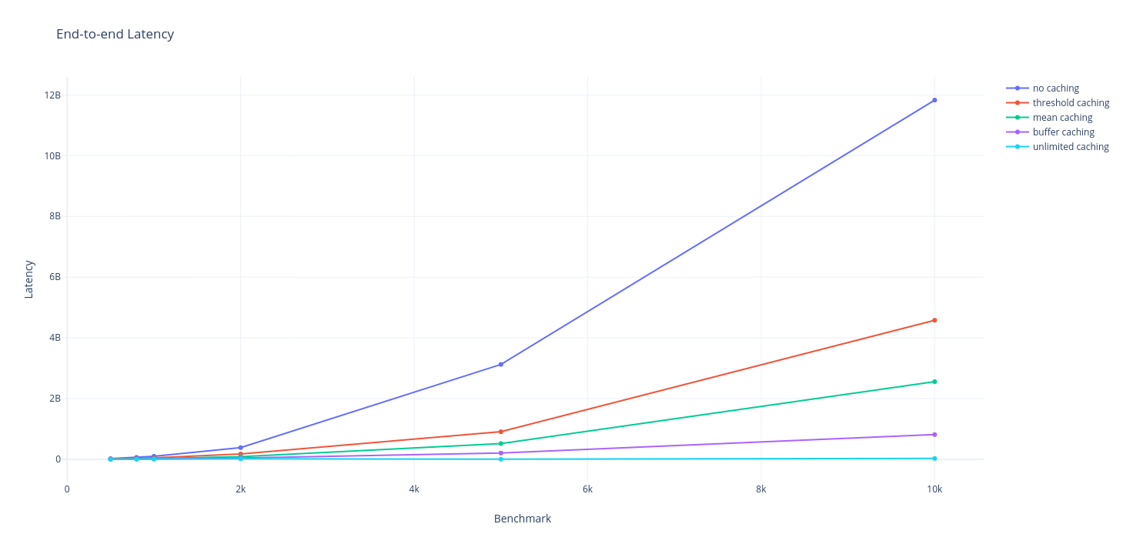
Latency vs. Benchmarks

Slide 14
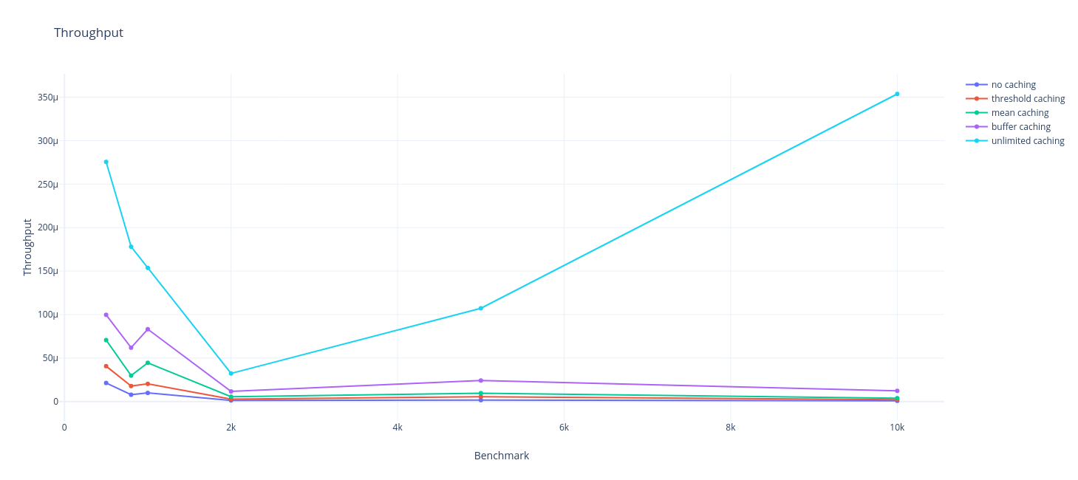
Throughput vs. Benchmarks

Slide 15
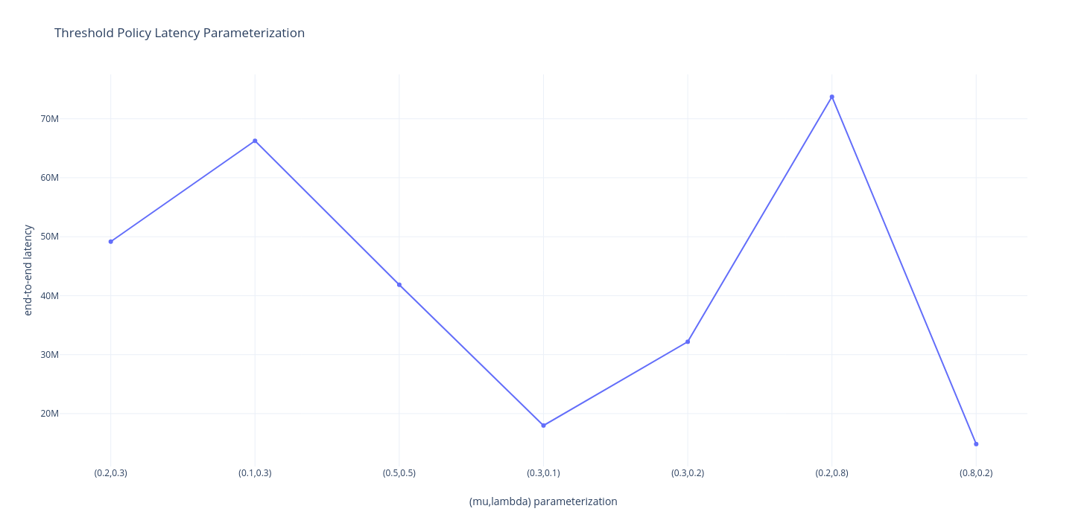
Threshold Policy Optimization

Slide 16
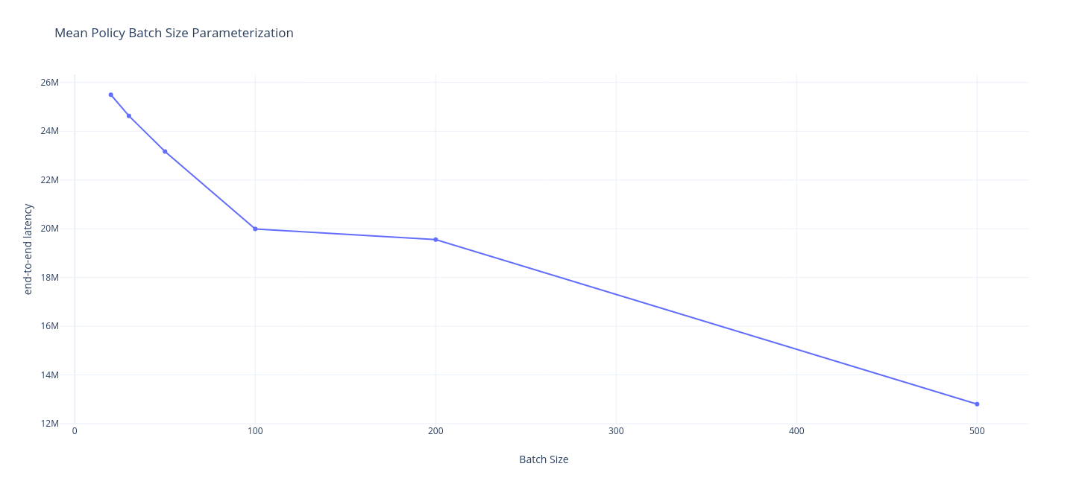
Mean Policy Optimization

Slide 17
Future Work
Dynamic Addition/Removal of Publishers & Consumers
Enrichment of Publication Content
Modification of Subscriptions over time
Cache Size Aware Caching Policies

Slide 18
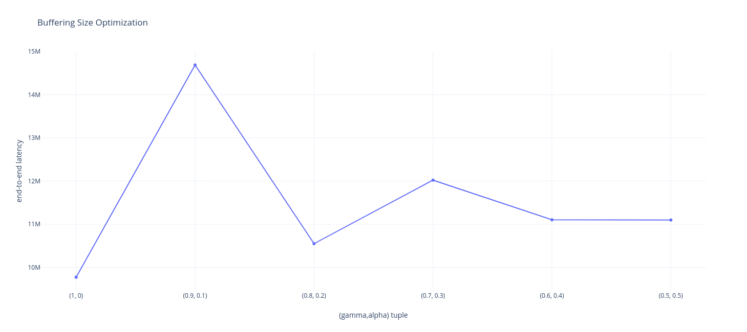
Buffering Policy Optimization

Slide 19
Conclusion
Content-Based Pub/Sub over Kafka
Highlight the benefits of caching at broker for QoS purposes
Design of three novel caching policies
Performance comparison across policies
Scalability with respect to Publishers
High availability & Fault tolerance (inherently provided by Kafka)

Slide 20
Questions?

Slide 21
Thank you

