Slide 1
Diabetic Retinopathy Detection
Kunal Narayan(2016EE10439)
Tarun(2016EE10438)

Slide 2
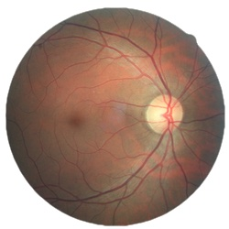
Problem statement:
Diabetic Retinopathy : leading cause of blindness in the working-age population
Severity Diabetic retinopathy in each image on a scale of 0 to 4, according to the following scale
0 - No DR
1 - Mild
2 - Moderate
3 - Severe
4 - Proliferative DR

Slide 3
Problem statement (contd):
Large dataset of high-resolution retina images of left and right eye can be used to identify DR to fair level of accuracy
Challenges:
The images in the dataset come from different models and types of cameras
Images have different brightness, saturation and may be inverted
Preprocessing required to bring all images onto the same page

Slide 4
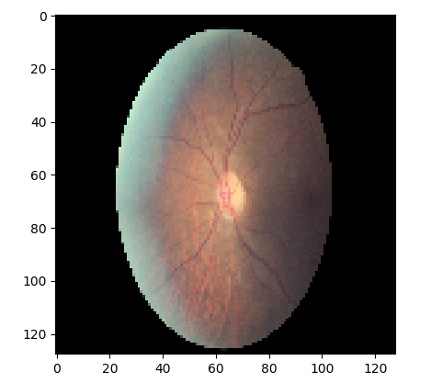
Preprocessing :
Done in batches each consisting of 48 images
Cropped all the images to remove unnecessary regions
Adjusted the brightness, contrast, saturation and hue for the images to the desired levels
Reduced pixel count of all images to (128,128) or (224,224) or (299,299) depending on the model used
Training data has 35,124 images classified into 5 different classes.
Class 0 : 25809
Class 1 : 2442
Class 2 : 5292
Class 3 : 873
Class 4 : 708
Preprocessed sample image
(128, 128)

Slide 5
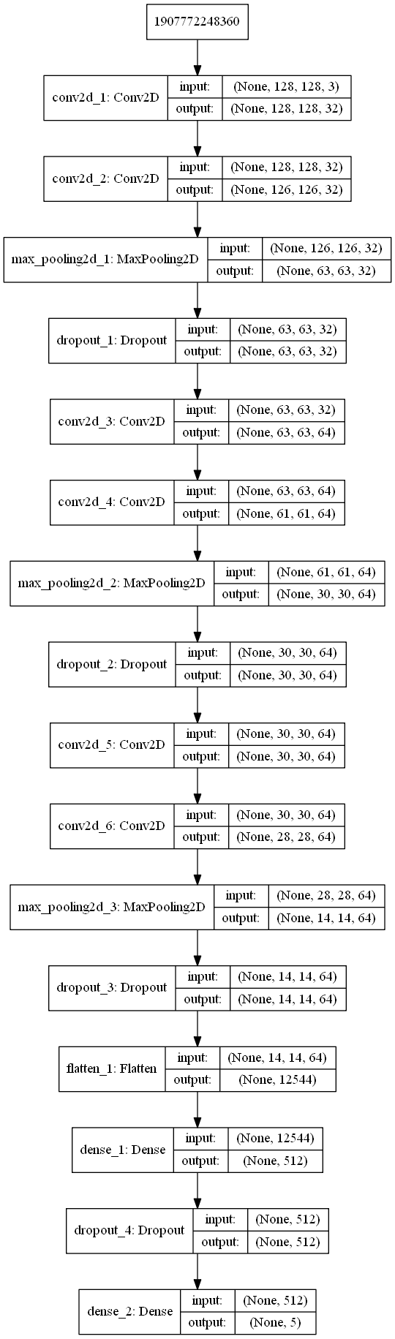
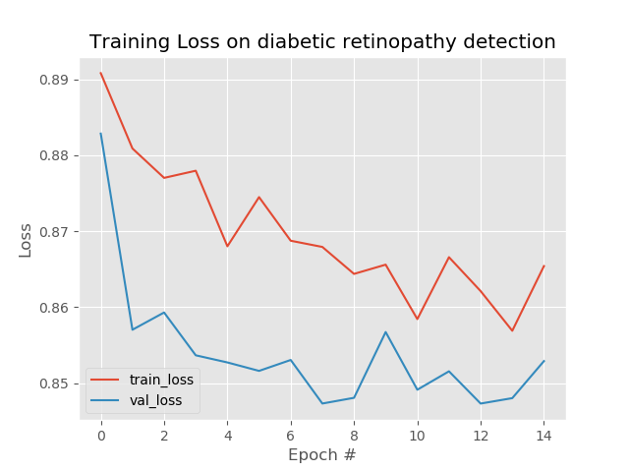
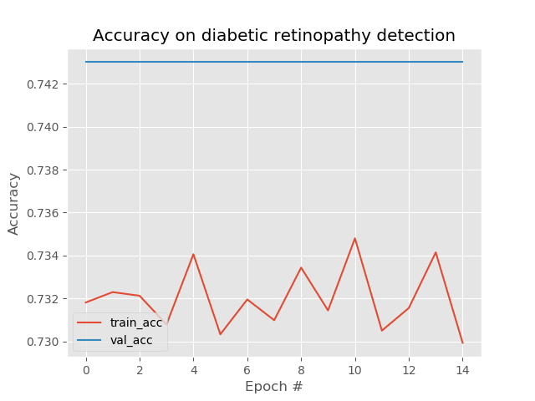
Try 1 :
Model
Tested the dataset on a self made model shown (input size = (128,128)) :
Validation accuracy obtained ~ 74%
Train accuracy obtained ~ 73%

Slide 6
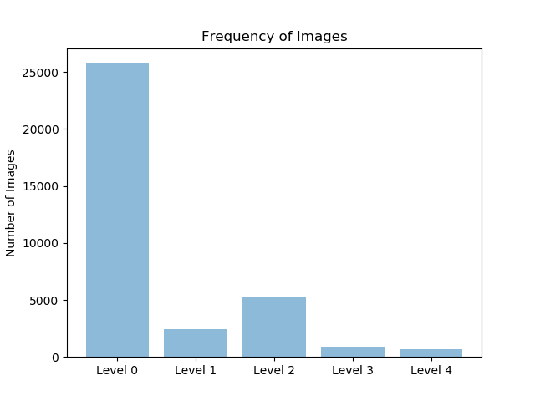
Try 1(contd) :
Problem encountered :
Most of the predicted labels for test samples are 0’s and 2’s
Reason :
Skewed dataset; Most of the images of class 0 .
Complex model overfit the data

Slide 7
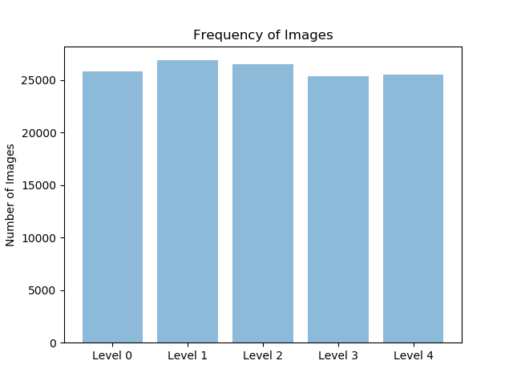
Data Augmentation :
If an images of the retina is rotated or flipped or the brightness is changed, the level of the disease will not change.
So a more random and larger dataset can be created using these transformations.
New training data has 120,621 images classified into 5 different classes.
Class 0 : 25,809
Class 1 : 24,420
Class 2 : 21,168
Class 3 : 24,444
Class 4 : 24,780
Training data = 98,230 images
Validation data = 22,391 images

Slide 8
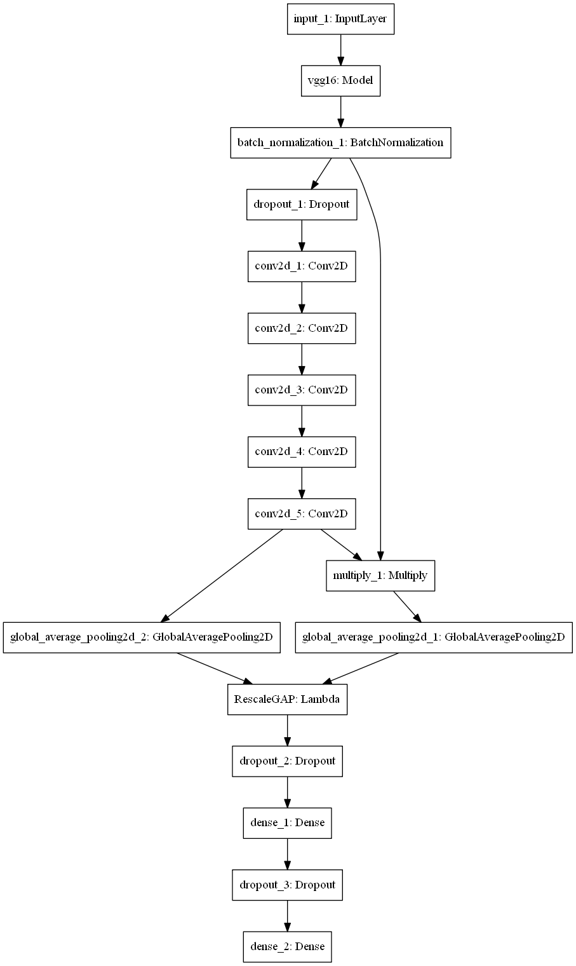
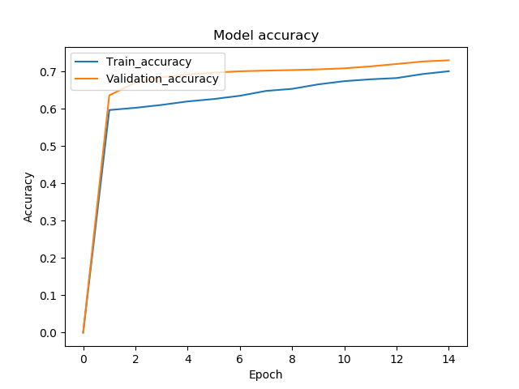
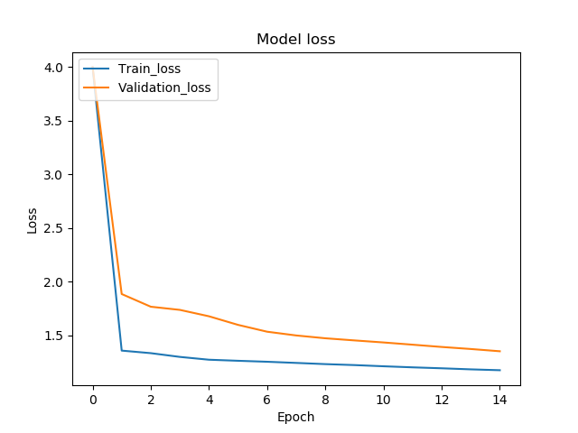
Try 2 :
Model
Tested the dataset on a self made model shown (input size = (224,224)) :
Base model used: VGG16
Validation accuracy obtained ~ 71%
Train accuracy obtained ~ 69%

Slide 9
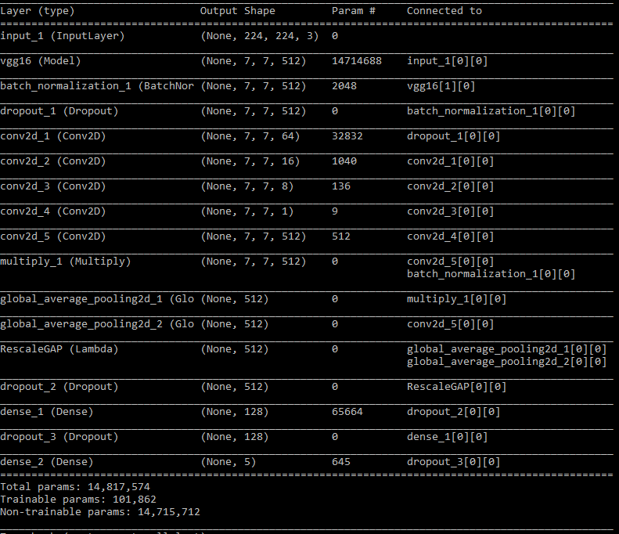
Try 2(contd) :
Model Parameters
Result:
Added 5 extra convolutional layers
Kept the number of trainable parameters at
101,862
Other parameters kept fixed with values in line
with ImageNet.
Train accuracy < Validation accuracy, indicating that
model most likely will perform better on unseen
data.

Slide 10
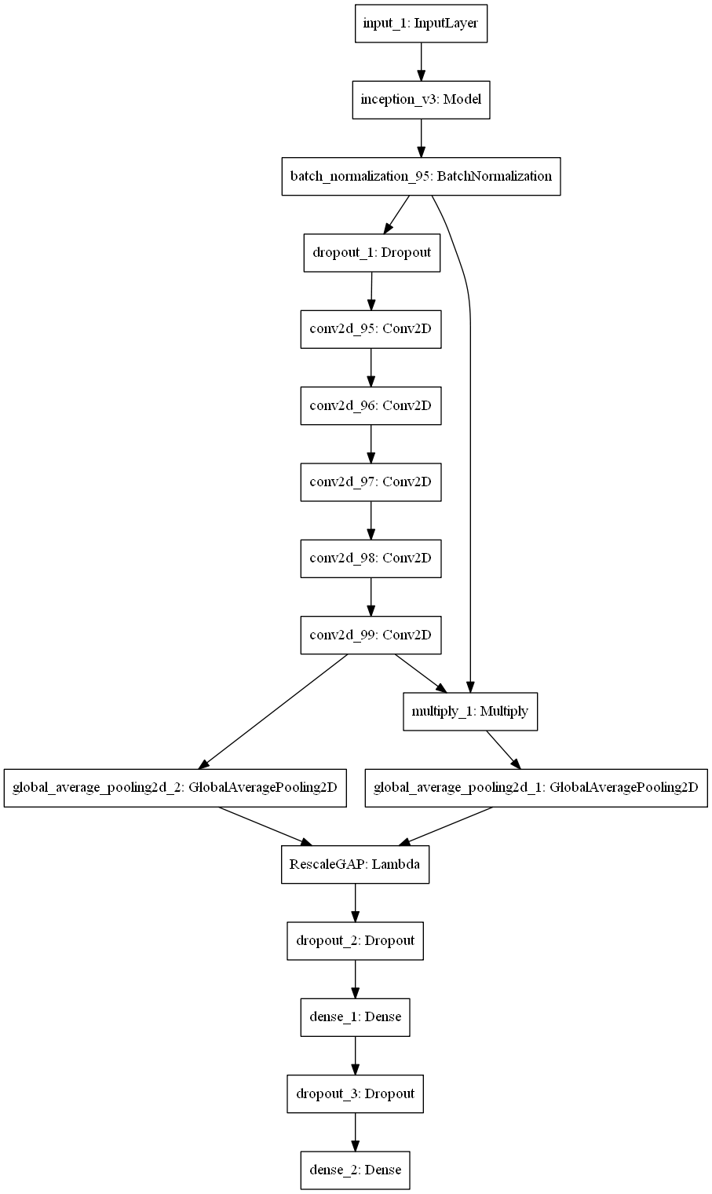
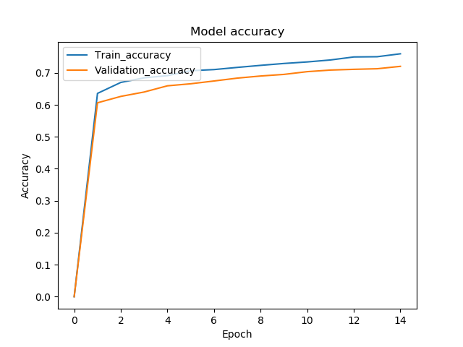
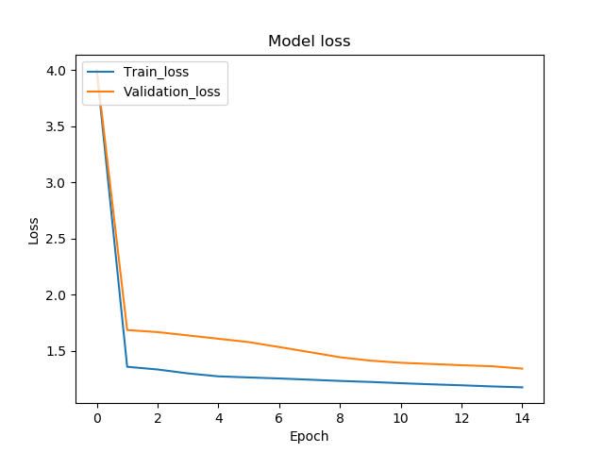
Try 3 :
Model
Tested the dataset on a self made model shown (input size = (299,299)) :
Base model used: Inception V3
Validation accuracy obtained ~ 69%
Train accuracy obtained ~ 73%

Slide 11
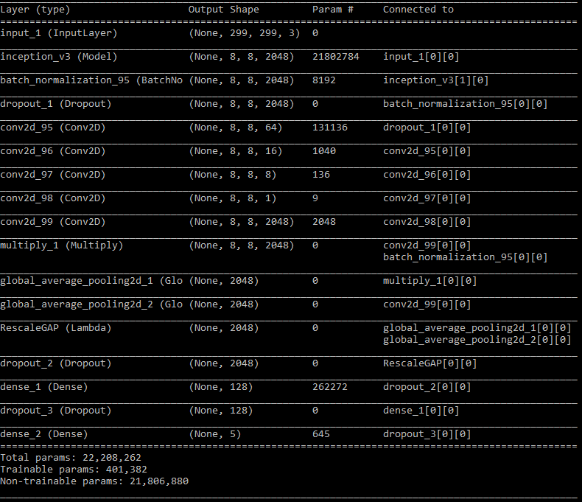
Try 3(contd) :
Model Parameters
Result:
Added 5 extra convolutional layers
Kept the number of trainable parameters at 401,382
Other parameters kept fixed with values in line
with ImageNet.
Train accuracy > Validation accuracy, indicating that model most likely will not perform better on unseen data.

Slide 12
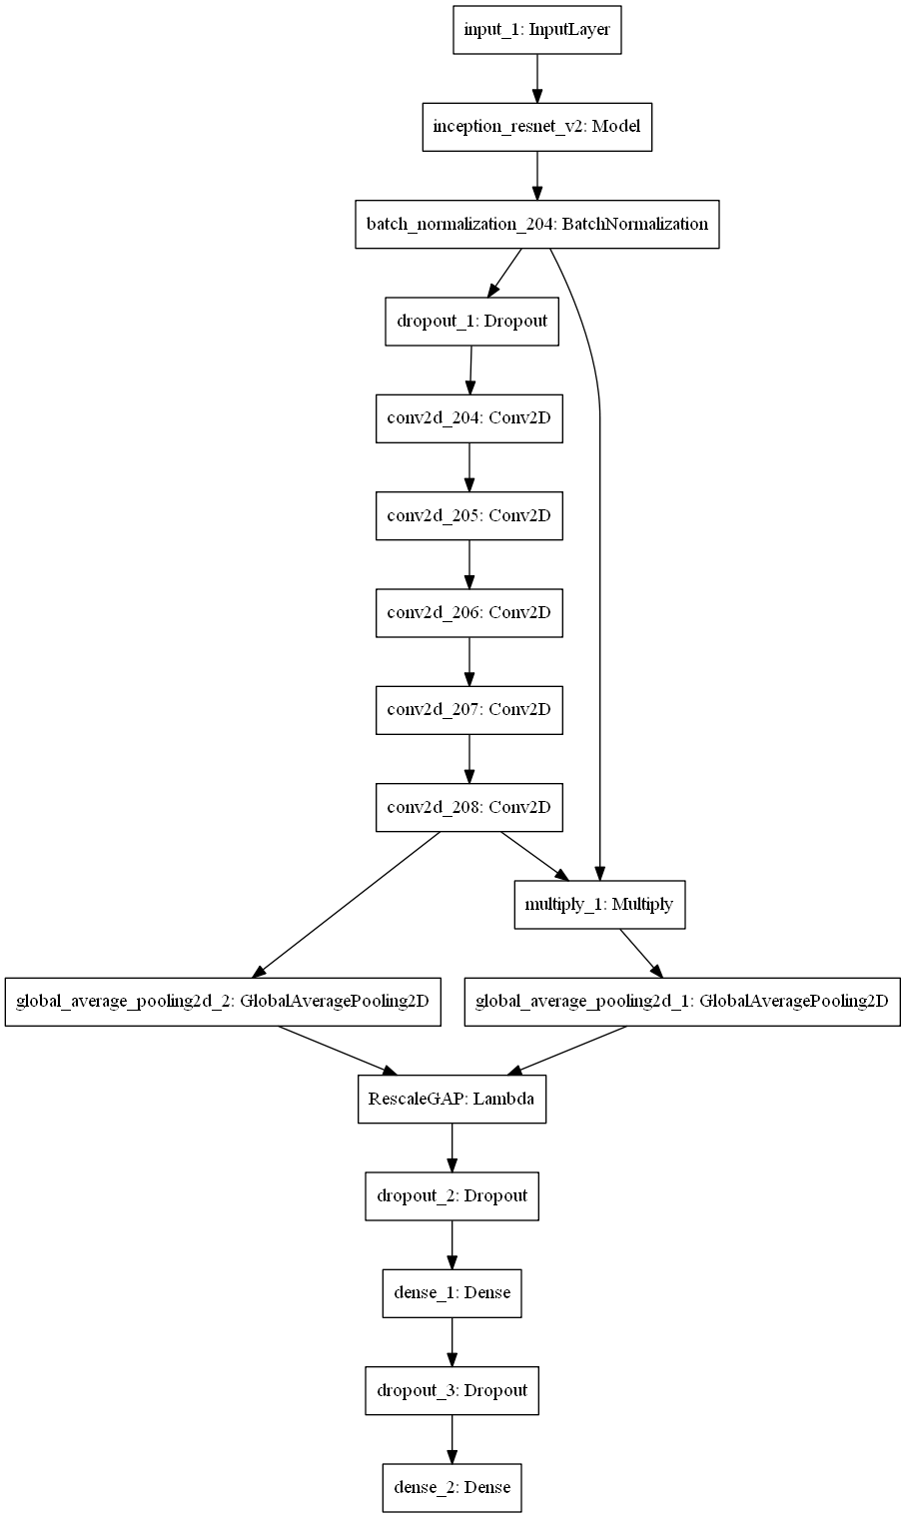
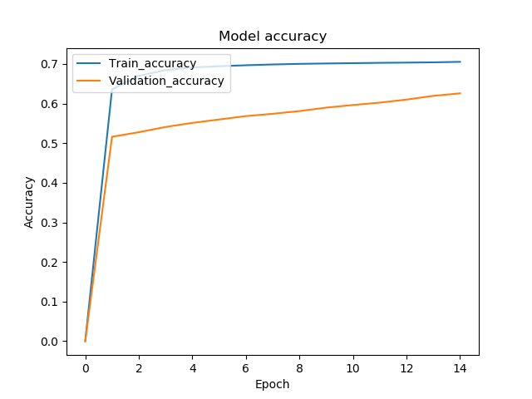
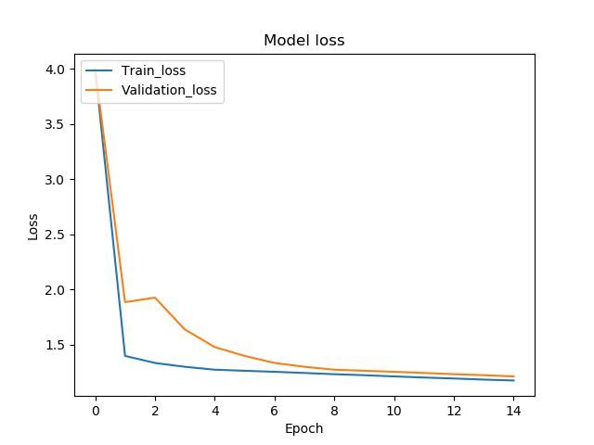
Try 4 :
Model
Tested the dataset on a self made model shown (input size = (299,299)) :
Base model used: InceptionResNetV2
Validation accuracy obtained ~ 62%
Train accuracy obtained ~ 71%

Slide 13
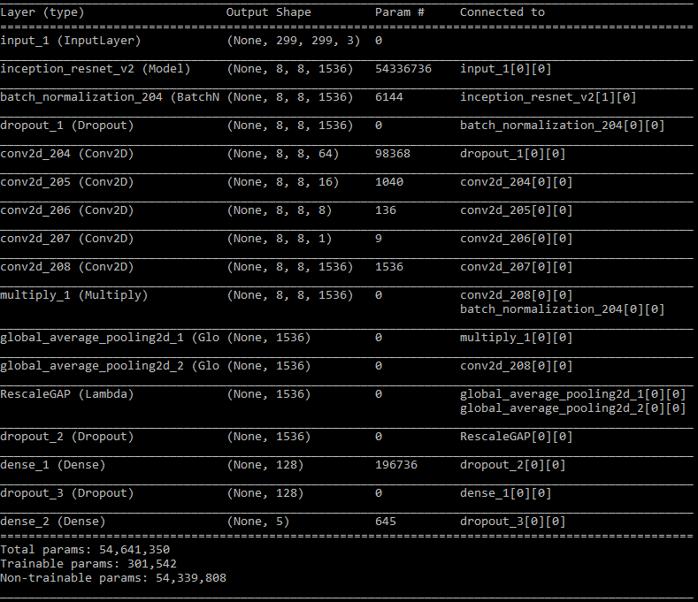
Try 4(contd) :
Model Parameters
Result:
Added 5 extra convolutional layers
Kept the number of trainable parameters at
301,542
Other parameters kept fixed with values in line
with ImageNet.
Train accuracy > Validation accuracy, indicating that
model most likely will not perform better on unseen
data.

Slide 14

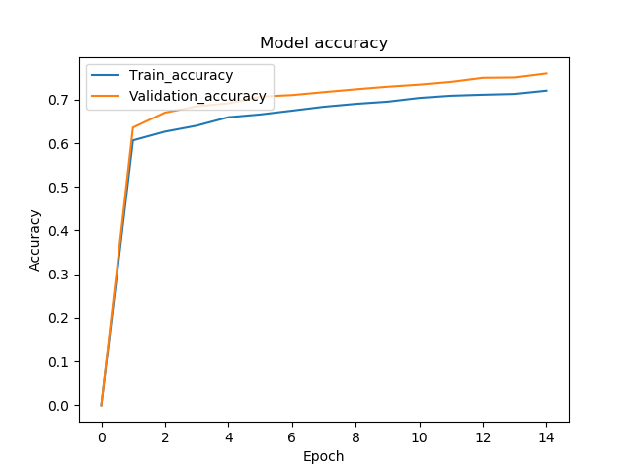
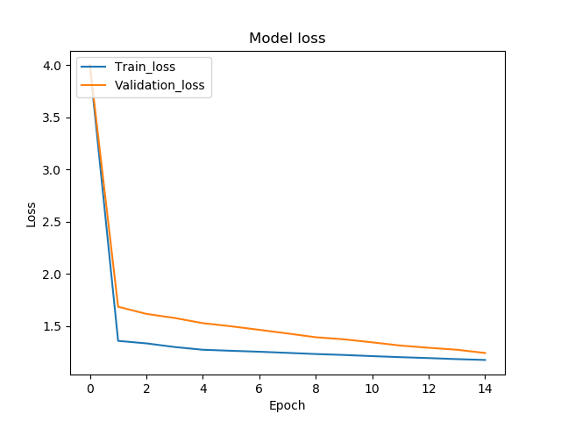
Try 5 :
Model
Tested the dataset on a self made model shown (input size = (224,224)) :
Base model used: VGG19
Validation accuracy obtained ~ 76%
Train accuracy obtained ~ 71%

Slide 15

Try 5(contd) :
Model Parameters
Result:
Added 5 extra convolutional layers
Kept the number of trainable parameters at
101,862
Other parameters kept fixed with values in line
with ImageNet.
Train accuracy < Validation accuracy, indicating that
model most likely will perform better on unseen
data.

Slide 16
Comparison :
Best train accuracy was obtained by the model which uses Inception V3 as the base model.
Best validation/test accuracy was obtained by the model which uses VGG19 as the base model.
This suggests that our model number 5 ,ie, the one with the base model as VGG19 will perform the best on unseen data.
Training standard models like VGG16, VGG19, Inception V3 and InceptionResNetV2 using the kaggle given training data, the train accuracy obtained was around 45% - 55%.
Our method of data augmentation and improvising the standard models performed much better.
Hardware used for training:
Processor : Intel core i7-7700
RAM : 16GB
Graphics card : Nvidia GeForce GTX 1050 card with 4GB memory
OS : Windows

Slide 17
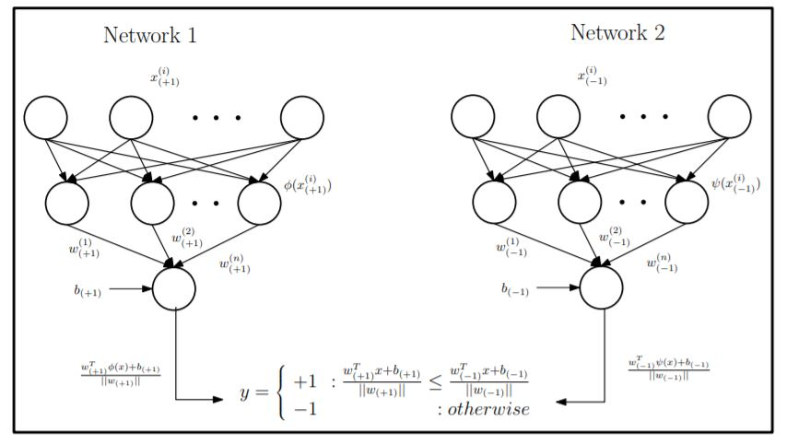
Alternative to Data augmentation :
Found your paper on “Twin neural networks for classification of unbalanced data”
Similar to neural network, minimize the error
function for separately using samples from the
corresponding class
y = +1 : wT (+1)φ(x)+b(+1) /||w(+1)|| ≤ w T (−1)φ(x)+b(−1) /||w(−1)||
−1 : otherwise
Multiclass extension with K classes is done simply by training K such
networks , with an extra output layer for each network
Image ref : Scalable Twin Neural Networks for Classification of Unbalanced Data ; Jayadeva Et Al.

Slide 18
Thank you

