Slide 1
Diabetic Retinopathy Detection
Kunal Narayan(2016EE10439)
N Tarun Sai Ganesh(2016EE10438)

Slide 2
Objectives:
Diabetic Retinopathy is the leading cause of blindness in the working-age population of the developed world
We want to develop a model which can identify accurately whether a person has Diabetic Retinopathic disorder or not by processing the image of eye of the patient.
Timeline:
Jan 23 - Feb 1 : Finding the dataset and appropriate resources
Feb 10 - present : Retraining of standard models like VGG and inception and understand how they work.

Slide 3
Work until now:
Downloaded data from kaggle competition named Diabetic Retinopathy Detection
Training data has 35,126 images classified into 5 different classes.
Class 0 : 25810
Class 1 : 5292
Class 2 : 2443
Class 3 : 873
Class 4 : 708
Upon further reading, we decided to use standard convolutional models like vgg or inception for this problem.
Inception (First try)
We re-trained a model and tried to understand how does it work. Link
For this purpose, we had to rearrange our dataset a bit. The earlier dataset was 35,126 images in a folder. For the given code to run, the dataset has to be in a specific way. Folders for each class was made and images belonging to that specific class was in it.
The accuracy obtained was around 45.8%.

Slide 4
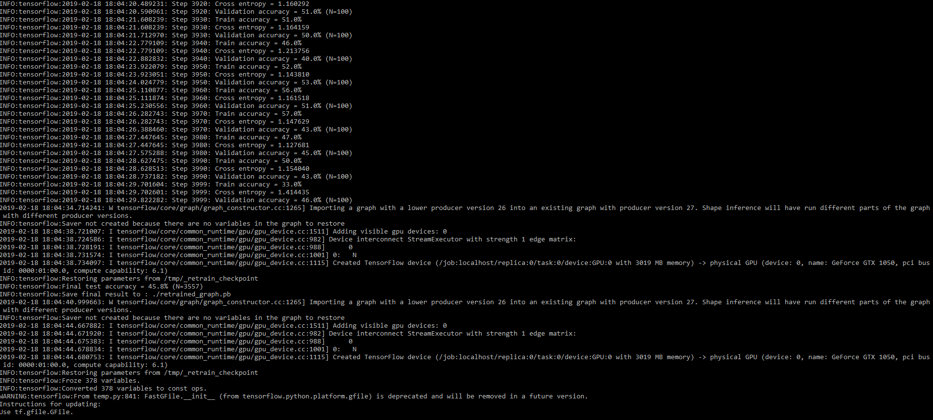

Slide 5
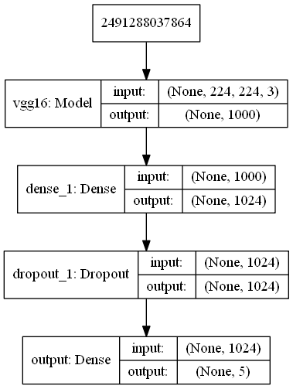
VGG (First try)
We tried retraining a standard model to understand how it works. Link
We are encountering some error which we are trying to solve currently.
Error: Failed to get device properties, error code: 30

Slide 6
References:
https://robopress.robotsandpencils.com/build-your-own-image-classifier-in-less-time-than-it-takes-to-bake-a-pizza-9a7b898264de
https://www.kaggle.com/c/diabetic-retinopathy-detection/kernels
Work to be done :
After understanding the working of standard models, we will implement our model using different methods
Train the model using the available dataset which is split into Train and Validation
Test the model on new images in Validation
Try to improve accuracy by removing unnecessary features

