Slide 1

Adversarial Emulation Using Atomic Red Team and MITRE ATT&CK
- Tarun Sai Katta Sreenivasulu

Slide 2
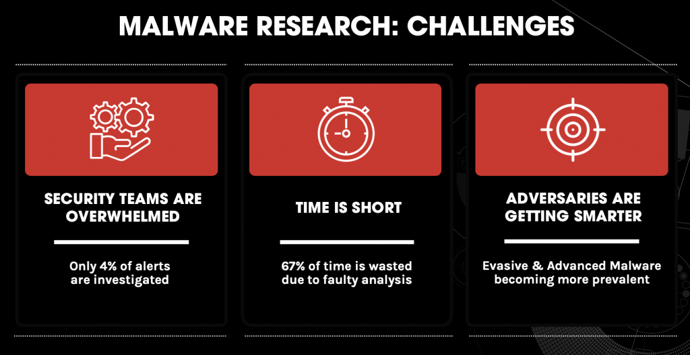
Challenges

Slide 3
Key Expectations to resolve Challenges
Testing should be quick.
Frameworks to rely on testing.
Sharing and collab of results.

Slide 4
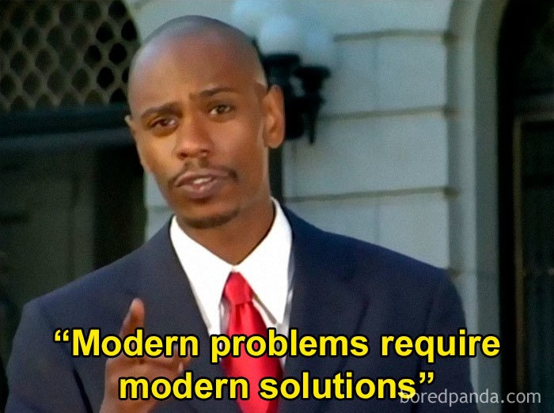
Solutions
Testing should be quick - Atomic-Red-Team
On what basis do we have to test - MITRE ATT&CK
Sharing and collab of results - YARA, STIX, TAXII

Slide 5

What is Adversary ?
An individual, group, or organization that carries out cyber threats with malicious intent.

Slide 6
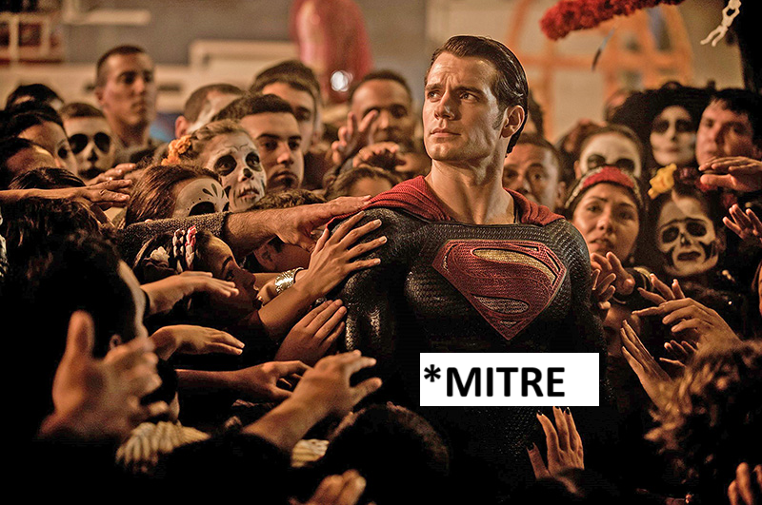
MITRE???
The Mitre Corporation (stylized as The MITRE Corporation and MITRE) is an American not-for-profit organization.
Released two of the greatest and most used things by Cybersecurity Professionals.
ATT&CK – Adversary Tactics Techniques & Common Knowledge.
CVE – Common Vulnerabilities and Exposures.

Slide 7
MITRE? ATT&CK?
The Mitre Corporation (stylized as The MITRE Corporation and MITRE) is an American not-for-profit organization.
Released two of the greatest and most used things by Cybersecurity Professionals.
ATT&CK – Adversary Tactics Techniques & Common Knowledge.
CVE – Common Vulnerabilities and Exposures.

Slide 8
ATT&CK
ATT&CK amasses information that can help you understand how attackers behave so you can better protect your organization and defend against cyber threats.
MITRE organizes its observations about attack behaviours (TTP’s) into tables called Matrices.
Each Matrix addresses a different target, like Enterprise operating systems and cloud platforms, Mobile devices, or Industrial Control Systems (ICS).

Slide 9
TTP’s
TTP – Tactics, Techniques and Procedures
Tactics represent the technical goals of an adversary.
Techniques represent “how” an adversary achieves a tactical goal by performing an action.
Procedures are the specific implementations that adversaries use for techniques or sub techniques.

Slide 10
Tactics for Enterprise
ID | Name | Description
TA0043 | Reconnaissance | The adversary is trying to gather information they can use to plan future operations.
TA0042 | Resource Development | The adversary is trying to establish resources they can use to support operations.
TA0001 | Initial Access | The adversary is trying to get into your network.
TA0002 | Execution | The adversary is trying to run malicious code.
TA0003 | Persistence | The adversary is trying to maintain their foothold.
TA0004 | Privilege Escalation | The adversary is trying to gain higher-level permissions.
TA0005 | Defense Evasion | The adversary is trying to avoid being detected.
TA0006 | Credential Access | The adversary is trying to steal account names and passwords.
TA0007 | Discovery | The adversary is trying to figure out your environment.
TA0008 | Lateral Movement | The adversary is trying to move through your environment.
TA0009 | Collection | The adversary is trying to gather data of interest to their goal.
TA0011 | Command and Control | The adversary is trying to communicate with compromised systems to control them.
TA0010 | Exfiltration | The adversary is trying to steal data.
TA0040 | Impact | The adversary is trying to manipulate, interrupt, or destroy your systems and data.

Slide 11
Techniques
Example for a technique could be – Adversary in the Middle (formerly known as Man-in-the-Middle Attack) – Tactics – Credential Access, Collection
It has 3 sub-techniques
ID | Name
T1557.001 | LLMNR/NBT-NS Poisoning and SMB Relay
T1557.002 | ARP Cache Poisoning
T1557.003 | DHCP Spoofing

Slide 12
Procedure
Adversaries may redirect network traffic to adversary-owned systems by spoofing Dynamic Host Configuration Protocol (DHCP) traffic and acting as a malicious DHCP server on the victim network.

Slide 13
Matrices
It is a matrix of TTP’s that provides key insights on different systems like enterprise, mobile and ICS

Slide 14
Enterprise Matrix

Slide 15
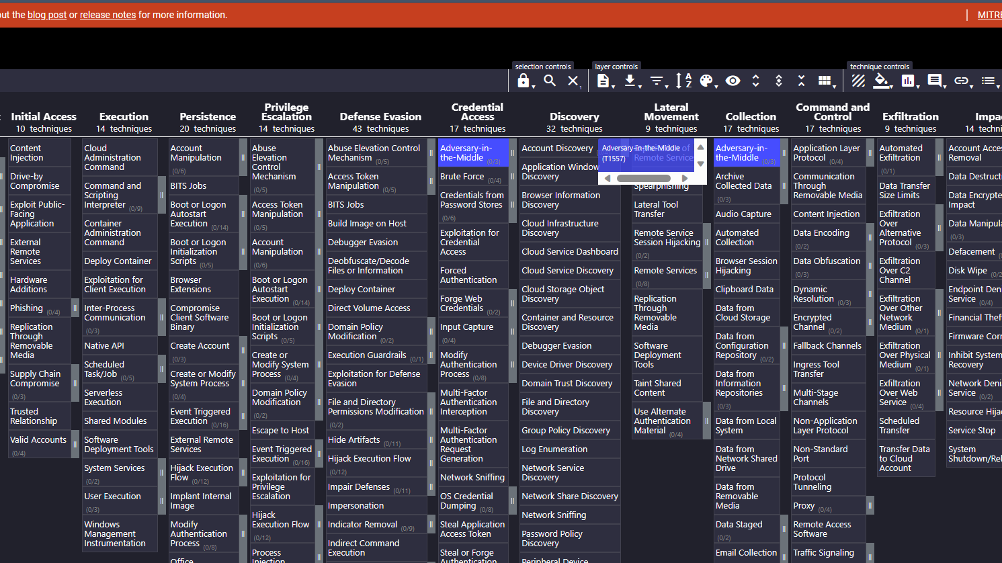
Enterprise Matrix

Slide 16

Automated malware analysis on ANY.RUN

Slide 17
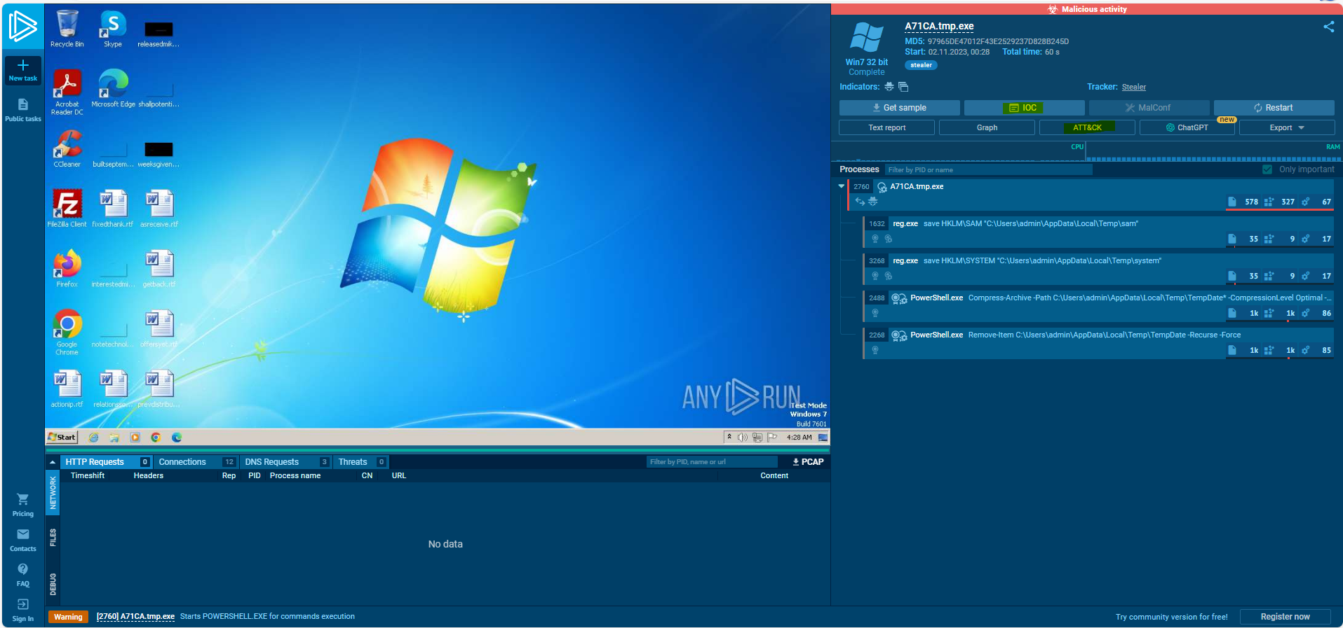
ANY.RUN Public Task Report Page

Slide 18
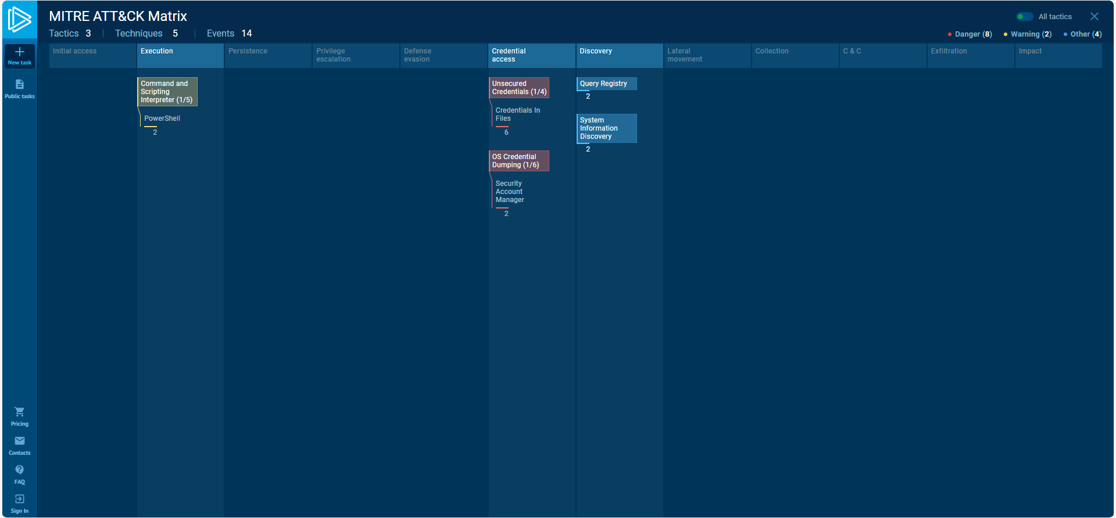
ANY.RUN – MITRE ATT&CK Matrix

Slide 19
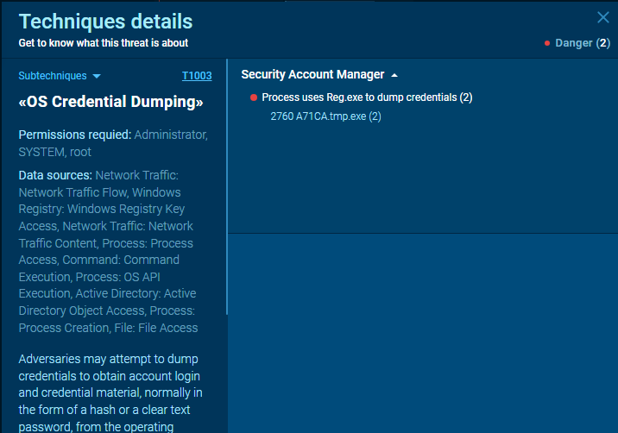
T1003 – OS Credential Dumping

Slide 20
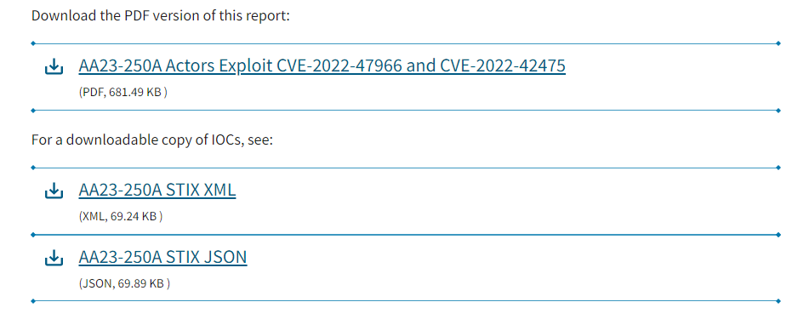
Multiple Nation-State Threat Actors Exploit CVE-2022-47966 and CVE-2022-42475 | CISA
Example

Slide 21
Atomic Red Team

Slide 22
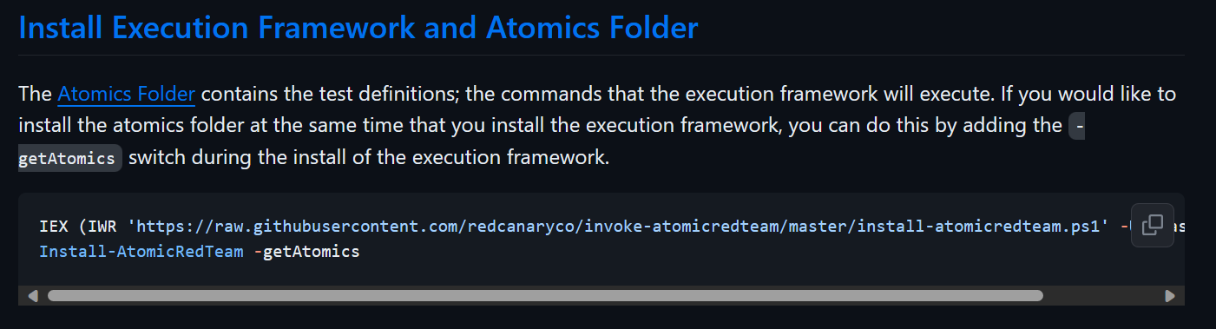
Installing Atomic Red Team
Installing Invoke AtomicRedTeam · redcanaryco/invoke-atomicredteam Wiki · GitHub

Slide 23
Atomic Red Team - Demo
Will be delivered in person

Slide 24
Sharing Results and Collaboration
By sharing threat actor TTPs through standards such as STIX and TAXII, the security community benefits together.
Groups like MITRE’s Center for Threat Informed Defense (CTID) bring together sophisticated security teams from leading organizations around the world to expand the global understanding of adversary behaviors.

Slide 25
YARA Rules
Used to Identify and Classify malware samples
It is a free and Open-source tool from VirusTotal.
It allows easy integration with SIEM tools like Splunk/IBM QRadar/Microsoft Sentinel.

Slide 26
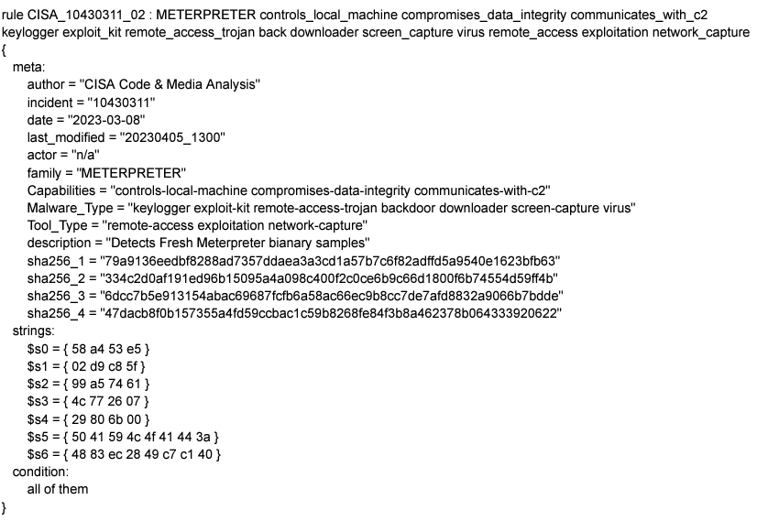
YARA in Real
MAR-10430311.c1.v1.CLEAR_.pdf (cisa.gov)

Slide 27
STIX and TAXII
STIX/TAXII is a global initiative designed to mitigate and prevention of cyber threats.
Structured Threat Information eXpression (STIX) is a standardized language that uses a JSON-based lexicon to express and share threat intelligence information in a readable and consistent format.
Trusted Automated eXchange of Intelligence Information (TAXII) is the format through which threat intelligence data is transmitted. TAXII is a transport protocol that supports transferring STIX insights over Hyper Text Transfer Protocol Secure (HTTPS).

Slide 28
CONCLUSION
Conducted signature-based malware detection, MITRE ATT&CK, and Adversarial Emulation using Atomic Red Team.
This comprehensive approach strengthens malware detection, identifies vulnerabilities, and promotes threat intelligence and its key part - sharing.
By prioritizing continuous improvement and adaptability, towards MITRE ATT&CK Technique mappings, I aim to elevate cybersecurity readiness, learning from past experiences and proactively addressing emerging threats for a more resilient digital landscape.

