Slide 1
CD Catalog
Tarun Kumar Sarkar

Slide 2

Task
Task: Describe a collection of CDs using XML from the given template by:
Artist
Title of the CD
List of pieces (title)
Result: XML file of the CD Collection

Slide 3
Problem Description
PROCESS
Plain text file input
Read input data
Parse data
Manual input
Capture data
Map data
Structure definition
Store data
Plain text file
Manual
RECORD
INPUT
RETRIEVAL

Slide 4
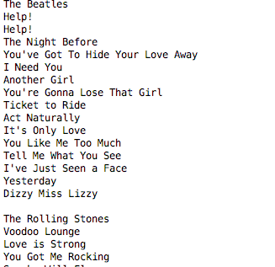
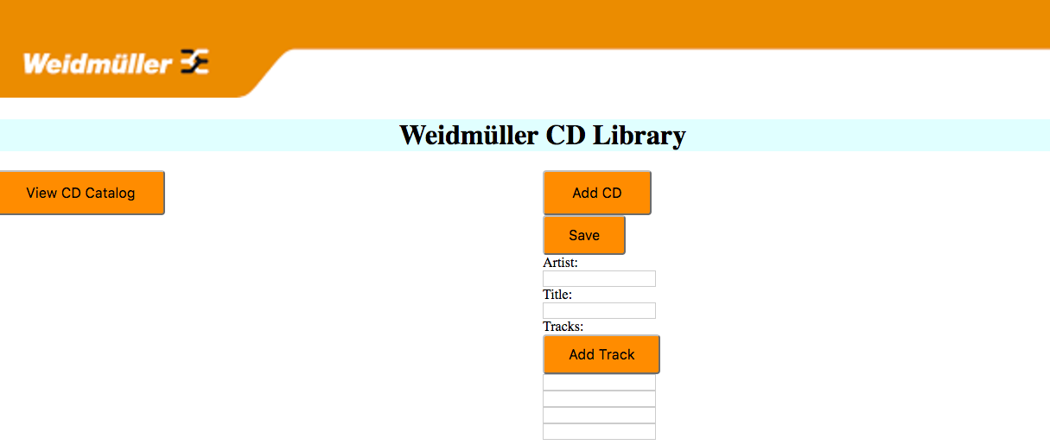
Input Types
Notes:
Album

Slide 5
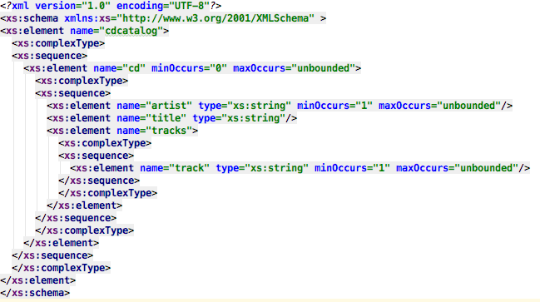
Structure Definition (XSD)
Notes:
xmlns:xs="http://www.w3.org/2001/XMLSchema"
ndicates that the elements and data types used in the schema come from the "http://www.w3.org/2001/XMLSchema" namespace. It also specifies that the elements and data types that come from the "http://www.w3.org/2001/XMLSchema" namespace should be prefixed with xs:
targetNamespace="https://www.w3schools.com"
xmlns="https://www.w3schools.com"
elementFormDefault="qualified"
xmlns:xsi="http://www.w3.org/2001/XMLSchema-instance"
Once you have the XML Schema Instance namespace available:
you can use the schemaLocation attribute. This attribute has two values, separated by a space. The first value is the namespace to use. The second value is the location of the XML schema to use for that namespace:
xsi:schemaLocation="https://www.w3schools.com note.xsd"

Slide 6
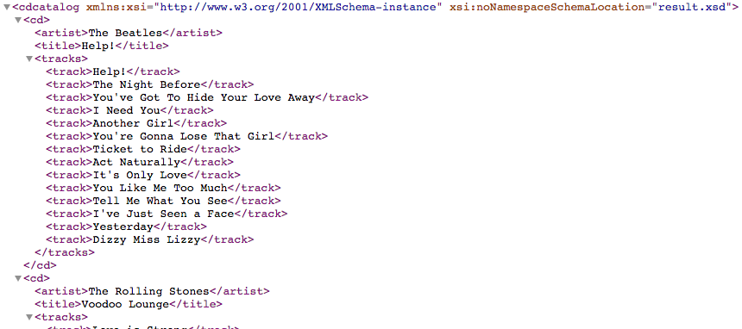
Result (XML)

Slide 7
Demonstration

Slide 8
Thank you!

