Slide 1

Hackathon Presentation
POWER GRID FORECASTING (Time Series Regression)
Submitted By:
Tarun Sirohi
(intern25@omniesolutions.com)
Under the supervision of:
Anand Shukla
Chhatra Pratap Bharti

Slide 2
Table of Content
Introduction & Objective : Sets the stage by defining the project's goal, the dataset used, and the core problem being solved.
Data Understanding & Cleaning : Details the initial data exploration, outlier removal, and the strategy for handling missing values.
Approach / Methodology : Explains the project's workflow, the choice of the XGBoost model, the train-test split strategy, and the critical time-weighted tuning technique.
Results & Insights : Presents the final model performance metrics (MAE and RMSE), showcasing the drastic improvement over the baseline, and highlights key findings from visualizations.
Challenges, Learnings & Next Steps : Reflects on key challenges like data leakage, summarizes the main takeaways, and proposes ideas for future enhancements to the model.

Slide 3
Dataset Overview
Source: power_grid_corp_power_demand.csv
Size & Type: A time series dataset with 92,218 hourly records and 14 columns, spanning from April 2015 to June 2025.
Content: Contains the target variable demand_mw, along with generation_mw and various power generation sources (gas, coal, hydro, etc.).

Slide 4
Objective / Problem Statement
The primary goal is to build an accurate machine learning model to forecast the hourly demand_mw.
A key objective is to significantly outperform a naive baseline model to demonstrate the value of a data-driven, feature-engineered approach.
The project aims to create a reliable forecasting tool by identifying key drivers of power demand and optimizing a model for predictive accuracy.

Slide 5
Data Understanding & Cleaning
Key Insights from EDA:
Missing Values: The initial analysis and heatmap revealed significant missing data in key columns: solar (24%), wind (80%), india_adani (92%), and nepal (94%).
Outliers: A plot of demand_mw showed a few extreme outliers. A threshold of 25,000 MW was identified, with 8 data points exceeding it.
Seasonality: The data exhibits a clear upward trend over the years, with strong yearly seasonality (demand peaking in summer) and daily seasonality (demand peaking in the evening).

Slide 6
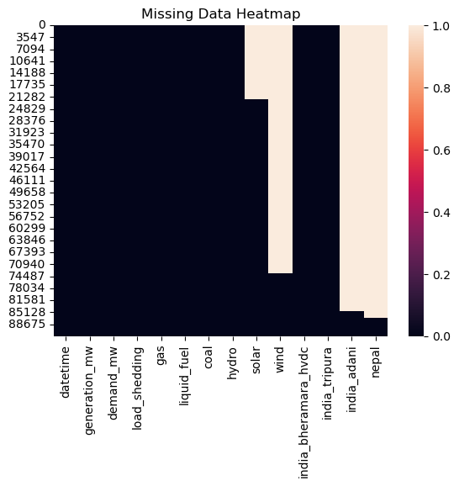
Data Understanding & Cleaning (Cont.)
Bright gaps shows where the missing values are in the specific columns.

Slide 7
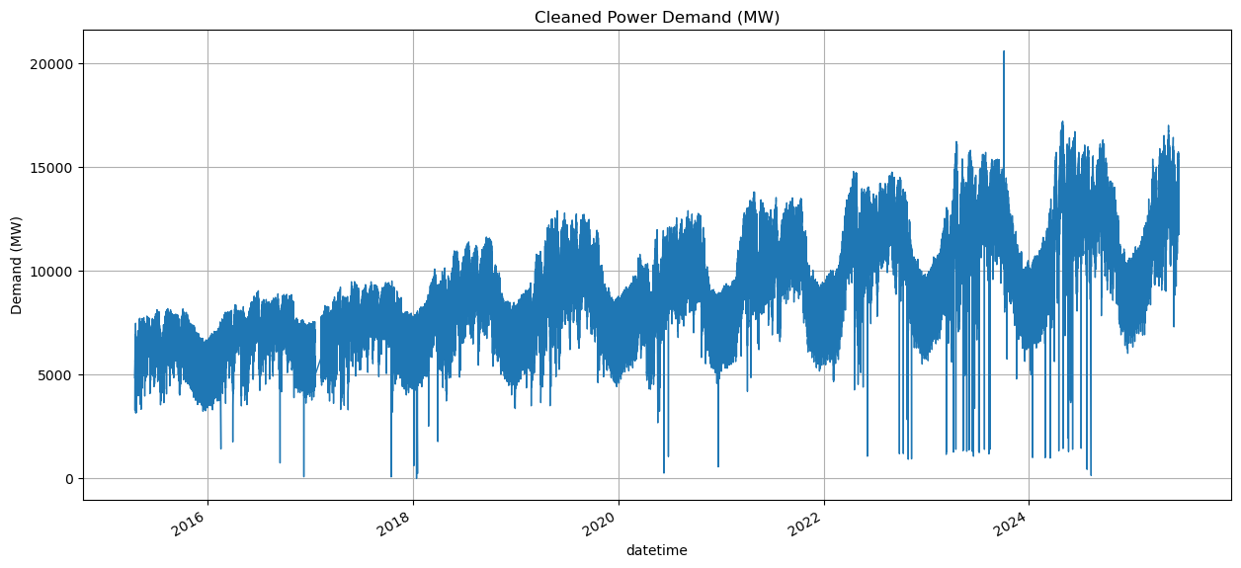
Data Understanding & Cleaning (Cont.)
Clean Upward Trend - Long term growth in electricity demand. A simple feature like "year" will be useful.
Strong Yearly Seasonality - Wave like pattern. It peaks in the middle of the year everytime. Those are the summer months telling us that the demand of electricity supplies increases during summer times.
Features like month and day_of_year will be crucial for the model to capture this.
Mean/ Variance - Mean and Variance keeps on increasing every year i.e. the trend plus the season multiplies.
So, we can say that this is a multiplicative time series model.

Slide 8
Data Understanding & Cleaning (Cont.)
Major Cleaning & Preprocessing Steps:
Outlier Removal: The 8 rows where demand_mw exceeded 25,000 MW were removed.
Feature Dropping: The wind, india_adani, and nepal columns were dropped due to excessive missing values and low predictive signal. This was a critical step to avoid noise.
Missing Value Imputation: The solar column's missing values were filled with 0, based on the assumption that no data means no solar generation.
Final NaN Removal: After creating a rolling-window feature, the first 24 rows of the dataset (which contained NaNs) were dropped.

Slide 9
Data Understanding & Cleaning (Cont.)
Challenges Faced:
Conflicting Stationarity Tests:
The ADF test suggested the data was stationary, while the KPSS test suggested it was non-stationary.
This conflict was resolved by observing the clear upward trend in the data, concluding that the ADF test was "fooled" by the strong daily seasonality. The data was treated as trend-stationary.

Slide 10
Approach / Methodology
Process Flow Diagram:
Data Prep: Loaded, cleaned, and removed outliers from the raw data.
EDA
Feature Engineering: Created time-based features (hour, dayofweek, year) and a rolling_mean_solar_24h feature to act as a weather proxy.
Feature Selection: Critically evaluated features and intentionally excluded data leakage sources like generation_mw and coal from the final feature set, as they are reactive to demand, not predictive of it.
Train-Test Split: Split the data chronologically, using data before 2023-01-01 for training (76%) and data from 2023 onwards for testing (24%).
Modeling & Tuning: Established a naive baseline, trained an initial XGBoost model, and then performed weighted hyperparameter tuning using RandomizedSearchCV.

Slide 11
Approach / Methodology (Cont.)
Techniques and Rationale:
Model: Used XGBoost, a powerful algorithm ideal for handling the complex, non-linear patterns found in the data.
Metric: Root Mean Squared Error (RMSE). This metric was chosen as t heavily penalizes large prediction errors, which is critical for grid stability. Also used MAE (Mean Absolute Error)
Key Technique (sample_weight): During tuning, I applied a sample_weight that increased linearly over time. This forced the model to prioritize learning from recent data, a crucial strategy for time series forecasting.

Slide 12
Results & Insights
Model Performance - A Story of Progressive Improvement:
My evaluation used two key metrics: Mean Absolute Error (MAE), representing the average error in MW, and Root Mean Squared Error (RMSE), which penalizes larger errors more heavily.
Baseline Naive Model:
MAE: 399.05 MW
Initial XGBoost Model (Before Tuning):
MAE: 187.20 MW (A 53.1% improvement in average error)
Final Validation RMSE (from logs): ~582 MW
Final Tuned XGBoost Model:
Best Cross-Validated MAE (from tuning): 56.37 MW
This represents a massive 85% improvement in average error compared to the original baseline.

Slide 13
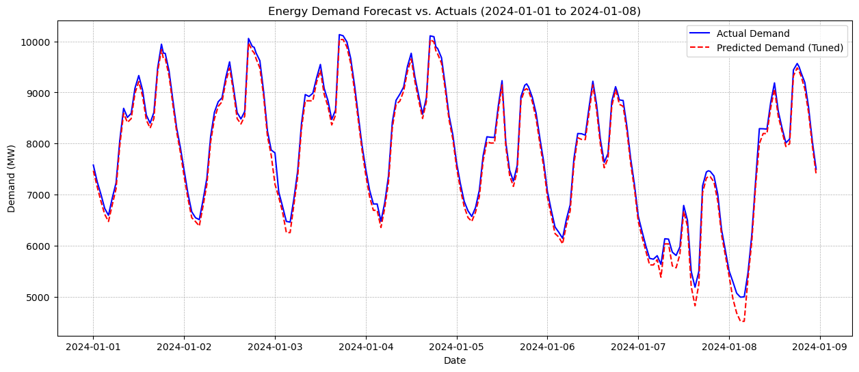
Results & Insights (Cont.)
Key Visualization 1: Final Forecast Accuracy
Insight: The plot confirms the final model's high accuracy. The predicted red line tracks the actual blue line very closely, successfully capturing the daily demand cycles. The model shows minor deviation on weekends (Jan 7-8), a known challenge and an area for future improvement.

Slide 14
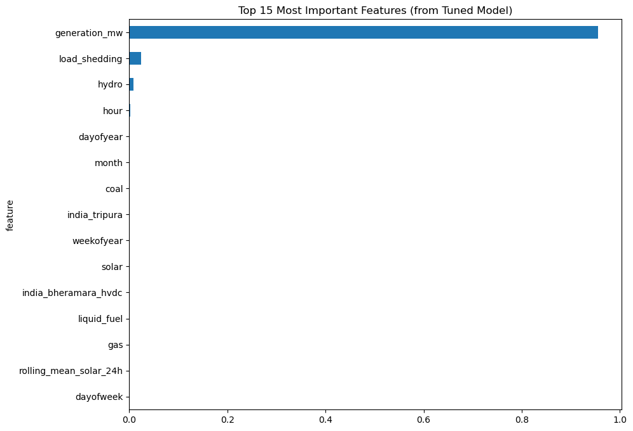
Results & Insights (Cont.)
Key Visualization 2: Feature Importance & Data Leakage Discovery
The feature importance plot provided a critical insight. It revealed that generation_mw had an importance score of 0.95. This is a classic example of data leakage, as generation is a direct reaction to demand. This finding validates the decision to exclude such features from a real-world forecasting model. The next most important features were time-based (hour, dayofyear), confirming the model correctly learned the underlying seasonal patterns.

Slide 15
Challenges, Learnings & Next Steps
Major Challenges & Solutions:
Challenge: Preventing data leakage from reactive features (generation_mw, coal).
Solution: Made a conscious and documented decision to exclude these "cheater" columns from the feature set used for modeling, ensuring the model is genuinely predictive.
Challenge: Making the model prioritize recent, more relevant data.
Solution: Implemented a sample_weight strategy during hyperparameter tuning, which was instrumental in finding better model parameters.

Slide 16
Challenges, Learnings & Next Steps (Cont.)
Key Learnings from the Project:
Feature Engineering is King: The biggest performance jump came from creating good time-based features.
Domain Knowledge Prevents Disaster: Understanding that generation follows demand was key to identifying and avoiding a critical data leakage flaw.
Context-Aware Tuning is Powerful: Weighting samples by time is a superior strategy for time series forecasting compared to standard tuning.

Slide 17
Challenges, Learnings & Next Steps (Cont.)
Future Improvements:
Incorporate External Data: Add external features like weather forecasts (temperature, humidity) and public holiday data.
Advanced Modeling: Experiment with deep learning models like LSTMs to potentially improve performance on complex patterns like weekends and holidays.

Slide 18
THANK YOU

