Slide 1
England Football Stadiums Segmentation
By
Tarun Sirpi H

Slide 2
Introduction
Football is the most popular sport in England. Almost everyone follows and supports a football club in England.
Fans come to stadiums to watch teams play.
Food consumption plays an important part in their match experience.
Thus, segmenting various stadiums in England based on the types of food available in the region around the stadiums becomes important. This would help travelling fans to know the type of food before/after matches and have their best match experience.

Slide 3
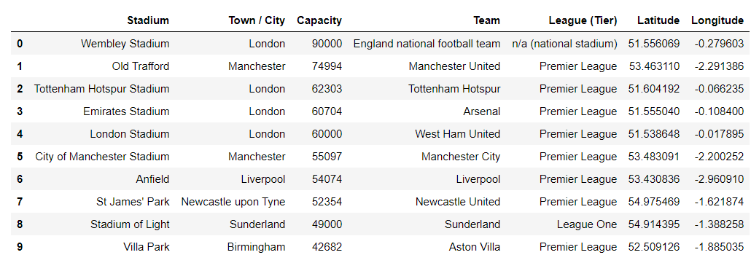
Top stadiums based on capacity

Slide 4
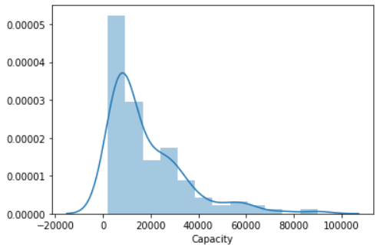
Distribution
The Stadiums considered has capacity ranging from 90,000 to 2,000

Slide 5
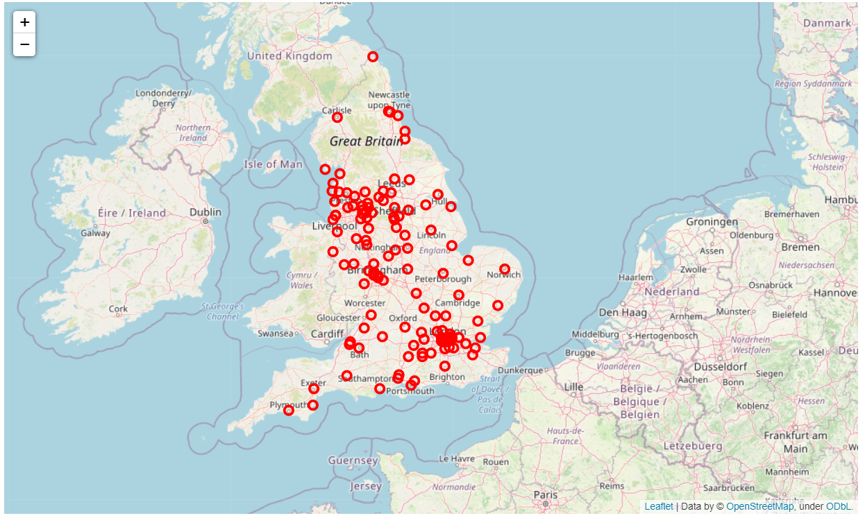
Location of stadiums in map

Slide 6
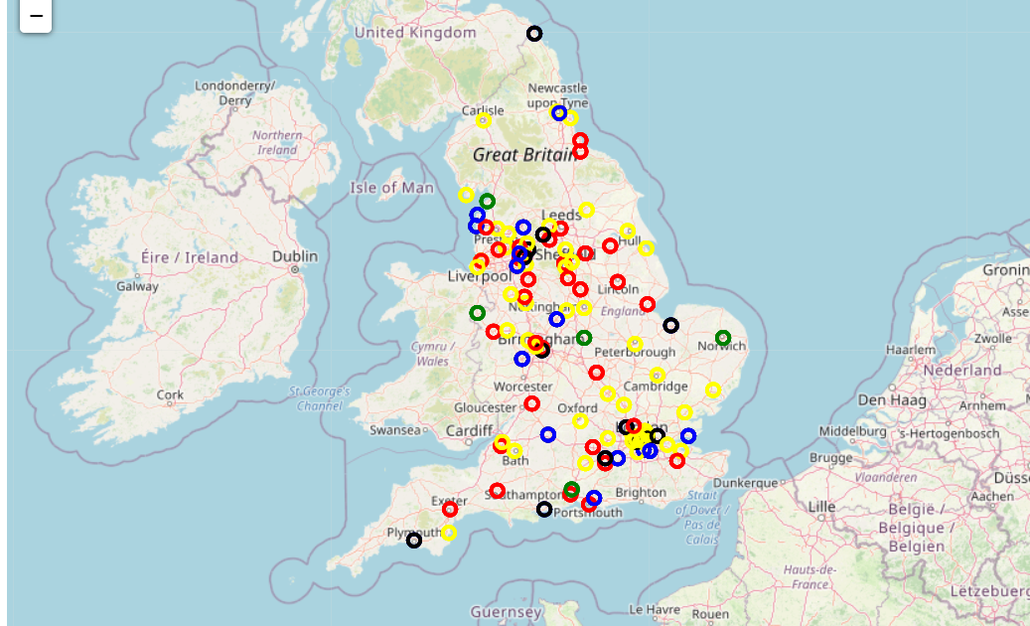
Clustering
Map after clusteing the stadiums .

Slide 7
Result
It is observed that the food choice in England is very vast and a lot of different types of food based venues are present. It is also seen that various cuisines other than native to England are very frequent (example, High frequency of Indian, Italian, Chinese cuisine based venues in the cluster number 3).
Hence, the motive of this study is to suggest the football fans who visit the stadiums to see thier teams live the popular food spots. This study will be of some use to better their live match experience.

