Slide 1




LENDING CLUB - CASE STUDY
-Tarun Tiwari
-Pranavi Chapala

Slide 2
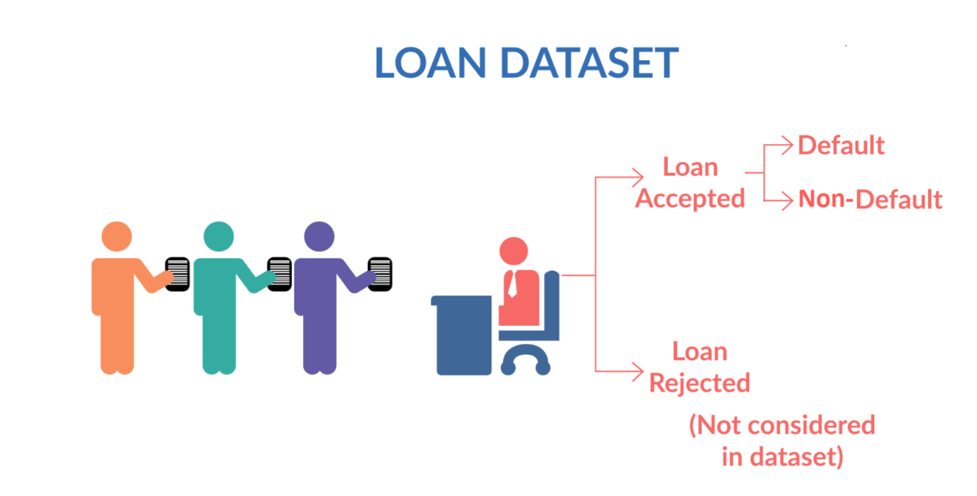
Problem Statement
You work for a consumer finance company which specializes in lending various types of loans to urban customers. When the company receives a loan application, the company has to make a decision for loan approval based on the applicant’s profile. Two types of risks are associated with the bank’s decision:
If the applicant is likely to repay the loan, then not approving the loan results in a loss of business to the company
If the applicant is not likely to repay the loan, i.e. he/she is likely to default, then approving the loan may lead to a financial loss for the company

Slide 3
Data Dictionary
loan_amnt: The listed amount of the loan applied for by the borrower.
Int_rate: Interest Rate on the loan
Funded_amnt: Amount recommended/approved by LC
Funded_amnt_inv The amount funded by investors
Term: The number of payments on the loan. Values are in months and can be either 36 or 60.
Purpose: purpose of the loan like home, education, credit card, small business, vacation, medical etc…
Earliest_cr_line: The month the borrower's earliest reported credit line was opened
Title : The loan title provided by the borrower
Emp_length: Employment service/length in years. Possible values are between 0 and 10 where 0 means less than one year and 10 means ten or more years.
Emp_title: The job title supplied by the Borrower when applying for the loan
Installment: The monthly payment owed by the borrower if the loan originates.
Grade: LC assigned loan grade
Home_ownership: The home ownership status provided by the borrower during registration or obtained from the credit report. Our values are: RENT, OWN, MORTGAGE, OTHER

Slide 4
Problem Solving Methodology-EDA
1. Data Sourcing
Importing libraries Reading the data into dataframe Printing the information and statistics
2. Data Cleaning
Checking and dropping null values(missing values) Imputing all missing value columns according to there data type Checking outlier using box plot Removing outliers with Interquartile range
3. Data Derived Metrics
Data Processing Data Filtering Dropping irrelevant columns Converting (object) columns into numeric
4. Univariate Analysis
Continuous Variable Categorical Variable
5. Segmented Univariate Analysis
Continuous Variable Categorical Variable
6. Bivariate Analysis
Continuous Variable Categorical Variable Plotting word cloud and Live Frame plotting
7. Multivariate Analysis
Correlation Matrics using heat map

Slide 5
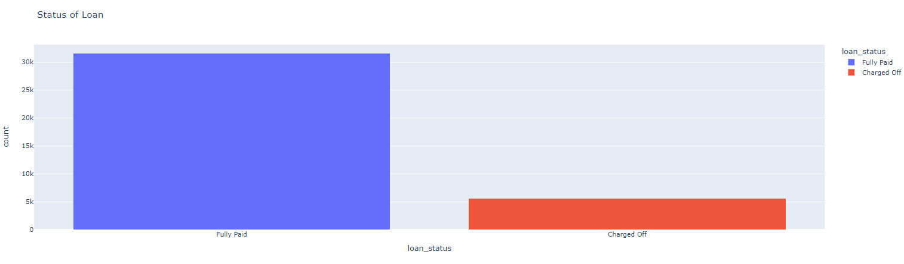
Univariate Analysis
Above graph loan_status shows class is biased by Fully Paid which is good for Lending Clud. Fully Paid has 30k+ and Charged Off has 5K+ entries

Slide 6
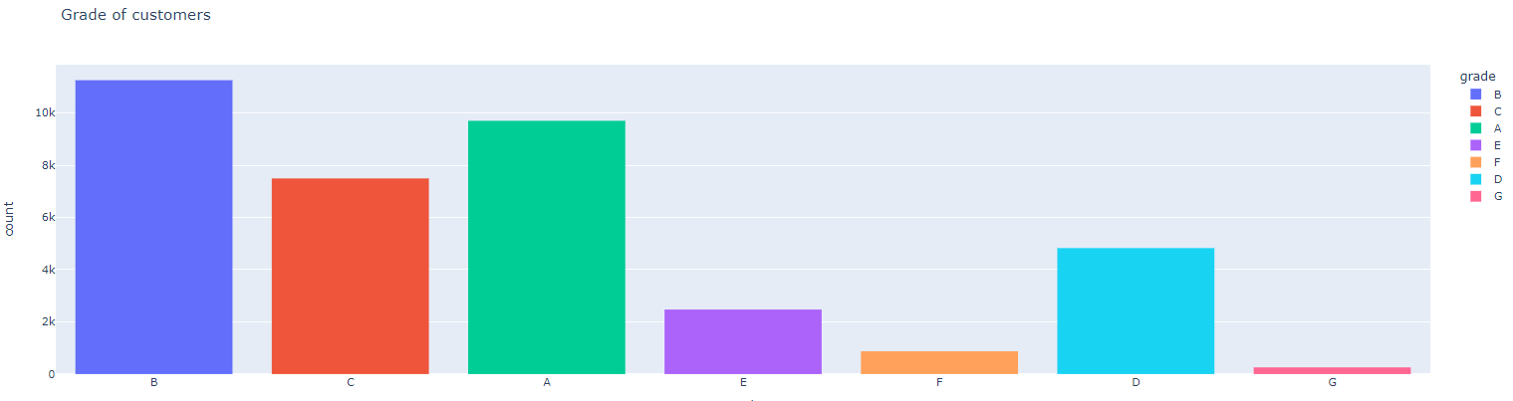
Univariate Analysis
Above graph shows 'B' grade customers have taken Loan Compare to 'A' Grade Customers. 'G' grade customers has low count.

Slide 7
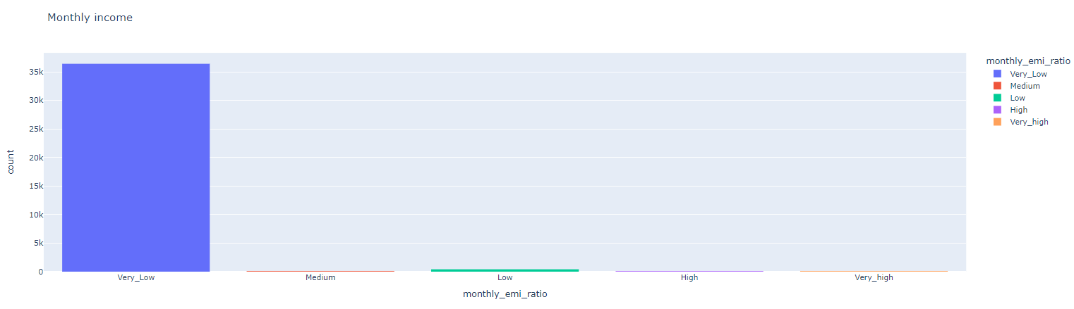
Univariate Analysis
Above graphs shows the ratio of monthly income w.r.t monthly installments. According to Very_Low most of the customers paying monthly EMI less than 30% of monthly salary. About 60 customers paying EMI more than 50% of monthly salary.

Slide 8

Univariate Analysis
Above graph loan_status shows class is biased by Fully Paid which is good for Lending Clud. Fully Paid has 30k+ and Charged Off has 5K+ entries
Above image is plotting word cloud for title, which shows mostly used text from data. Like Consolidation is used many times so its Font size is bigger than other words.

Slide 9
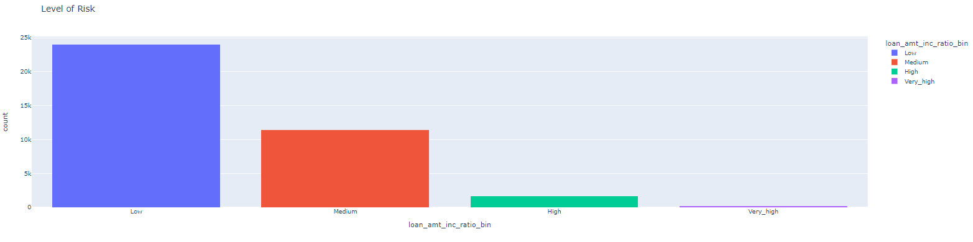
Univariate Analysis
Above graph shows the ratio of loan amount w.r.t annual income

Slide 10
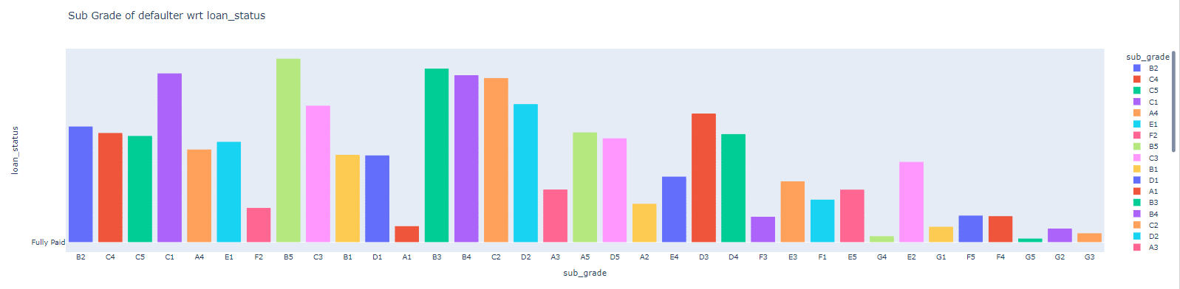
Segmented Univariate Analysis
From above plot for ‘sub_grade’ we can infer that the defaulters rate is
increasing wrt sub_grade, hence the chances of loan getting defaulted increases with the sub_grade from A1 moving towards G5.

Slide 11
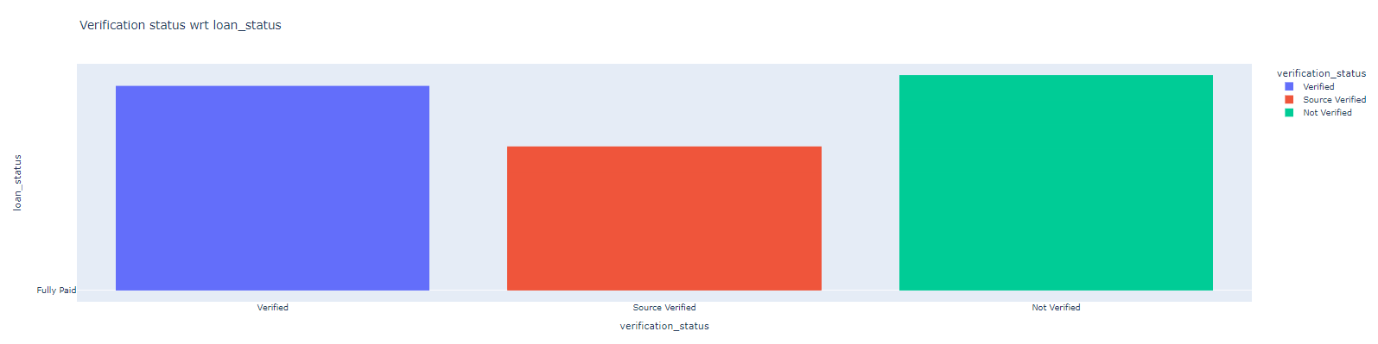
Segmented Univariate Analysis
From above plot for ‘verification_status’ we can infer that the defaulters rate is increasing and is less for Not Verified users than Verified ones, but not useful for analysis.

Slide 12
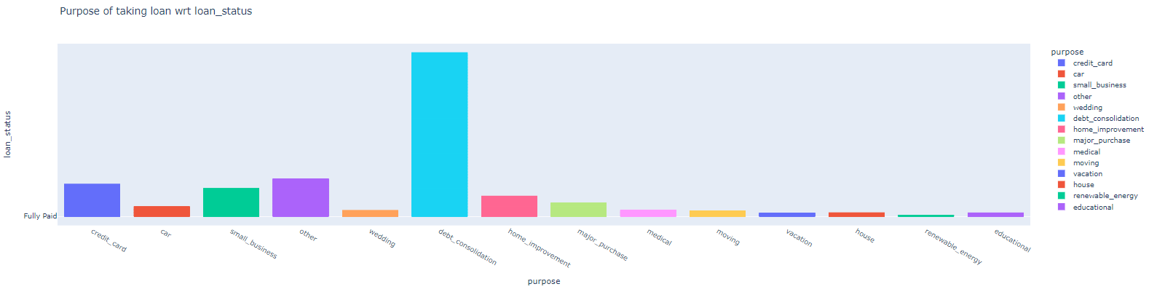
Segmented Univariate Analysis
From above plot for ‘purpose’ we can infer that the defaulters rate is nearly constant for all purpose type except ‘small business’, hence rate will depend on purpose of the loan

Slide 13
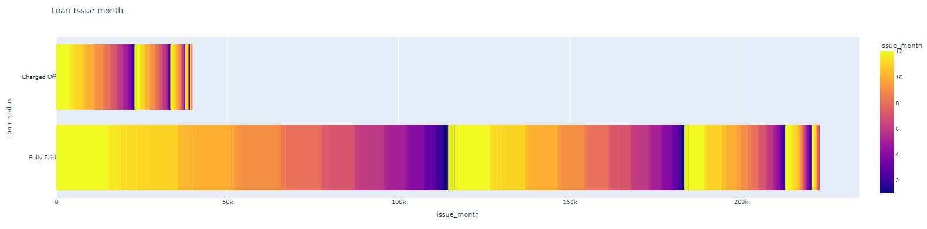
Segmented Univariate Analysis
From above plot for ‘month’ we can infer that the defaulters rate is nearly constant here, not useful

Slide 14
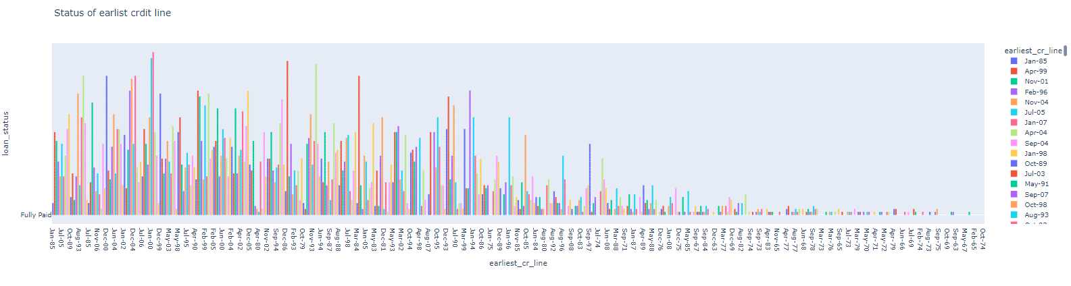
Segmented Univariate Analysis
From above plot for ‘earliest_cr_line’ we can infer that the defaulters rate is nearly constant for all purpose type except year around 65, hence rate does not depends on earliest_cr_line of the person

Slide 15
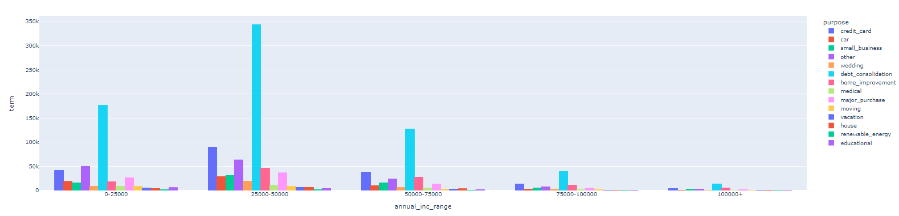
Bivariate Analysis
From above plot, we can infer it doesn’t show any correlation

Slide 16
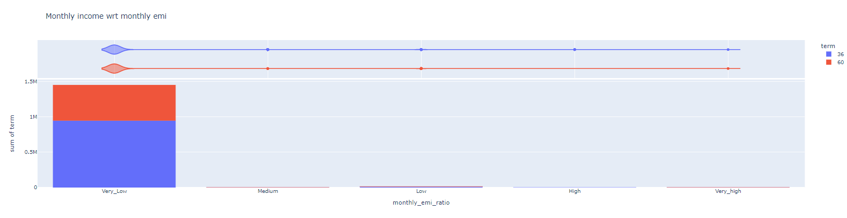
Bivariate Analysis
From above plot for `monthly_emi_ratio` we can infer that the defaulters rate is increasing w.r.t `term`.

Slide 17
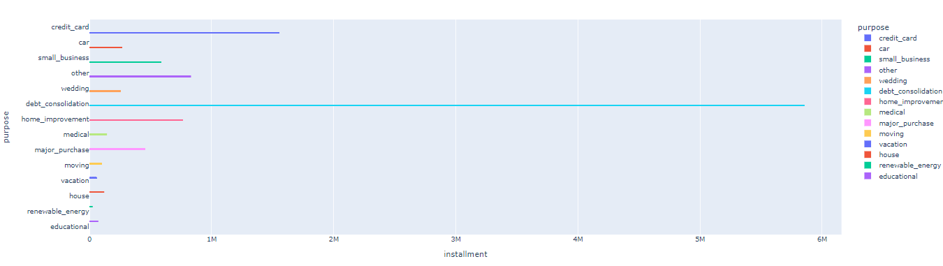
Bivariate Analysis
As we can see straight lines on the plot, default ratio increases for every purpose w.r.t installment except for small_business

Slide 18
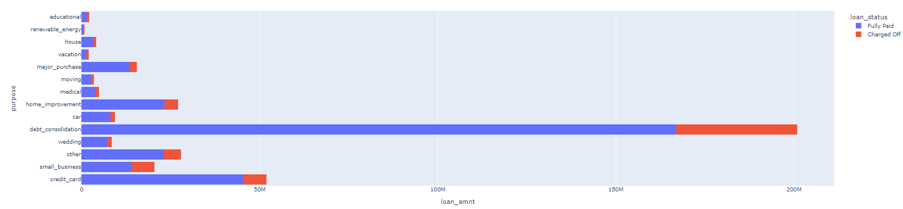
Bivariate Analysis
As we can see straight lines on the plot, default ratio increases for every purpose wrt loan_amnt

Slide 19
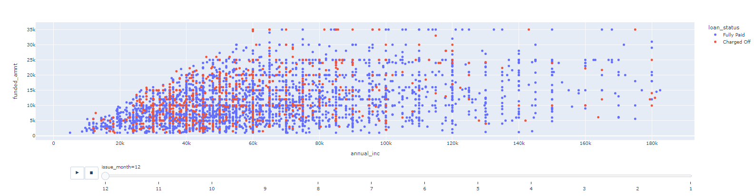
Bivariate Analysis
Above graph shows the scatter plot for ratio of Fully Paid and Charged off customers

Slide 20
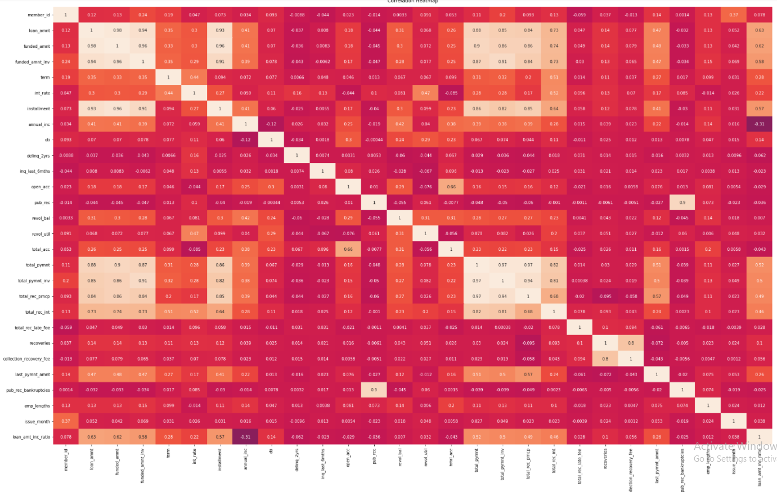
Multivariate Analysis
Above graph shows Correlation Matrics

Slide 21
Conclusion
As part of the Lending Club Case Study we have analyzed and would recommend that the following factors be considered by Consumer Finance Company to approve / reject the loan of an applicant:
Purpose
Term
Grade
Loan Amount
Interest Rate
Monthly Income
Applicants who stay in rented house or mortgage are the maximum who take loans, so bank can take this as an advantage to grow customers.
Customers with a loan purpose of Small Business are more likely to default as compared to other categories.
The defaulters rate is increasing w.r.t term, hence the chances of loan getting defaulted is less for 36m than 60m.
Applicant having purpose debt_consolidate are the maximum applicant for the loans.

