Slide 1

Bus Booking System
Directed By
Tarun Uikey
Contact :-
+91 8878986291
tarunuikey30@gmail.com

Slide 2
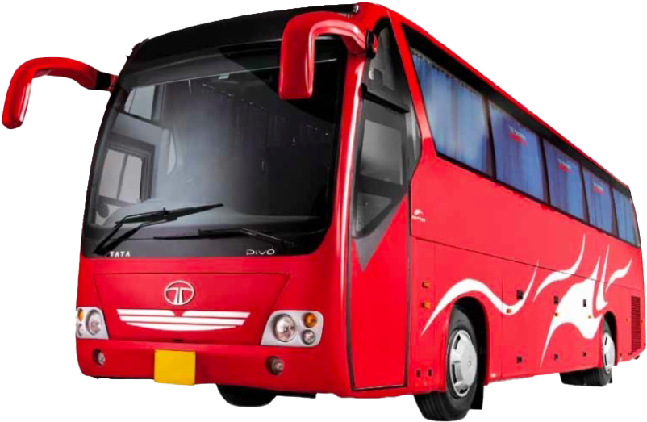
Bus booking System
The use of bus traveling is a large growing business in India and other countries; the manual use of bus reservation is presently very strenuous and also consumes a lot of time by having to stay on a long queue. For this reason, an efficient system is to be proposed in this project to ease the issue of bus reservation amongst indigenes within the country.

Slide 3
INTRODUCTION
The Online Bus Ticket Reservation System is a web-based application that allows visitors check bus ticket availability, buy bus ticket and pay the bus ticket online .This system is established for all the home/office users after gaining access from the administrator.
Online Bus Reservation System provides bus transportation system, a facility to reserved seats, cancellation of seats and different types of enquiry which need an instant and quick reservation. This system can be used by the users in performing online reservation via internet for their all business purposes. Users can use this program directly on their websites and no need to install it.

Slide 4
Bus reservation system deals with maintenance of records of each passenger who had reserved a seat for a journey. It also includes maintenance of information like schedule and details of each bus. Also, we get to know that there are many operations, which they have to do manually.
This project aims to describe the project background, problem statement, objectives, scopes, project significance and expected output of the system. The system is Bus Booking Reservation System.

Slide 5
Research And Analysis
The basic components of an Online Bus Ticketing System web portal that provides enhanced service to the bus operators and customers consist of the following:
Capture of customer information such as name, address, phone number and e-mail address.
Price list .
Bus operators ranking .
Seating chart .
Search engine .
Payment information .
Organization's advertisement/slogan, phone number, fax number, and address .
Comments and suggestions section / option .
Reports.

Slide 6
The reservation system has three modules. First module helps the customer to enquire the availability of seats in a particular bus at particular date, the second module helps him to reserve a ticket and with the third module he can cancel a reserved ticket

Slide 7
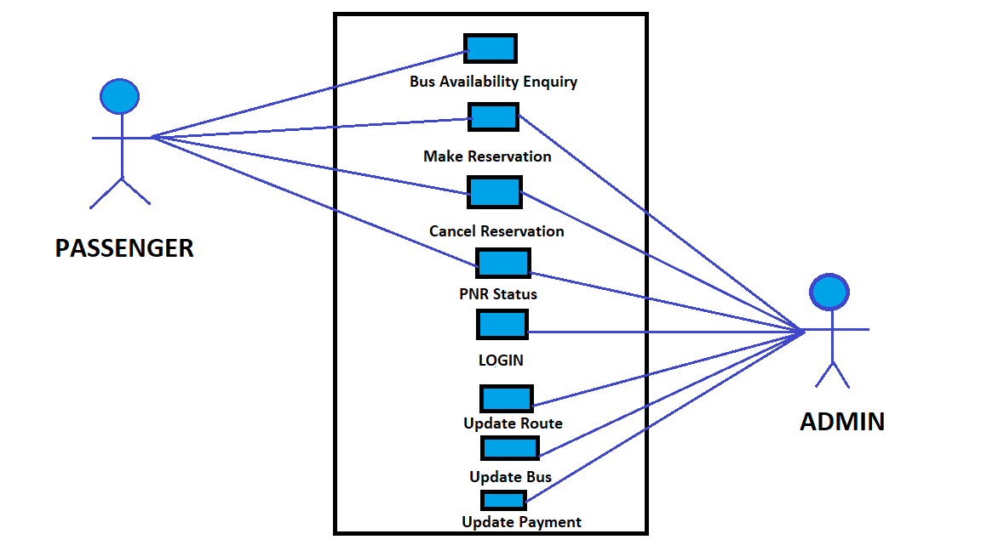
Case Diagram For Passenger And Admin

Slide 8
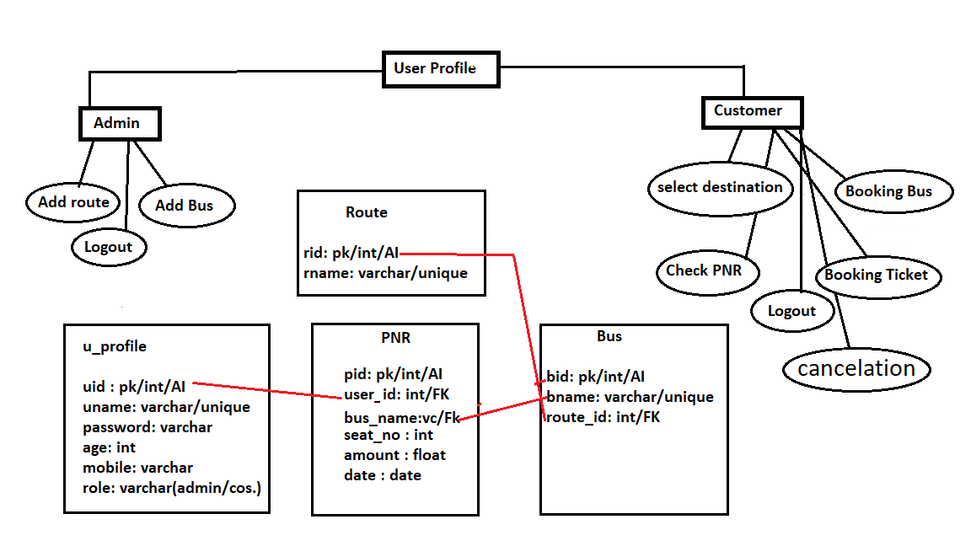
Database Design

Slide 9
Refrences
https://www.researchgate.net
https://core.ac.uk
https://www.academia.edu
http://shivajivarma.com
http://www.aessweb.com
https://en.wikipedia.org

Slide 10
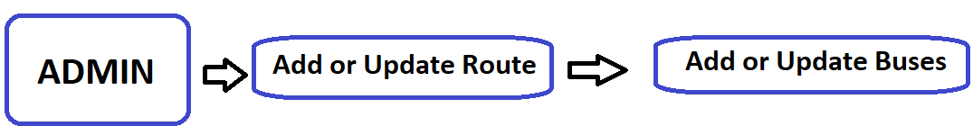
This Project Has Three Modules
First Module :-
First Module Admin Can add or Update Route and Buses.

Slide 11
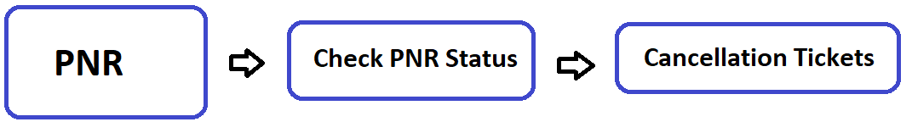
Second Module :-
Second Module helps the Customer to enquiry the availability of seats in a particular bus at a particular date.
Third Module :-
Third Module helps the customer to Check PNR status and Cancel a reserved tickets.

Slide 12
System Requirements
Operating system | Windows 95 or NT or superior
CPU | Pentium processor at 90 MHz or higher
Memory | 16 MB RAM
Free space | 80 MB available
Media | CD-ROM, 2x or higher
Graphics hardware | DirectX 3.0 or higher
Sound hardware | DirectX 9.0b compatible 16-bit sound card

Slide 13

Thank You

