Slide 1
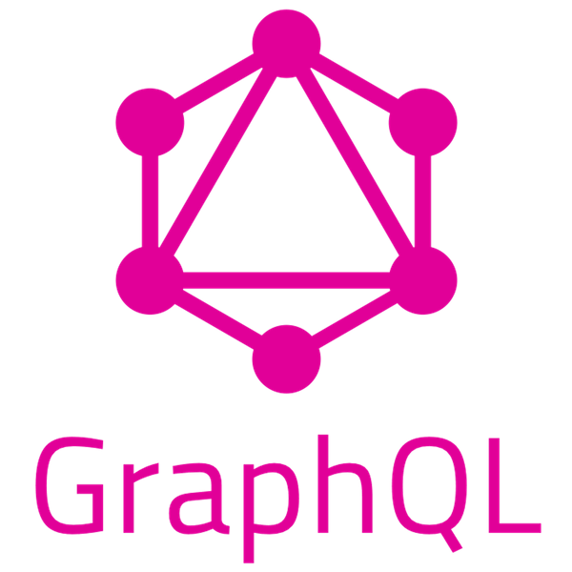

Slide 2

What is GraphQL
GraphQL is a query language for your API
And a server side runtime for executing queries
It is not tied to a specific database or storage engine
Has implementations in many different languages including .NET and Node

Slide 3
REST
Each resource identified by a URL
GET verb used for retrieving data
Multiple verbs for updating data: POST, PUT, PATCH, DELETE
GET /developers/1
{
"name": "Henry Ing-Simmons",
"title": "Senior Developer",
"projects": [
{
"client": "Experian",
"name": "EBC"
}
]
}
Notes:
Server author decides what fields are returned
The shape of the result is coupled to the endpoint

Slide 4
GraphQL
GraphQL has a single endpoint: /graphql
Through this you can make two types of requests:
Queries
Mutations

Slide 5
Schema
type Developer {
_id: ID!
title: String!
name: String!
projects: [Project!]!
}

Slide 6
Queries
query {
developers {
_id
title
name
}
}
{
"data": {
"developers": [
{
"_id": "5dd45f228f40504184bbb589",
"title": "Senior Web Developer",
"name": "Henry"
}
…
]
}
}

Slide 7
Queries
query {
developers {
_id
title
name
projects {
name
client
}
}
}
{
"data": {
"developers": [
{
"_id": "5dd45f228f40504184bbb589",
"title": "Senior Web Developer",
"name": "Henry",
“projects": [
"name": “EBC",
“client": “Experian"
]
}
…

Slide 8
Queries - Arguments
query {
developers(client: "Momenta") {
title
name
}
}
{
"data": {
"developers": [
{
"title": "Senior Web Developer",
"name": "Owen"
},
…
]
}
}
Notes:
Queries can also take arguments

Slide 9
Queries -Arguments
query {
developers(client: "Momenta") {
title(type: SHORT)
name
}
}
{
"data": {
"developers": [
{
"title": "Senior Dev",
"name": "Owen"
},
…
Notes:
You can even pass arguments to nested objects and scalar fields

Slide 10
Mutations
mutation {
createDeveloper(
title: "Principal Developer"
name: "Binks"
) {
_id
name
}
}
{
"data": {
"createDeveloper": {
"_id": "5dd571eb3f797b4868b6a2b5",
"name": "Binks"
}
}
}
Notes:
Mutations look exactly like queries
- they have arguments
- you can specify which fields you want returned
You could use a query to update data – its more of a convention for read/write separation

Slide 11
GraphQL vs REST
Makes deprecations easy
title: String! @deprecated
Retrieving nested/relate resources is cleaner and easier
Devolves power to Clients
Caching is easier with REST
Many “benefits” of GraphQL are possible with good REST design
GraphQL spec has no provision for file uploads
Notes:
Nested = single request, can specify required fields on nested object
Devolves power = If you have different clients web, mobile, etc. that need different data – this is easy
Caching = with endpoints, we can use HTTP caching to easily avoid re-fetching resources, and for knowing when two resources are the same. (though some of the packages make this easier).
Benefits = can use OData.
Uploads = this has been handled by Apollo Sever
Of course you can use both. Makes sense with microservices.
Could have one GraphQL API as a proxy over several REST APIs

Slide 12
References
https://phil.tech/api/2017/01/24/graphql-vs-rest-overview/
https://blog.apollographql.com/file-uploads-with-apollo-server-2-0-5db2f3f60675

