Slide 1


Web Dev Workshop Conducted by WIT NIT KKR

Slide 2
Agenda
Introduction
HTML,CSS and JavaScript
MySQL
NodeJS
Hands on Coding

Slide 3
Client-side Code: Frontend Server-side Code: Backend

Slide 4
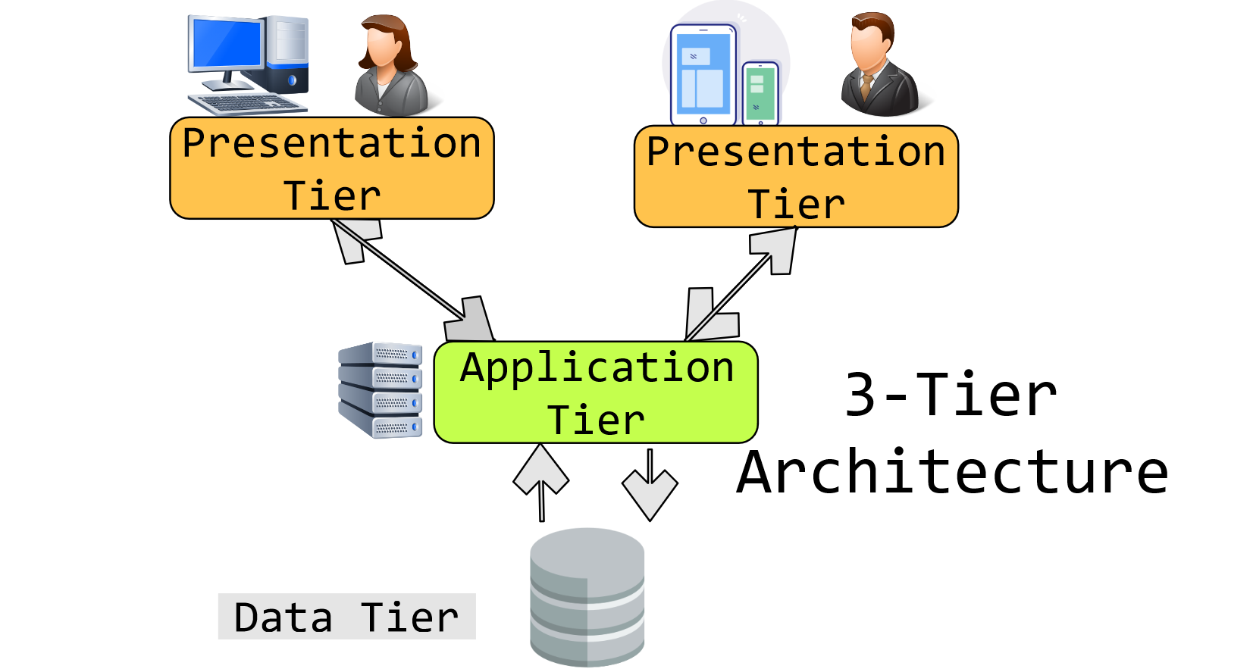
3-tier architecture

Slide 5

HTML
HTML (HyperText Markup Language) is the most basic building block of the Web. It defines the meaning and structure of web content.

Slide 6

CSS
Cascading Style Sheets (CSS) is a stylesheet language used to describe the presentation of a document written in HTML or XML (including XML dialects such as SVG, MathML or XHTML).
CSS describes how elements should be rendered on screen, on paper, in speech, or on other media.

Slide 7

JavaScript
JavaScript (JS) is a lightweight interpreted (or just-in-time compiled) programming language with first-class functions.
While it is most well-known as the scripting language for Web pages, many non-browser environments also use it, such as Node.js etc.

Slide 8

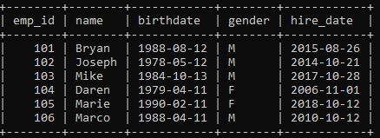
MySQL
MySQL is a widely used relational database management system (RDBMS).
MySQL is free and open-source.
MySQL is ideal for both small and large applications.

Slide 9
Road Map
Frontend:
HTML,CSS,Javacript: Traversy Media
ReactJS: Codevolution
Backend:
NodeJS: freecodecamp
Advance JS: Namaste Javascript
Rest API with Nodejs and MongoDB: Academind

Slide 10

NodeJS
Node.js® is an open-source, cross-platform JavaScript runtime environment.

Slide 11
Thank you
Tarun Singh Yadav
Email: tarunydav148@gmail.com
LinkedIn: linkedin.com/in/tarunyadav148/

