Slide 1
Smart Civic Connect
Next-Generation AI-Powered Civic Issue Reporting & Municipal Management Platform
Final Project Review Presentation | Computer Science & Engineering

Slide 2
Problem Statement & Urban Governance Challenges
01. Spam & Paper Note Uploads
Citizens submitting paper notes, document screenshots, drawings, or non-civic photos that waste municipal inspection time.
02. Category Misclassification
Citizens misclassifying complaints (e.g. reporting water leakages under 'Garbage'), sending reports to wrong departments.
03. Lack of SLA Escalations
Open complaints remaining pending indefinitely without executive visibility or automated escalation protocols.
04. High Cloud Storage Fees
Traditional cloud storage services requiring expensive monthly subscription plans for municipal bodies.

Slide 3
Full-Stack System Architecture
FRONTEND LAYER:
Vanilla HTML5 / CSS3 (Bootstrap 5 Glassmorphism Layout) + JavaScript ES6
Hosted on Firebase Hosting CDN
BACKEND REST API:
Python 3.11 Flask API + Gunicorn WSGI Web Server
Deployed on Render.com Linux Container
DATABASE & AUTH:
Google Cloud Firestore (NoSQL) + Firebase Authentication
Real-time complaint documents & role security
DUAL-LAYER AI VISION:
Layer 1: Google Gemini 1.5 Flash Vision API
Layer 2: PIL Visual Feature Classifier (Edge Fallback)

Slide 4
Frontend UI/UX Design System & Architecture
🎨 Glassmorphism Aesthetic
Translucent dark slate backgrounds (#0F172A), 12px blur filters, border highlights, and vibrant status accent badges (#3B82F6 Blue, #10B981 Emerald, #EF4444 Rose).
📷 Live Mobile Camera Enforcement
File inputs use capture='camera' to automatically open mobile device camera interface, eliminating fake/stock gallery uploads.
⚡ Base64 Client Canvas Compressor
Resizes photos to 800px max dimension and compresses to 70% JPEG Base64 (<100KB), completely bypassing paid cloud storage costs.
🌐 Multi-Role Portals & Bilingual i18n
Dynamic role switcher tabs (Citizen, Officer, Super Admin) with instant client-side English / Telugu language toggling.

Slide 5
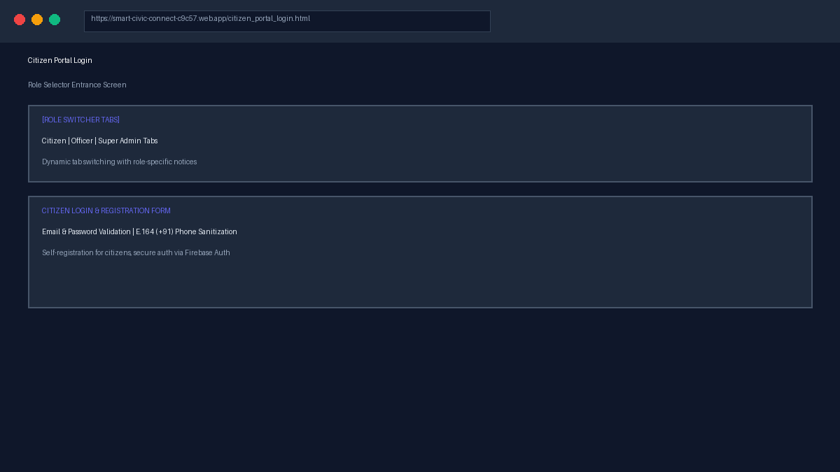
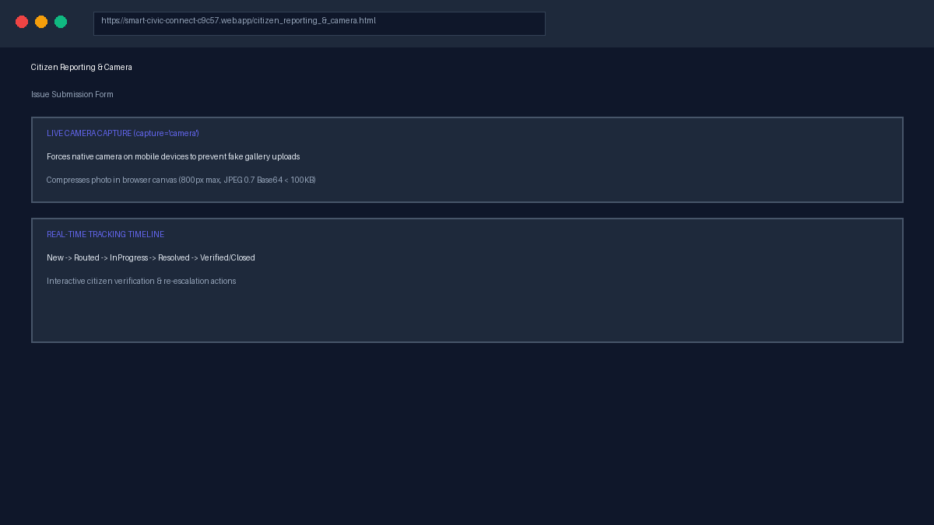
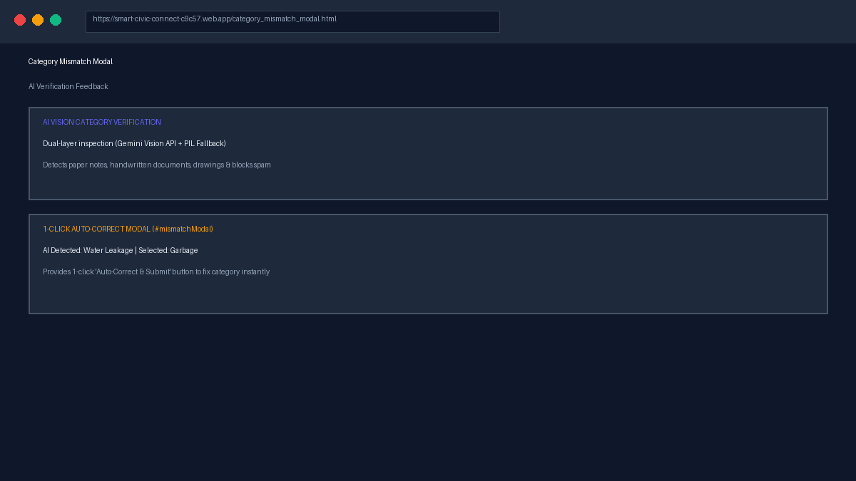
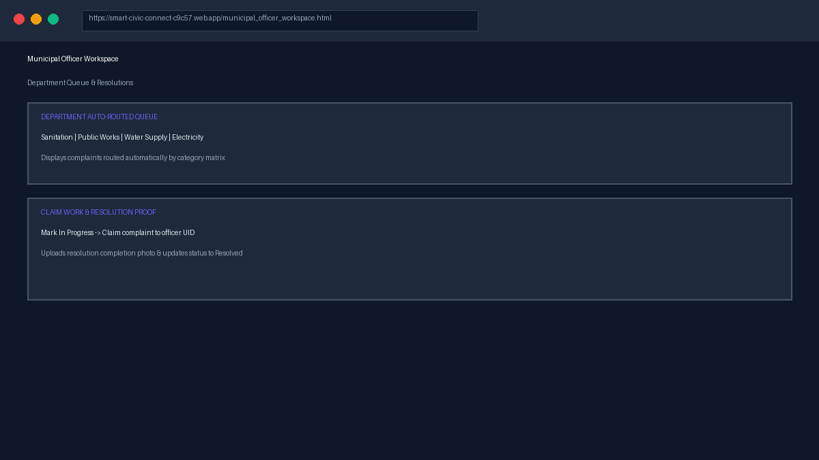
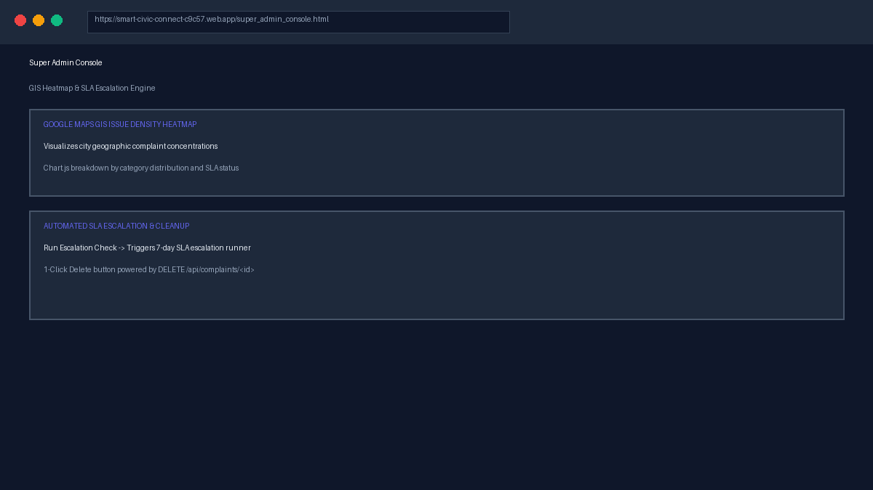
Frontend User Interface Showcase & Mockup Gallery

Slide 6
Dual-Layer Computer Vision AI Pipeline
LAYER 1: Google Gemini Vision API
• Deep generative image analysis evaluating category match.
• Rejects handwritten notes, paper documents, drawings, clipart, and non-civic photos.
• Returns structured MATCH / MISMATCH / INVALID tokens.
LAYER 2: PIL Visual Feature Classifier
• Automatic edge fallback if Gemini API is offline or rate-limited.
• Analyzes light background paper ratios (r,g,b > 175, saturation < 22).
• Rejects low color depth clipart (colors < 150) without external API costs.

Slide 7
Municipal Officer Workspace & Resolution Workflow
1. Auto Routing
Garbage ➔ Sanitation
Potholes ➔ Public Works
Water ➔ Water Supply
Lights ➔ Electricity
2. Claim Work
Officer clicks 'Mark In Progress', assigning complaint to officer UID & setting status = InProgress.
3. Resolution Proof
Officer uploads repair photo compressed via local Base64 canvas, updating status to Resolved.

Slide 8
Super Admin City Intelligence Console
🔥 GIS Density Heatmap
Visualizes geographic complaint concentrations across city coordinates using Google Maps Heatmap visualization layer.
📊 Chart.js Analytics
Interactive doughnut and bar charts breaking down city complaints by category distribution and SLA resolution status.
⏱️ SLA Escalation Runner
REST endpoint (/api/escalate/trigger) evaluating open complaints past the 7-day threshold and upgrading to Level 1 Escalation.
🧹 Test Data Cleanup
Directory listing all complaints with a 1-click Delete button powered by DELETE /api/complaints/<id> to clean test reports.

Slide 9
Security Model & Zero-Cost Cloud Deployment
🔒 Security & Key Protection
• serviceAccountKey.json is protected by .gitignore.
• Render backend loads keys securely from FIREBASE_SERVICE_ACCOUNT_JSON env var.
• Admin REST endpoints protected by verify_id_token() authentication.
☁️ Zero-Cost Cloud Deployment
• Backend hosted on Render.com (Linux Gunicorn).
• Frontend deployed on Firebase Hosting CDN.
• Base64 client canvas compression eliminates paid cloud storage fees.

Slide 10
Conclusion & Demonstration
Smart Civic Connect provides an automated, AI-verified, zero-cost municipal grievance platform.
Thank you! Ready for Live Demo & Q&A.

