Slide 1
Aspect Based Sentiment Analysis
Supervisor:
Dr. Sugata Gangopadhyay
Deepanshu Singhal
Tarun Kumar
Tejal Singh

Slide 2
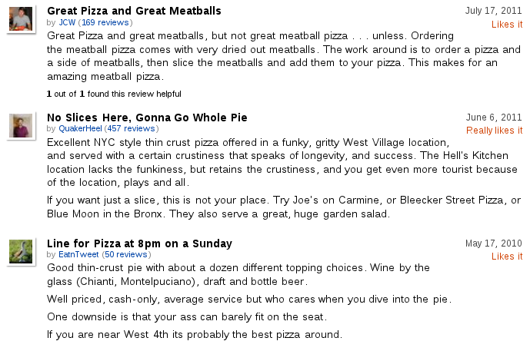
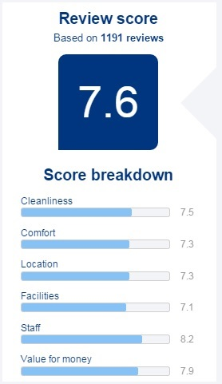

Introduction

Slide 3
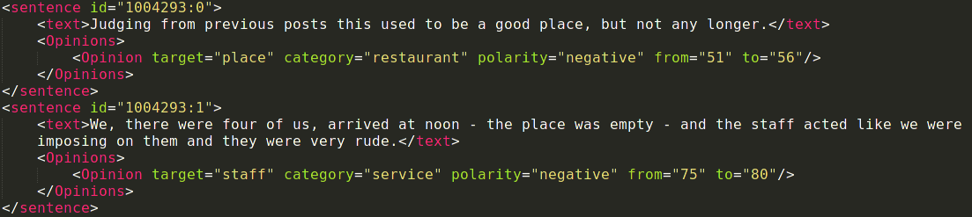
Dataset

Slide 4
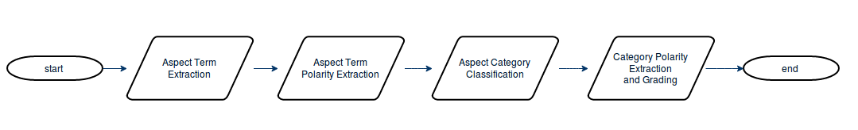
Modules
Aspect Term Extraction
Aspect Term Polarity Extraction
Aspect Category Classification
Category Polarity Extraction and Grading

Slide 5
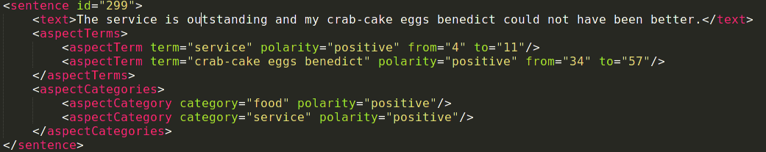
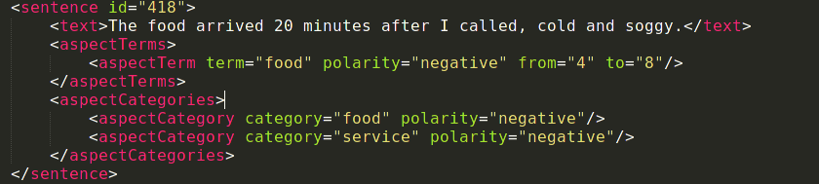
Demo Sentences

Slide 6
Aspect Term Extraction
Preprocessing
Stanford CoreNLP
POS Tagger
Approaches
Hu and Liu, 2004 method
Aspects using frequency
Multi word aspect term
Extracting adjectives
Hu and Liu method with Lemmatization

Slide 7


The service is outstanding and my crab-cake eggs benedict could not have been better.
The food arrived 20 minutes after I called, cold and soggy.

Slide 8
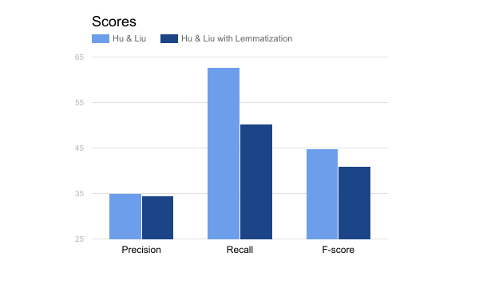
Module Scores (Aspect Term Extraction)

Slide 9


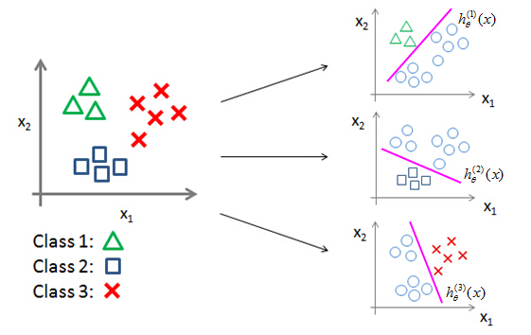
Aspect Term Polarity Extraction
SVM (67%)
Vectorizer
Tfidf
One Vs Rest Classifier

Slide 10

LSTM (62%)
Glove pre-trained word embedding
Embedding Layer -> LSTM -> Layer with ‘relu’ -> Softmax Layer
Last layer with ‘softmax’ for categorical classification
Dropout = 20%

Slide 11
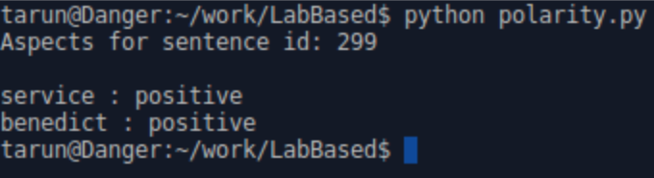

The service is outstanding and my crab-cake eggs benedict could not have been better.
The food arrived 20 minutes after I called, cold and soggy.

Slide 12
Aspect Category Classification
Similarity Matching - aspects with categories
Similarity Matching - aspects with aspects
Using Support Vector Machines
Threshold Decision Function

Slide 13

The service is outstanding and my crab-cake eggs benedict could not have been better.
The food arrived 20 minutes after I called, cold and soggy.

Slide 14
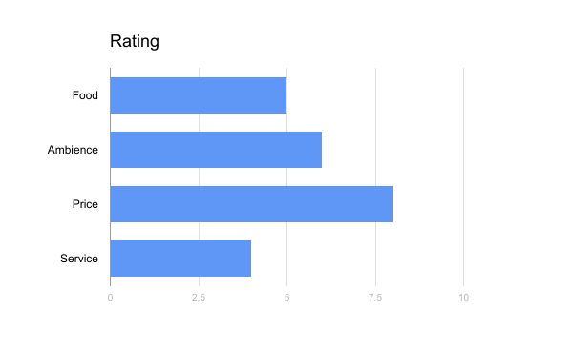
Category Polarity Extraction and Grading

Slide 15
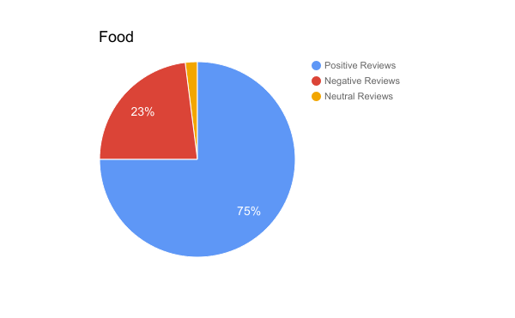
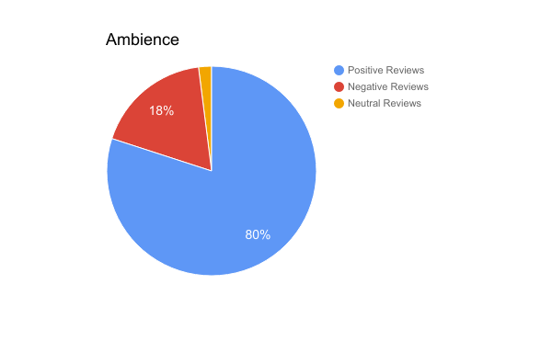
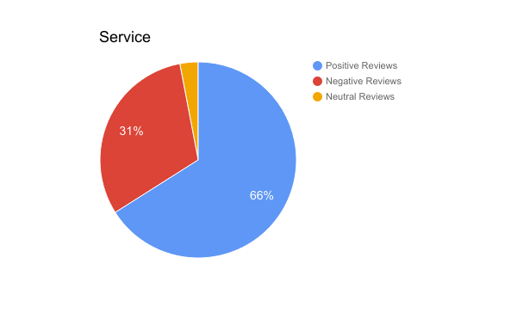
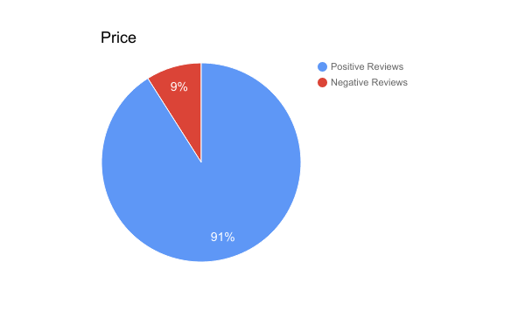

Slide 16
"It's not that I'm so smart, it's just that I stay with problems longer." --Albert Einstein
Thank You

