Slide 1
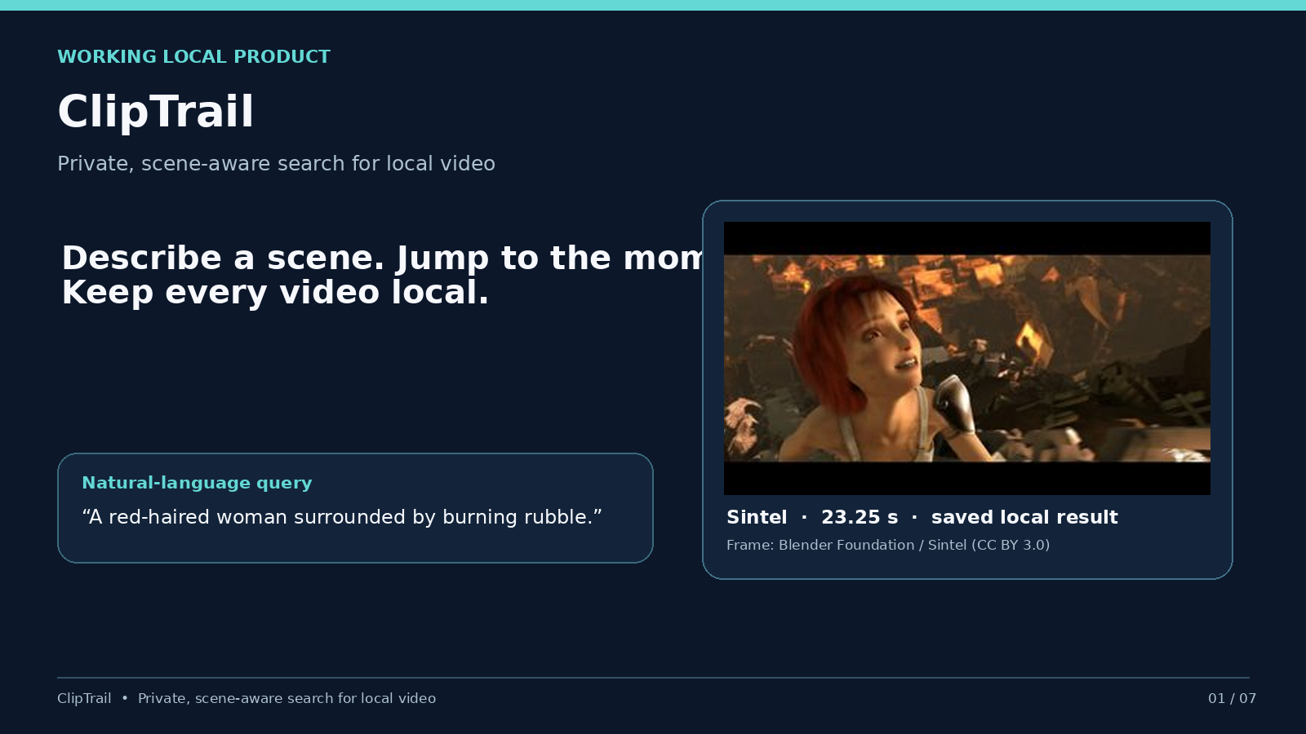
Notes:
Video filenames cannot tell us what happens inside a recording. ClipTrail lets people search private videos without uploading them.

Slide 2
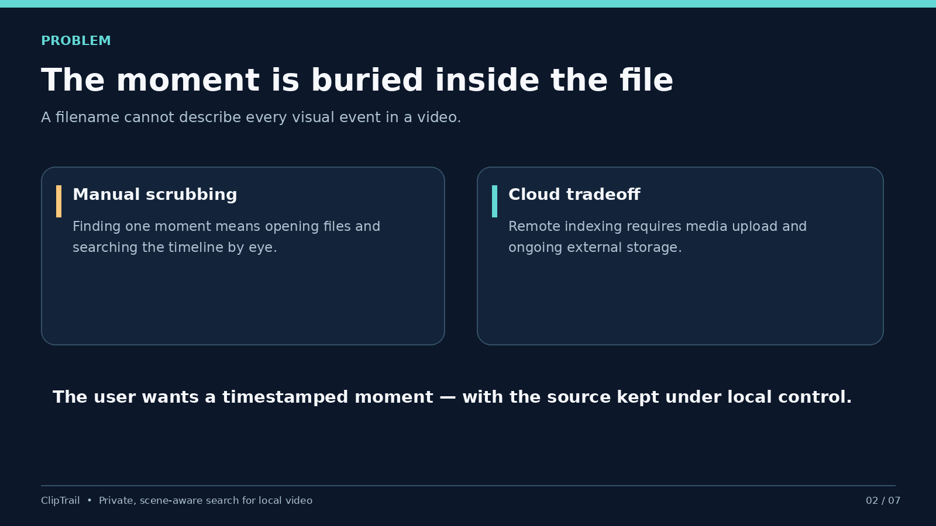
Notes:
The user needs a moment, not another file list. ClipTrail addresses visual events that are buried in the source.

Slide 3
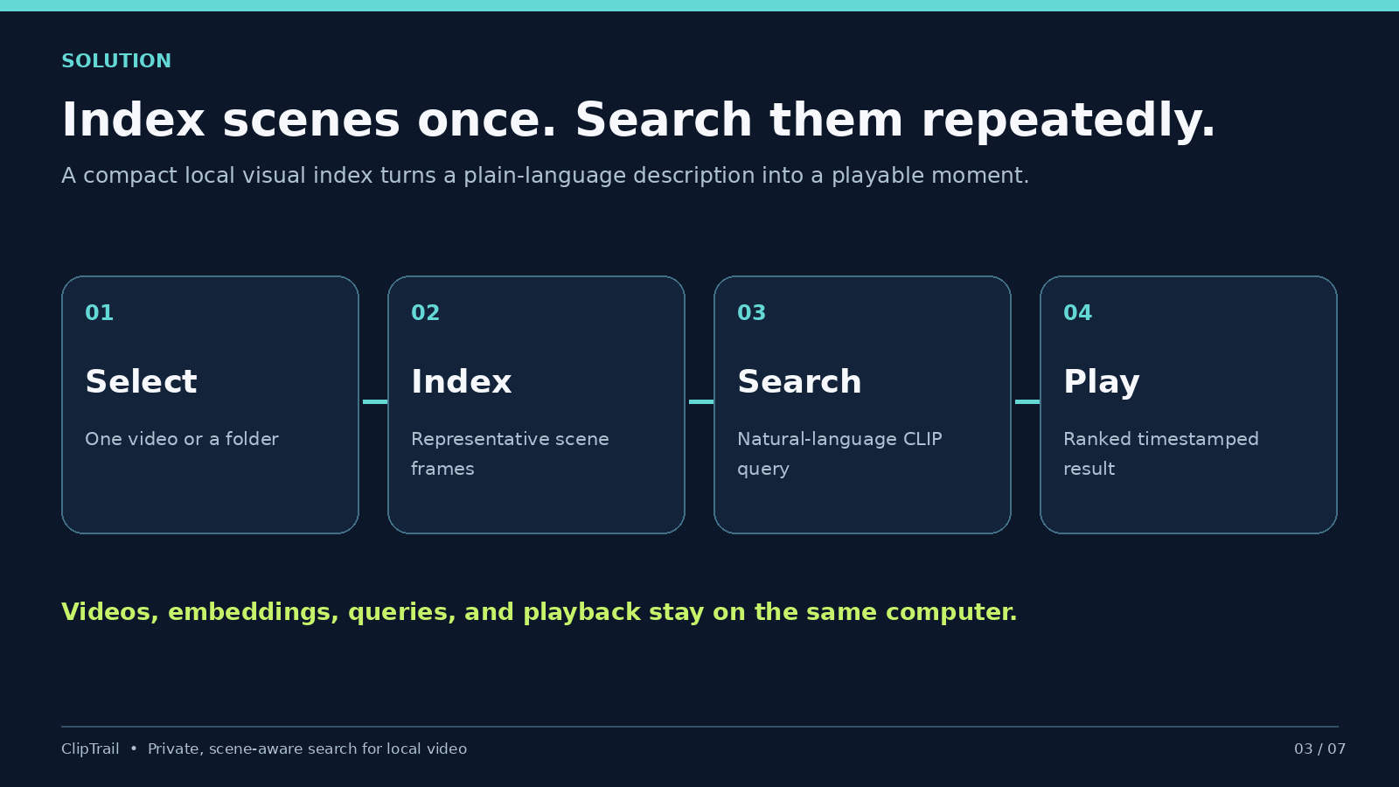
Notes:
The application indexes representative scenes once, then searches saved vectors locally and opens the source at the result timestamp.

Slide 4
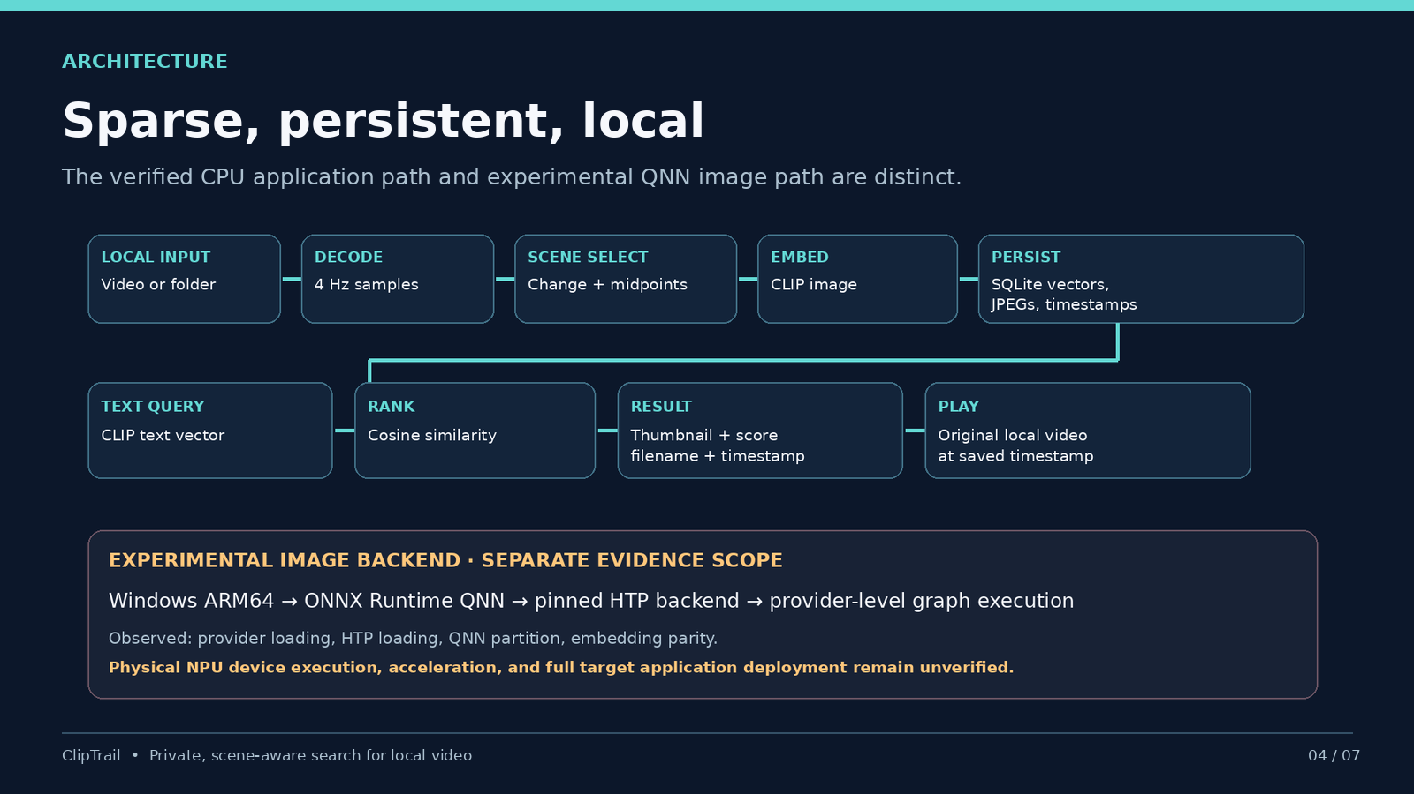
Notes:
The CPU path is the verified product. The Windows ARM64 QNN image backend is experimental and has separate evidence.

Slide 5
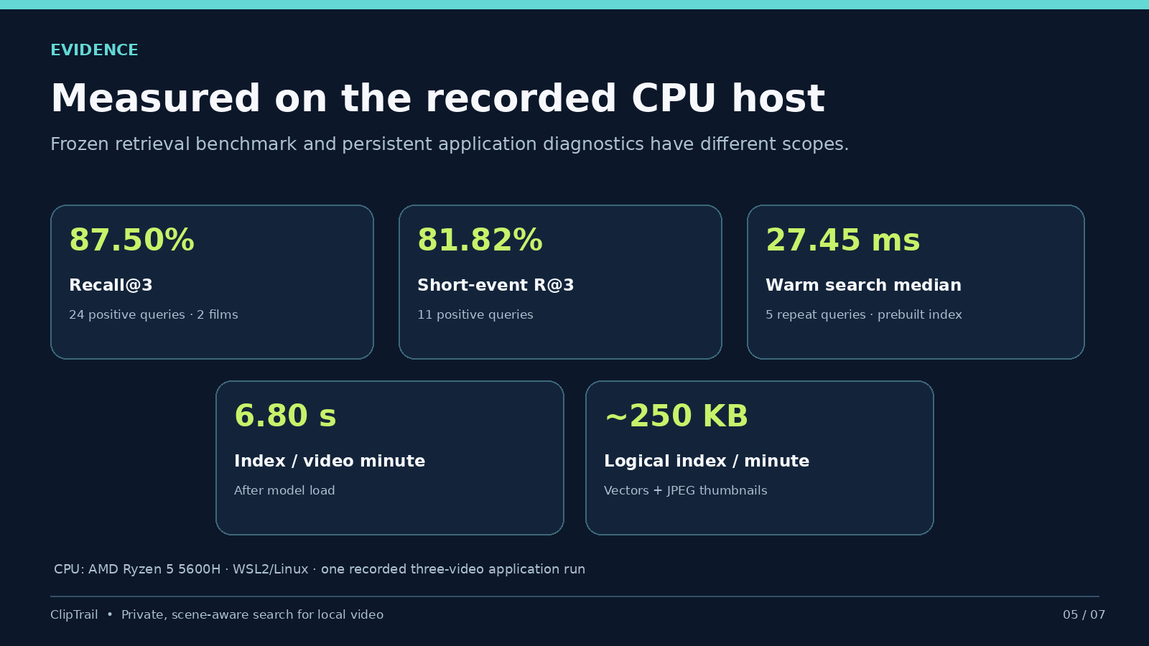
Notes:
Quality is from a small frozen positive-query corpus. Application speed and size are from one recorded CPU host, not Snapdragon.

Slide 6
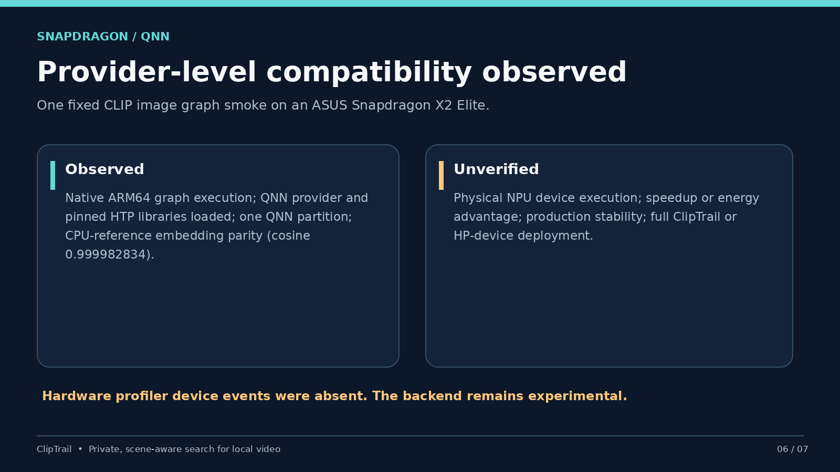
Notes:
Native ARM64 QNN graph execution, HTP loading, partitioning and parity were observed. Physical NPU execution was not verified.

Slide 7
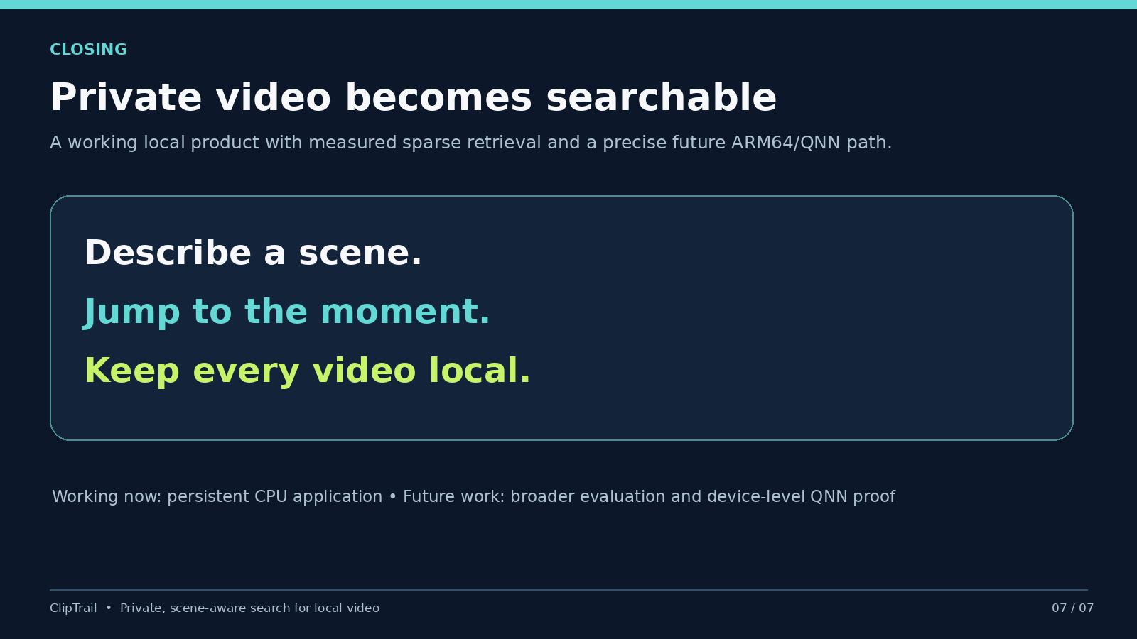
Notes:
ClipTrail is useful today as private video search. Broader evaluation and device-level QNN proof are future work.

