Slide 1
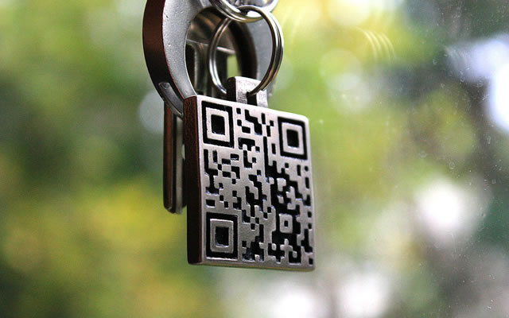
Enhanced security approach for Online User Authentication
Presented by :-
Isha Patil
Neeti Deshmukh
Srinivasan Jayaraman
Taru Tak

Slide 2
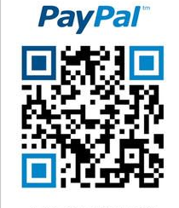
Introduction
Today Internet is the most widely used medium for accessing info. On the internet, many websites provide the services such as cloud, banking, insurance, shopping, social networking etc. carrying sensitive information and thus require strong authentication.
Multiple authentication methods have been developed such smart card based system, one time password, SMS based OTP system and some using biometric features.
We propose a system for secured authentication using Quick Response Code and ubiquitous Smartphones.
A Quick Response code is a two dimensional matrix code which can store encrypted data.

Slide 3
Objectives:
1. The main objective and motivation of the proposed system is to eliminate the use of alpha numeric passwords in online banking transaction by making use of random QR code generation.
2. The ﬁnal scenario would be that a person or a ﬁrm would be able to do the transaction which would be secure from diﬀerent cyber-attacks like phishing.The user would be able to do the transaction using untrusted system.
3. We aim to have three modules that will be the main functioning units of the application. First would be the QR code generation and scanning module then AES encryption module and a ﬁnal communication module. There will be two phase of a System Registration phase and login phase.
4. At the end, user would be able to use the android application and a website to do an online banking transaction which will be safe from cyber-attacks. Mainly this will be helpful for a huge and complete secure transaction.

Slide 4
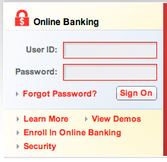

Traditional System
User enters credentials
ACCESS GRANTED!!

Slide 5
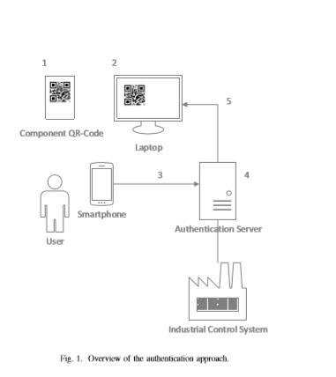
Implemented system

Slide 6
Overview of the implemented system
The user ﬁrst registers itself to the bank server with credentials name, phone number, username, IMEI number and the password. In this way the user gets registered in the bank database.
In the login phase, the user logins to the website
After the user logs in, a QR code is generated on the website.
The android application is used for the scanning of QR code. After scanning we get the username, random number and IMEI number.
The password is entered on the android application and all the details are encrypted and the QR code is generated again on the application.
The newly generated application is then sent to the bank server for transaction purpose.
The bank server then veriﬁes the received QR code with the bank server and then grants the user access to the system.
Advanced Encryption Standard (AES) algorithm is used for the encryption purpose

Slide 7
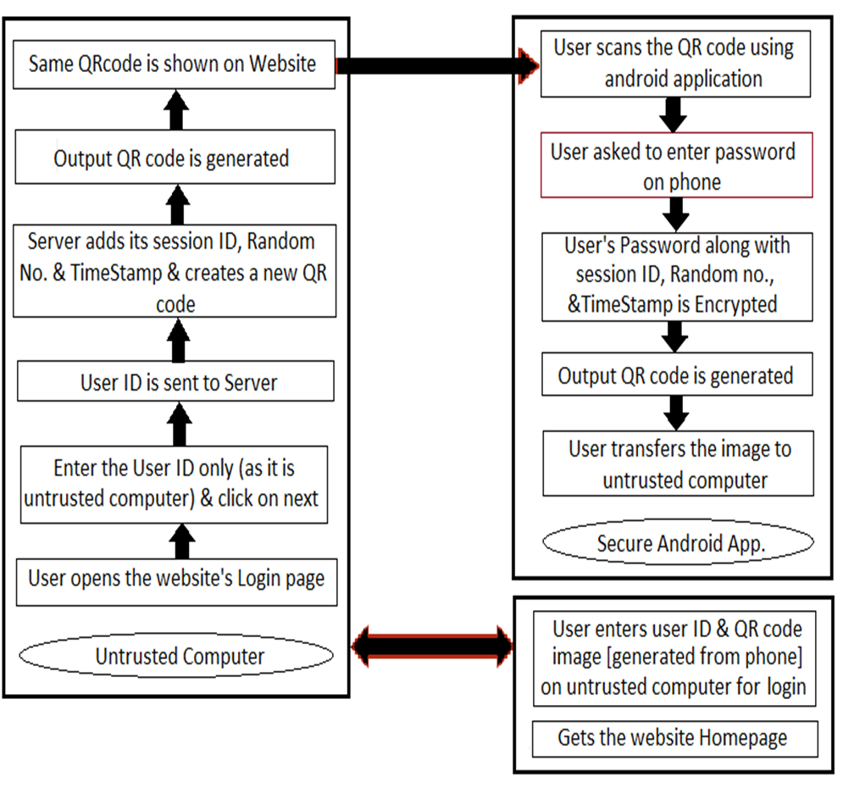
System Architecture

Slide 8
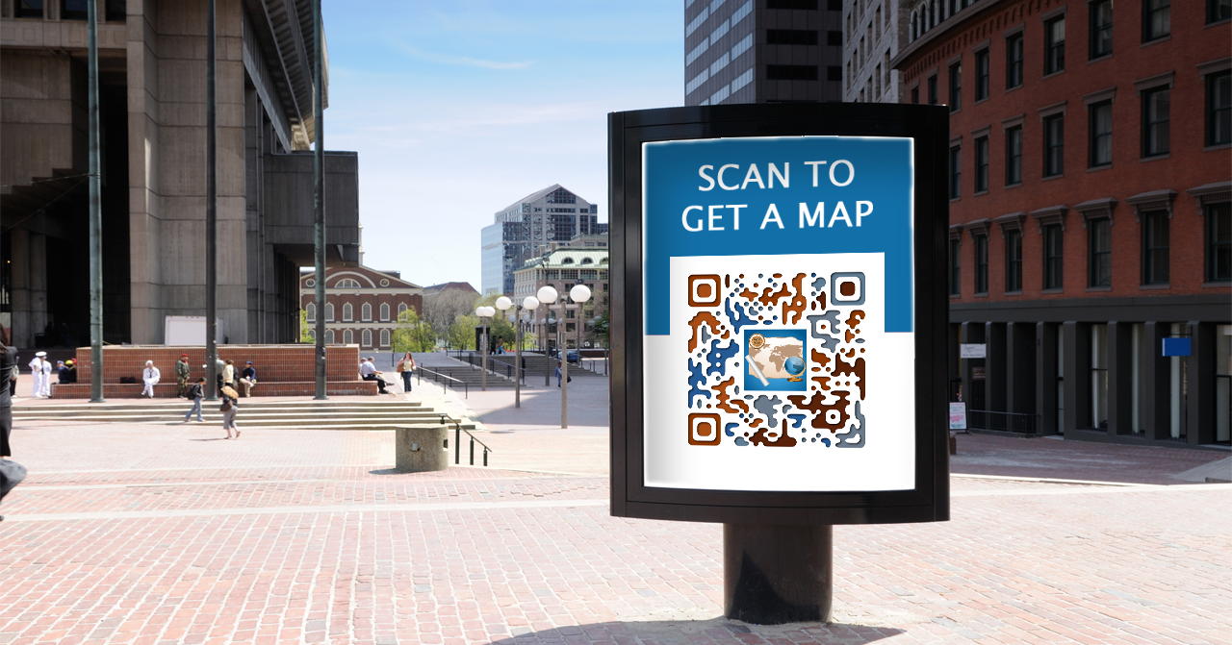
Modules :-
Project would be consisting of three modules,
-QR code generation and scanning,
-AES encryption module and
-Communication module
Two phases of System :-
-Registration phase
-login phase

Slide 9
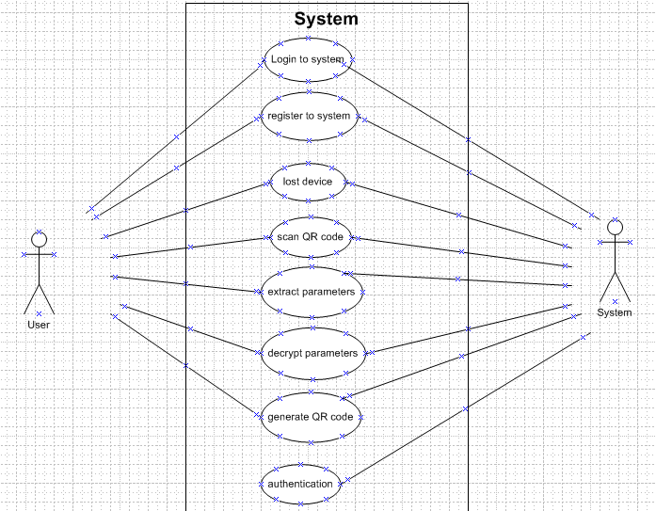
Use Case diagram

Slide 10
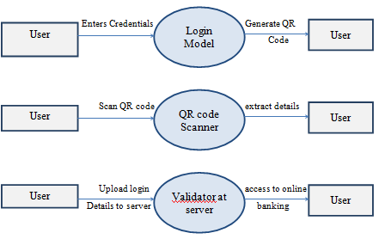

Data Flow
Traditional
Implemented

Slide 11
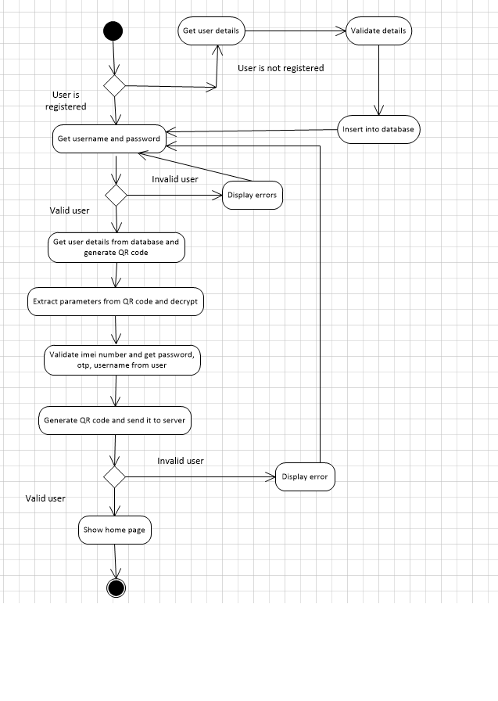
Activity diagram
Fig 5. Activity Diagram

Slide 12
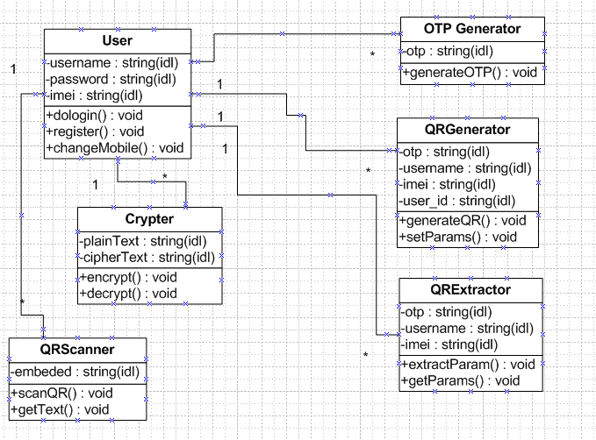
Class Diagram

Slide 13
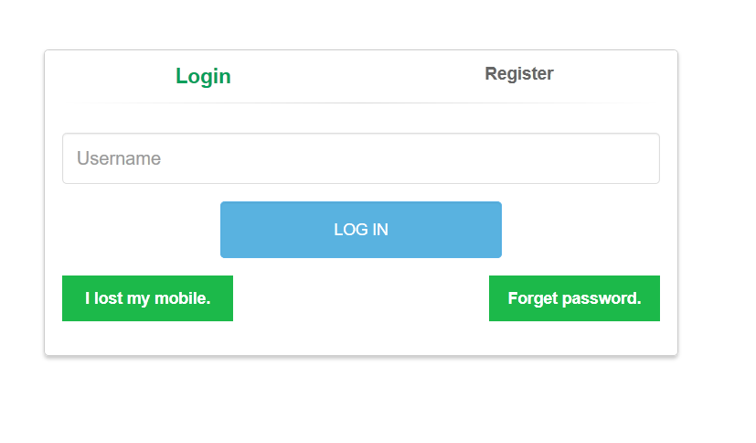
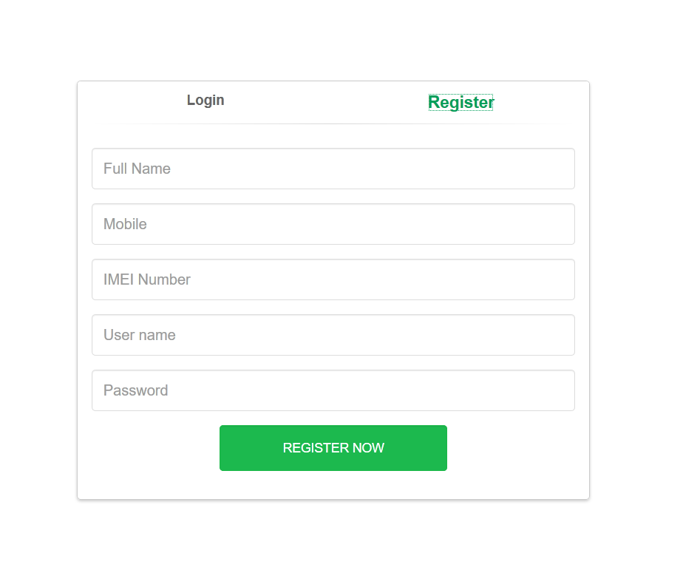
Login & Registration phase

Slide 14
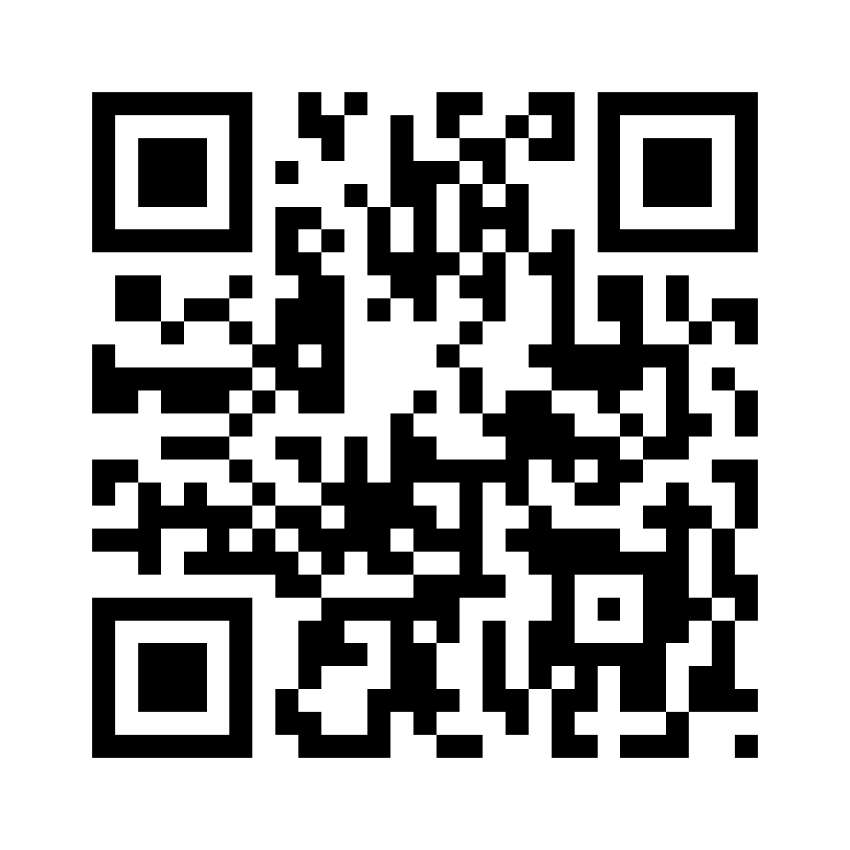
QR code
Quick Response code
It is a 2-d bar code
Used to encode information(URLs, automated SmS, text data) in two dimensional space
History
Created by a Japanese company- Toyota subsidiary Denso-wave in 1994.
Used to track parts during vehicle manufacture

Slide 15
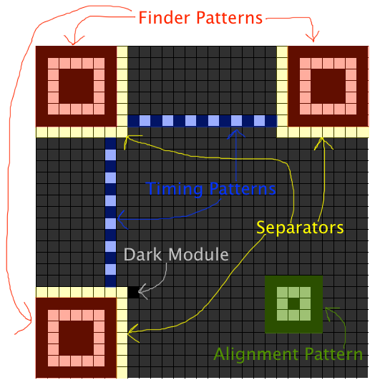
structure
Finder Patterns:
Finds if the given code is a QR Code
Separators:
Separates data from the patterns
Timing Pattern:
Tracks the timing of the incoming code
Alignment Pattern:
Tells about initiation & Separation of data.
Dark Module:
A black module placed beside the bottom left finder pattern

Slide 16
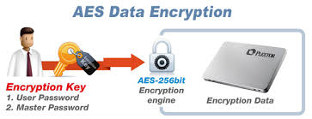
The AES algorithm :
- The Advanced Encryption Standard (AES) cryptographic algorithm can be used to protect electronic data.
-The AES algorithm is a symmetric block cipher that can encrypt (encipher) and decrypt (decipher) information.
- The AES algorithm is composed of three main parts:
1.Cipher
2.Inverse Cipher
3.Key Expansion
Cipher converts data to an unintelligible form called cipher text.
Inverse Cipher converts data back into its original form called plaintext.
Key Expansion generates a Key Schedule that is used in Cipher and Inverse Cipher procedure.

Slide 17
Hardware & Software Resources Required
1. RAM 2GB or more.
2. Processor Intel Core i5 or above versions.
3. Android Smartphone with 512 MB RAM.
Platform : Windows
1. Operating System: Windows 7 or above
2. Netbeans
3. Java JDK 1.6 or above
4. Android SDK 2.3.3 or above.
5. MySQL
6. Android OS V4.0 and above

Slide 18
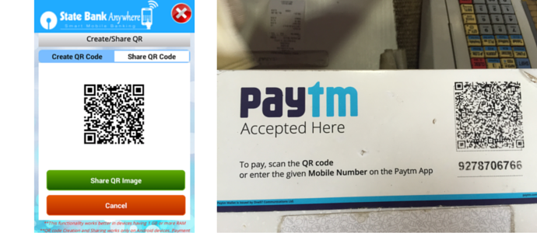

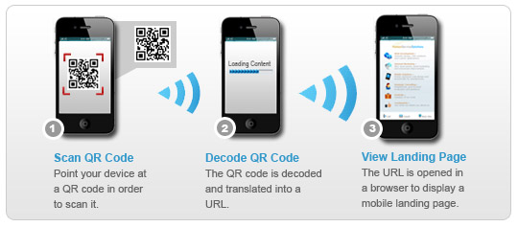
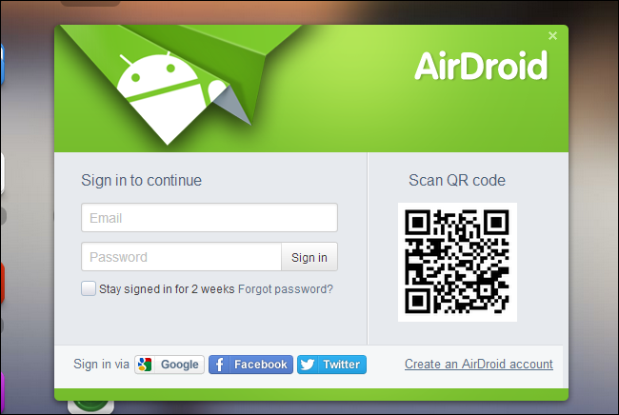
Applications
Net Banking System
Digital Lockers
E-commerce transactions
Military applications

Slide 19
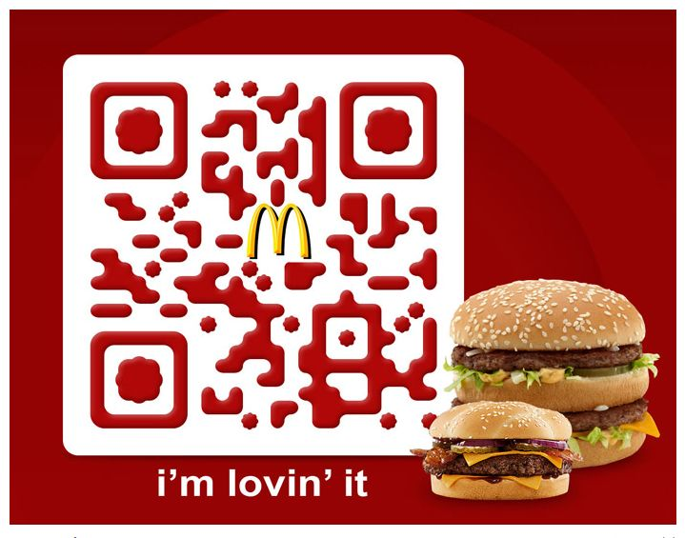
Future Scope
Security has become extremely important in the digital society. Authentication methods should be seriously considered by services that store sensitive information
As a mobile phone has become an indispensable accessory and carry-on device in real life, compared with the traditional key or access card, sending the authentication image by using mobile phones through MMS (Multimedia Messaging Service) allows the user to carry fewer objects and no extra specific hardware cost needed.
Using QR Code, successful authentication can be done. The use of QR code image for authentication makes it difficult to be accessed, modified and copied, and it can be applied to many services that require authentication

Slide 20
Bibliography
A.S. Narayanan. “QR Codes and security solutions,” International Journal of Computer Science and Telecommunications Volume 3, Issue 7, July 2012
Soon,TanJin.,“QR Code.” ,Synthesis Journal: 59-78
AvielD.Rubin. “Independent One-Time Passwords”, June 1995. Website- http://avirubin.com/onetime.pdf
Azhar,Rizwan.“Camera Based Authentication Methods”. Website www. ida.liu.se/ TDDD17/old projects/2010/projects/ 011.pdf
Open ID Foundation, “Get an Open ID”. [Online]. Available: http://openid.net/get-an-openid

Slide 21
