Slide 1
Jane Austen
1775 - 1817

Slide 2
Austen Family
George Austen (1731 – 1805)
Cassandra (1739 – 1827)
James (1765 – 1819)
George (1766 – 1838)
Edward(1768 – 1852)
Henry (1771 – 1850)
Cassandra (1773 – 1845)
Frank (1774 – 1865)
Jane Austen (1775 – 1817)
Charles (1779 – 1852)
30
40
50
60
70
80
90
00
10
20
30
40
50
60
1700
1800
Notes:
Married in 1764. 8 children in 15 years. Jane Austen died young. Edward left…

Slide 3
Austen Family
George Austen (1731 – 1805)
Cassandra (1739 – 1827)
James (1765 – 1819)
George (1766 – 1838)
Henry (1771 – 1850)
Cassandra (1773 – 1845)
Frank (1774 – 1865)
Jane Austen (1775 – 1817)
Charles (1779 – 1852)
Thomas & Catherine Knight
Edward (1768 – 1852)
Fanny (1793 – 1882)
30
40
50
60
70
80
90
00
10
20
30
40
50
60
1700
1800
Notes:
Edward adopted by Thomas Knight. Child Fanny. Fanny & Jane wrote letters. Charles and Fanny wrote “Pocket Books” found on next slide.

Slide 4
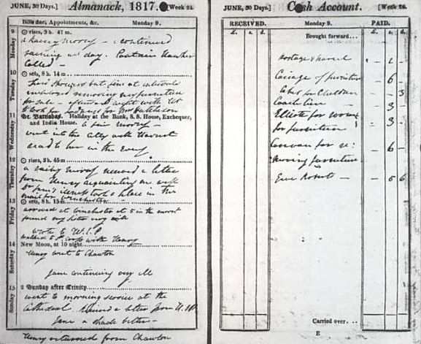
Pocket-Book
June 14, Saturday
Godmersham: A letter to me from Uncle HA - a sad account of my poor dear Aunt Jane.
Winchester: Henry went to Chawton. Jane continuing very ill.
June 15, Sunday
Godmersham: Another hopeless account fm. Winchester.
Notes:
Pocket Book. Charles Austen. Locations

Slide 5
Major Books

Slide 6
Major Books cont.
Sense & Sensibility (1811)
Dashwood sisters, Elinor & Marianne
Move to cottage
Love, romance, and heartbreak
Does sense and sensibility merge into one?

Slide 7
Major Books cont.
Pride & Prejudice (1813)
Elizabeth Bennet
Manners, upbringing, morality, education, and marriage of high upper class England
Land Gentry
Pride of the upper class
Prejudice to all else and all else to them

