Slide 1

VISUAL SERVOING WITH CAMERA ON DJI TELLO DRONE
Taryar Myint Mo

Slide 2
Project Brief
Camera Calibration using checkerboard.
Develop object detection algorithm.
Develop visual servoing algorithm on webcam.
Develop drone interface.
Integrate control velocities with drone navigation.

Slide 3
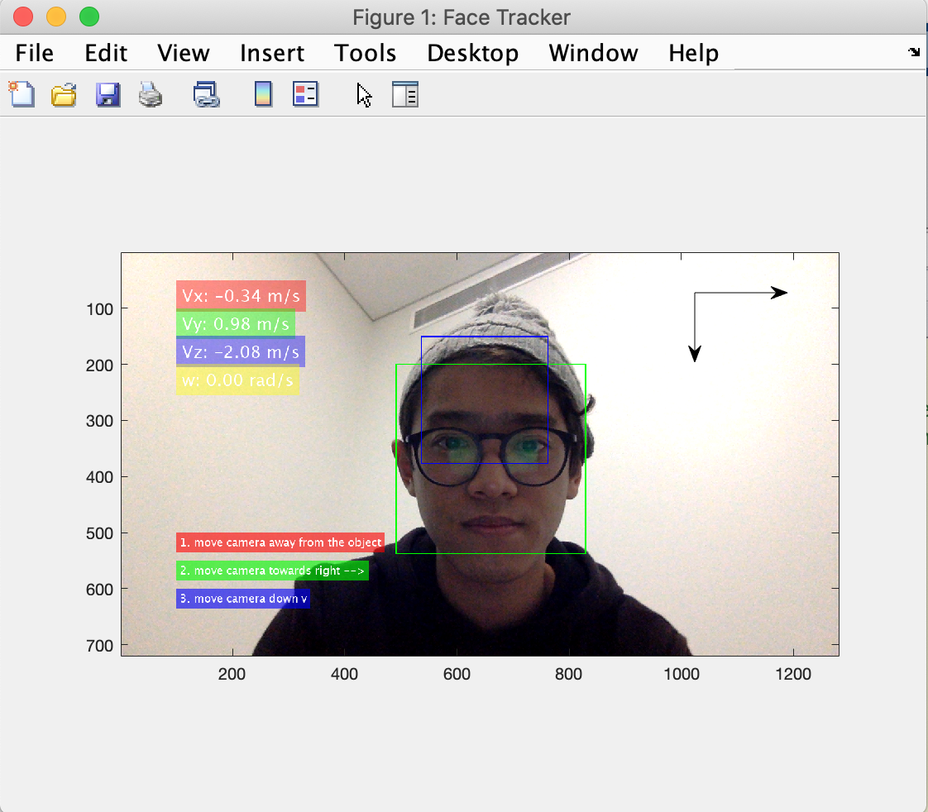
Object Detection
Experience with machine learning.
Computer Vision Toolbox.
Vision.CascadeObjectDetector().
Output = Coordinates for the bounding box.
Results in similar (but different) type of information from HarrisCornerDetector.

Slide 4
Visual Servoing
Intrinsic parameters are obtained from calibration.
Z is derived through extrapolation.
Image Jacobian is calculated using derived Z value.
Algorithm is looped to continuously get the control velocity.

Slide 5
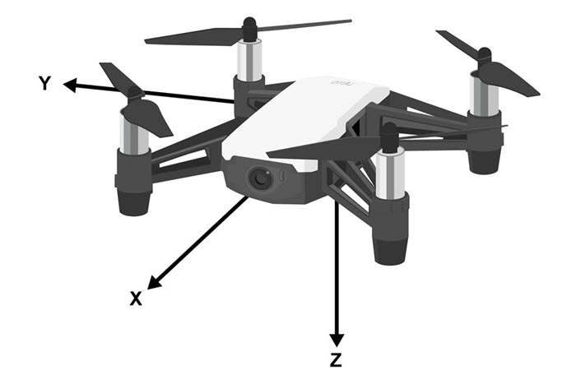
Drone Interface
MATLAB support package.
Pros: easy interfacing.
Cons: Blocking and not versatile.
Coordinate transformations.
Translations and rotations.

Slide 6
Further Improvements
Better control over the drone is required.
Python script for seamless interfacing.
Acute velocity controls the drone would allow a very decent drone visual servoing system.
Better object detection mechanisms for more accurate controls.

Slide 7
Thank You!

